Slide 1
Energy Island

Slide 2
Overall learning objectives:
Investigate how maths can support the modelling of a multi-faceted system using data and logic.
Apply ideas about energy transfer and sustainability to a novel context to produce a practical overall system.
Devise technical solutions, appreciate their impact on ecosystems and communities and explore how they can be modified to respond to demands.

Slide 3
Overall learning outcomes:
To identify various characteristics to be allowed for in effective energy provision.
To evaluate different methods of supplying energy for domestic consumption.
To present and evaluate plans effectively and persuasively.

Slide 4
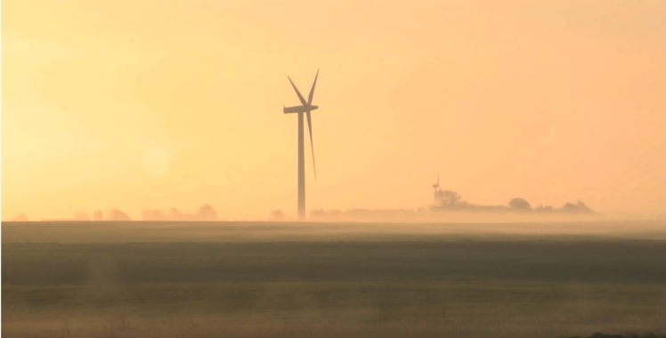
‘Island in the Wind’
Notes:
Show video clip “Island in the Wind”. This is on YouTube at: www.youtube.com/watch?v=VMuim2KVBvc
Ask students for their responses as to why the islanders moved towards being self-sufficient in energy.

Slide 5
How have the islanders made their island self-sufficient?
Why do you think they wanted to?
Do you think it’s easier or more difficult to do that with an island than with, for example, a large town on the mainland?
Which of the techniques they used might work where you live?
Notes:
Ask students to work in groups to consider these questions and formulate responses.
Take feedback and draw out key points including:
The island uses several different sorts of energy provision.
The islanders wanted to reduce their dependency on oil.
Explore how transferable the ideas are and emphasize that although this development might be easier to implement on an island, especially one where the energy requirements may be lower and where there is plenty of sun and wind, the ideas can be used in a variety of settings.

Slide 6
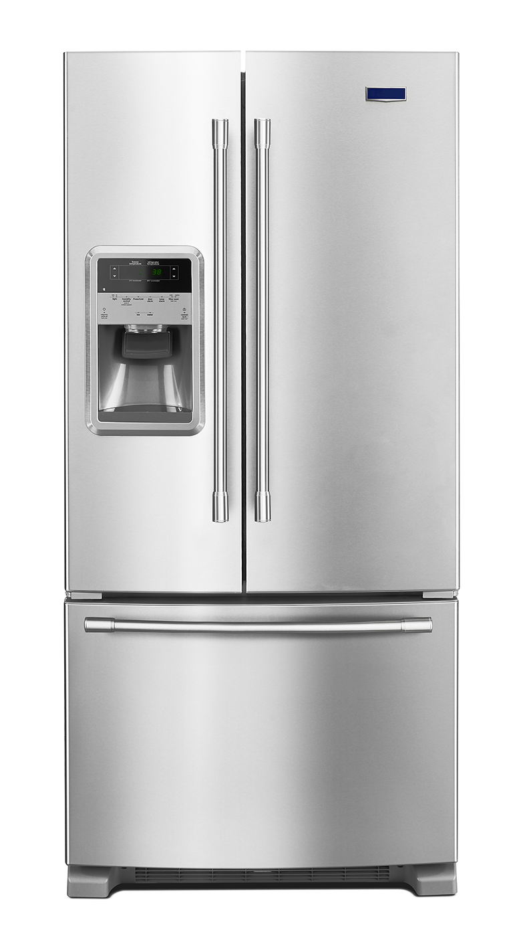
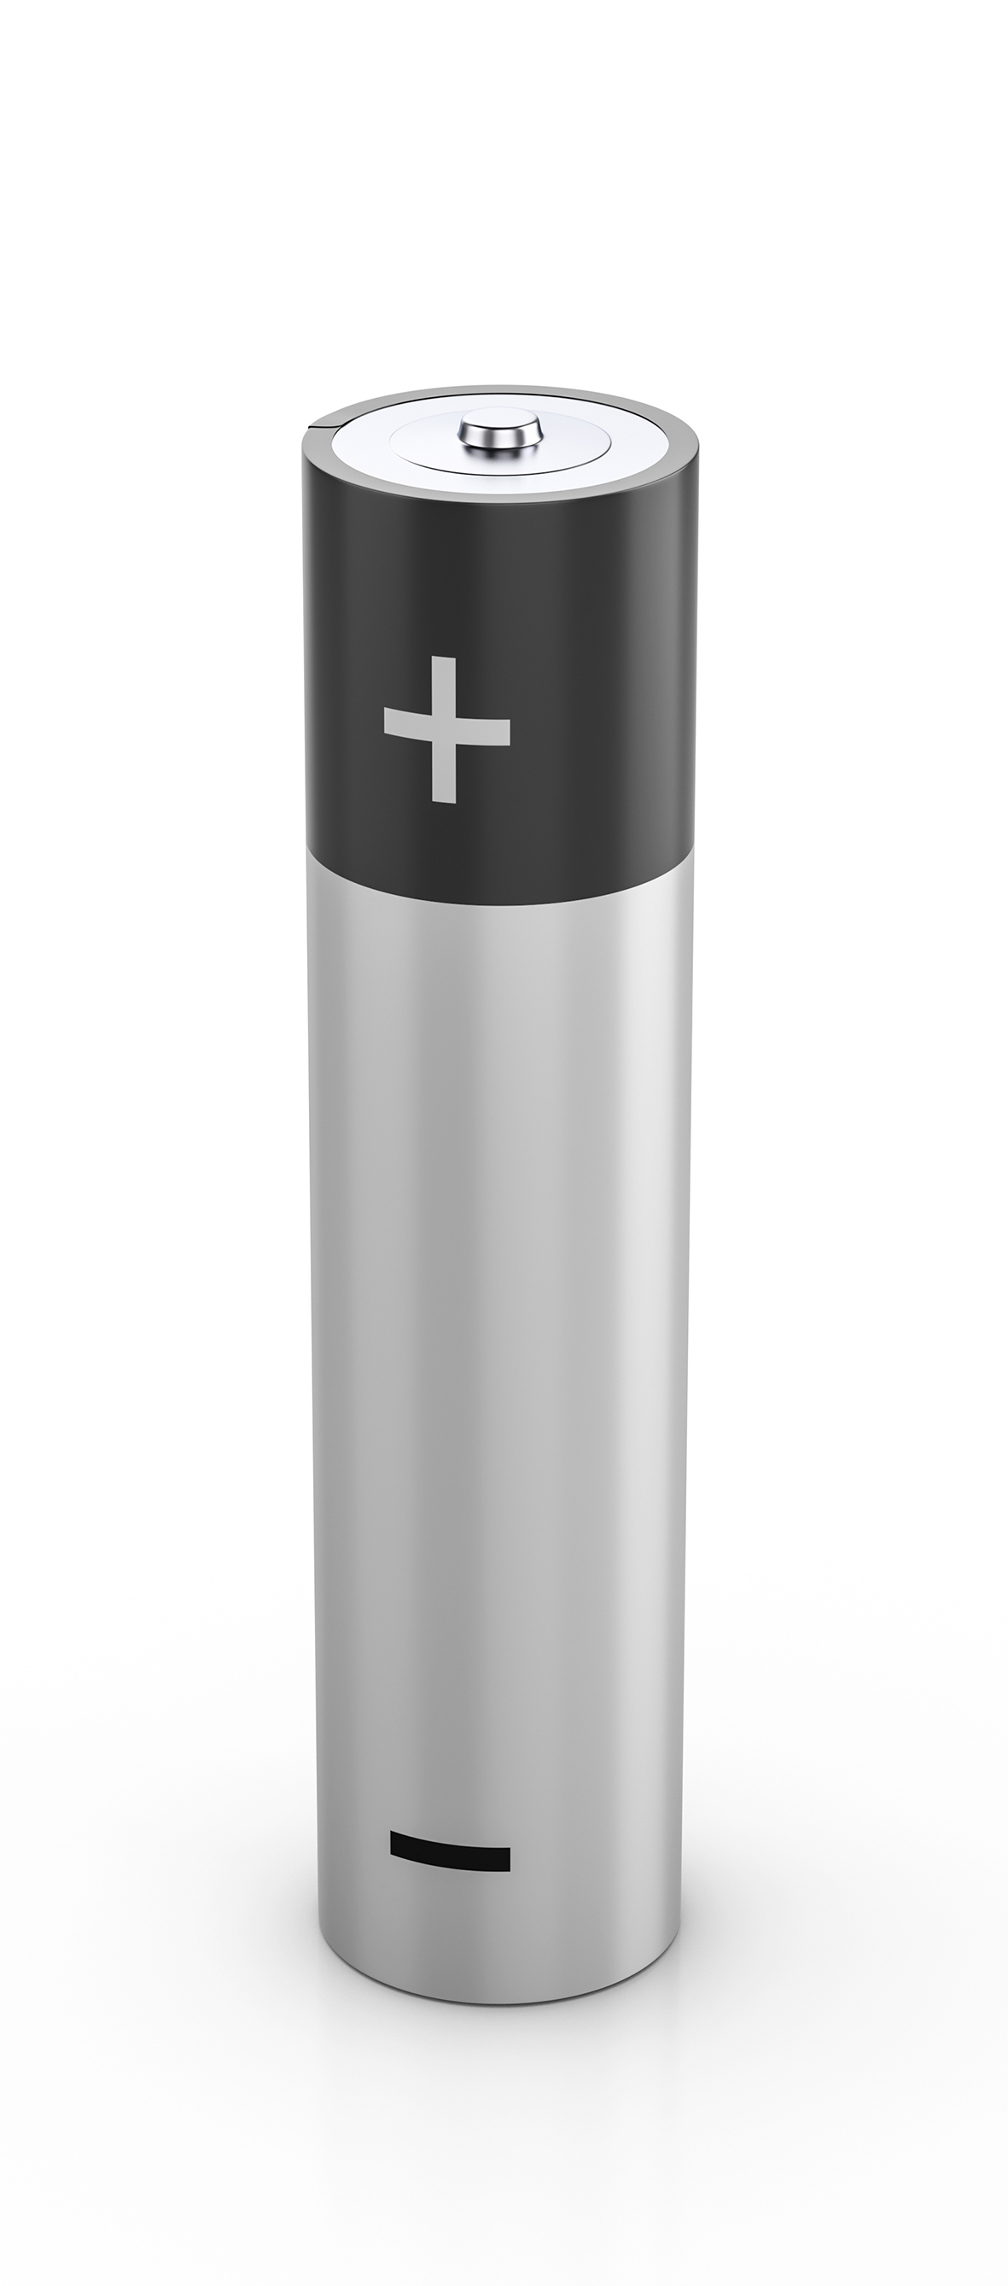
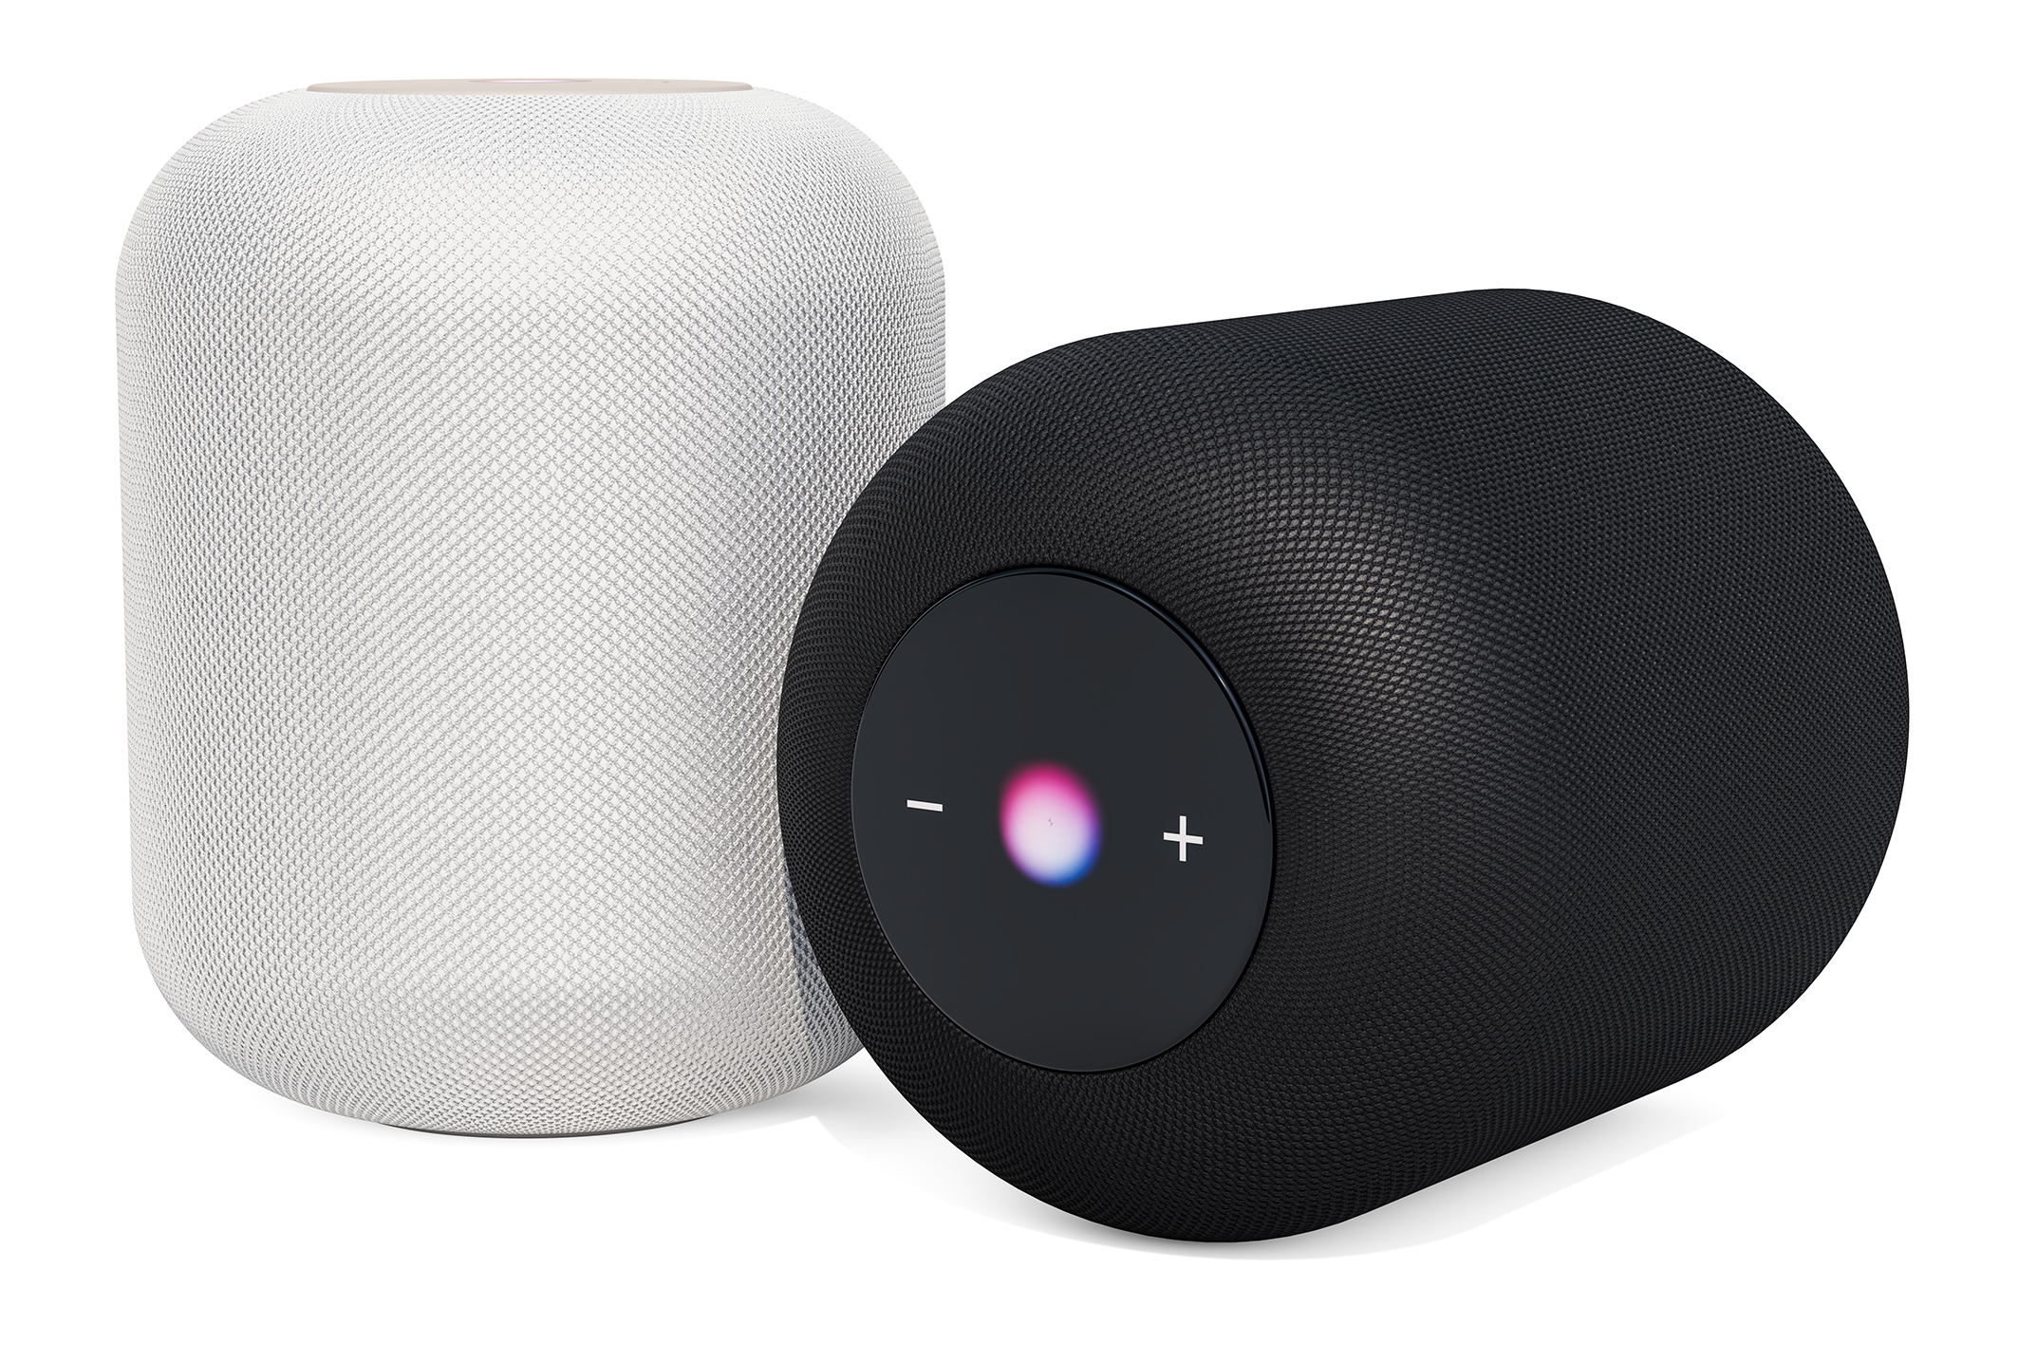
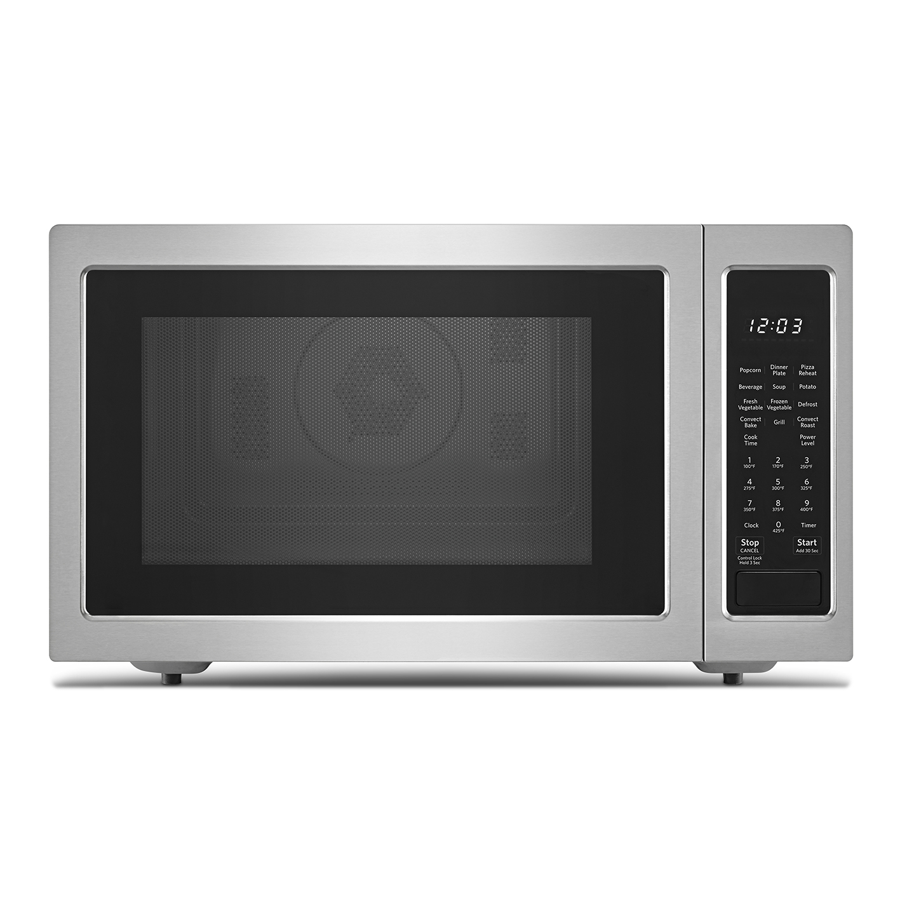
Notes:
Explain that electricity is very useful as it can easily be used to produce a range of effects, such as heat, light, sound and movement. Ask students to work in groups to identify a range of typical uses to which electricity is put in the home (they should not include battery powered devices, but they should include mains chargers for these).
Then ask them to go through that list and to divide it into two – those devices which have to run on electricity, such as TVs, and functions which could be powered by electricity but don’t have to be, such as water heating.
Ask students to think about how the total energy demand in a home varies over a 24-hour cycle. They should sketch the shape of a graph to represent demand and label it to explain the main features. Ask students to identify the assumptions made in drawing the graph and draw out points such as whether the home is empty during the day, whether the temperature outside is much lower than inside, whether it is insulated and how many people live there.

Slide 7
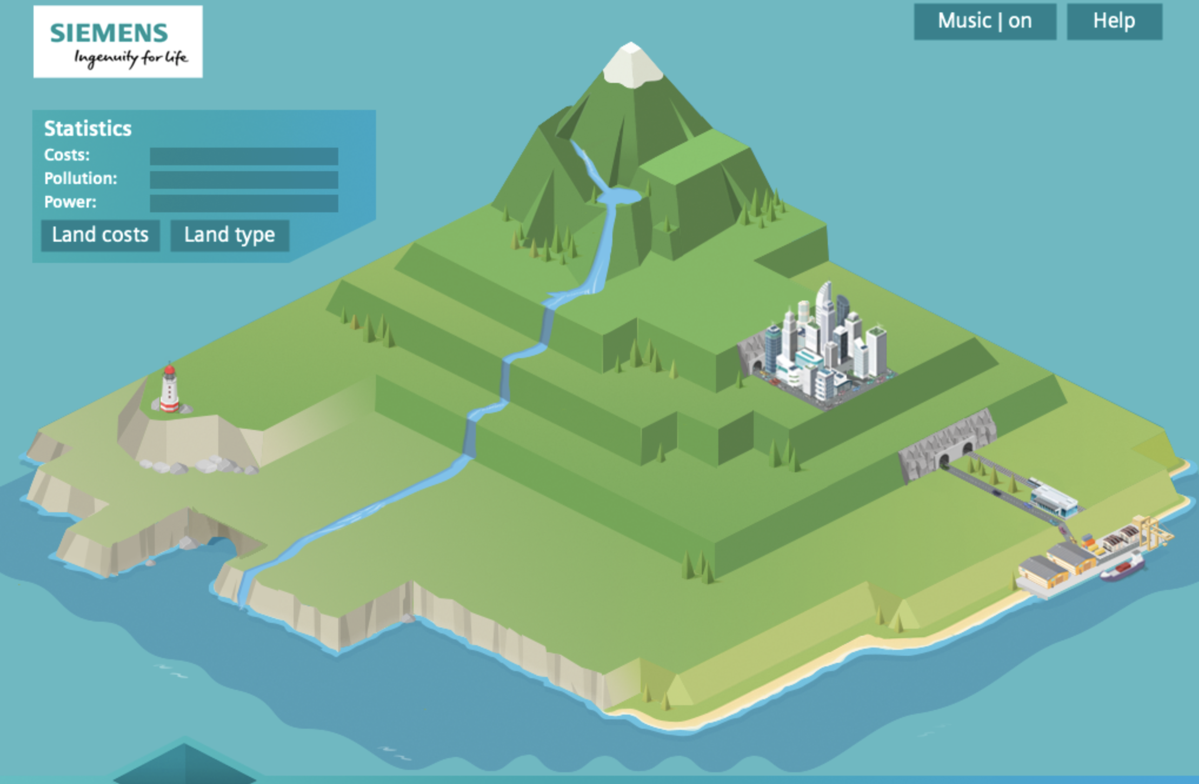
Notes:
Show the students a picture of an island and explain that their challenge is to provide the islanders with a power generation system. Say that there will be various alternatives as to how electricity can be generated. Then ask for suggestions about what would make a good energy source. They should be encouraged to think about price, pollution, reliability, storage and ease of starting up.
Gather ideas together and capture key points for future reference.

Slide 8
Notes:
In this episode students select an energy plan for the island from a number of alternatives. As well as making decisions about how to provide energy they have to consider the pollution caused, the reliability of the supply, how easy it is to store and how easily it can be regulated to allow for fluctuating demand. They can either do this using the online activity at: http://siemens.zincmediadev.com/energy/island/index.html or by using the resource sheets in this suite of activities.
Explain that the task they are to undertake is to provide for the energy needs of the islanders. They will have to make decisions about the fuels to use, whether to generate electricity or to use it directly. The plan will have to allow for fluctuating, demand, ease of storage and use, and pollution.
Say that because this is an island, options that only work on a large scale, such as fossil or nuclear power stations aren’t available.

Slide 9
Look at the information about the various energy supply systems and decide on the one (or ones) you would propose using.
You should, for the selected ones, consider:
a How their proposals will supply electricity to the island
b The environmental impact of their plans.
c How responsive the system would be if the demands upon it changed.
d The advantages of their plan.
e Any disadvantages
Notes:
(If working offline)
Either provide students with access to the online activity or provide each group with a map of the island and a set of energy card student support sheets 7 and 7A. In either case they will have access to information about the various sources. If the online resource is shown it might be useful to briefly introduce this feature and explain what is shown. If using the resource sheets, each energy card represents the same number of units of energy; it shows the cost, advantages and disadvantages of that energy source. Groups are given a weather forecast and a prediction of the energy requirements. They decide what combination of energy resources to use.
Students should then decide on the source(s) they intend to use. (If using the offline resources they could summarise this in a poster.) They should demonstrate awareness of: the points in the slide.

Slide 10
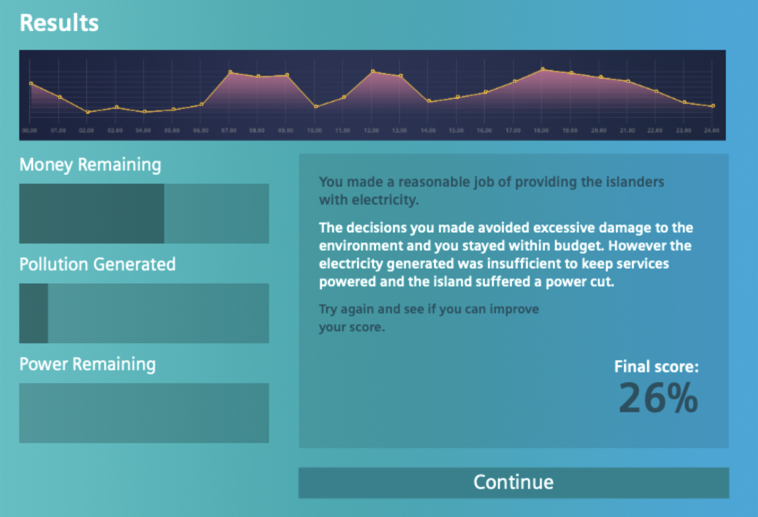
Notes:
(If using the online resource)
At the end of running the simulation students get a report as to how well their plan worked. This refers to environmental impact, financial management and security of supply. They may well want to refine their plan to improve their performance and get a better score.
After they have had reasonable opportunity to engage with the activities, ask them to make notes on how they got a good score and which energy sources to use to satisfy the requirements. This could take the form of comments such as:
“This source is really good because it’s good value and causes little pollution.”
“This source is bad for pollution but it’s reliable and stops the light from going out.”
“This source is good to have as part of the plan but you wouldn’t want to rely on it completely.”
Ask students to consider what they’ve learned overall about the advantages and disadvantages of various energy sources.

Slide 11
Group discussion
Notes:
(If using the offline resources)
Three or four teams are selected to ‘make a pitch’ for the contract of supplying the island with its energy. The teams could have had their poster presentations on display.
Each team gets, say, three minutes to present the key features of the energy provision plan to the governor of the island (possibly played by the teacher) and to groups of islanders (students not making
presentations – best in groups of two or three). The audience should think through what they would be looking for, example:
a) Islanders: happier if costs lower, less mess, energy needs met.
b) Governor: happier if less pollution, island looking attractive to tourists, islanders happy.
Say that the last contractor didn’t make a good job of it and there were some instances where the power went off. Both the governor and the islanders can ask questions.
At the end the groups of islanders explain which plan they prefer and why. The governor then provides a summing up, offering a broader perspective and ensuring that strengths from all bids are recognised. It may be considered appropriate for the governor to award the contract to a particular team.

Slide 12
Engineering the future. Inspire and be inspired.
For further information about the Siemens Education website and all support materials and downloads please visit us at www.siemens.co.uk/education

