Slide 1
Lesson Plan MRI Scan Experience
Siemens Education

Slide 2
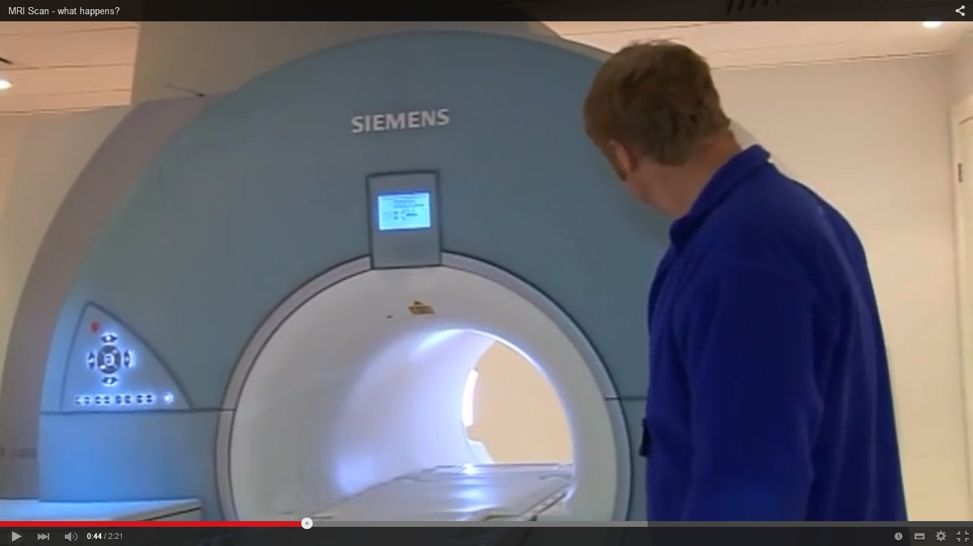
MRI Scan Experience
Episode 1 – Introduction
B. MRI Scan Film
https://www.youtube.com/watch?v=AwXJNXNcLNs
Notes:
Support Slide 1 B
B MRI Scan Film
You tube clip of MRI scan
https://www.youtube.com/watch?v=AwXJNXNcLNs

Slide 3
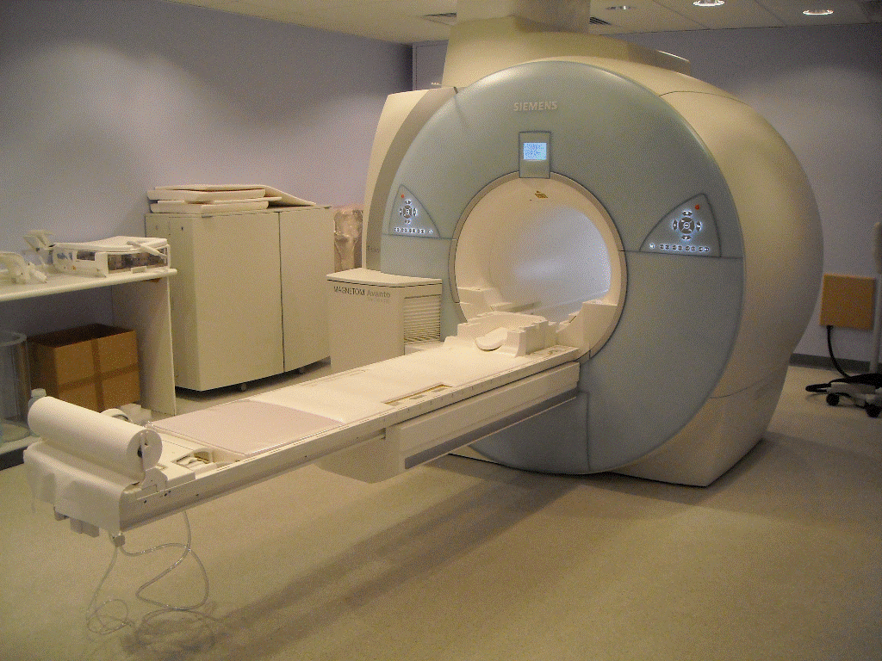
MRI Scan Experience
Episode 1 – Introduction
C. MRI Scanner Machine
Notes:
Support Slide 1
Episode 1 Introduction
C. MRI Scan Machine
You tube clip of MRI scan
https://www.youtube.com/watch?v=AwXJNXNcLNs

Slide 4
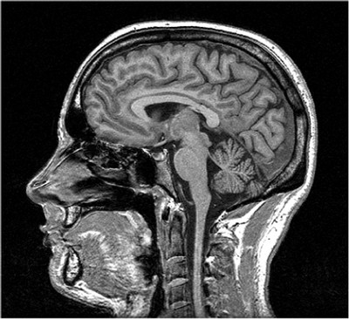
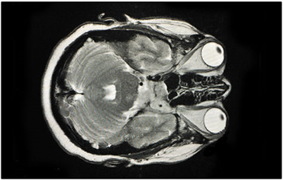
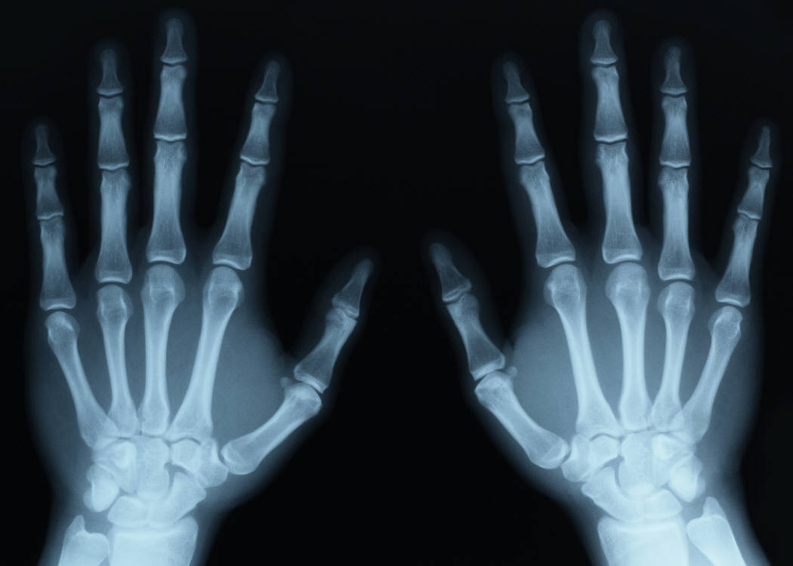
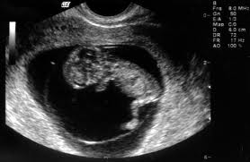
MRI Scan Experience
MRI Scan
CT Scan
X-ray image
Ultrasound Scan
Notes:
Support Slide 3
Episode 2 Engagement activities
B - Medical Images

Slide 5
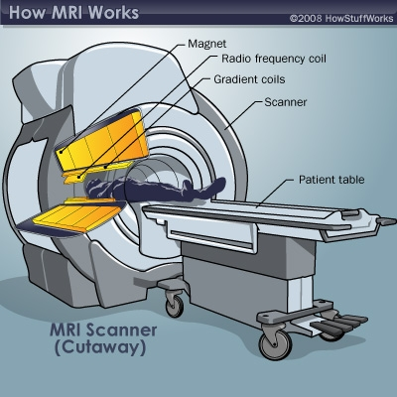
MRI Scan Experience
There are four key components:
A powerful permanent magnet
Gradient coils, which produce a variable magnetic field
Radio frequency (RF) coils, which produce radio waves
Scanner, which detects energy emitted from the body
Notes:
Support Slide 4
Episode 3 Development activities
C. Finding out how MRI Scanners work
MRI scanning works as follows: the patient lays inside the MRI scanner, which generates a magnetic field which changes rapidly in strength. This oscillating field excites protons in tissues in the body that contain water molecules.
These protons emit radio signals which are detected by coils in the scanner and interpreted to produce images. Changing the magnetic field at different rates helps to identify the position of different tissues and it is these changes that cause the distinctive sound. Contrast between them shows up by the rate at which the excited particles return to their previous state; this may be enhanced by contrast agents which may be administered in a variety of ways.
MRI scans aren’t the only way of producing images. However, they do have a number of advantages. Unlike X-rays the radiation involved is far less dangerous and doesn’t carry the same risks of radiation induced cancer (which also applies to CT scans). MRI scans take longer though, usually between 20 and 40 minutes, during which time the patient is inside the scanner.

