Slide 1
Energy Farm Briefing
KS3
A simulation to explore how the nature of power generation is changing.

Slide 2
Objectives
KS3
This activity is designed to get you to understand:
How different technologies can be used to provide energy for people and their work.
How these different technologies have different pros and cons.
How to set up a system to supply enough energy to meet demand whilst keeping costs down and minimising negative impact on the environment.

Slide 3
A changing model of power generation
It used to be that a common model of power generation and consumption was this:
Image source: adapted from National Energy Education Development Project (public domain)
Notes:
Summarise the background to changing energy supply systems.
Characteristics of this model:
In this model, a number of things can be seen:
The power generation is done on a large scale by utility companies.
The power is distributed from the large generators to the consumers.
The consumers use the energy and pay the utility company for providing it.

Slide 4
Changing times
This model is now, in some places, being changed in a number of ways:
Power can now be generated using smaller generators, with a variety of energy sources, and distributed over a wide area.
These generators may be owned or controlled by the consumer, who can produce at least some of the energy they need themselves.
In some cases they may even sell excess energy to the distribution system.
This simulation is to explore how this might work in a particular context.

Slide 5
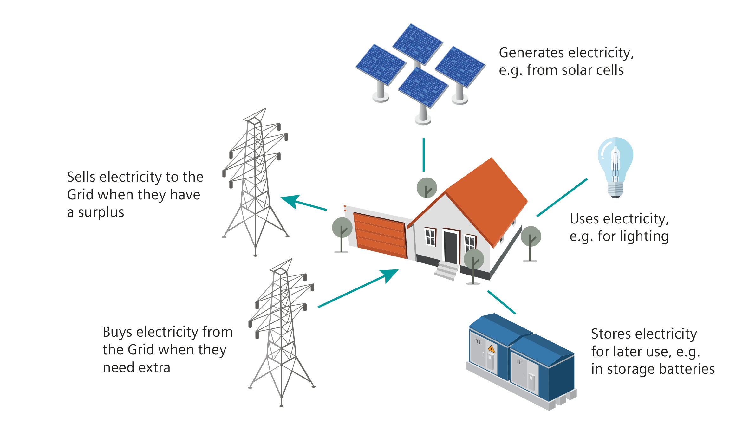
Alternative power distribution system

Slide 6
The scenario
Your task is to organise the energy technology for a farm. This has to provide the farm with energy to carry out various functions, such as keeping the lights on (when it’s dark), powering the equipment (such as the milking parlour) and keeping the house warm.
You have a budget of 20 tokens to set the system up. Each piece of equipment has a price, so you will need to make decisions about what to spend the tokens on.
Once you’ve set the system up, you then run it for a week. At the end of the week you can then see how well it has worked.
Notes:
Introduce the resource in broad terms.

Slide 7
Success criteria
There are three sets of criteria you will be judged against:
Did you get through the week without the lights going out?
What were your running costs?
Did you manage to minimise the negative impact on the environment?

Slide 8
The technology
There are six different kinds of technology you can use.
You can mix and match the different kinds of technology.
You can also return equipment and reclaim tokens to spend on other items.
Notes:
The next two slides introduce these and suggest why you might (or might not) want to use them.

Slide 9
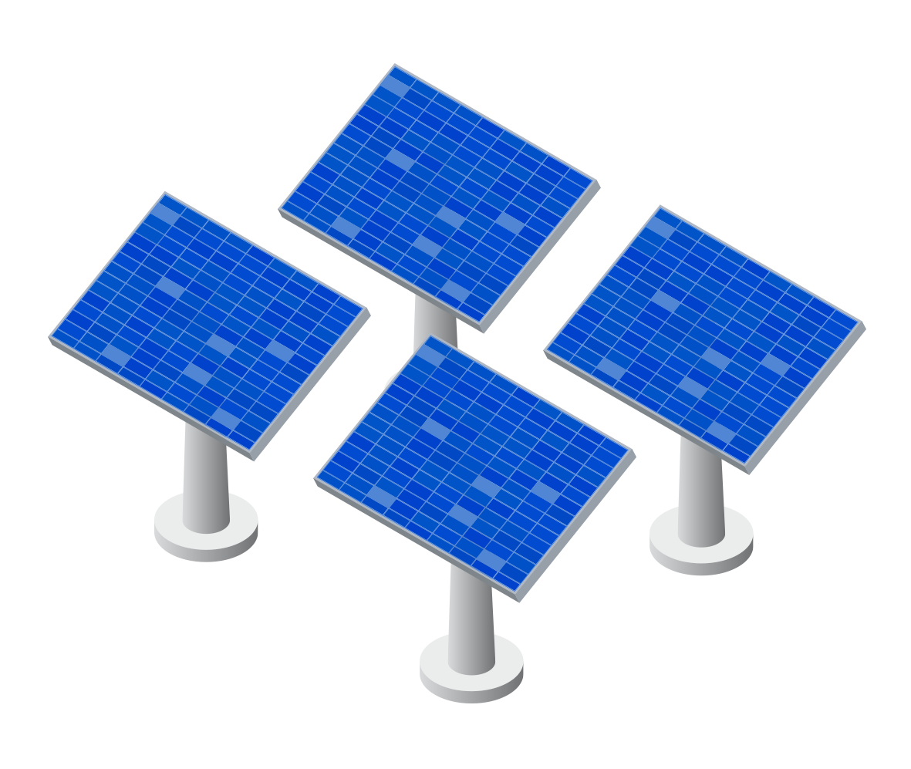
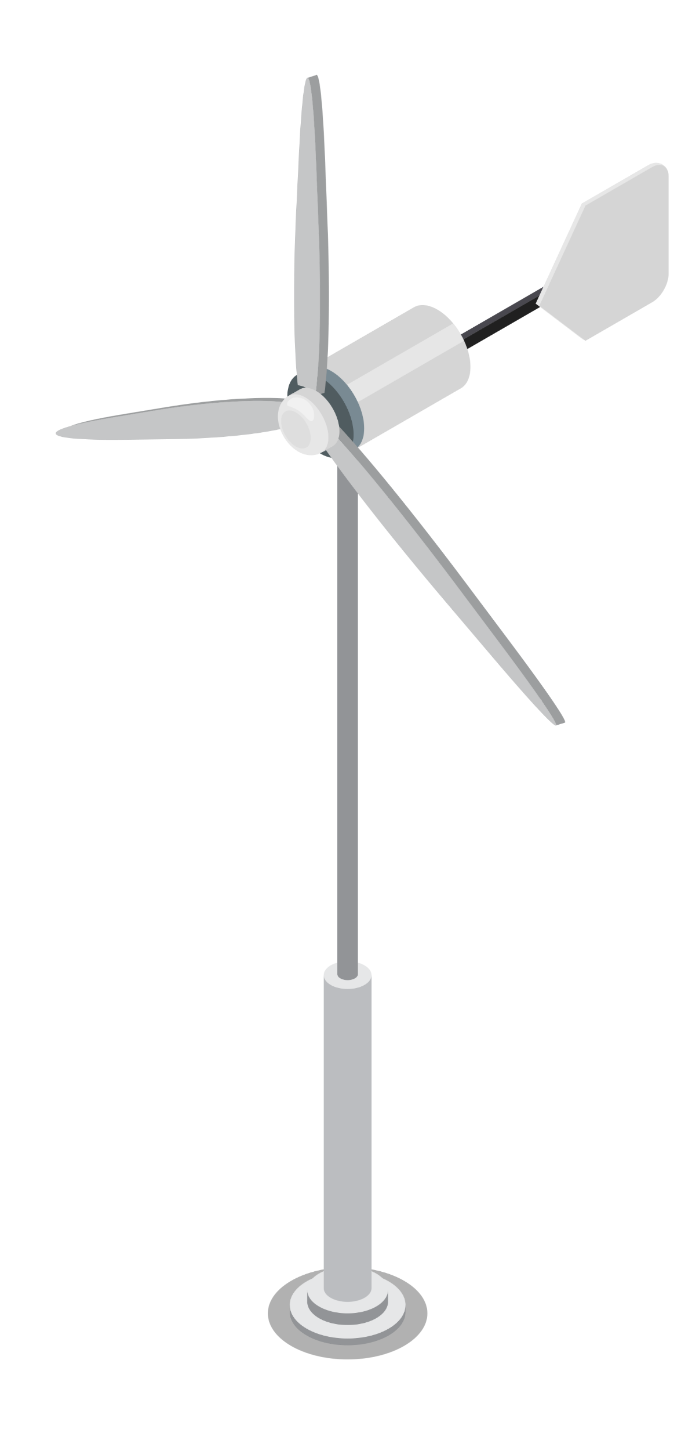
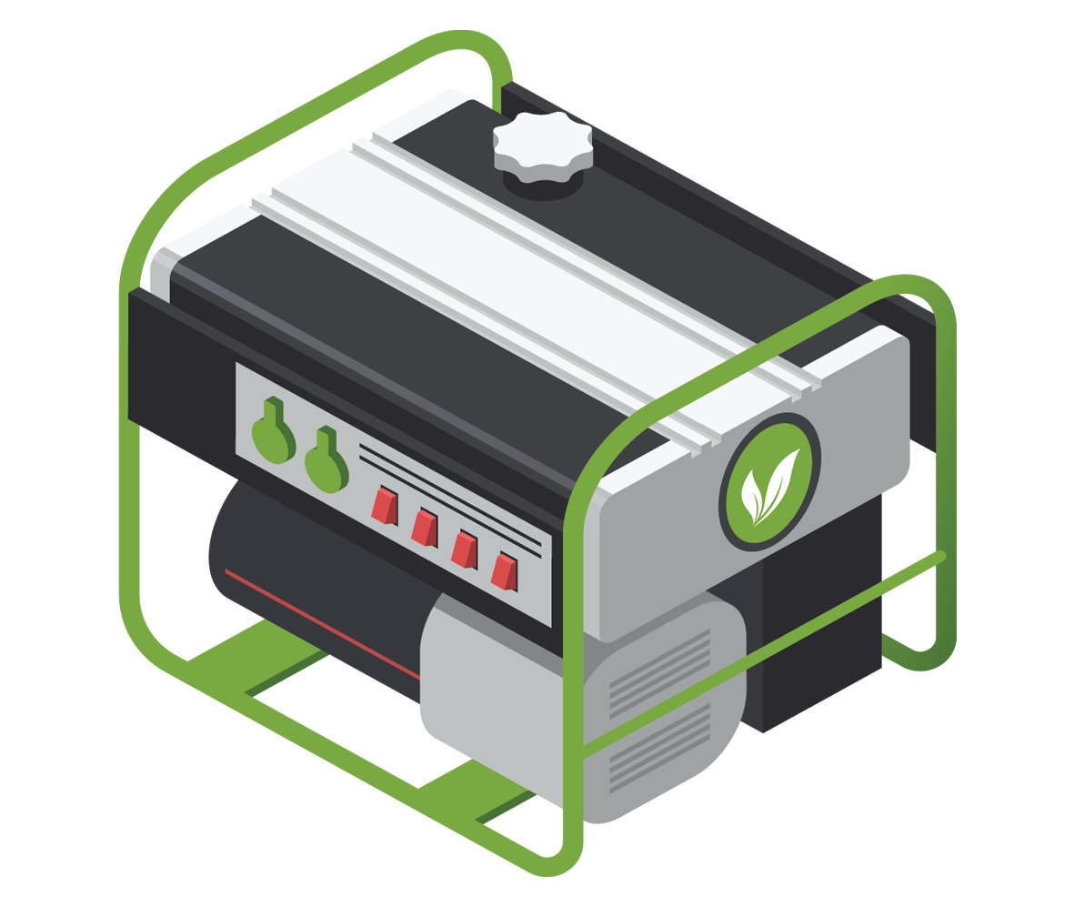
Equipment to purchase (1)
Solar cells
Solar cells produce electricity from sunlight. Once installed they are free to run and their impact on the environment is low.
They only produce electricity when light is falling on them; on a gloomy day their output is less.
Wind turbines
Wind turbines produce electricity from the wind. Once installed they are free to run and their impact on the environment is low.
They only produce electricity when the wind is blowing.
Biogas generator
Biogas generators produce fuel gas from decomposing materials such as manure, which farms often have copious quantities of. Their impact on the environment is fairly low.
The gas they produce can only be used for certain applications, such as space or water heating.
Notes:
The next two slides introduce these and suggest why you might (or might not) want to use them.

Slide 10
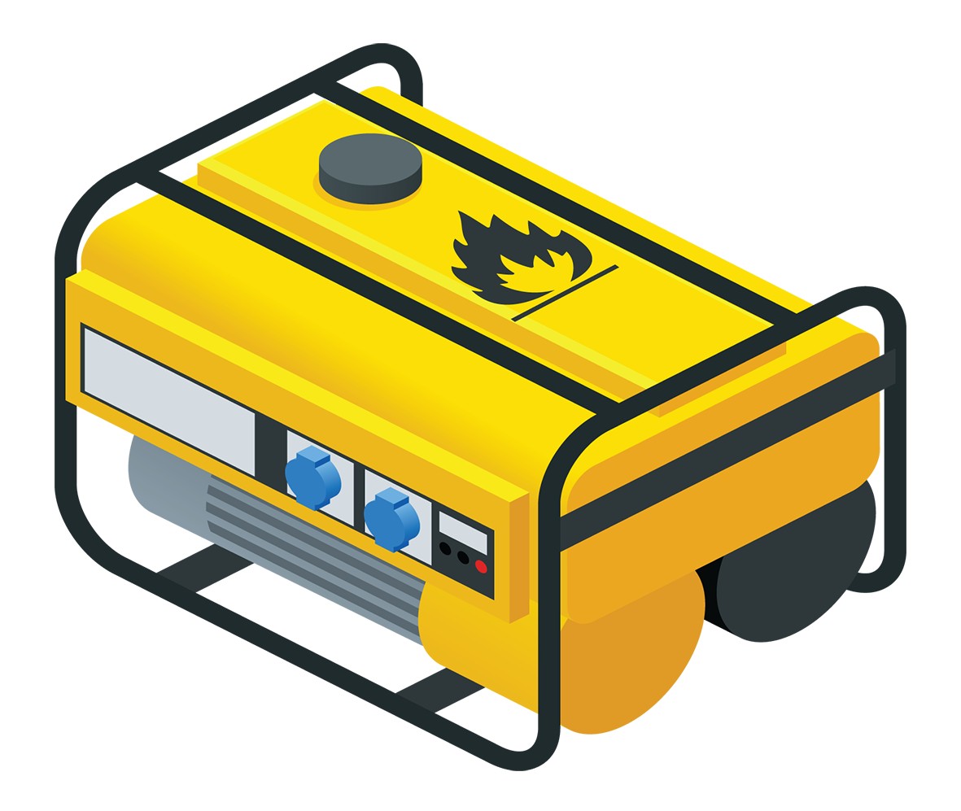
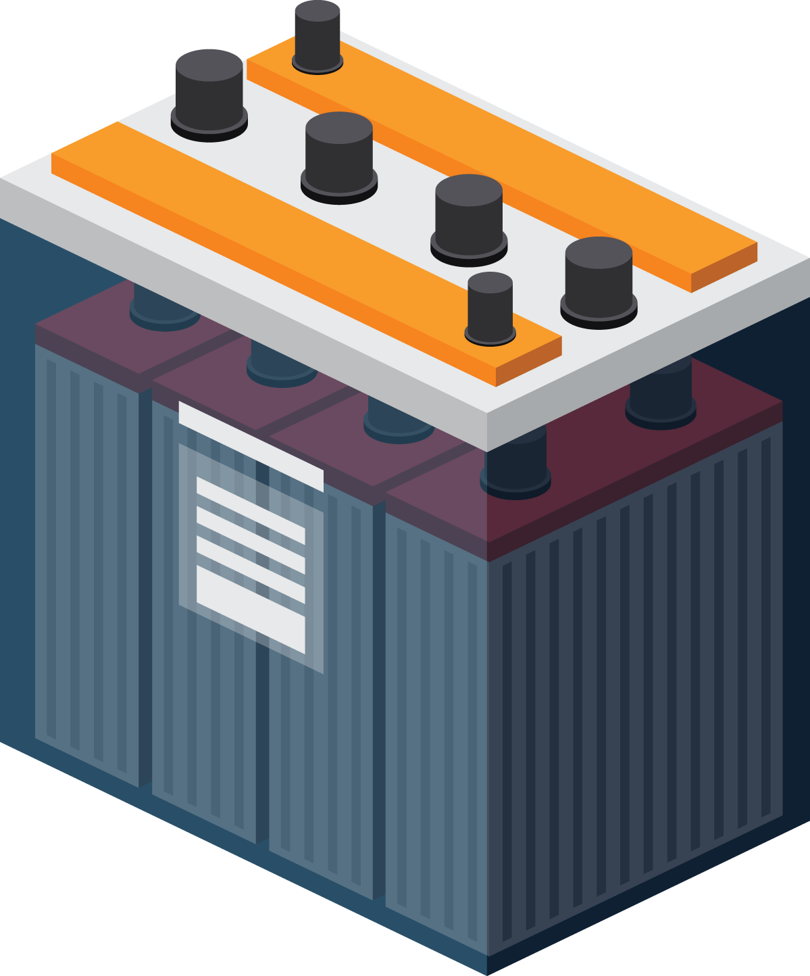
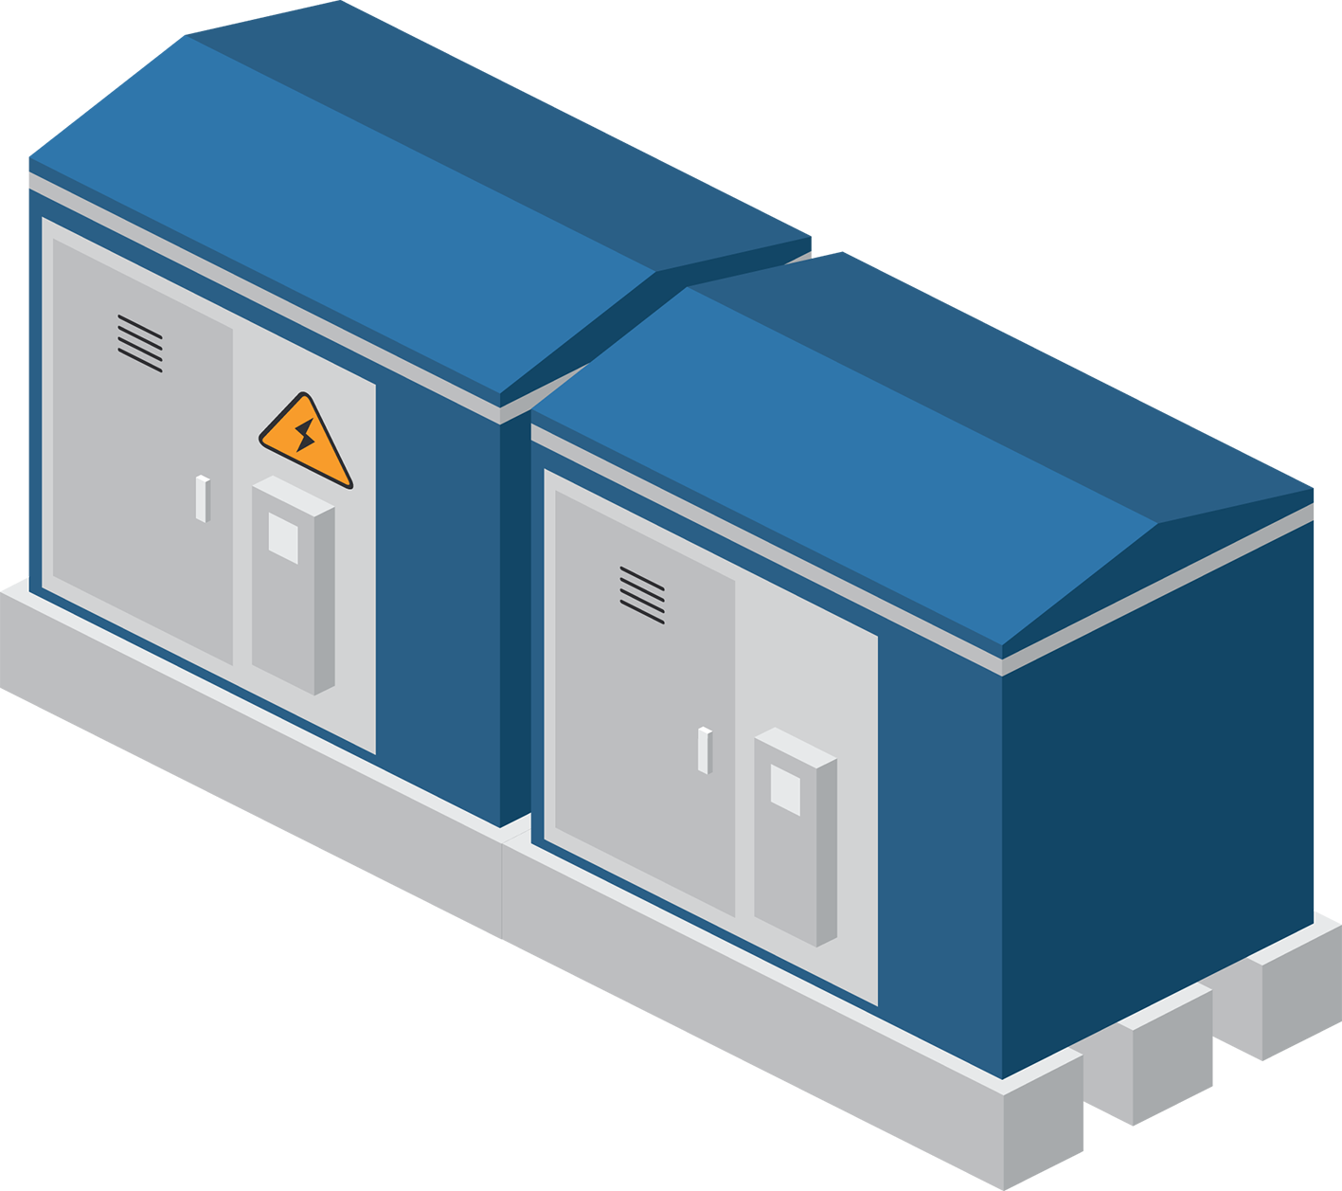
Equipment to purchase (2)
Storage batteries
Storage batteries don’t produce electricity but they store it, so if your system produces more energy than you need at certain times of the day they will store the electricity for times when demand would otherwise exceed supply. Their impact on the environment is low.
If storage batteries are full and if you have a connection to the National Grid then the system will sell excess electricity to the Grid and reduce your energy bill.
The National Grid
If you want to connect your system to the National Grid you will need to pay for the connection and also for any electricity you use. However the supply will ensure that you have a continuous source of electricity.
The environmental impact of the National Grid is higher than solar, wind or biogas.
Petrol generator
The petrol generator will start up if you don’t have a link to the National Grid and if you run out of energy from other sources so it will ensure that the lights stay lit. It’s cheaper than a link to the National Grid.
You have to pay for fuel and the environmental impact is higher than any other means of producing electricity.

Slide 11
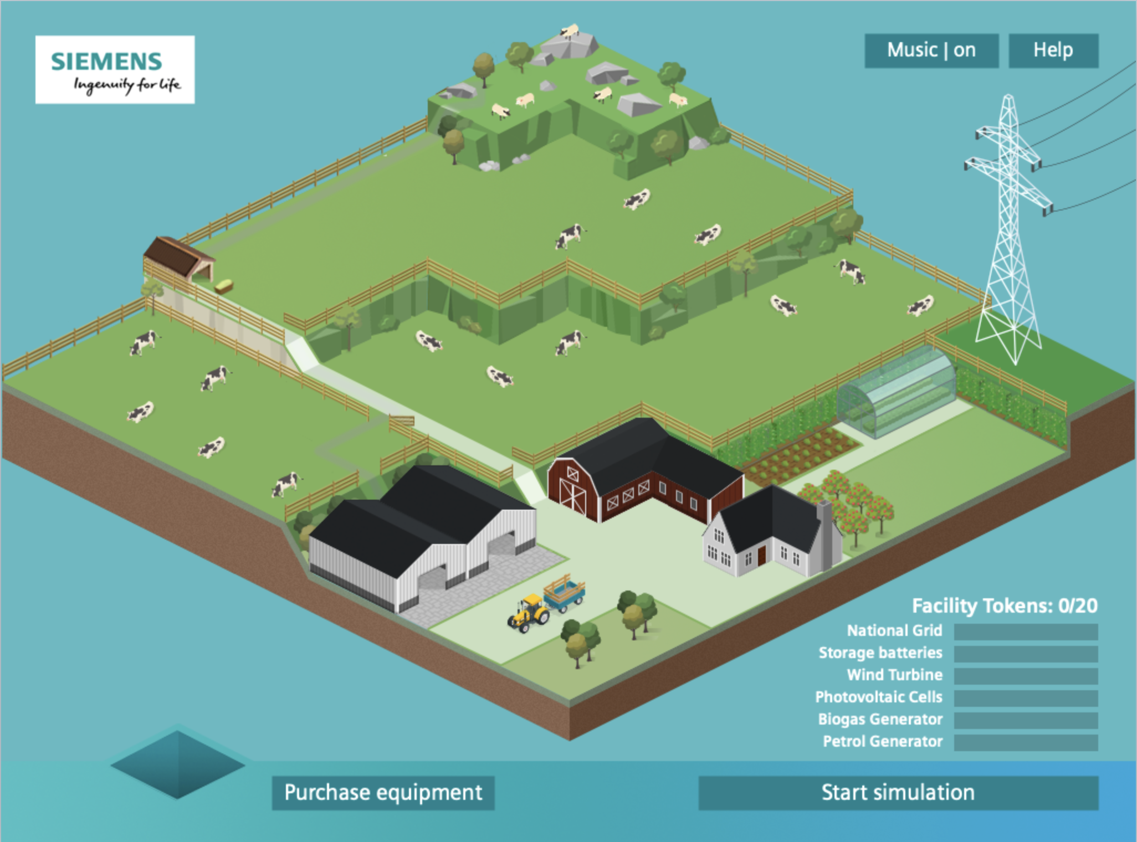
How to install equipment
Go to the ‘set up’ screen and select ‘purchase equipment’. This will bring up a list of icons; each represents a different piece of equipment.
Select a piece of equipment; you will be given some information about it. If you decide to buy it then click on ‘purchase’.
The equipment is delivered to the bottom left corner of the screen; you will need to select a location. The possible locations are indicated. Batteries have to go in the barn and the National Grid link has to go by the pylon.
You will see how many tokens you have left.

Slide 12
Remember - you’re a producer as well as a consumer!
The set up on the farm is clearly capable of producing at least some of the energy needed and therefore reducing demand on the National Grid.
Clearly some of the devices are weather dependent – the solar panels need sun and the wind turbines need wind so you may be producing more energy than you need at some points of the day. You may store some of this.
However if the storage batteries are full the excess electricity is sold back to the National Grid - they pay you to produce electricity that they can then sell elsewhere.

Slide 13
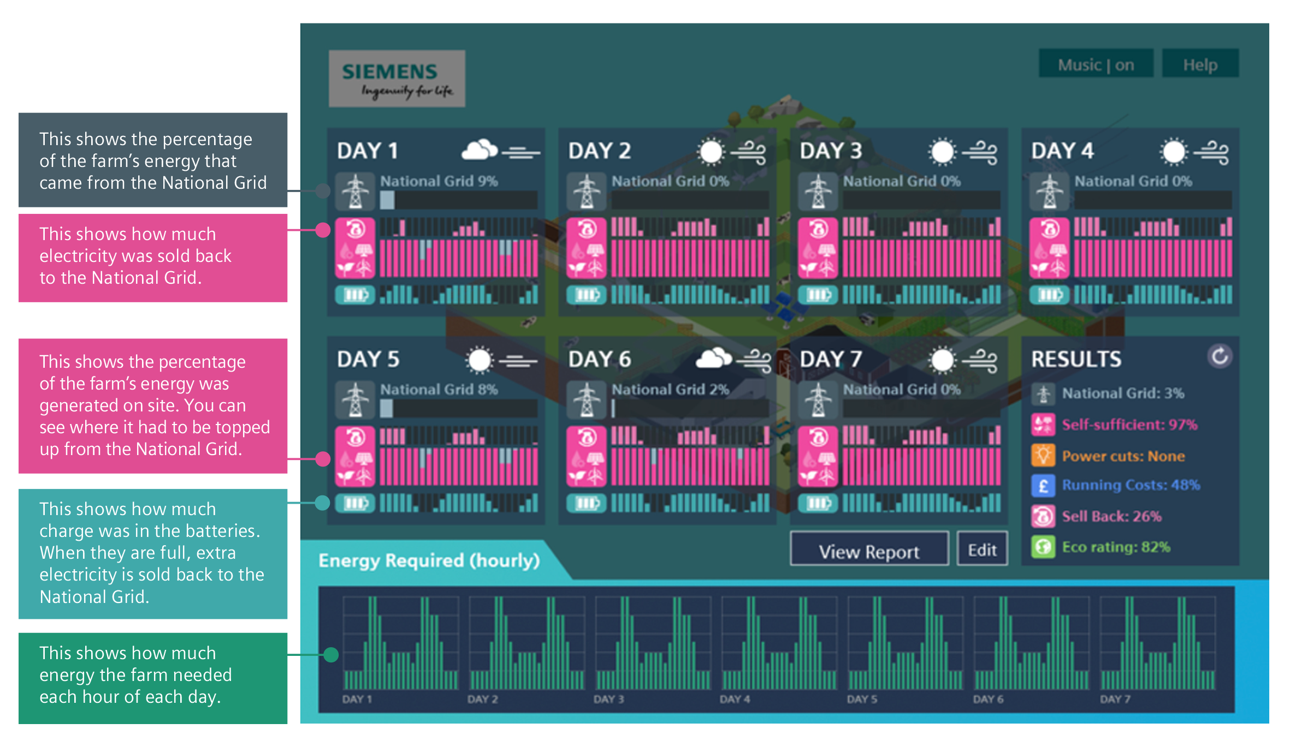
Daily performance
Notes:
How to run the simulation: When you have set up the system, click on ‘start simulation’ and confirm.
The system then runs over seven days and shows you how it has performed.
For each day you will see:
What the weather was like
How much energy you generated yourself
What the demand was
Whether there was a continuous supply

Slide 14
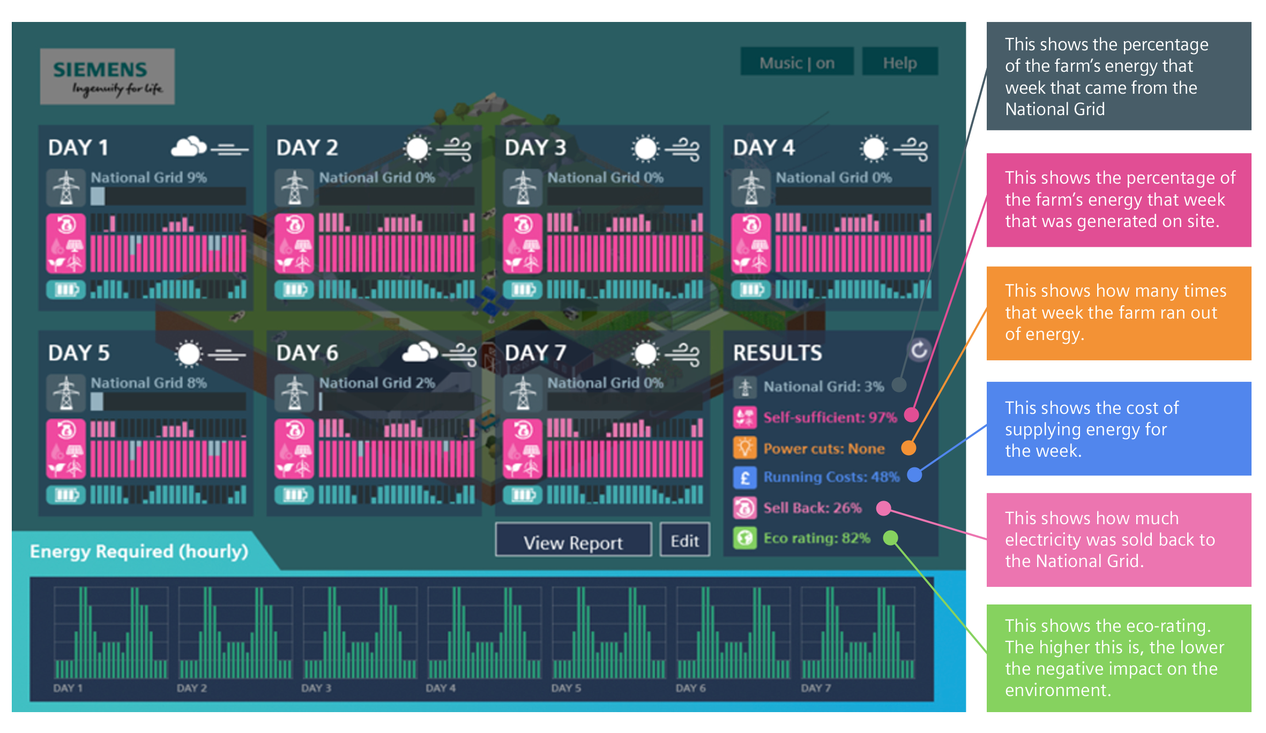
Weekly performance
Notes:
How to run the simulation: When you have set up the system, click on ‘start simulation’ and confirm.
The system then runs over seven days and shows you how it has performed.
For the week, the summary shows
The proportion of the electricity you used that you generated yourself
Whether there had been a continuous supply
The running costs of the system
The environmental impact of the system

Slide 15
Questions
Why is each day broken down on the graph into 24 bars?
Why might the sun and the wind affect the system?
The graph showing energy generated on-site isn’t all from renewables - what else is included in this?
Suggest why the energy requirements vary in that way during the day.
Looking at the weekly results scores, why will the first two always add up to 100%?

Slide 16
How to modify the system
If you decide you can improve the system and achieve better performance you can go back to the set up screen and return equipment (drop it into the delivery chute).
You will then be credited with those tokens, which you can then use for other equipment.
You can then run the system again and see how the new one performs.

Slide 17
KS3
Energy Farm Debriefing
A simulation to explore how the nature of power generation is changing.

Slide 18
Objectives
This activity is designed to get you to understand how:
Different technologies can be used to provide energy for people and their work
These different technologies have different pros and cons
To set up a system to supply enough energy to meet demand whilst keeping costs down and minimising negative impact on the environment

Slide 19
So, how did it go?
From your best performance:
Did you manage to keep the lights on all week?
What did the system cost to run?
What was the environmental impact of the system?
Notes:
Invite students to consider how well they did with reference to the key performance indicators.
This could be displayed towards the end of the students setting up and trying systems; the importance that is that they have a record of their best performance that they can then use as a comparison.
It might be better to avoid too great an emphasis upon who go the best score as this depends upon factors such as the weather as well as upon system design.
Mention to students that it is possible to devise a system that performs well on all three fronts.

Slide 20
How did you do it?
What hints would you give to someone trying to set up an effective system and get a good score?
What would you say about whether (and, if appropriate, how many) to use of:
- Solar cells
- Wind turbines
- Biogas generators
- Batteries
- National Grid link
- Petrol generators
Notes:
Ask students to consider how they achieved this? It uses the context of giving advice to another user. Encourage students to be analytical and gather key points made.

Slide 21
Making sense of the data
Look at the following three panels. Each shows one day from three different systems.
For each panel, discuss in your group and agree:
- What the data shows.
- Whether it’s a system that is performing well.
- What you might suggest doing to improve it.
Notes:
Show students the graphs from three other users and ask them to comment on what each shows, whether that system is working well and how it could be improved.
Some students may have happened upon a successful combination without knowing why it is effective.

Slide 22
System 1
What does this show about the system in operation?
What’s going well with it?
Suggest how it could be redesigned to improve it.
Notes:
System 1:
Shows a systems that consists entirely of solar and wind power technology.

Slide 23
System 2
What does this show about the system in operation?
What’s going well with it?
Suggest how it could be redesigned to improve it.
Notes:
System 2:
Shows a few wind turbines with a petrol generator as back up.

Slide 24
System 3
What does this show about the system in operation?
What’s going well with it?
Suggest how it could be redesigned to improve it.
Notes:
System 3:
Has a large wind farm and a National Grid connection.

Slide 25
Questions to think about
Why do the designers of systems like this often use a variety of different technologies?
Why might it not be a great idea to have both a National Grid link and a petrol generator?
Why, in real life, might it be a good idea to have a petrol generator if you had no National Grid connection, even though you rarely if ever used it?
Is solar energy really free?
Do solar cells have any negative environmental impact? (You might need to do a bit of research on this)
(This one’s a bit harder) Is it better to buy batteries to store surplus electricity or to use all the tokens on generating equipment, sell any excess and buy it back when you need to?
Notes:
Draw out some more general points about the use of alternative energy sources.

Slide 26
Not only on farms …
This simulation uses the context of a farm. Some of the solutions available here might not work so well in other situations. However, some other contexts might not need to produce as much energy.
How would the simulation need to be altered if, instead of a farm, the situation was:
- A detached family home with a large garden?
- A terraced town house with a small garden?
- A corner shop with a yard in a town?
Notes:
Get the students to think about how settings other than a farm can also use these ideas.

