Slide 1
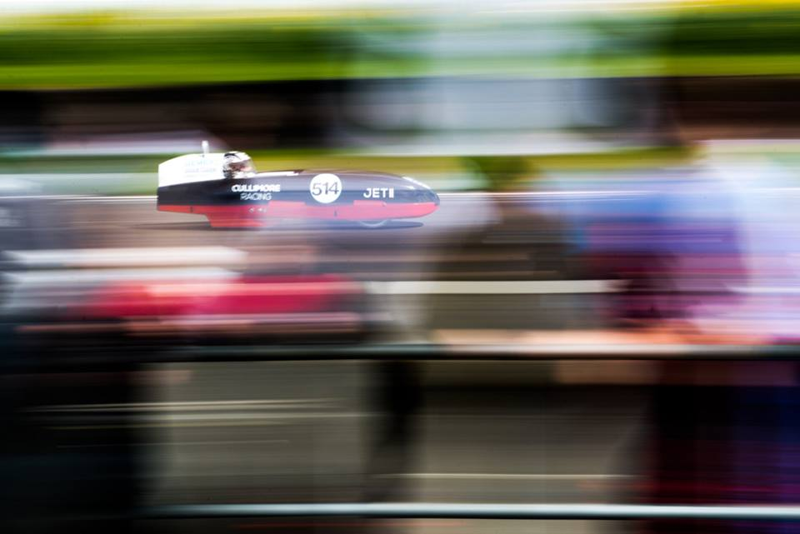
Speed
[Speed] noun
The rate at which something moves, is done, or acts.
(physics) a scalar measure of the rate of movement of a body expressed either as the distance travelled divided by the time taken (average speed) or the rate of change of position with respect to time at a particular point (instantaneous speed).
Unrestricted

Slide 2

Speed
Learning Aims
Knowledge | Skills
Speed can be recorded in a range of units which can be inter-converted Instantaneous speed is the speed over a short time period Average speed is the speed for a whole journey The calculation of speed, distance and times | Working collaboratively Using stopwatches Measuring distances to an appropriate level of precision Construction and interpretation of distance-time graphs and speed-time graphs Appreciate the difference between speed and velocity

Slide 3
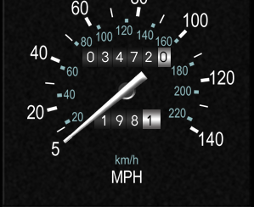
Speed
Speed: distance travelled in a period of time…
Speed can be measured in
Kilometres per hour (km/h) e.g. 100 km/h
Metres per second (m/s) e.g. 27.8 m/s
Miles per hour (mph) e.g. 62 mph
80

Slide 4

Calculating Speed
D
Distance = Speed x Time
distance travelled (metres)
time taken (seconds)
S
T
average speed =
D
Distance
Speed
Time =
S
T
D
Distance
Time
Speed =
distance
S
T
time
00:00
00:01
00:02
00:03

Slide 5
Calculating Speed
D
Distance = Speed x Time
A girl walks 90 metres in 30 seconds.
  What is her speed?
A cyclist travels at 12 m/s for one minute.
  How far has he travelled?
How long would it take a car to drive 1000 metres if it travelled at 20 m/s?
S
T
90m ÷ 30s = 3 m/s
D
Distance
Speed
Time =
S
T
D
Distance
Time
Speed =
12 m/s x 60 s = 720 m
S
T
1000 m ÷ 20 m/s = 50 s

Slide 6
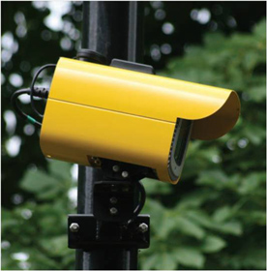
Calculating Average Speed
Siemens SafeZone is for urban speed enforcement and uses Automatic Number Plate Recognition (ANPR).
Siemens SafeZone calculates the average speed of a vehicle over a measured distance within the identified speed enforcement zone.
What are the benefits of Siemens SafeZone average speed measurement over instantaneous speed enforcement systems?
Will the calculation of average speed allow the police to catch all speeding offenders?
Notes:
Siemens SafeZone:
http://www.siemens.co.uk/traffic/en/road-safety-and-enforcement/anpr-average-speed-cameras-safezone.htm#toc-1

Slide 7
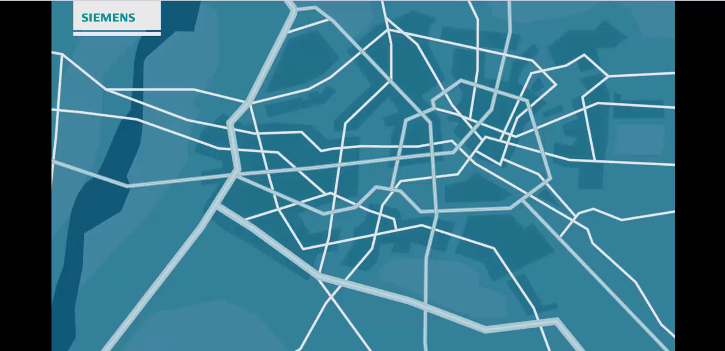
Notes:
Click to start the movie.
This movie shows how the Siemens SafeZone system works. (50 seconds)

Slide 8
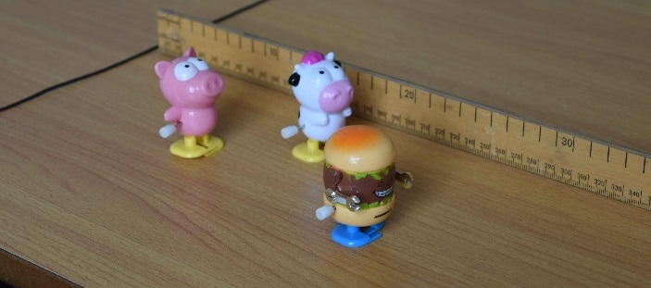
Calculating Speed
Use a ruler and stopwatch to measure distance covered over time and then calculate the speed of some clockwork toys.
Time (s) | Distance (cm) | Speed (cm/s)
0
5
10
15
20
25
Calculate the speed from 0 to 5 seconds,
then from 5 to 10 seconds, etc.
This will be the instantaneous speed at
different sections of the journey.
Does the speed remain the same?

Slide 9
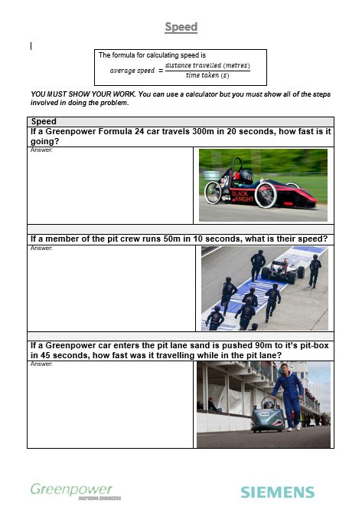
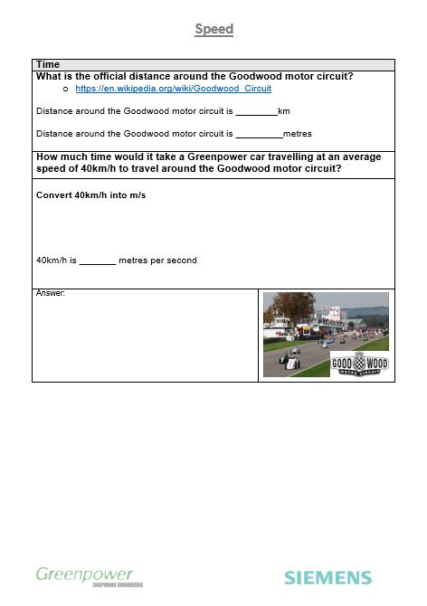
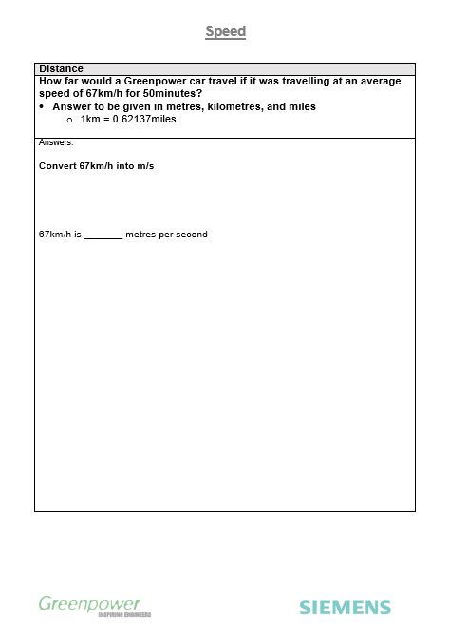
Speed: Classroom exercise
Notes:
Hand out the Student Class Work Sheet

Slide 10
Speed
If a Greenpower car travels 300 metres in 20 seconds how fast is it going?
If a member of the pit crew runs 50 metres in 10 seconds what’s their speed?
If a Greenpower car enters the pit lane and is pushed 90 metres to it’s pit box in 45 seconds, how fast was it travelling while in the pit lane?
15 m/s
5 m/s
2 m/s
D
distance
time
speed =
S
T

Slide 11
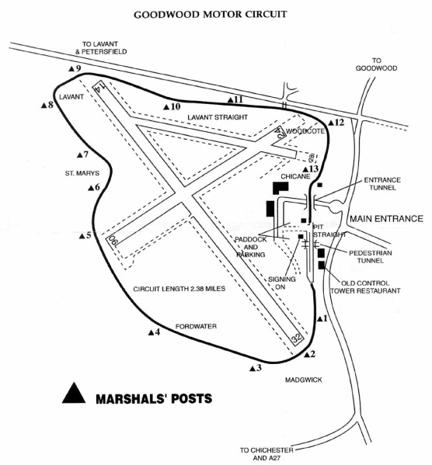
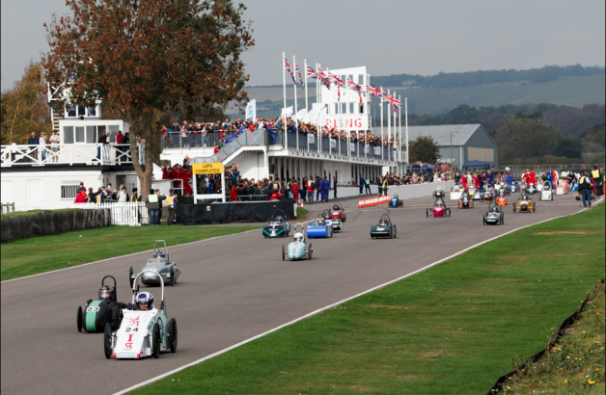

Speed:time
How much time would it take a Greenpower car travelling at an average speed of 40km/h to travel around the Goodwood motor circuit?
  Answer to be given in minutes and seconds.
3 minutes 42 seconds
D
distance
time
speed =
S
T
Notes:
Goodwood: Students may be guided to undertake research to find out the length or distance around the Goodwood motor circuit. The following link is a good source of information - https://en.wikipedia.org/wiki/Goodwood_Circuit. The official distance is stated as 3.8km with the accurate distance being 3.809km
The students will need to convert the distances into metres, speed into metres per second (m/s) and time into seconds and then convert the answer into minutes and seconds, i.e. 5 minutes and 30 seconds and not 5.5minutes.
1 kilometre = 1,000 metres
3.8 km = 3,800 metres
1 hour = 60minutes
1 minute = 60 seconds
1 hour = 3,600 seconds
Useful video on converting kilometres per hour (km/h) to metres per second (m/s) https://www.youtube.com/watch?v=xrelaubLUPc
40km/h = 11.1111 m/s
Answer 3 minutes 42 seconds.

Slide 12
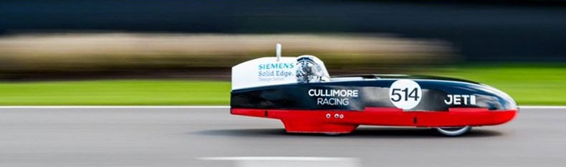
Speed: distance
How far would a Greenpower car travel if it was travelling at an average speed of 67km/h for 50minutes?
  Answer to be given in metres, kilometres, and miles.
    1 km = 0.62137 miles
Distance covered = 55833 m
= 55.833 km
= 34.69 miles
D
distance
time
speed =
S
T
Notes:
JET II, from Cullimore racing, averaged 39.3mph over the 1 hour Formula 24+ race in 2015. The fastest lap time around the 2.38 KM track was 2 minutes 5 seconds.
www.cullimoreracing.com
Students will need to convert the speed into metres/second and the time into seconds
67km/h = 18.611 m/s
50minutes = 3000 seconds
distance = speed x time
distance = 18.611 x 3000
distance = 55833 metres
distance = 55.833 km
distance = 34.69 miles

Slide 13

Calculating Speed
Two Greenpower teams travel from their respective schools to a Greenpower event. A teacher from the school is driving the minibus.
A section of each journey is on roads with average speed cameras
  School A has 3 km of road with a 50km/h speed enforcement zone; it covers this distance in 3 minutes and 45 seconds
  School B has 2 km of road with a 30 km/h speed enforcement zone which takes 3 minutes and 20 seconds to complete.
Calculate the average speed of each mini-bus through their respective speed enforcement zones
Will one of the teachers get a speeding fine?
School A = 48 km/h
School B = 36 km/h
Notes:
This is a ‘Challenge’ question.

Slide 14
A girl leaves home and walks 200 metres to a local shop.
On the way she meets a friend.
They walk the rest of the way to the shop together.
What speed was she going at A, B and C?

Slide 15
A girl leaves home and walks 200 metres to a local shop.
On the way she meets a friend.
They walk the rest of the way to the shop together.
What speed was she going at A, B and C?
The area under the speed-time graph is equal to the distance travelled
10 x 10 = 100
2.5 x 40 = 100

Slide 16
Distance (m)
Which am I?
A horse can run at 12.5 m/s
A Cheetah can cover 60metres in 2 seconds
Time (s)
The Olympic 100m record is 9.58 seconds
A zebra can run at 18 m/s
A lion runs at 80 km/h
E
D
C
A
B

Slide 17
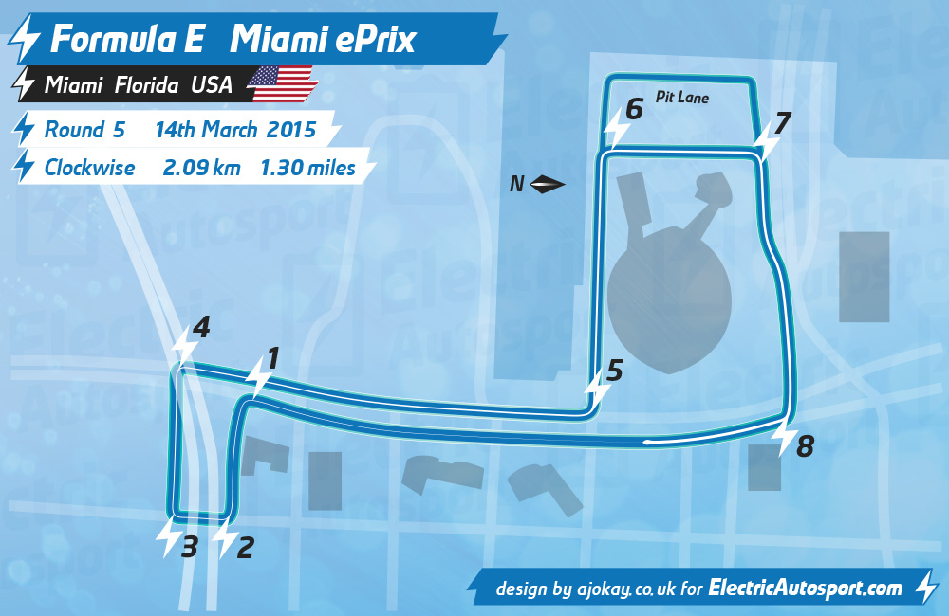

Video starts here

Slide 18
Briefly constant speed
Braking = negative acceleration
Hard acceleration
Gentle acceleration

Slide 19
Video starts here
8
5
7
1
4
6

Slide 20
Challenging Ideas
Relative speed
The speed of light
Velocity

Slide 21
Relative Speed
The speed of an object is always relative to another object or the observer.
If you’re in car A and your friend is in car B your relative speed to each other is 0km/h. If you can ignore your surroundings, the other car does not seem to move.
However, if car B increases speed to 31km/h it will seem to move away from you slowly.
30km/h
30km/h
A
B

Slide 22
Relative Speed
If you’re in car A and your friend is in car B your relative speed to each other is 60km/h
30km/h
30km/h
B
A

Slide 23
The Speed of Light
300,000,000 m/s or sometimes shown as 3 x 10⁸ m/s
The speed of light in a vacuum is a constant
  The symbol for the speed of light is “c”
  You may have heard of the famous equation E = mc²

Slide 24
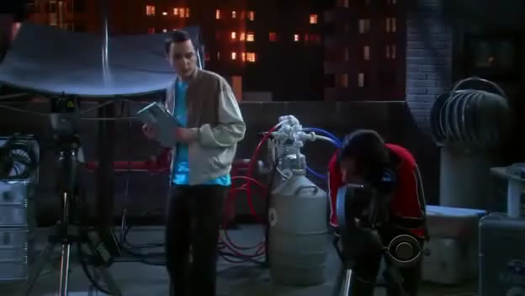
Calculating the distance from the Earth to the Moon
Use the information from the experiment in the video (The Big Bang Theory) to find out the time it takes light from the laser to travel to the Moon and return.
The precise value for the
speed of light is 299 792 458 m/s
With this information, calculate the distance from the Earth to the Moon.
Notes:
More information on Lunar Laser Ranging can be found here https://en.wikipedia.org/wiki/Lunar_Laser_Ranging_experiment
Distance=(Speed of light × Time taken for light to reflect) / 2.
Students need to divide the time taken by the laser to reflect from the Moon or divide the distance by 2 as the time measured is for the light to travel to and from the moon.
Also remember; the Moon does not have a perfectly circular orbit around the Earth so the distance between the Earth and the Moon changes every day.

Slide 25
Velocity: the speed of something in a given direction
Speed is a scalar quantity, the rate at which an object covers distance. Speed has no indication of direction
Velocity is a vector quantity: it has both magnitude and direction.
Velocity is the speed of an object in a particular direction in the defined time period.
displacement (metres)
time (seconds)
velocity =

Slide 26

Velocity
A student walks 5 metres north in 5 seconds and then runs 10 metres east in 5 seconds.
15 m
10 s
Average speed = = 1.5 m/s
Distance = 10 metres
B
BUT
Displacement = $\sqrt{5^{2}+{10}^{2}}$ = 11.18m
Distance = 5 metres
Displacement
11.18 m
10 s
Velocity = = 1.1 m/s
A

Slide 27
Speed
Learning Aims
Knowledge | Skills
Speed can be recorded in a range of units which can be inter-converted Instantaneous speed is the speed over a short time period Average speed is the speed for a whole journey The calculation of speed, distance and times | Working collaboratively Using stopwatches Measuring distances to an appropriate level of precision Construction and interpretation of distance-time graphs and speed-time graphs Appreciate the difference between speed and velocity

