Slide 1
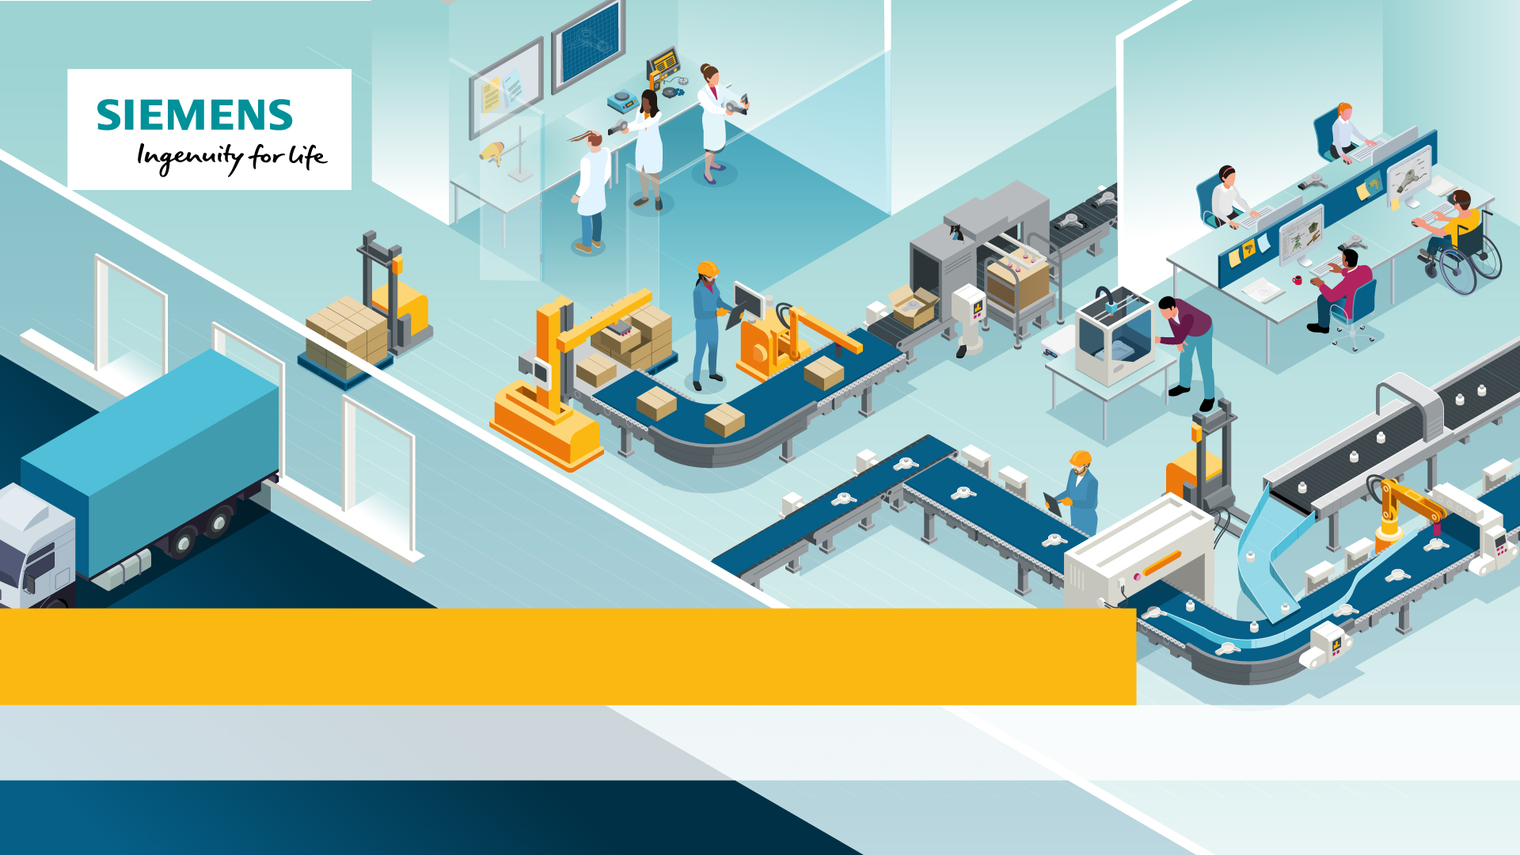
Siemens NX: Designing The Future
Episode 3: To Manufacturing and Beyond

Slide 2
Objectives
This episode is designed to get you to:
Describe range of digital manufacturing tools
Explain the benefits of digital manufacture
Use 3D printing to prototype a product
Notes:
Introduce the learning objectives. This lesson introduces digital manufacturing, culminating in students 3D printing a figurine.

Slide 3
What is Digital Manufacture?
Digital manufacture is the use of digitally connected machines to manufacture products or product components.
These machines are digitally controlled and require little tooling or set-up. They also produce real-time production data that can be transmitted to PLM databases.
Notes:
Introduce the concept of digital manufacture. Digital manufacturing machines are manufacturing machines that are digitally connected, enabling digital simulation of processes and full integration into PLM and Smart Factory systems. Many digital manufacturing machines use IoT technology and require less set up and tooling for individual jobs.

Slide 4
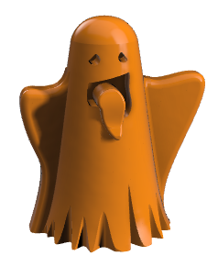
Digital Manufacturing in your Classroom
From CNC Milling to 3D printers, digital manufacture is now commonplace in classrooms and maker spaces. But how do you choose the right machine for your project?
Challenge 1: Digital Manufacturing in Your Classroom
Using the table on your worksheet, decide which digital manufacturing tool would be most suitable for each product. Write the suitable tool below each image.
Notes:
Introduce each type of manufacturing. You may have examples to show students in your classroom.

Slide 5
Additive or Subtractive manufacture?
Which of the processes could be described as additive manufacture?
Which could be described as subtractive?
What is the difference?
Notes:
Ask students to decide which processes could be described as additive and which ones as subtractive manufacture. All of the listed processes are subtractive, as they cut or remove material, whilst 3D printing is additive as it builds a shape from layers of material.

Slide 6
Digital Manufacturing & Product Design
Digital manufacturing is also changing the way that products are designed. Fast and cost effective, processes such as 3D printing enable the rapid prototyping and testing of ideas.
Challenge 2: Digital Manufacture and Product Design
Read the worksheet and explore the Siemens Designing The Future Interactive to find out how digital manufacturing is used by product designers.
Notes:
Digital manufacturing has many advantages for product designers. The main advantages are speed, cost effectiveness, the ability to create complex shapes in plastic without moulds, products require little finishing and can be made in a range of colours, a 3D printer can be small enough to sit on a desk. The advantage over traditional plastic manufacturing is that no tooling is required which can be costly and labour intensive. If you have a 3D printer, show students it working, and some complex printed objects.

Slide 7
Digital Manufacturing & Product Design
What are the advantages of 3D printing?
What are the advantages of 3D printing over other methods of making 3D plastic shapes?
Notes:
Use this slide to discuss the answers.

Slide 8
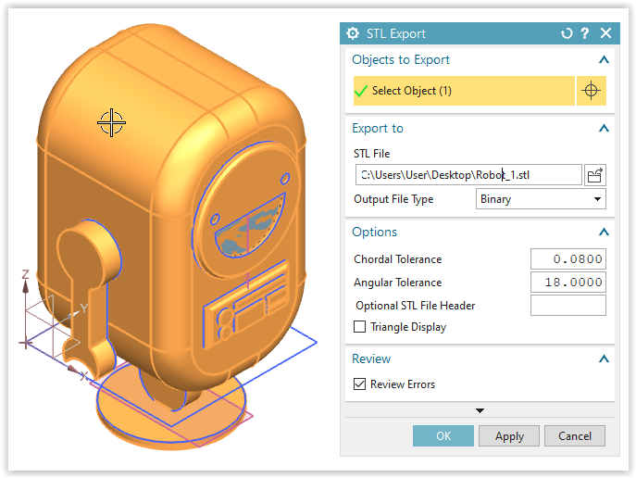
NX Challenge: Roblet Figurine
It’s time to try 3D printing for yourself. Add a stand to your Roblet model, and send it for printing as a .stl file.
Challenge 3: NX Challenge: Roblet Figurine
Follow the step-by-step to 3D print your very own Roblet Figurine.
Notes:
In this part of the session, students will 3D print their Roblet model, by adding a base and exporting their model as an .stil file (stereolithography file). Students should be encouraged to customise their Roblet.

Slide 9
Questions to think about
What types of digital manufacture are available?
What are the advantages of digital manufacture?
What are the qualities of a 3D printed product?
Notes:
Use these questions for the plenary. Challenge students to name all types of digital manufacture discussed and encourage students to define them as additive or subtractive. Students should consider the advantages at different scales, from the designer to the product user. Students should evaluate the qualities of their 3D printed Roblet. How long did it take? Would this manufacturing method be useful for mass production?

