Slide 1
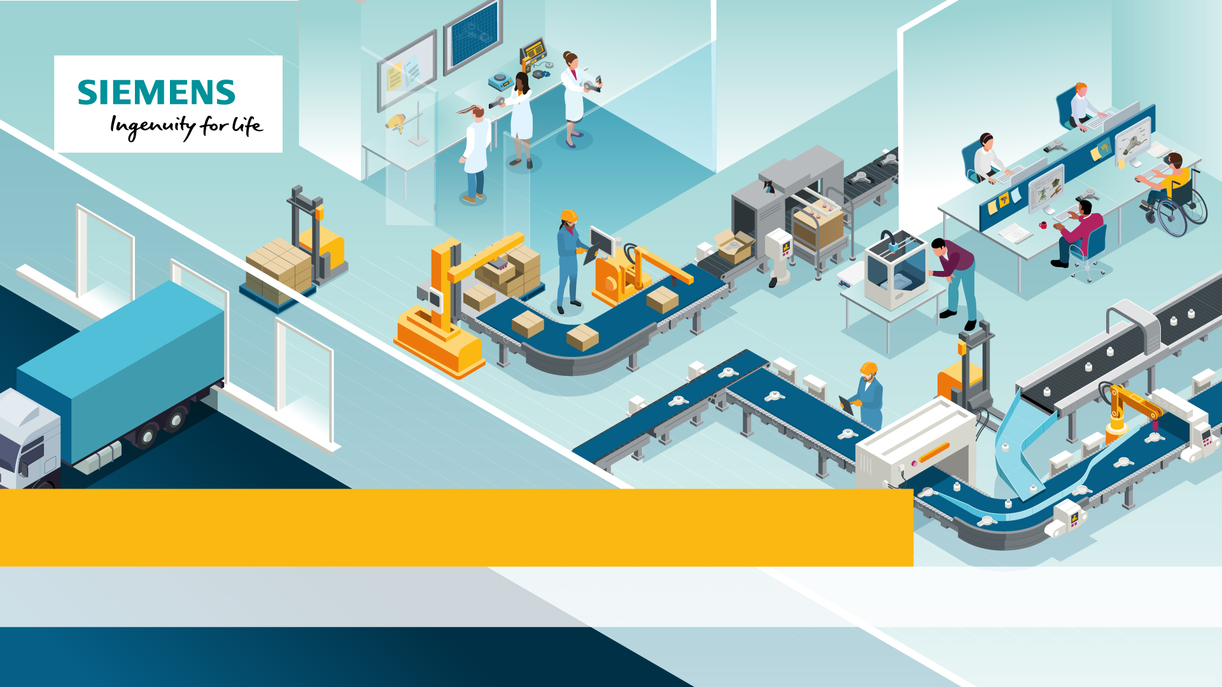
Siemens NX: Designing The Future
Episode 2: Digital Modelling

Slide 2
Objectives
This episode is designed to get you to:
Describe the common features of a CAD model
Model a complex part using Siemens NX Software
Notes:
Introduce the learning objectives for the lesson. This lesson introduces students to CAD terminology and modelling using Siemens NX.

Slide 3
Product Lifecycle Management
Last session we examined how a hairdryer has been designed, manufactured and then distributed as part of it’s product lifecycle.
How was it made?
Who made it?
What was the role of digital technology in its manufacture?
Notes:
Recap on last weeks learning.

Slide 4
Describing digital models
This session you will be learning some more advanced CAD skills. Before we start, it is important to have an understanding of the terminology used by CAD designers.
Challenge 1: Describing Models
Match each letter to the word that describes it, then the definition for each word.
You can use the Siemens NX: Designing The Future Interactive to find the answers.
Notes:
Introduce the activity and direct students to the online interactive. The answers are found in the design studio, on one of the product designers PCs.

Slide 5
Answers
A | Part | A single component of an assembly or product .
E | Face | A flat surface of a part or body
F | Vertex | A corner
B | Chamfer | A flatly angled edge
D | Edge Blend | A rounded or radiused edge, sometimes called a fillet
B, C & D | Feature | An aspect of a form such as a hole, chamfer or fillet
C | Hole | A circular opening
Notes:
Answers to the worksheet.

Slide 6
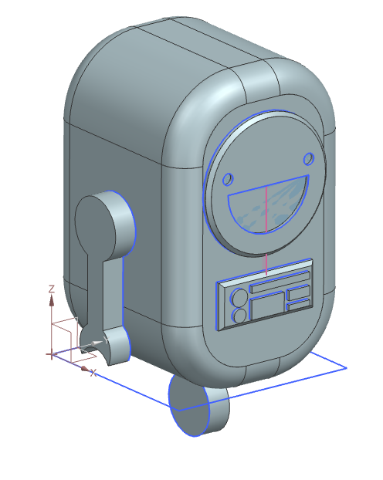
Advanced Digital Modelling
Digital modelling is an important part of the design process. Digital models help designers to visualise and test their products before manufacture. Models also help to plan production.
Last session you modelled an emotion badge. This session you will use more advanced tools to model Roblet, the Siemens Robot.
Notes:
Explain how CAD models can help designers to visualise their ideas. CAD models are quicker and more cost efficient than practical models, and be tested safely and under conditions not easily replicable, simulating wear and tear over time or otherworldly conditions such as the vacuum of outer space.

Slide 7
Advanced Digital Modelling
Challenge 2: NX Challenge - Roblet the NX Robot
Follow the steps to model this cute NX robot, Roblet. In the next session you will learn how to 3D print your own Roblet figurine!
Top Tips:
Use the search bar if you cannot locate a tool
Don’t forget to name your sketches. This will help you to stay organsied.
Right click to adjust your view, or select the ‘View’ menu.
Notes:
This activity introduces students to more advanced CAD modelling. You will need Siemens NX education installed on your institution machines. Next session features the 3D printing of their models.

Slide 8
Siemens NX Reflection
How did you find modelling Roblet?
What was different this week?
How have your skills improved?
What else could you use NX to model?
Notes:
Challenge students to reflect on their learning. The Roblet model is a significant step up from last session, so be heavy with the praise!

Slide 9
Questions to think about
Which tool would you use to turn a sketch from 2D to 3D?
Which tool would you use to round an edge?
What tool would you use to create an angled surface?
What sort of line do you create as guides in your sketch?
Notes:
Plenary Questions: Use these questions to challenge students learning for the episode. Break each question into sub questions as you go. The aim of this exercise is to get students to verbalise their CAD skills. Use objects around the room to help explain what you mean.

