Slide 1
The Human Body Part 1: Skeleton-Muscular System
Siemens Education

Slide 2
The Human Body
Overall learning objectives
To understand the functions of the skeleton
To be able to explain various features of the skeleton
To relate images of bones, muscles and joints to diagrams and the body

Slide 3
The Human Body
Learning Outcomes:
Clear identifications of key features of the skeleton
Explanation of form and function of parts of the skeleton

Slide 4
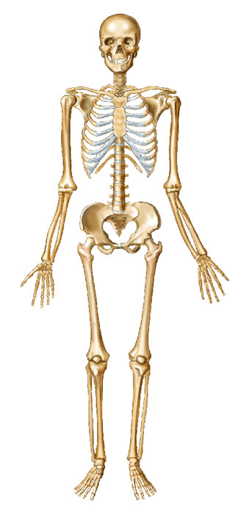
The Human Body
Skeletons
Do you have a skeleton?
How do you know?
Notes:
Start off by displaying a picture of a human skeleton. Use the Inside the Human Body interactive to support this and invite pupils to suggest what it is.
Ask pupils if they have ever seen a real one.
Ask them if they have one.
Ask them how they know they have one.
Ask for suggestions as to what evidence they have – what can they do to show you that they have bones? Take ideas and recognise that there are parts of the body where the bones can be felt quite easily. You might need to indicate that some parts, such as the nose, are not bones (but cartilage) but that nevertheless we can tell a lot about the shape of the bones by gently feeling.

Slide 5
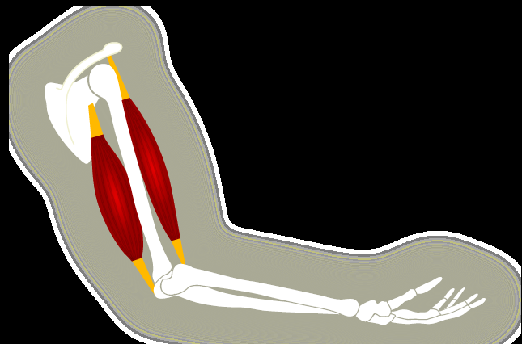
The Human Body
What makes your arm move?
If you use the animation on the Siemens interactive you can see how the muscles in your upper arm make your lower arm move.
Try it with your own arm – can you feel the muscles working?
Notes:
Ask what would happen if we didn’t have bones.
Most pupils will probably realise that without support we couldn’t stand or walk, but they should also be encouraged to think about other aspects, such as protection for organs such as the brain or lungs.
Draw out the point that movement depends upon bones as well as muscles.
Using the “Inside the Human Body” interactive and images of bones, muscles and joints, explain to pupils that we have joints in many parts of our bodies and that they are essential for movement.

Slide 6
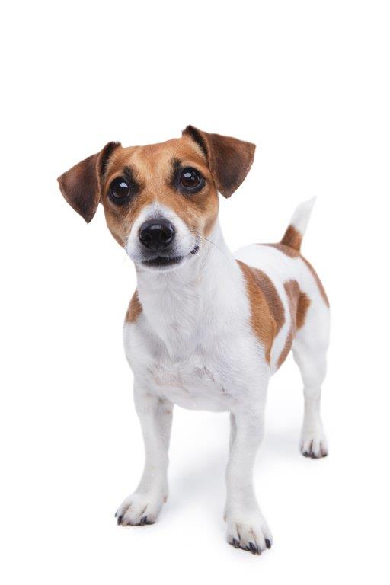
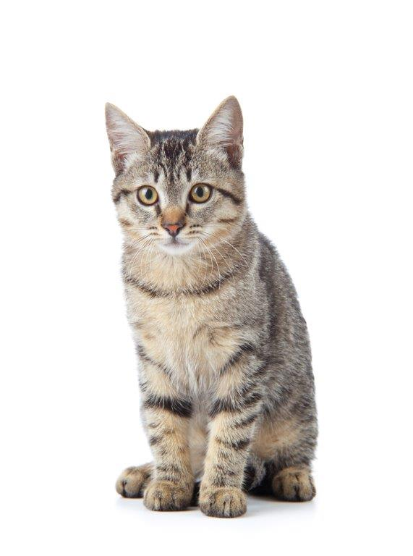
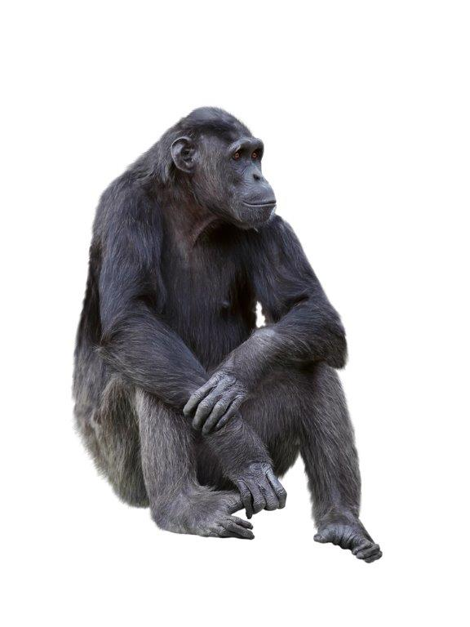
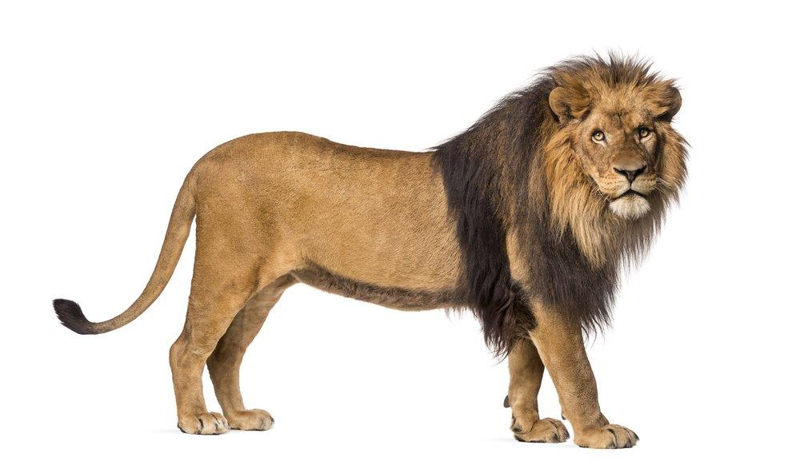
The Human Body
What other animals have skeletons?
Notes:
Ask pupils what other animals do – whether they have skeletons. Draw out that some do, and show some images.
Ask pupils to compare images of different skeletons and identify similarities. Draw out that even though the shape and size varies, a common feature is the backbone. This is why scientists use the presence (or absence) of a backbone as an important way of grouping animals. Animals with backbones are vertebrates.

Slide 7
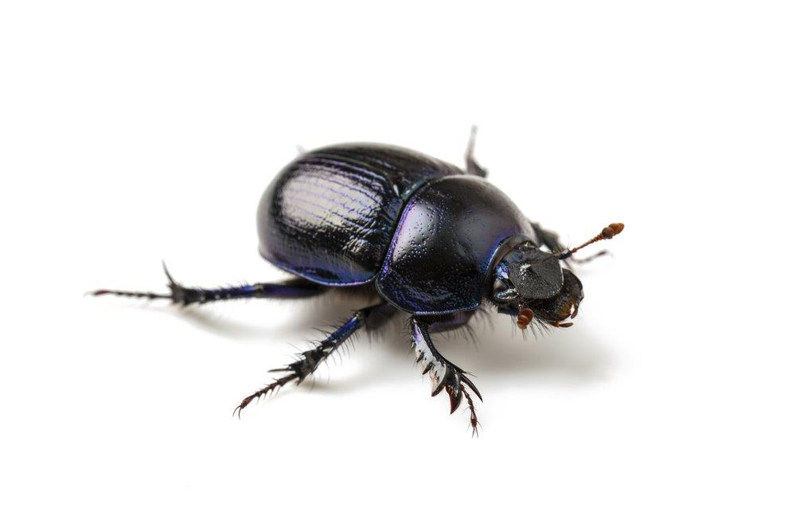
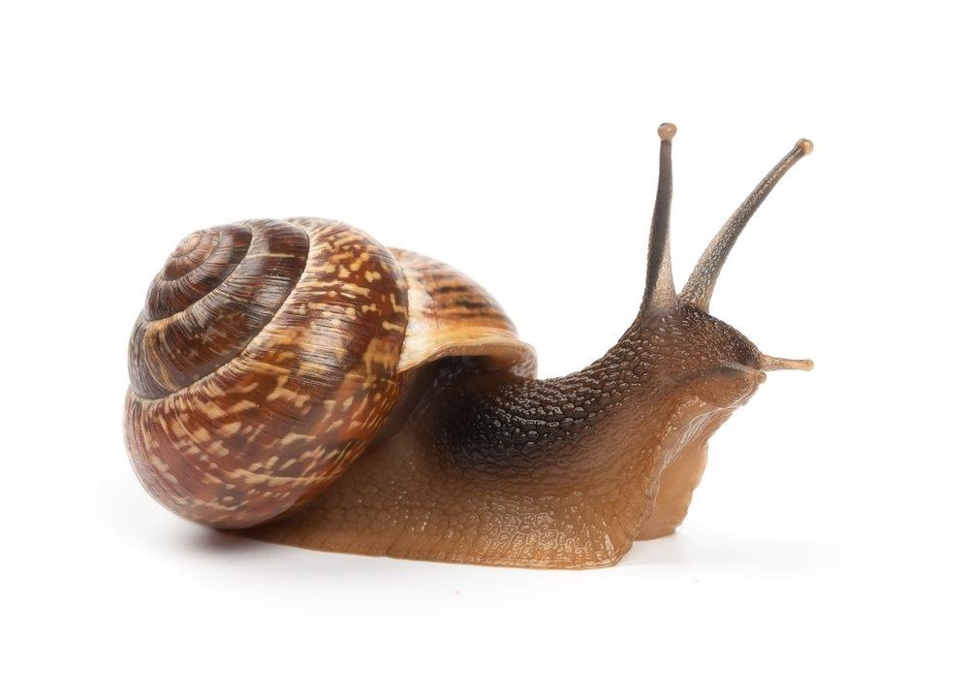
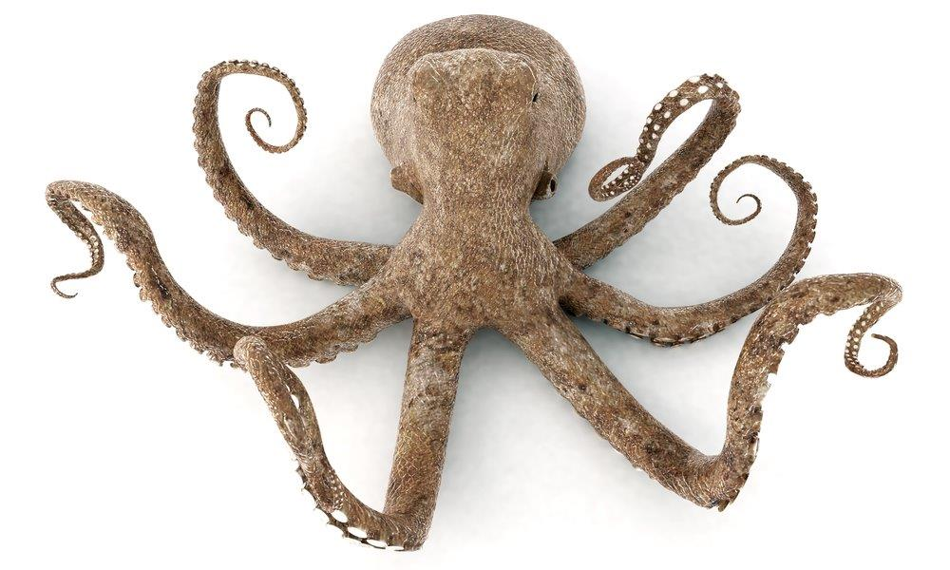
The Human Body
Not all animals have skeletons.
Can you name some that don’t?
Notes:
Draw out that many (indeed, most) animals don’t have skeletons, or at least, not skeletons made of bones. Show pictures of invertebrates, such as:
Beetles (exoskeleton – instead of our endoskeleton)
Snails (no skeleton but a shell)
Octopus (no skeleton)

Slide 8
The Human Body
Why do we have a skeleton?
Notes:
Ask pupils to identify the reasons why we have a skeleton.
Group the ideas and develop these points:
A skeleton provides protection, e.g. skull and ribs
A skeleton provides support, e.g. legs and backbone
A skeleton enables movement in conjunction with muscles, e.g. arms and legs
At this stage use could be made of the Inside the Human Body Interactive resource to consolidate ideas about the functions of the parts of the skeleton, images of bones and supporting information.

Slide 9
The Human Body
Imagine if we didn’t have bones
What would our limbs feel like?
Could we move and, if so, how?
Could we stand?
Would our muscles still function?
How do animals that don’t have bones function (e.g. octopus, snail, spider)
Notes:
Ask pupils to imagine what a human body without bones would be like.
Draw out that we depend on bones to give our bodies support and enable us to stand and walk. Bones aren’t essential for life but without them it limits the size an animal can be. Our muscles are attached to our bones and work with them to provide support.
Development: ask pupils to suggest the names of bones in the body. Make it clear you’re not looking for the scientific names but accept common terms such as ‘skull’ and ‘pelvis’. Assemble a list on the board. Use the ‘whole skeleton’ image on the resource and help pupils to navigate around firstly the resource and secondly the skeleton. If resources allow, provide pupils with the opportunity to use the ‘build a body’ function.
Ask pupils to suggest which bones help to support us. Encourage pupils to go beyond ‘legs’ and identify other bones, which should include pelvis, backbone and arms. Take responses and discuss.

Slide 10
The Human Body
What are the names of the bones in the body?
Notes:
Resources required:
Tennis ball (one for each team)
Ten sheets of A4 paper
Metre of sellotape
Ask pupils to suggest the names of bones in the body.
Make it clear you’re not looking for the scientific names but accept common terms such as ‘skull’ and ‘pelvis’.
Assemble a list on the board.
Use the ‘whole skeleton’ image on the resource and help pupils to navigate around firstly the resource and secondly the skeleton. If resources allow, provide pupils with the opportunity to use the ‘build a body’ function.
Ask pupils to suggest which bones help to support us. Encourage pupils to go beyond ‘legs’ and identify other bones, which should include pelvis, backbone and arms. Take responses and discuss.
Exploration: ask pupils to work in teams to compete in a challenge. Provide each team with a tennis ball (or similar), ten sheets of A4 paper (recycled is fine) and a metre of sellotape (these can be varied but should be the same for all teams). Ask each team to design and construct a structure that will support the ball as high above the table top as possible. The structure should be stable and may not be fixed to the table.
This is supported by Activity sheet 1.
Allow pupils to develop responses and construct structures; then test and compare the structures. Encourage students to identify key features of effective solutions, which might include the use of tubes and the structure being broader at the top where it supports the ball.
Consolidation: now go back to images of the skeleton and ask pupils to identify what makes bones such as the legs, pelvis and backbone effective at support.
Draw out points such as:
Tubular structure (such as legs and backbone) being light and strong
Broader structure (such as pelvis and feet) providing stability

Slide 11
The Human Body
What if we walked on ‘all fours’?
Would that make us more or less stable?
What is it about our arms that might make us more stable?
Why don’t we walk on ‘all fours’?
Notes:
Ask pupils to consider humans walking on all fours.

Slide 12
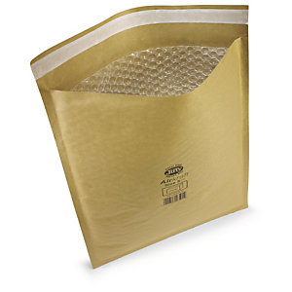
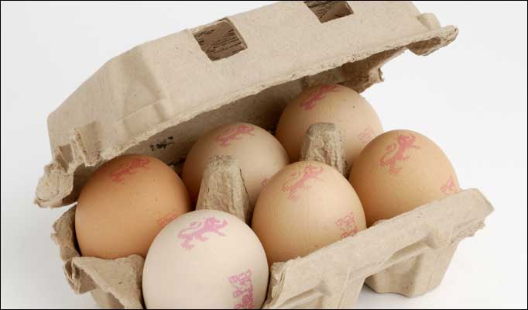
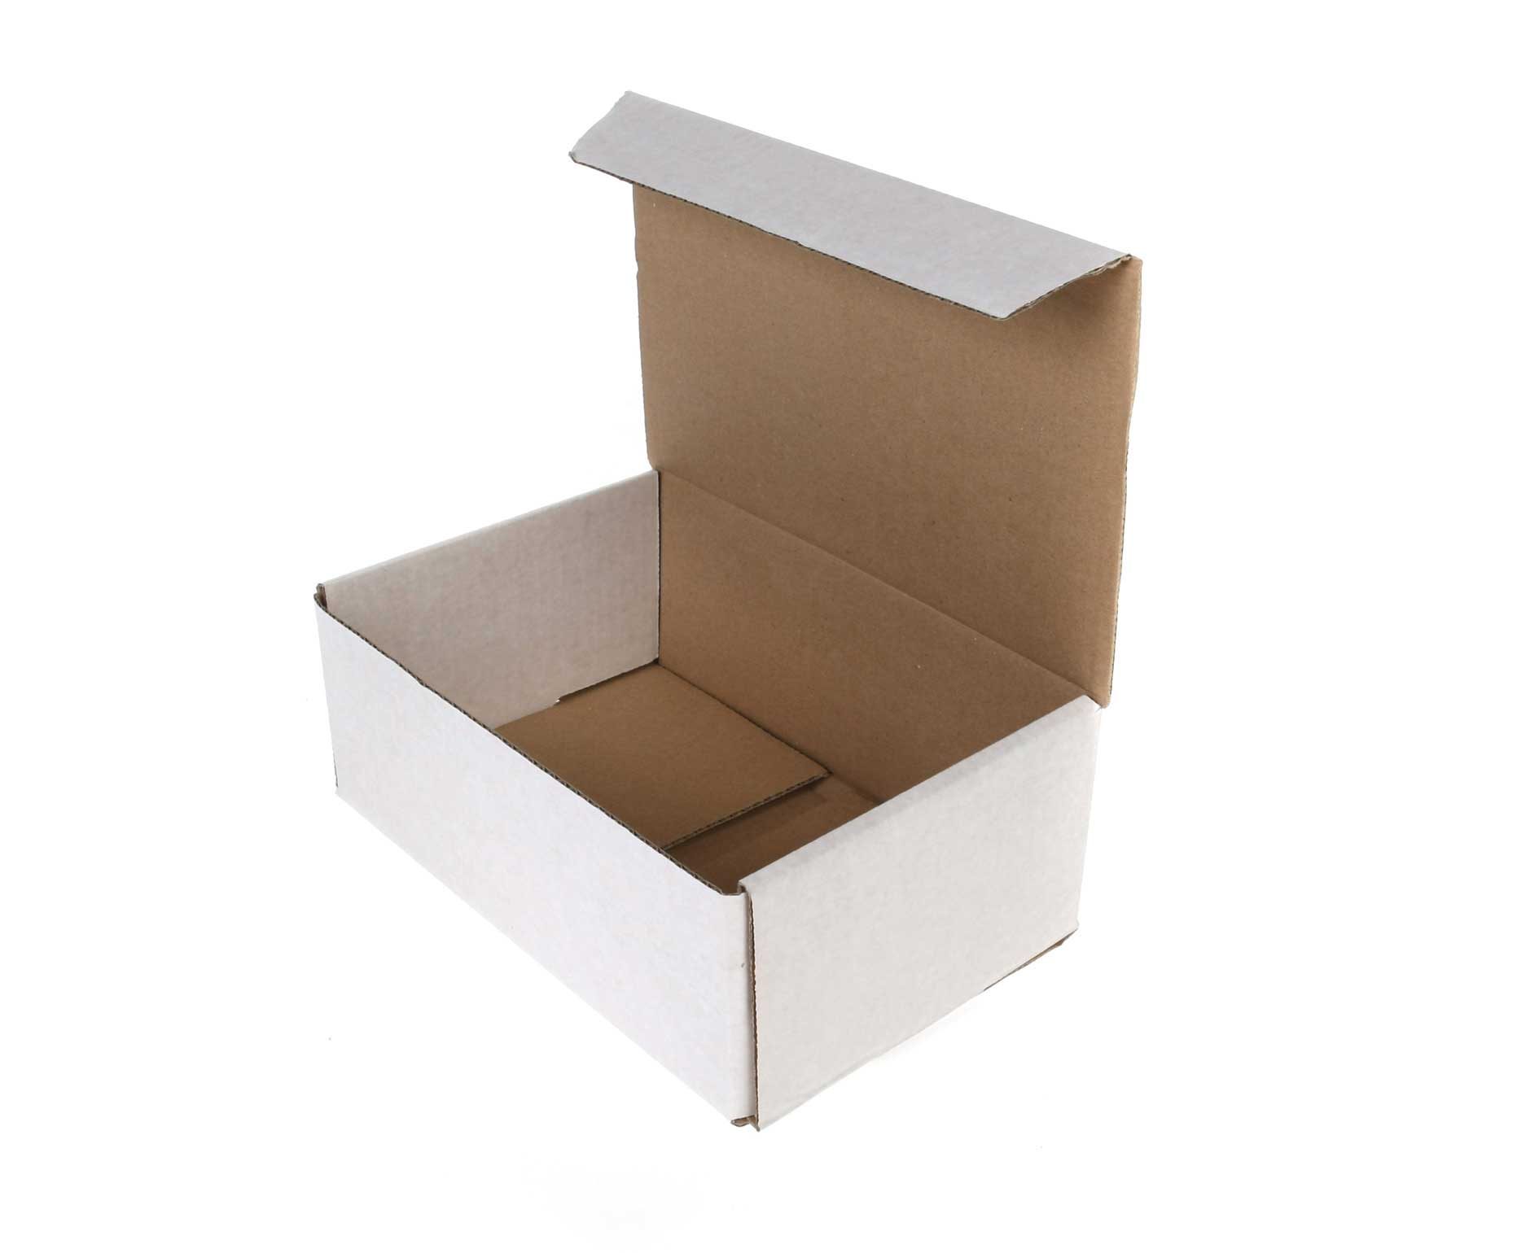
The Human Body
How do these packets protect their contents?
Protection
Notes:
Resources required:
Egg box
Paper
Card
Drinking straws
Sellotape
Jiffy bag, moulded packaging containers
Starter: show pupils an egg box and ask what it is for. Follow up with asking how it protects eggs. Then provide pupils with a number of packaging materials and containers, such as boxes with expanded polystyrene in, jiffy bags, moulded plastic containers etc. Note that the focus should be upon the shape of the container rather than just the material, so several (or all) of the items should be boxes or packets. Ask pupils to identify how those packets protect the contents.
Development: now use the resource to show pupils the skeleton and ask them to suggest which bones are there to protect. Pupils are likely to identify the skull, rib cage and pelvis. Add that the spinal cord also protects some important nerves.
Exploration: provide teams of pupils with materials such as paper, card, drinking straws and sellotape (each team having the same quantity). Ask them to design and construct something that will protect the chocolate covering on a chocolate teacake from cracking if dropped. The teacake cannot be attached to the structure; the structure will be dropped from, say, 0.5m above the floor. This is supported by Activity sheet 2.
Test and compare the devices, encouraging pupils to identify key features of effective designs. Draw out various features, including protecting the teacake (as far as possible) from all angles and also that effective designs aren’t necessarily rigid.
Consolidation: now go back to the resource and draw attention to the images and information around protective structures, drawing attention to features in common with pupils’ designs, possibly including:
All round protection (e.g. skull)
Flexibility (e.g. rib cage and backbone)
Lightweight structure (e.g. rib cage)
Plenary: ask pupils to compare the skeleton with a suit of armour and identify what is similar, what is different and why. Draw out that movement is important as well as protection.

Slide 13
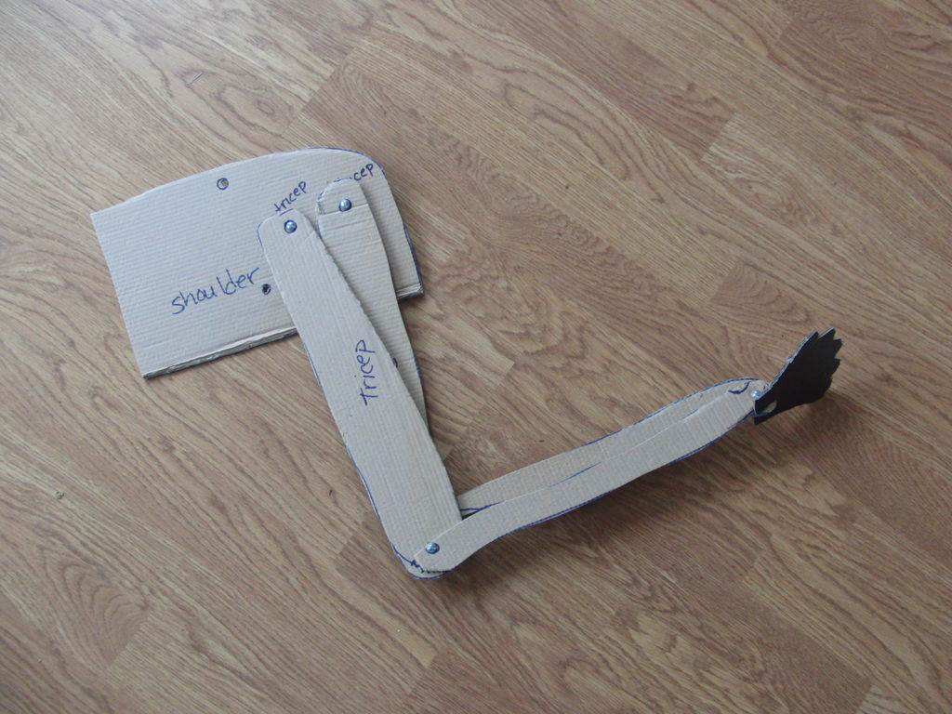
The Human Body
How can a skeleton of rigid bones move?
Construct a model arm to see how bone and muscle work
How well does cardboard represent bone?
How well elastic represent muscle?
How well does the paper fastener represent a joint?
Notes:
Resources required:
Stout card
Elastic
Paper fastener
Starter: commence by asking pupils how a skeleton made of rigid bones can move. Draw out that there are joints and that joints need muscles.
Development: show pupils the resource and the images of bones, muscles and joints. Explain that we have joints in many parts of our bodies and that they are essential for movement.
Exploration: supply groups of pupils with two pieces of stout card, two pieces of elastic and a paper fastener. Holes should be made in advance and assistance may be required in tying knots.
The purpose of the model is to represent the arm, showing how it is jointed and how the lower arm is controlled by two sets of muscles. Ask pupils to construct the model and explore how it works. They should then compare it to an image of the elbow joint and identify what they have made and how it compares with the actual joint. This is supported by activity sheet 3.
Consolidation: ask pupils to feel their upper arms and identify the bones and muscles in their own arms. They should feel which muscles are tensed when they:
Raise their lower arm
Force their lower arm down
Plenary:
Ask pupils to comment on their model of the arm and discuss how good a model it is, using questions such as:
How well does cardboard represent bone?
How well elastic represent muscle?
How well does the paper fastener represent a joint?
Key points about each of these functions can be reinforced either now or at a later stage by using the Inside the Human Body interactive resource.

Slide 14
The Human Body Part 2: The Digestive System
Siemens Education

Slide 15
The Human Body
Overall learning objectives:
Identify parts of the digestive system
Describe their function
Overall learning outcomes:
Describe what happens to food as it goes through the body

Slide 16
The Human Body
Draw and annotate what you think happens to food when you eat it
Notes:
Provide pupils with an outline of the body and ask them to draw and annotate what they think happens to food when they’ve eaten it. Monitor carefully the developing ideas and select pupils to share their ideas.
This might work well using a visualiser.

Slide 17
The Human Body
Organ | What happens | Why
Mouth | Food is chewed up and mixed with saliva | Breaking it down into smaller pieces
Stomach | Food is mixed with chemicals and churned up | Continuing to break it down
Small intestine | Some chemicals are absorbed into the blood. | Those nutrients can then be used to supply parts of the body with energy and what they need to stay alive and grow.
Large intestine | Absorbing water. | Water is re-used by the body.
Notes:
Tell pupils that they are going to make a model of the digestive system to show how it works. This is supported by Activity sheet 4.
Resources needed:
Prepare materials needed:
Small banana
Digestive biscuit or Weetabix
Funnel
Small container of water
Small container with very small amount of food colouring in it (preferably green)
Small cup of water
Pipette or syringe
Plastic bag rolled and taped to form a tube (with the bottom cut off)
Plastic sealable bag
Stocking or leg from tights
Small plastic bag with a small hole cut in the bottom
Kitchen towels, plastic bin bags, scissors.
Refer to Activity sheet 4 for step-by-step instructions.
Afterwards, go through the digestive system using a diagram again. Key points about the function of organs can be reinforced either now or at a later stage by using the Human Body Interactive resource.

Slide 18
The Human Body Part 3: The Circulatory System
Siemens Education

Slide 19
The Human Body
Overall learning objectives:
To describe how the circulatory system works
To describe to purpose of the main parts of the circulatory system
Overall learning outcomes:
To be able to explain what the circulatory system does and how

Slide 20
The Human Body
Which parts of the body does the blood system include?
What does blood do?
What else do you know about the blood system?
Notes:
Ask pupils to suggest what they already know about the blood system.
Use these to gather ideas and see what pupils are aware of already.

Slide 21
The Human Body
Where is the heart?
Body diagram
Notes:
Show pupils a diagram of the body (use could be made of The Human Body interactive tool) and ask them where the heart is. Ask them to translate this into its position on their own body.
Click the image to go to the Human Body interactive.
Then ask where they can feel a pulse and take suggestions. There are, in fact, several places:
Side of the neck
Side of the wrist
Inside of the foot
Ankle
Behind the knee
Ask what the pulse is and draw out that it is the heart beating, pumping blood around the body.
Then ask pupils to work in pairs to explore these questions and suggest answers:
There are many places where blood vessels can be seen, such as on the palm of the hand. Why can no pulse be felt there?
When you’re feeling your pulse, you should use your finger tips and not your thumb. Why?
Why is the heart pumping blood around your body?
Take ideas and establish that blood flows out from the heart and then back again. A pulse is felt on the outward journey, where the pressure is higher. This is where the blood flows in veins and they tend to run deeper (away from the likelihood of damage). The thumb has its own pulse, which is why fingers should be used to find a pulse.
Blood has a number of functions and there may be several suggestions that can be accepted at this stage. This includes:
Carrying oxygen to where it is needed
Removing carbon dioxide
Carrying warmth around the body
Fighting infection
Sealing gaps and cuts.
Carrying nutrients
Getting rid of waste chemicals

Slide 22
The Human Body
The pulse is the heart beating, pumping blood around the body
Work in pairs to think about answers to:
There are many places where blood vessels can be seen, such as on the palm of the hand. Why can no pulse be felt there?
When you’re feeling your pulse, you should use your finger tips and not your thumb. Why?
Why is the heart pumping blood around your body?

Slide 23
The Human Body
Trace around with your finger, showing how blood is pumped to the lungs where oxygen is collected and carbon dioxide released, and then returns to the heart.
It then goes to other parts of the body, carrying oxygen and nutrients, and collecting carbon dioxide and waste.
Notes:
Show a diagram which represents the double circulatory system that humans have (use could be made of the Human Body interactive).
Trace around with your finger, showing how blood is pumped to the lungs where oxygen is collected and carbon dioxide released, and then returns to the heart. It then goes to other parts of the body, carrying oxygen and nutrients, and collecting carbon dioxide and waste.

Slide 24
The Human Body
Blood flows from arteries (at high pressure), through capillaries (very narrow) and back via the veins (lower pressure) to the heart again.
Capillaries are where the transfers take place.
Notes:
Show a diagram that indicates how blood flows from arteries (at high pressure), through capillaries (very narrow) and back via the veins (lower pressure) to the heart again (use could be made of the Human Body interactive tool).
Explain that it is in the capillaries where the transfers take place. There is then a consolidation activity, supported by Activity sheet 5, which revisits these ideas and enables learning to be embedded.
Key points about the form and function of the circulatory system can be reinforced either now or at a later stage by using the Human Body interactive.

Slide 25
The Human Body
Think about your ideas bout blood and the circulatory system.
Did you have any ideas that you now think were not correct?
Do you have any new ideas?
Notes:
Plenary:
Revisit the initial activity, in which students shared their ideas about blood and the circulatory system. See if there are any ideas that pupils now decide aren’t right, or that they want to develop. Ask for other ideas to add.

