Slide 1
Here Comes the Sun
Climate and Sustainability - Sustainable Energy & Infrastructure

Slide 2

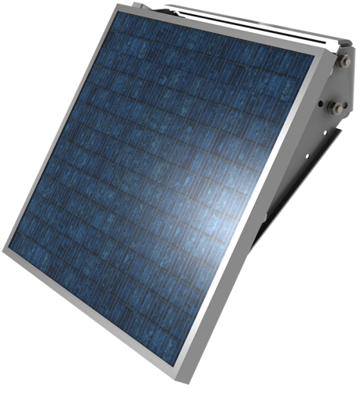
Here Comes the Sun
Climate and Sustainability - Sustainable Energy & Infrastructure
Imagine that you are living in an isolated location, many miles from the nearest supply of mains electricity. These are two ways of producing electricity to be used in the home.
Electric Cars vs. Petrol

Slide 3
Here Comes the Sun
Climate and Sustainability - Sustainable Energy & Infrastructure
The device on the left is a portable petrol-powered generator. When the petrol engine is started it drives a generator which produces electricity. It can be moved to where the electricity supply is needed.
The device on the right is a solar panel. It can also be moved to where it is needed but doesn’t need any fuel such as petrol. It is positioned to point at the Sun.
Suggest advantages and disadvantages for the petrol generator as a way of supplying electricity.
Suggest advantages and disadvantages for the solar panel as a way of supplying electricity.
Suggest a good way of producing electricity in an isolated location. Your answer could use either or both of these devices or some other technology.
Electric Cars vs. Petrol

