Slide 1
Digital Twinning challenge
Siemens 2023

Slide 2
Introduction
Digital Twinning is changing the way that engineers work!
Digital Twins are virtual copies of real-world things that help engineers to visualize and control complex systems and solve problems. Products, production processes, and whole factories now exist as digital twins.
This activity is about improving your understanding of digital twins and how this new and emerging technology is impacting the work of current professionals.
Restricted | © Siemens 20XX | Education | 2023

Slide 3
In this activity you will learn:
To define what a digital twin is.
To provide examples of how digital twins are used.
To explain how digital twins benefit individuals, society and the environment.
Restricted | © Siemens 20XX | Education | 2023

Slide 4
^{What is a Digital Twin?}
A digital twin is a virtual replica of a physical object that has been simulated digitally to explore a design’s performance without creating a physical prototype.
Using multi-physics simulation, data analytics and machine learning capabilities, digital twins can demonstrate the impact of design changes, environmental conditions, usage scenarios and other endless variables which eliminates the need for physical prototypes.
This is beneficial as it reduces development time and improves the quality of the finalized product or process.
You can learn more on our website here about the digital twin and you can play our interactive digital twinning game here.

Slide 5
Example: Racing car simulation
Racing cars are high performance machines with many engineered parts. They need constant improvement to win races and constant maintenance to keep the driver safe.
A digital twin enables engineers to have extra insight about the vehicle and to understand what is happening inside at different speeds and in different conditions. Data is collected using sensors inside the real racing car and sent to the digital twin using the Internet of Things (IoT). This gives an accurate view of how the real machine performs.
Watch the video on the next slide to learn more about the digital twin using the example of an all-electric car…

Slide 6
2

Slide 7
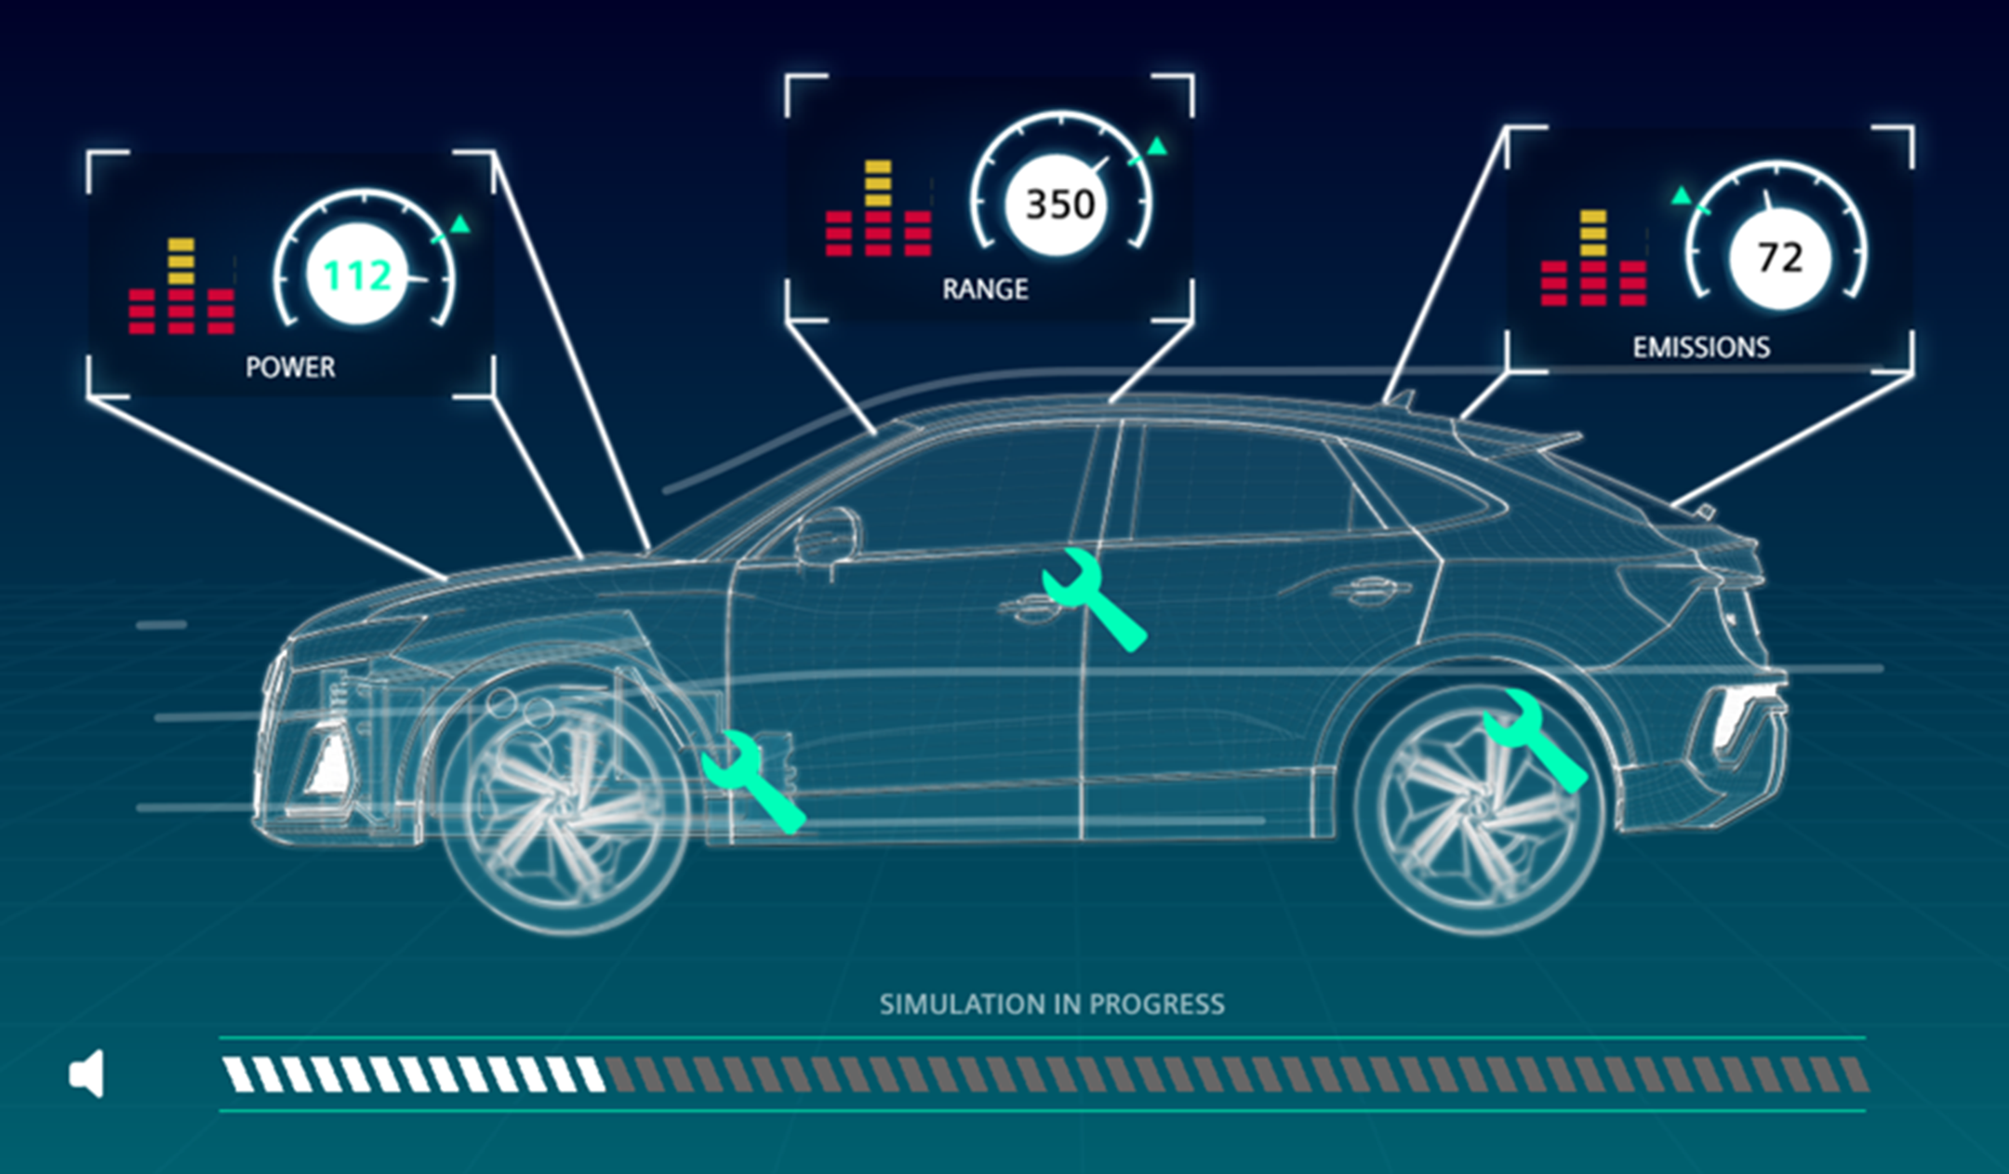
What parts of the real-world twin of a racing car do you think are linked to the digital twin version?
Write your answer down before moving onto the next slide…
Restricted | © Siemens 20XX | Education | 2023

Slide 8
The racing car digital twin is linked to its real-world counterpart through:
The Engine: Sensors built into the engine of the vehicle send temperature and performance data to the digital twin. The engine can be seen to work in real time by engineers before a race, or the driver or pit crew during a race.
The Brakes: Performance data from the braking system is collected using sensors, enabling the engineers and pit crew to gather insights into improvements and maintenance.
Its Fuel: Every aspect of the vehicle is measured and monitored using sensors and incorporated into the digital twin. Understanding how fuel is used by the vehicle helps to further understand and improve its racing performance.
Play our Lean Machines game here before moving onto the next slide to see just how many variable parts there are to a car production line.
Restricted | © Siemens 20XX | Education | 2023

Slide 9
Hopefully, after playing lean machines you saw just how many parts there are in the production process
This is why it is so useful to see a process virtually before building the physical production line.
It allows for the most effective, high-quality process possible before physically building the production line.
Restricted | © Siemens 20XX | Education | 2023

Slide 10
Digital Twinning and Manufacturing/ Production lines
Production lines can be very complex, involving many different machines and processes to manufacture a product. Engineers use digital twins of each machine to plan, control, monitor, and improve production.
The manufacturing of a product can be tested virtually using the digital twins of each machine in the production line. This can help production engineers to decide how a product will be made.
Just like the racing car, real-time simulation is also used during manufacture where sensors inside each real-life machine send data to the digital twin in real-time. This means that production engineers can see what is happening inside the machines as the product is being made.
Restricted | © Siemens 20XX | Education | 2023
Notes:
https://leanmachinesgame.co.uk/ - link lean machines game

Slide 11
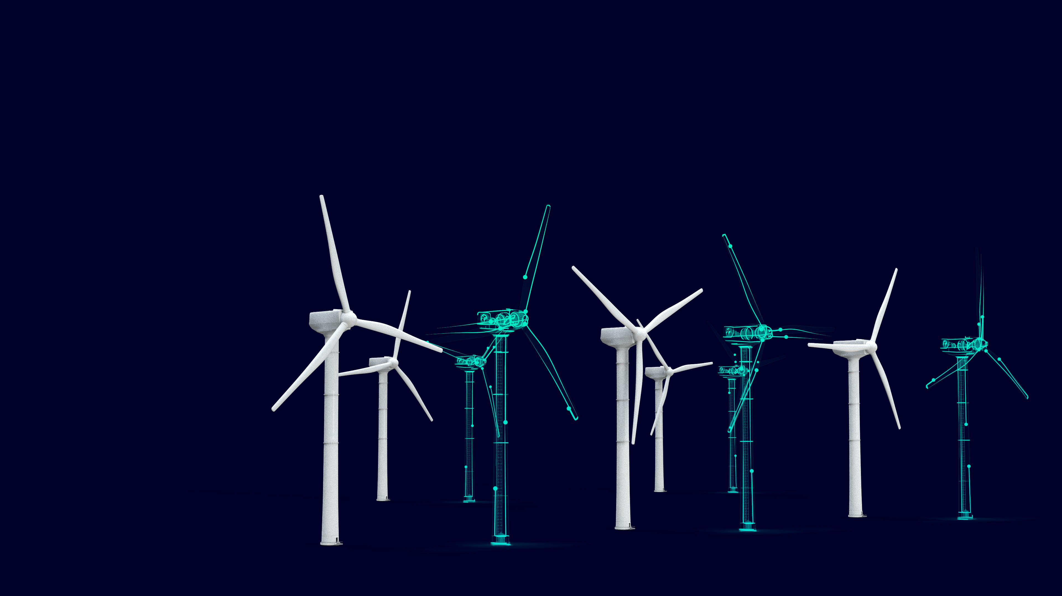
Optimisation and Machine Learning
Data from the digital twin is used to improve manufacturing processes, benefiting the quality, sustainability and cost of the product. IoT connectivity allows the machine to share its data with other similar machines all over the world for greater insight and understanding.
Using the digital twin data with artificial intelligence means that manufacturing machines can improve their own processes, increasing efficiency. Machines can also predict and signal when they will need maintenance.
Restricted | © Siemens 20XX | Education | 2023

Slide 12
The Big Question…
You are planning to drive an electric vehicle from the North Pole to the Equator. How could you use a digital twin to help plan your journey?
You must include:
How you will use the digital twin to test the cars suitability for the journey.
What information you will have to research to undertake these tests.
What information you will need to plan your route.
Restricted | © Siemens 20XX | Education | 2023

Slide 13
^{Things to think about:}
What conditions would you need to test? Snow, Polar Bears, Extreme Weather, Heat, Camels
What information would be useful to know? Fuel gauge, Speedometer, Calendar
What information would you have to research? A charging point, temperature, road texture
How far would the car be travelling?
Restricted | © Siemens 20XX | Education | 2023

Slide 14
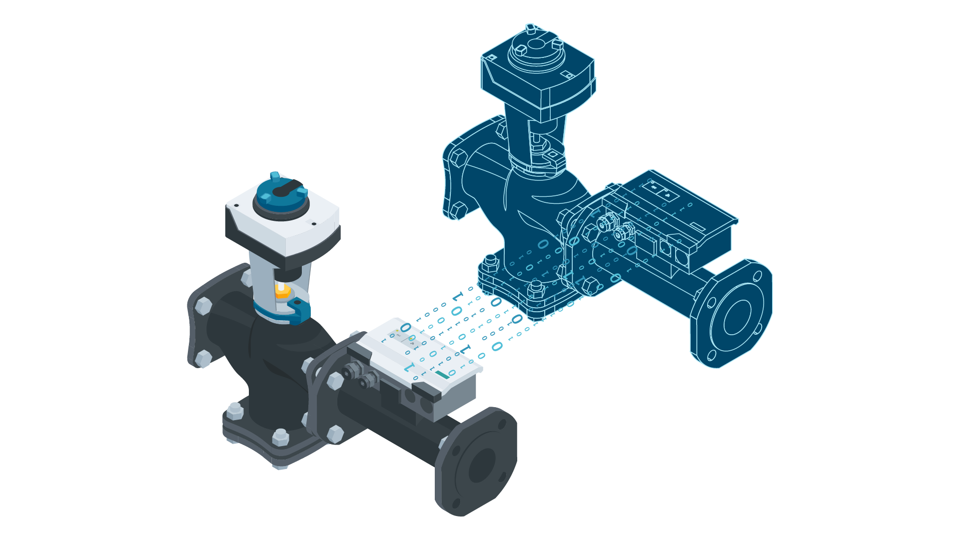
How you present your plan is up to you. Some suggestions are: - A slide or notes explaining your plan - A drawing representing the car, the journey and its digital twin.
Restricted | © Siemens 20XX | Education | 2023

Slide 15
Activity: Match the benefits of digital twinning technology on the right to the correct person on the left. See next slide for the answers.
Person | Benefit
Racing Car Driver | Data insights help to maintain machines, reducing downtime
 | Live vehicle data enables the pit team to locate problems before the car arrives.
 | New production processes can be planned digitally.
Production Manager | The quality of products available to purchase is higher.
 | Purchased products are of more consistent quality with fewer manufactures defects.
 | Digital twin data enables constant improvement of the vehicle to help win more races.
Consumer | Increased driver safety as vehicles can be tested under different conditions on different track surfaces.
 | Optimised machine processes are more energy efficient, cost effective and increase product quality and consistency.
 | Purchased products are of more consistent quality with fewer manufactures defects.
Restricted | © Siemens 20XX | Education | 2023

Slide 16
^{Answers}
Person | Benefit
Racing Car Driver | Increased driver safety as vehicles can be tested under different conditions on different track surfaces.
 | Live vehicle data enables the pit team to locate problems before the car arrives.
 | Digital twin data enables constant improvement of the vehicle to help win more races.
Production Manager | Optimised machine processes are more energy efficient, cost effective and increase product quality and consistency.
 | Data insights help to maintain machines, reducing downtime.
 | New production processes can be planned digitally.
Consumer | Products are lower in price and more sustainably produced.
 | The quality of products available to purchase is higher.
 | Purchased products are of more consistent quality with fewer manufactures defects.
Restricted | © Siemens 20XX | Education | 2023

Slide 17
Congratulations! You have now completed the Digital Twinning Challenge.

Slide 18
Next steps
You can download different student software's from our website here.
Download Tecnomatix Jack to learn about human simulation and ergonomics analysis where you can create digital human models to conduct what-if studies and human performance analysis for different workplace designs.
Or
Download Tecnomatix Plant Simulation to see how leading global companies use digital event simulations to design efficient factories and material handling systems.

