Slide 1
The Human Body
Understanding technology with purpose

Slide 2
Understanding Technology with Purpose
Seeing inside the Human Body
The technology used to see inside the body is called Medical Imaging Technology.
Finding out what is going on inside the body means that doctors and nurses can often diagnose, or find out what is wrong with a patient, more easily and often without the need to operate.
Better decisions can be made on how to care for patients, helping them get better more quickly.

Slide 3
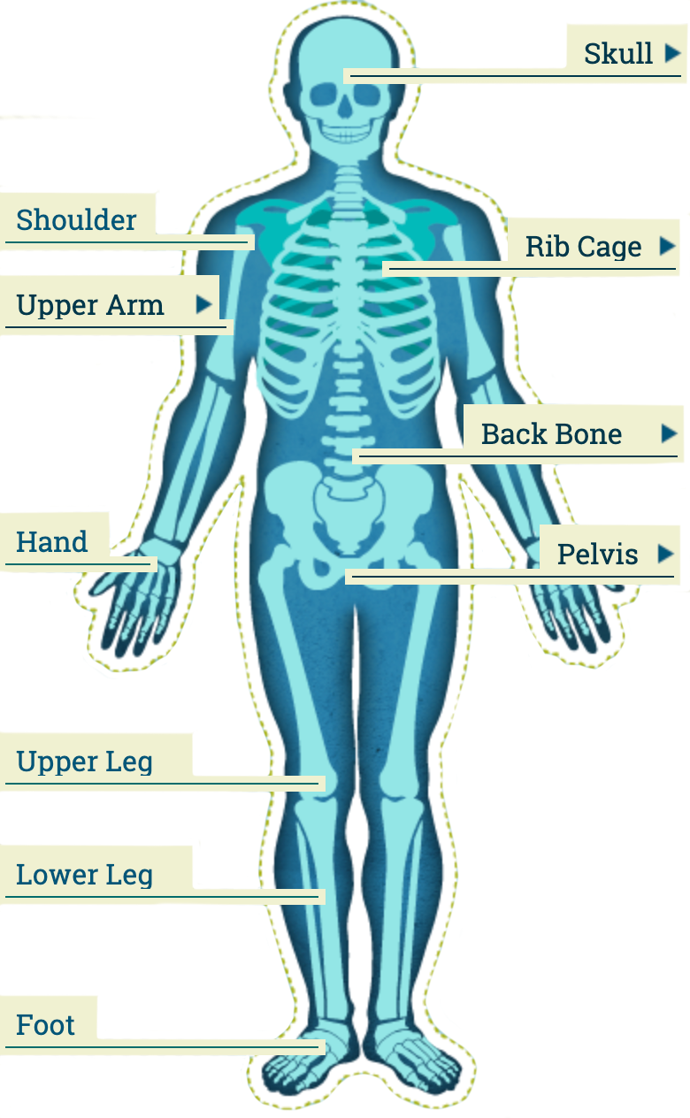
Activity Sheet
Answers
Question 1: match the labels to the parts of the skeletal system
  Your diagram should be labeled like this:

Slide 4
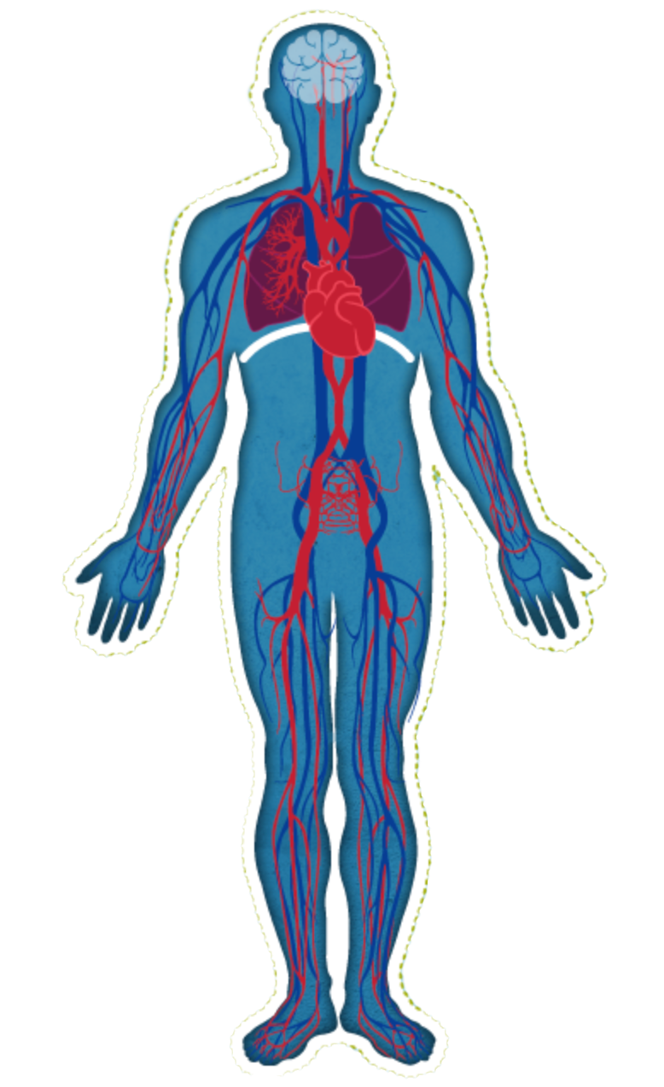
The Human Body
This diagram shows the circulation system of the human body. It shows how blood travels around, carrying oxygen and removing carbon dioxide.
  See if you can locate these organs:
      brain
      lungs
      Heart
  The blood is shown travelling around in arteries, veins and capillaries.
      what is the purpose of the heart?
      what is the purpose of the lungs?
  Suggest why having a good supply of blood to the brain is important.

