Slide 1
Lesson 3 Influencers and role models
Siemens Education

Slide 2
Influencers and role models
Learning objectives
To consider how positive role models may influence my life and possible future career choices (including STEM careers)
Notes:
Learning objective:
To consider how positive role models may influence my life and possible future career choices (including STEM careers)
Learning outcomes:
Identify positive role models in my life
Describe potential decisions and choices to be made in order to have a STEM career
Compile questions to ask a SIEMENS employee, parent or visitor in a STEM or STEM-related job

Slide 3
Groundrules
What should our groundrules be?
Notes:
At the start of the lesson review and re-visit with pupils.

Slide 4
What did we learn before?
Personal strengths?
Personal skills?
What do you notice about the pictures?
Notes:
Re-cap with the class the personal strengths and skills identified in Lesson 2 and how they may potentially support them in their future career choices.

Slide 5
What did we find out at home?
Parents, relatives or friends first jobs?
What do you notice about the pictures?
Notes:
Share findings from homework with parents from Lesson 2.

Slide 6
Dream jobs
What is your dream job?
Who or what influenced your choice?
Notes:
Ask pupils to write on a Post-it what their “dream” job is (they will have discussed this with their parent(s) as part of Lesson 2 homework).
Invite each pupil to stand up and describe what the job is and to consider what or who may have influenced their choice. Then ask them to put their Post-it onto the class flipchart, display board or graffiti wall.
(Alternatively, the dream jobs could be written or drawn on coloured A4 sheets of paper and displayed across the classroom on a ‘washing line’.)
Who or what do they notice are the most often mentioned influences on their choices?

Slide 7
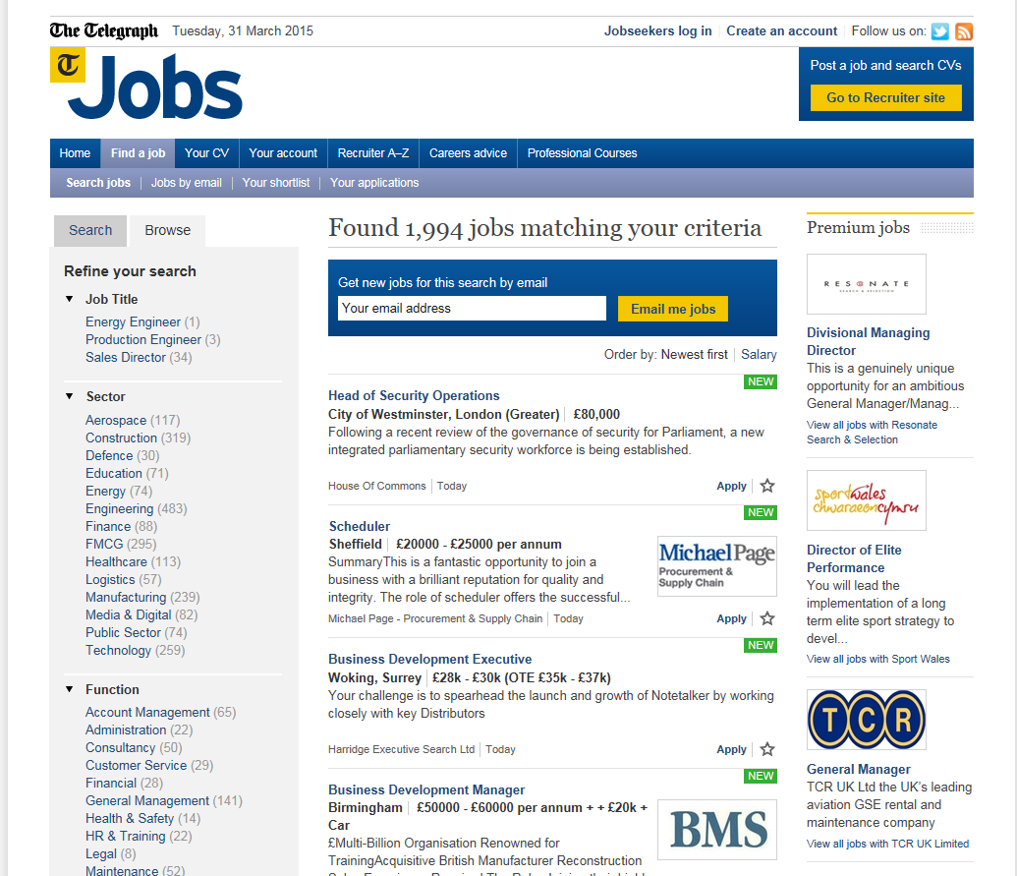
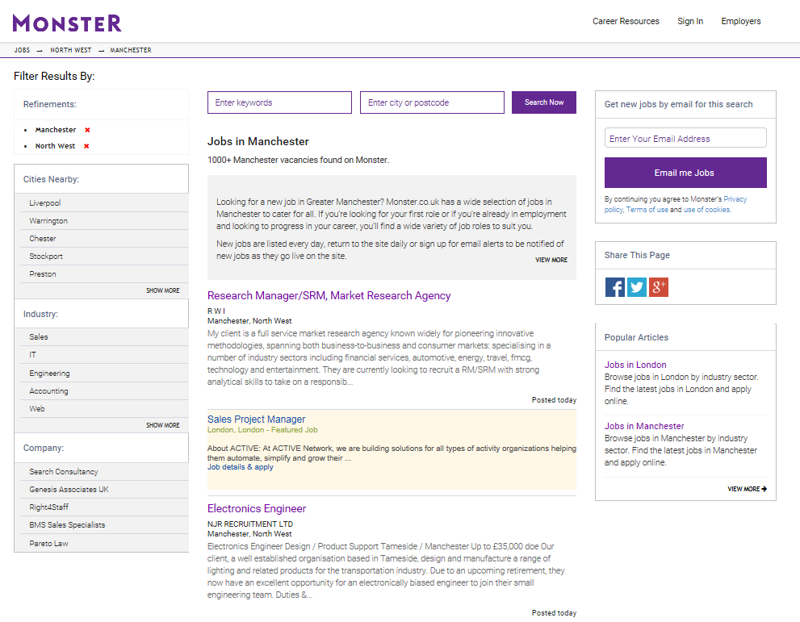
Looking at job adverts
What do you notice?
How many are STEM-based jobs?
Notes:
Ask the children to lay out the adverts they have collected on their tables.
Each group does a tally of the different jobs they have and feeds back to the rest of the class via a group spokesperson.
What do they notice?
How many are STEM-based jobs?

Slide 8
Interview questions
Share the questions you prepared at home.
What are the two best questions?
Notes:
In groups, ask pupils to share the questions they devised at home with.
Ask them to vote on the questions that they consider the best two to ask the visitor.
Remind the class that the questions they chose should be ‘open’ and not ‘closed’ and should enable the class to find out what a STEM job is like to do.
This activity should provide 10–14 questions for the class to ask the visitor. Check that the questions to be asked are appropriate, relevant and not too daunting for the visitor!

Slide 9
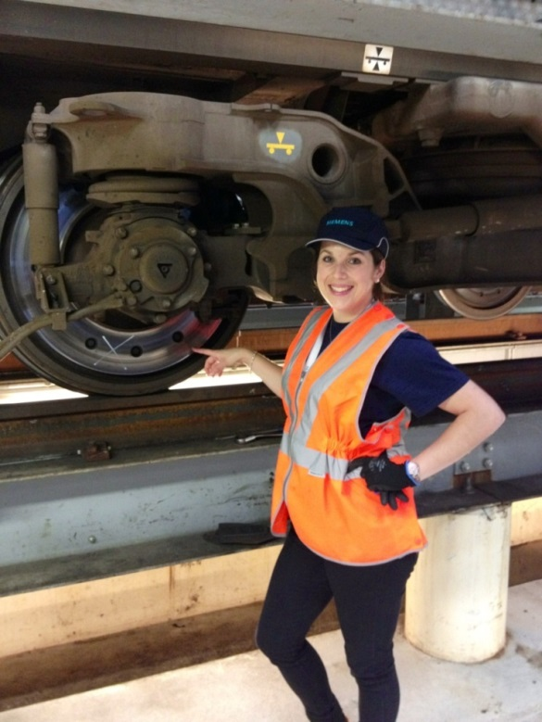
Visitor
Notes:
Talking to a SIEMENS employee or a member of the school community (parent or governor) who has a STEM career.

Slide 10
Review
What three key points did you learn about having a STEM career?
Was there anything that surprised you?
Did you find out something new?
Notes:
What three key points did they learn about having a STEM career?
Was there anything that surprised them or something that they didn’t know about this kind of career?

Slide 11
Homework
Interview a parent / carer and find out:
Who has been a positive role model in their life?
In what ways did they influence them?
Bring in a picture (can be a drawing or photograph) for Lesson 4
Ask a parent / carer to write down three hopes and aspirations they have for your future careers.
Write a list of your hopes and aspirations for your future career.
Notes:
Homework / working with parent
Interview with a parent/carer. Find out:
Who has been a positive role model in their parent’s life? In what ways did they influence them?
Ask pupils to bring in a picture (can be a drawing or photograph) for Lesson 4.
Ask parent / carer to write down three hopes and aspirations they have for their child in their future career.
Ask the pupils to do the same from their perspective.

