Slide 1


Topic 6: Totally in control
© Siemens AG 2012. All rights reserved.
www.siemens.co.uk/education

Slide 2
Totally in control
Overall learning objectives:
Identify how sequences of commands can be used to run equipment and how logic operation can respond to inputs and control outputs.
Apply ideas about circuits and energy transducers to using inputs in systems and about forces to simple and complex situations.
Overall learning outcomes:
Understand features of a system in terms of input, process and output, how the design of a system responds to a detailed brief and how it can be modified a system to improve its performance.
Introduction: Totally in control

Slide 3
Totally in control
Overall learning outcomes:
Understand features of a system in terms of input, process and output, how the design of a system responds to a detailed brief and how a system can be modified to improve its performance.
Introduction: Totally in control

Slide 4
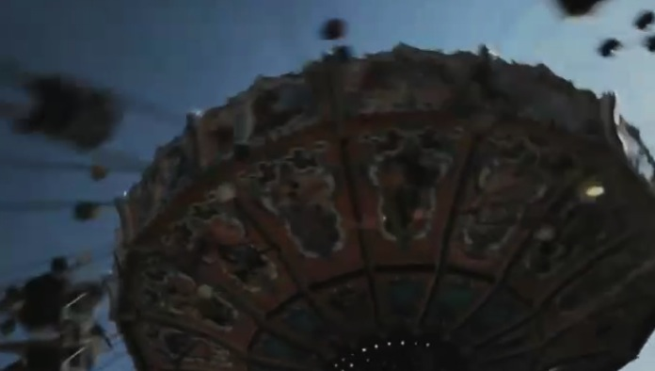
Totally in control
Oktoberfest - Emperors
Episode 1: Totally in control
Notes:
Show a video clip from, ‘Oktoberfest – Emperors’.
Ask students to share personal experiences of such rides.
Ask students to identify key features of the ride that make it fun and draw out points about chairs swinging out further as the ride goes faster.
Ask students to suggest why the balance of the ride may change from one group of passengers to another. Draw out the following points:
Some passengers may be heavier than others.
Passengers may not be evenly distributed and some chairs may be empty.
Ask for reasons why there is an automatic control system as well as the manual controls and draw out reasons for this being installed.

Slide 5
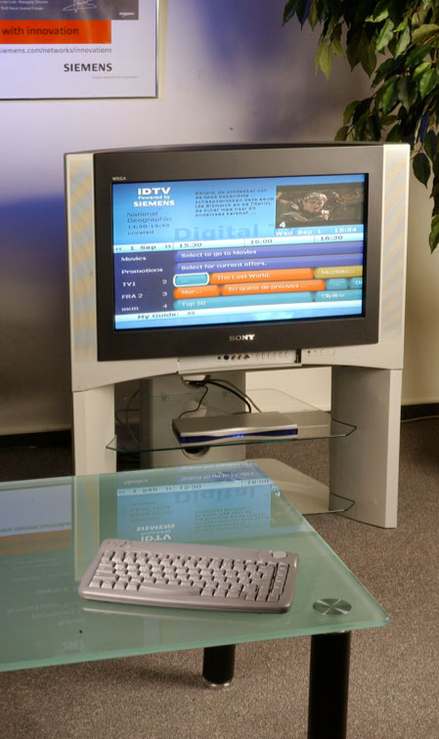
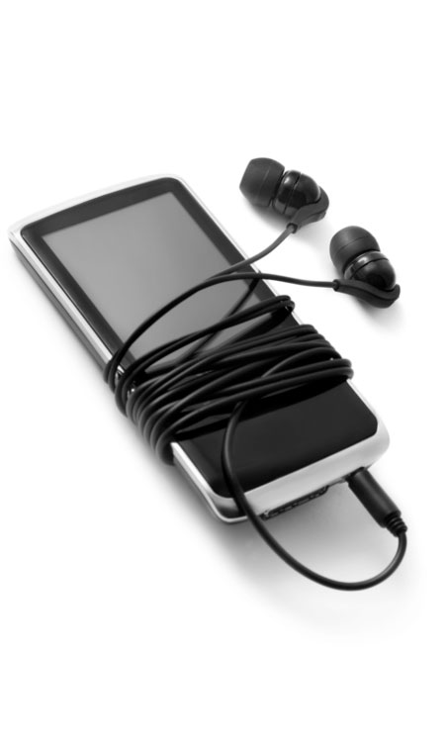
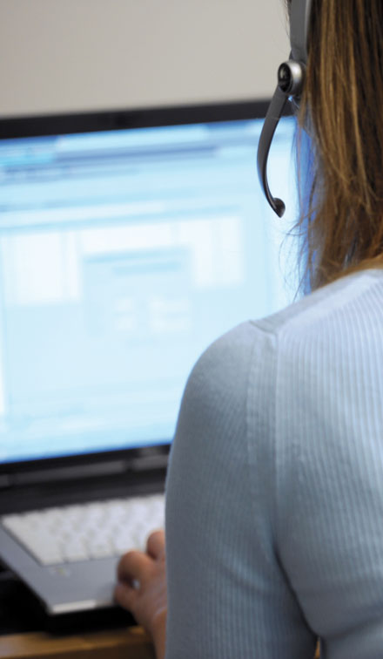
Totally in control
Exit vulnareus plexus est. Vulna pausta rhus tex, per itum Status ex land um exus rius.
Input-process-output
Episode 2: Totally in control
Notes:
Explain to students that many systems have inputs, a processor and outputs. Use a calculator as an example of this and show how the keypad is the input, the processor is in the circuitry inside and the output is the display. Ask students to apply this idea to:
A TV
A personal stereo
A computer
Show student support sheet 6A and ask students to think about the safety aspects of such a ride and how the ride might become unstable and dangerous.
Ask students to work in groups and to gather ideas under these headings:
The features that make it an exciting ride.
The potential hazards and how they can be avoided
Inputs and outputs
Take feedback and draw out:
Inputs
The weight of the passengers
The distribution of the weight
The height of the chairs
The speed of the chairs
Outputs
The height of the chairs
The speed of the chairs

Slide 6
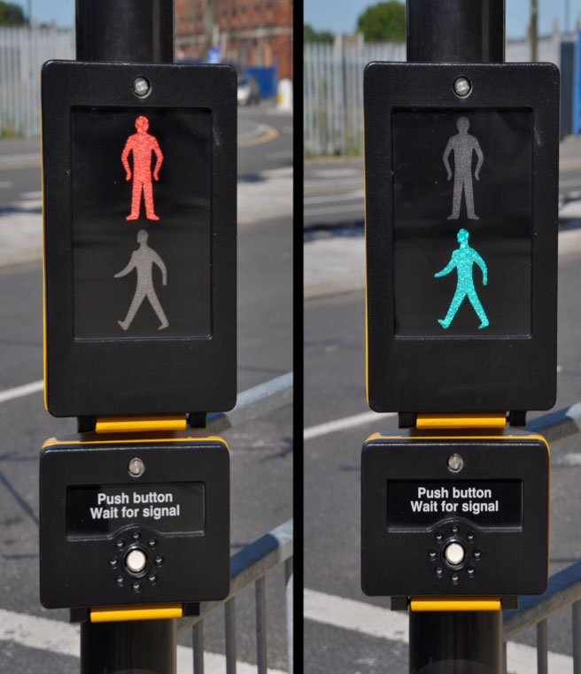
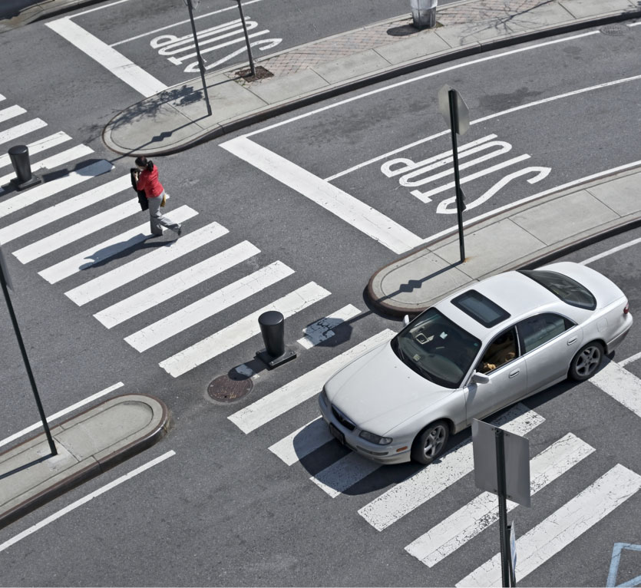
Totally in control
Exit vulnareus plexus est. Vulna pausta rhus tex, per itum Status ex land um exus rius.
Pedestrian controlled crossing
Oktoberfest - Emperors
Episode 3: Totally in control
Notes:
Show students an illustration of a pedestrian-controlled crossing and emphasise that this system responds to an input with an output. Ask students to identify these and establish that the input is the button and the output is the changed sequence of traffic lights.
Using student support sheet 6B ask students to sequence them in the correct order.
The order should read:
Traffic lights green and pedestrian light red
Button pressed
Traffic lights amber
Traffic lights red
Pedestrian light green and bleeper turned on
Bleeper turned off
Pedestrian light red
Traffic lights red and amber
Traffic lights green
Point out that it is not only the sequencing that is important but also the timing. Ask students to put suitable timings in between each of these stages.

Slide 7
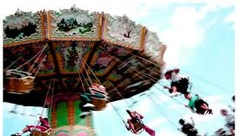
Totally in control
Totally in control
Episode 5: Totally in control
Notes:
Explain to students that the purpose of this part is to apply their understanding of inputs and outputs and also the correct sequencing of instructions to control the ride.
Say to students that once the controller is satisfied that it is safe to start, the hub (from which the chairs are suspended) starts to rotate. Then the hub rises vertically upwards. Near the top of its travel, the hub tilts slightly to one side.
Check students’ understanding of the context by asking them questions such as:
What does the controller do to satisfy themselves that it is safe to start the ride?
What will happen to the chairs as the hub turns more quickly?
What will happen to the chairs as the hub rises?
What will happen to the chairs as the hub tilts at the top?
Ask the students to suggest a series of instructions fro the controller. Assume no automatic control.
Now ask the students to consider what would happen if the ride was significantly unbalanced and what should happen in this case and how would they modify their control sequence. If necessary suggest that sensors in the hub might be part of the solution.
Ask the students to consider how a strong wind might make a difference to the ride and how this could be responded to by the control system.

Slide 8

Totally in control
Group discussion
What’s in the water?
Episode 6: Totally in control
Notes:
Say to students that it is now being proposed that an automatic control system be installed on the flying chairs ride. This will run parts of the control sequence automatically.
Ask them to work in groups to consider answers to these questions:
What would the advantages be of automatic control, thinking about;
Adverse weather?
Unbalanced loads?
Controller fatigue?
Which aspects would you still want to be manually controlled, and why?
Students should be prepared to share ideas and suggest a combined and refined set of responses.

Slide 9

Engineering the future. Inspire and be inspired
For further information about the Siemens Education website and all support materials and downloads please visit us at
www.siemens.co.uk/education
© Siemens AG 2012. All rights reserved.

