Slide 1


Topic 1: The Inspired Bus Company
© Siemens AG 2012. All rights reserved.
www.siemens.co.uk/education

Slide 2
The Inspired Bus Company
Overall learning objectives:
To explore the challenges facing bus designers when producing a bus for an urban environment.
To investigate how different solutions can be identified and evaluated.
To collaborate to present recommendations for an effective solution.
Overall learning outcomes:
To have investigated and summarised key features of alternatives.
To have presented a well evidenced case for a solution.
The Inspired Bus Company

Slide 3
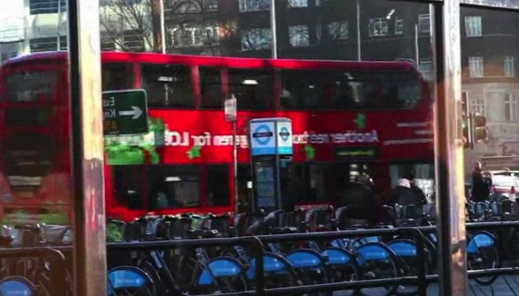
The Inspired Bus Company
‘Leon’s London’
Episode 1: The Inspired Bus Company
Notes:
Show a video clip of ‘Leon’s London’.

Slide 4
The Inspired Bus Company
Leon’s London
Why does Leon get different kinds of passenger on the bus at different times of the day?
What kinds of places are on Leon’s bus route?
What impact do you think that traffic congestion has on his journey?
Why is traffic pollution going to be an important factor in the design of the bus?
What would be the problem with using a bus that simply had a diesel engine driving the wheels?
Episode 1: The Inspired Bus Company
Notes:
Draw out the following points:
A whole range of people use the bus. A number of these people would be particularly sensitive to pollution.
The route includes schools, hospitals, houses, shops, and places of work. These are all places that people may spend significant amounts of time.
The Congestion will vary but could be significant at times, so the bus could be stationary in a queue or moving slowly.
A bus could produce a significant amount of pollution, close to where people are.
A diesel engine produces exhaust emissions which are released directly into the atmosphere. This is particularly noticeable at low speeds and in built up areas.

Slide 5
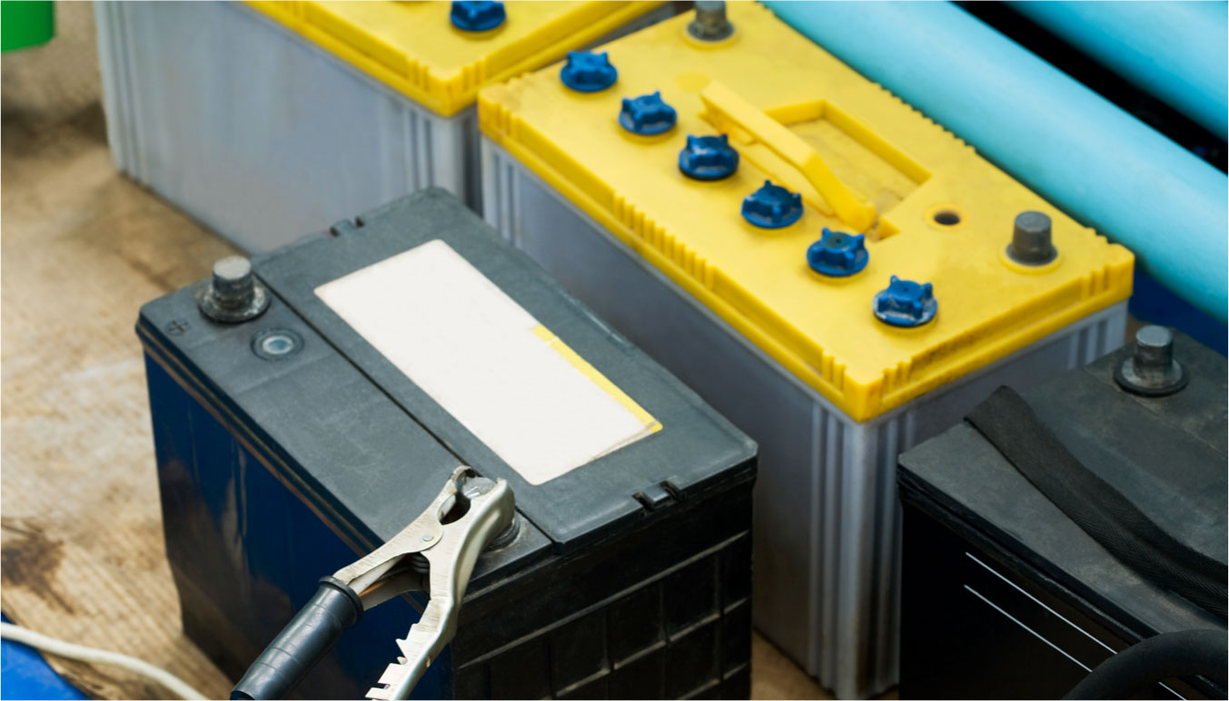
The Inspired Bus Company
Source A: battery power
Episode 3: The Inspired Bus Company
Notes:
Introduce this by means of a battery powered model vehicle and student support sheet 1A. Ask students to read the information, investigate the model and then ask questions about the power source to check their understanding.

Slide 6
The Inspired Bus Company
Battery power
How would the batteries be charged up in a full-sized vehicle?
Where is energy being transferred from and to?
What is the environmental impact?
What might affect the range?
What are the advantages and disadvantages of this source?
Episode 3: The Inspired Bus Company

Slide 7
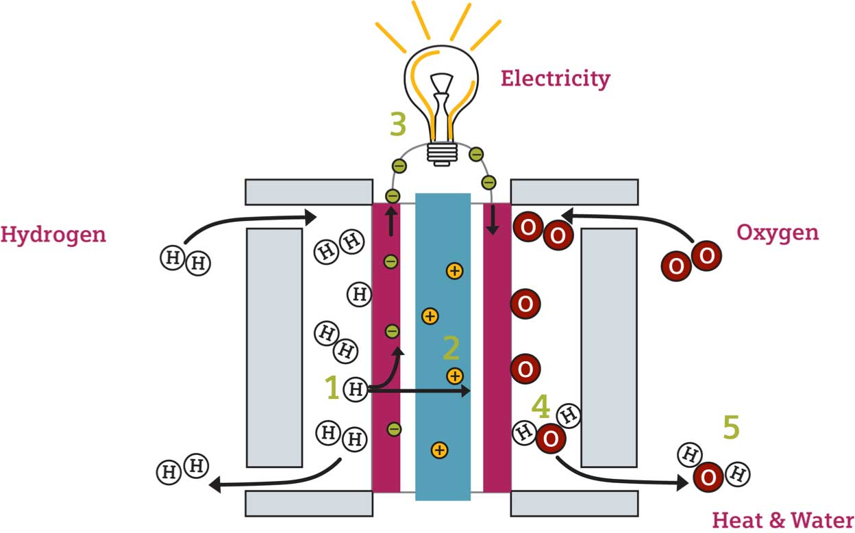
The Inspired Bus Company
Source B: fuel cell
Episode 3: The Inspired Bus Company
Notes:
Explain how the fuel cell works using student support sheet 1B, ask students to read the information and then ask them questions about the power source to check their understanding.

Slide 8
The Inspired Bus Company
Fuel cell
How would this work in a full-sized vehicle?
Where is energy being transferred from and to?
What is the environmental impact?
What might affect the range?
What are the advantages and disadvantages of this source?
Episode 3: The Inspired Bus Company

Slide 9
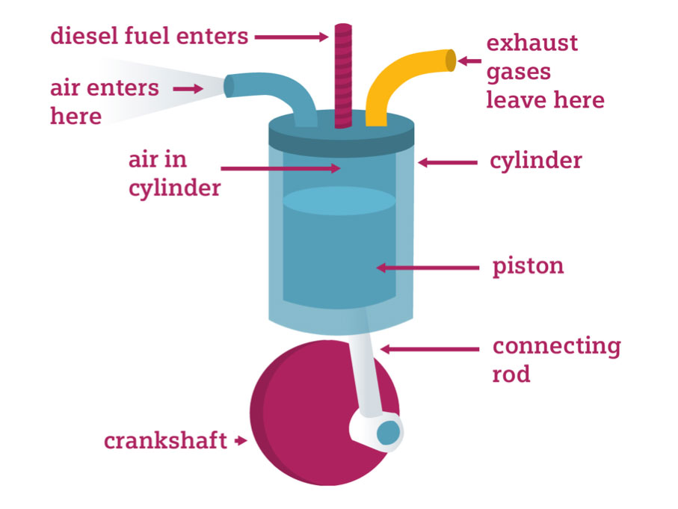
The Inspired Bus Company
Diesel engine
Episode 3: The Inspired Bus Company
Notes:
Explain how a diesel engine works using student support sheet 1C, ask students to read the information and then ask them questions about the power source to check their understanding.

Slide 10
The Inspired Bus Company
Diesel engine
Where is energy being transferred from and to?
What is the environmental impact?
How might this affect the range?
What are the advantages and disadvantages of this source?
Episode 3: The Inspired Bus Company

Slide 11
The Inspired Bus Company
Evaluate
Work together to explore ideas about the advantages and disadvantages of each power source.
Episode 3: The Inspired Bus Company

Slide 12
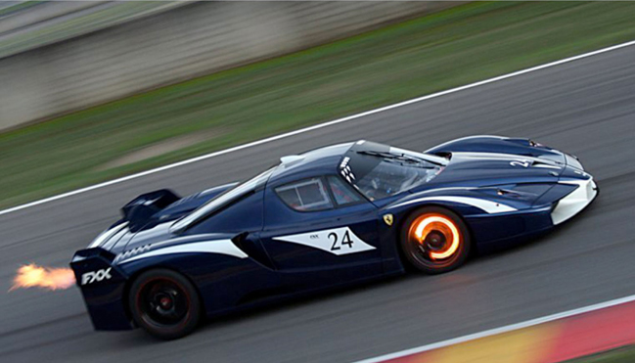
The Inspired Bus Company
Racing car
Episode 5: The Inspired Bus Company
Notes:
Generate answers to these questions:
Why is this happening?
What is the energy transfer that is taking place?
Why is this a challenge for the car designers?
Why is this a problem in terms of energy efficiency?
Take feedback and draw out these points:
The discs are glowing because of the high temperatures, caused by friction as the driver brakes.
The energy is being transferred away from the car as it slows down. The kinetic energy of the car is being reduced and released as heat. The heat will escape from the car into the atmosphere.
The designers need to make sure the brakes are cooled down. If they overheat they won’t work as well.
The energy is transferred away from the car in a way that cannot be used.

Slide 13

The Inspired Bus Company
Bicycle brakes
Episode 6: The Inspired Bus Company
Notes:
Ask students to recall from the previous activity what happens to the energy that a moving vehicle has when the brakes are applied.
Ask students to work in groups to suggest how this could be demonstrated and measured using a bicycle and other equipment.
Suggest that ideas are presented as labelled sketches and take feedback.

Slide 14
The Inspired Bus Company
Bicycle brakes
What happens to the temperature of the brakes if the bike wheel is set in motion and the brakes applied?
What happens to the temperature of the brakes if the speed is increased?
What happens to the temperature of the brakes if the speed is held for longer before braking?
Where does the energy go when the wheel has stopped?
How repeatable are these results?
Episode 6: The Inspired Bus Company
Notes:
Draw out points including:
Brakes heat up
Brakes heat up more if the wheel is going faster.
The energy is dissipated into the atmosphere.

Slide 15
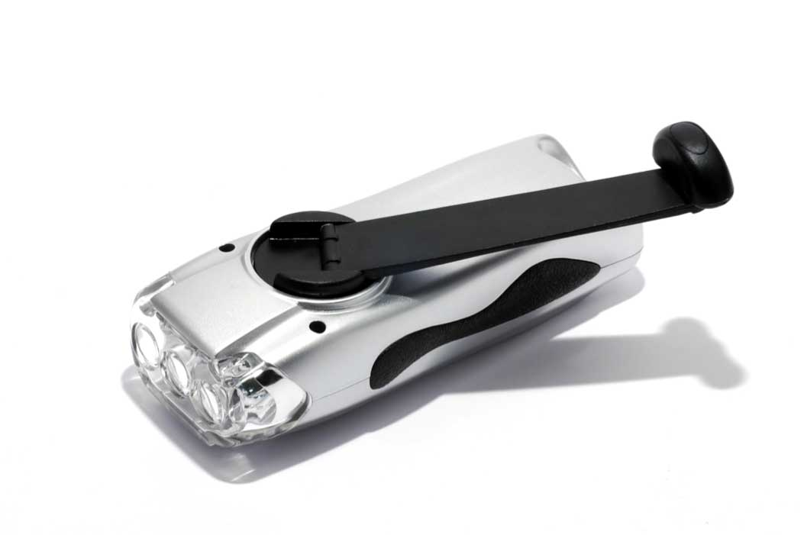
The Inspired Bus Company
Hand crank torch
Episode 7: The Inspired Bus Company
Notes:
Demonstrate hand crank device such as radio or torch, showing how it is possible to use the crank to charge up the battery and then to use the battery to power the device.
Ask students to think about the energy transfers that are taking place, suggest ideas and summarise.

Slide 16
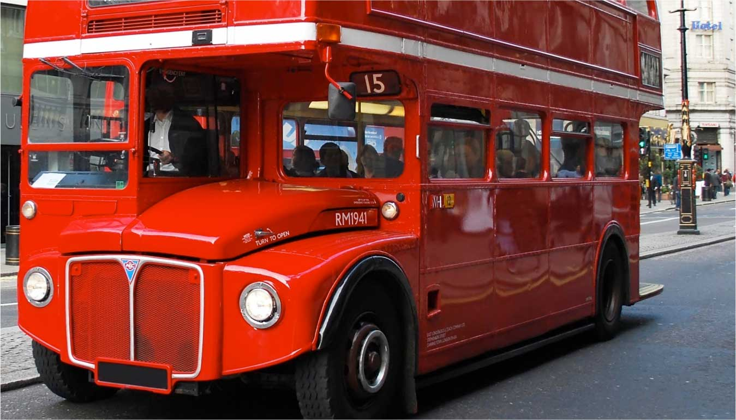
The Inspired Bus Company
London bus
Episode 8: The Inspired Bus Company
Notes:
The wheels are driven by electric motors.
The electricity could come from any of the power sources introduced earlier (diesel engine, battery or fuel cell).
In practice a bus wouldn’t have all three; it could have any one or both a battery and either a diesel engine or a fuel cell.

Slide 17
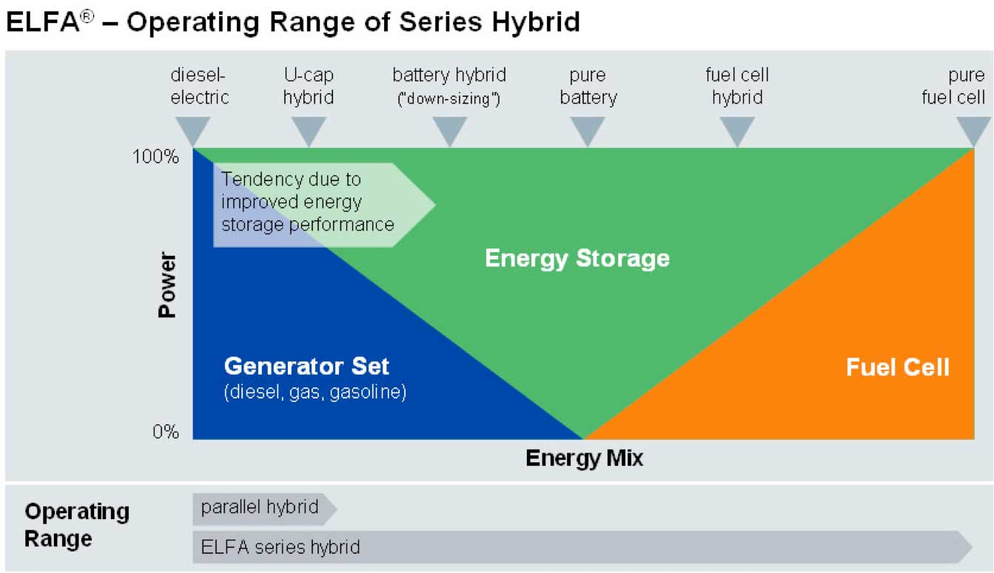
The Inspired Bus Company
Hybrid energy systems
Episode 8: The Inspired Bus Company
Notes:
Introduce the graph and explain what it shows.
A particular vehicle is at any point on the horizontal axis depending upon the ‘energy mix’ it has.
Explain that this means that the designer has a lot of flexibility when it comes to designing a bus for a particular application.
Ask students, where on this graph they would place an electric milk float?

Slide 18
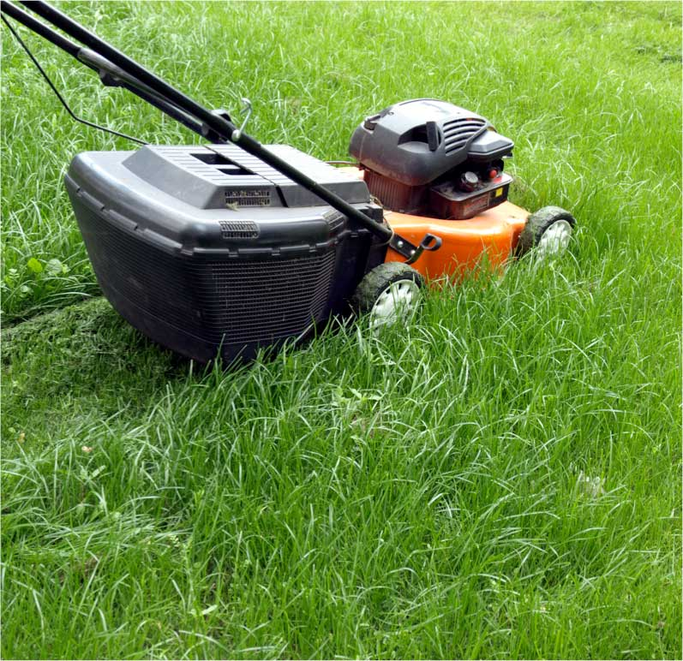

The Inspired Bus Company
Suggest an effective power source and explain why
Episode 8: The Inspired Bus Company
Notes:
Ask students to suggest the energy mix for the following situations:
Transport around a railway station for passengers with limited mobility
A farm tractor.
A lawn mower for a domestic garden.
A lawn mower for the school playing field.

Slide 19
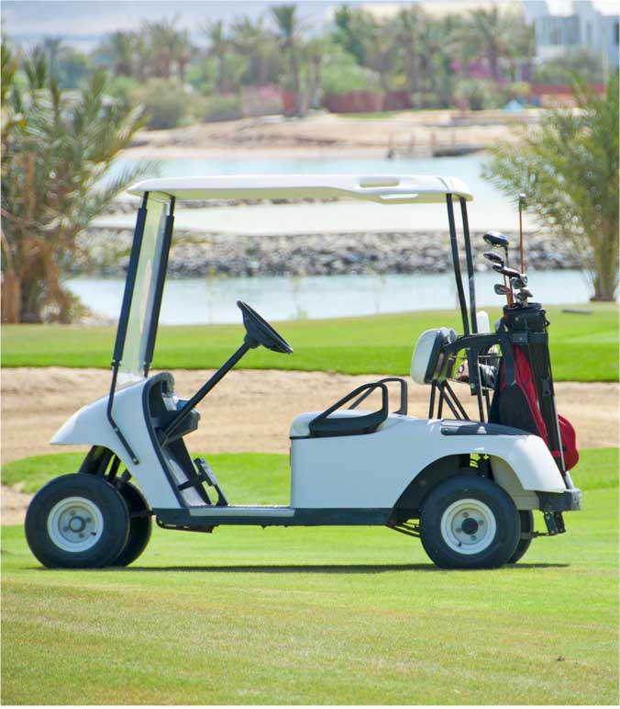
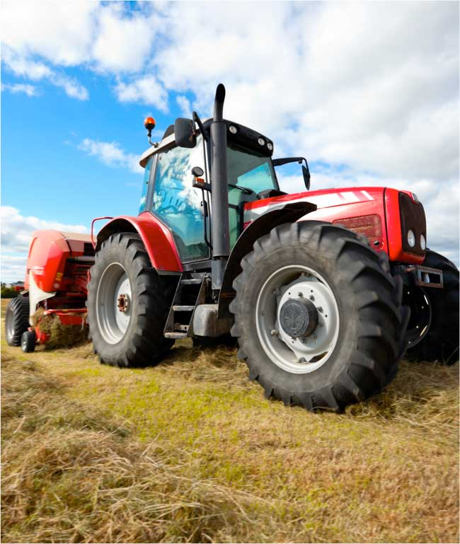
The Inspired Bus Company
Suggest an effective power source and explain why
Episode 8: The Inspired Bus Company
Notes:
Ask students to suggest the energy mix for the following situations:
Transport around a railway station for passengers with limited mobility
A farm tractor.
A lawn mower for a domestic garden.
A lawn mower for the school playing field.

Slide 20
The Inspired Bus Company
‘Leon’s London’
Siemens ELFA drive system video
Episode 9: The Inspired Bus Company
Notes:
Show students a video clip of the Siemens ELFA drive system in action.
Explain that whereas having more than one drive system offers advantages, it needs to be controlled and managed automatically.
Ask students to identify key points about the solution.

Slide 21

The Inspired Bus Company
Group discussion
Episode 10: The Inspired Bus Company
Notes:
Students will work in groups to present a case for the power systems for a fleet of new buses. These buses will each be dedicated to a particular route; the routes to be covered are:
Route 1: shuttle service between rail and bus stations in city centre
Route 2: ‘inner circle’ service around urban estates
Route 3: airport bus service using urban motorways
The presentation will need to explain how the team evaluated each kind of power system for each route and what their recommendations were.

Slide 22
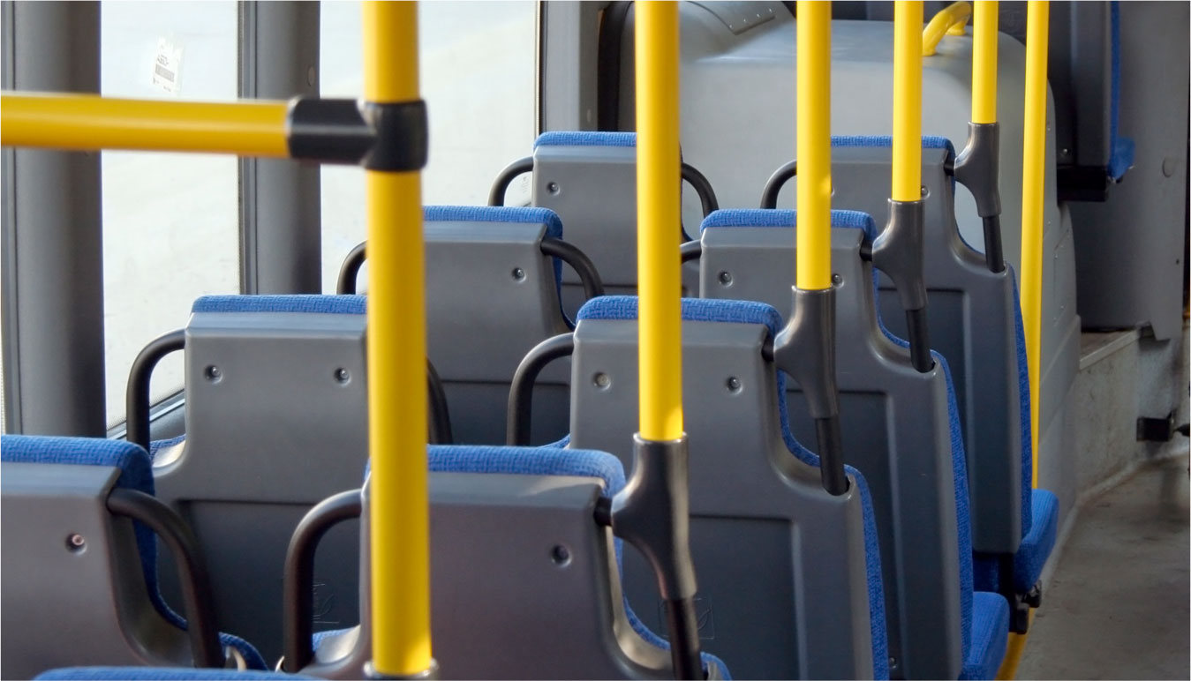
The Inspired Bus Company
Route one: rail/bus station shuttle service
Episode 10: The Inspired Bus Company
Notes:
Students will work in groups to present a case for the power systems for a fleet of new buses. These buses will each be dedicated to a particular route; the routes to be covered are:
Route 1: shuttle service between rail and bus stations in city centre…

Slide 23
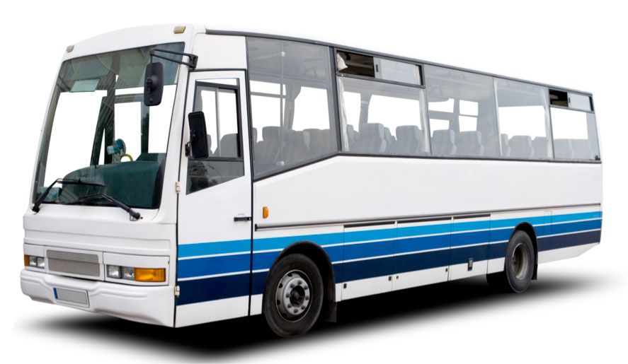
The Inspired Bus Company
Route two: ‘inner circle’ service
Episode 10: The Inspired Bus Company
Notes:
Students will work in groups to present a case for the power systems for a fleet of new buses. These buses will each be dedicated to a particular route; the routes to be covered are:
Route 2: ‘inner circle’ service around urban estates…

Slide 24
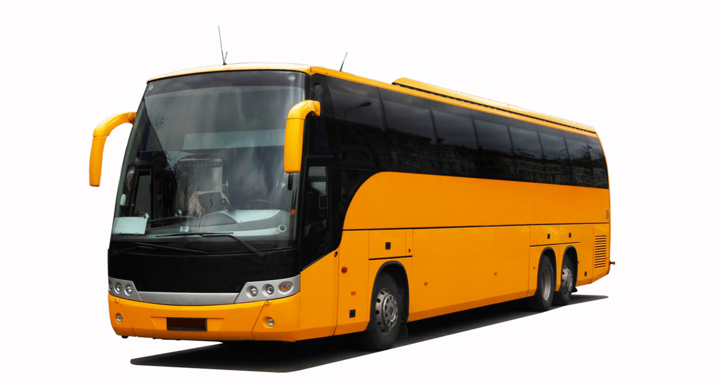
The Inspired Bus Company
Route three: city-airport link
Episode 10: The Inspired Bus Company
Notes:
Students will work in groups to present a case for the power systems for a fleet of new buses. These buses will each be dedicated to a particular route; the routes to be covered are:
Route 3: airport bus service using urban motorways.

Slide 25

Engineering the future. Inspire and be inspired.
For further information about the Siemens Education website and all supporting materials and downloads please visit us at:
www.siemens.co.uk/education
© Siemens AG 2012. All rights reserved.

