Slide 1
Build a wind turbine
Siemens Education

Slide 2
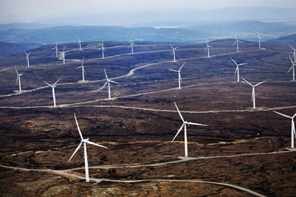
Build a wind turbine
What impacts do wind farms have?
Notes:
Crossing roads, rivers, estuaries
Carrying trains, cars, people
As sculptures

Slide 3
Build a wind turbine
Positive?
Minimise pollution
Fill the energy gap
Lower impact on their locality than conventional forms of power generation
Non-finite power source
Notes:
Crossing roads, rivers, estuaries
Carrying trains, cars, people
As sculptures

Slide 4
Build a wind turbine
Negative?
Noisy
Disturb wildlife
Unsightly
Expensive to build and maintain

Slide 5
Build a wind turbine
What can we do to improve wind farms?
Location of farm
Number of blades per turbine
Number of turbines at the farm
Height of the turbines

Slide 6
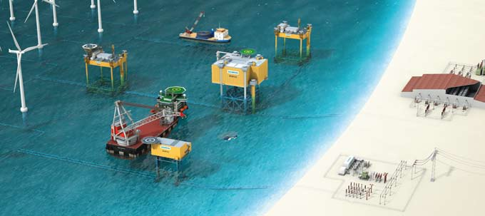
Build a wind turbine
Siemens solution
Notes:
WIPOS – Wind Power Offshore Substation – YouTube
WIPOS – Siemens Site

Slide 7
Build a wind turbine
Build your own turbine
Equipment:
2 x paper plate
2 x kebab stick
Clamp stand
Blu tack

Slide 8
Build a wind turbine
Test your turbine!

