Slide 1

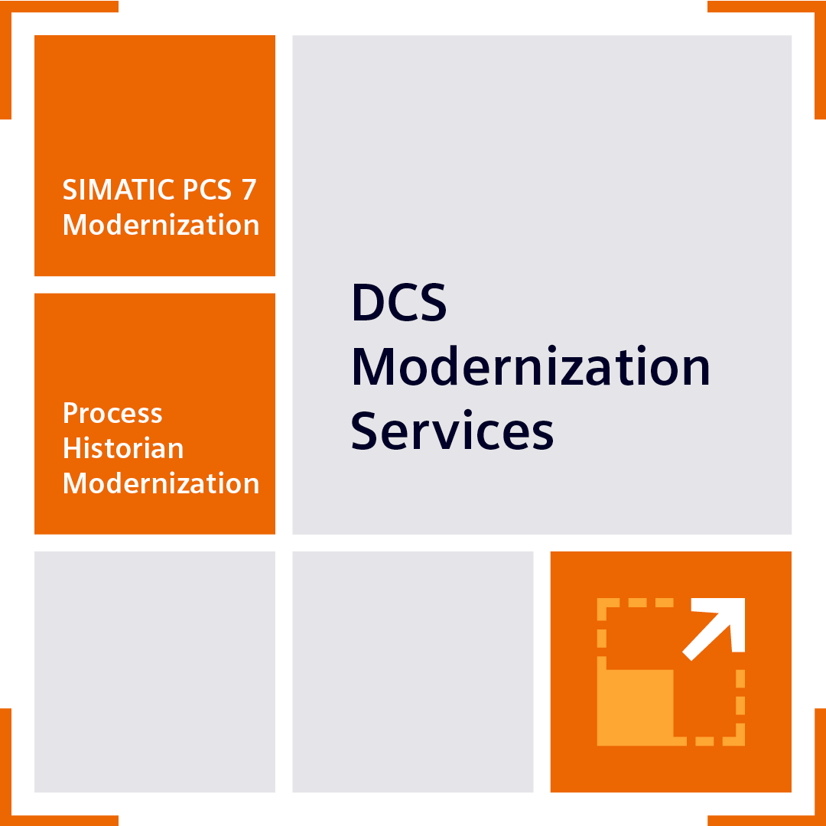
Process Historian Modernization
Permanent data availability through modernization of the SIMATIC Process Historian (PH)
Sales Slides

Slide 2


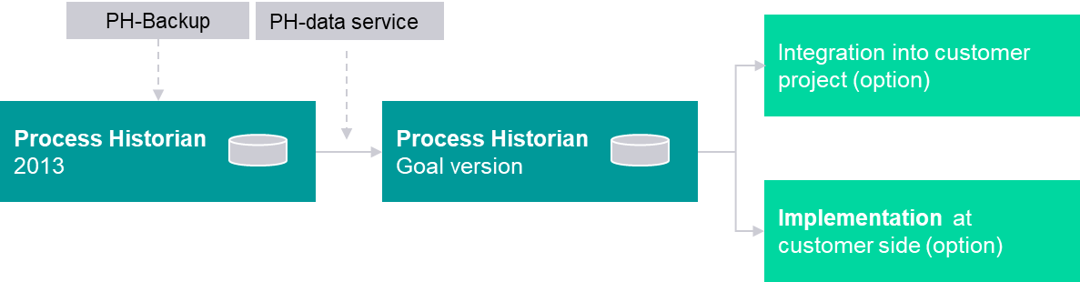
Permanent availability of historical process data with PH Modernization Services
Solution and Service
Your value
    PH Modernization Services offer standardized and system-tested service all around the modernization of SIMATIC Process Historian (SIDSI¹ PH).​
    The historic process data is saved and integrated into the new PH system environment by upgrading the PH database.
    Data porting distributes the old archive data to the new hardware environment.
Preservation of Historical Process Data
    DCS Modernization Services provide holistic and tailored support for the modernization
    of DCS systems and the preparation for upgrading to SIMATIC PCS neo.
    The service module „Process Historian Modernization“ provides an automated, standardized procedure for this with transfer of the historical process data.
High quality through automated workflows and standardized hardware (SIDSI PH)
Reduction of time and costs for upgrades
1 SIMATIC DCS/SCADA Infrastructure

Slide 3
Challenge
How can access to historical process data be ensured across modernization?
How can we achieve less risk in selecting the right Process Historian hardware?
How can performant access to historical process data be ensured across a modernization?
How can the operation of Process Historian be ensured in a new hardware environment?
How can we achieve less risk in selecting the right Information Server Update?

Slide 4
Permanent availability of historical process data with PH Modernization Services
Solution and Service
    PH Modernization Services offer standardized and system-tested service all around the modernization of SIMATIC Process Historian (SIDSI¹ PH).​
    The historic process data is saved and integrated into the new PH system environment by upgrading the PH database.
    Data porting distributes the old archive data to the new hardware environment.
1 SIMATIC DCS/SCADA Infrastructure

Slide 5

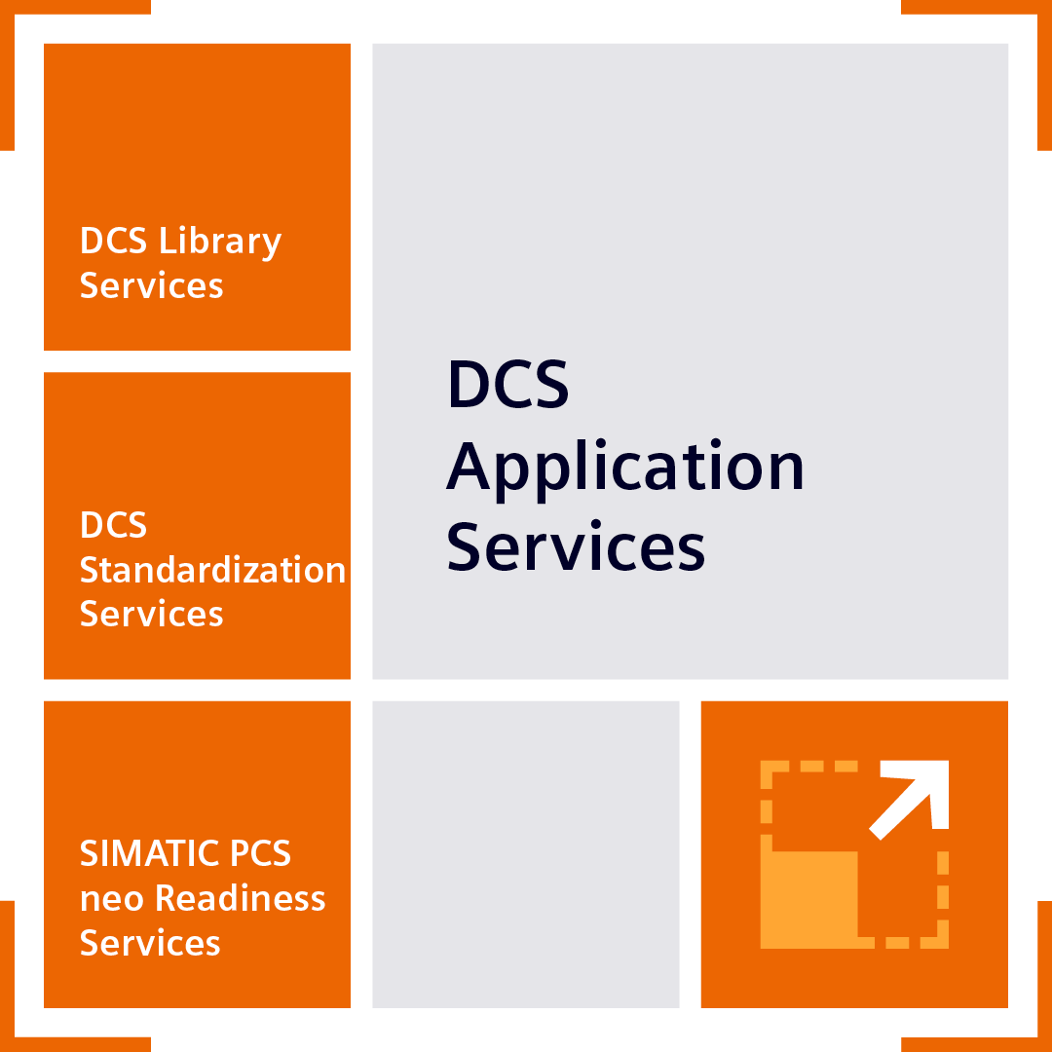
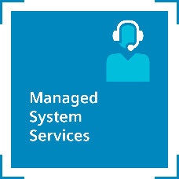
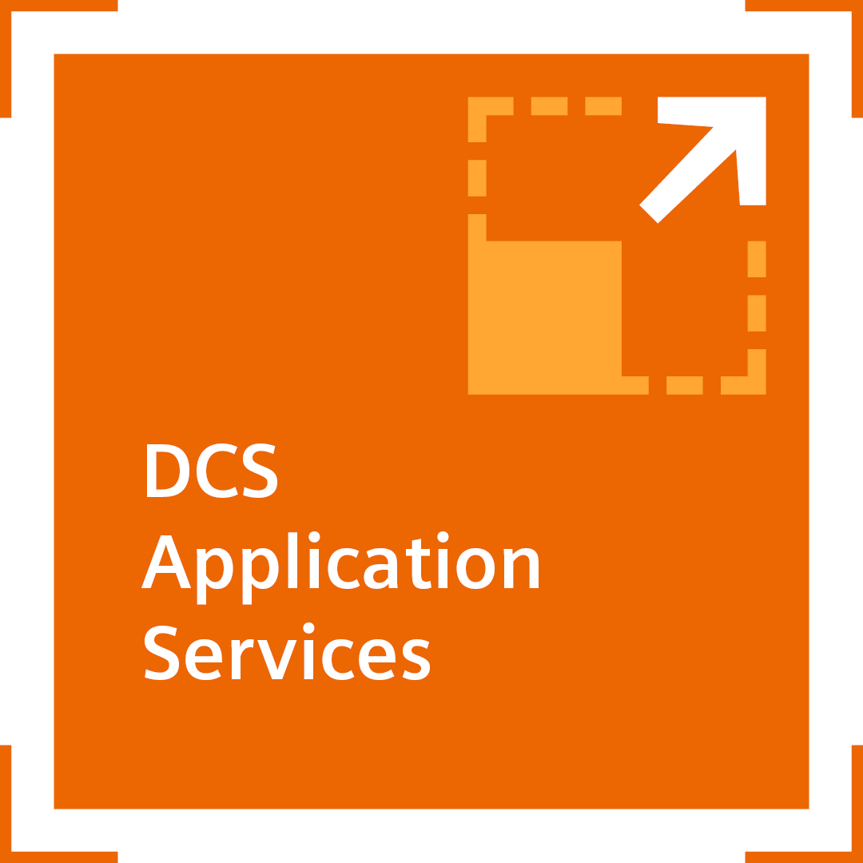



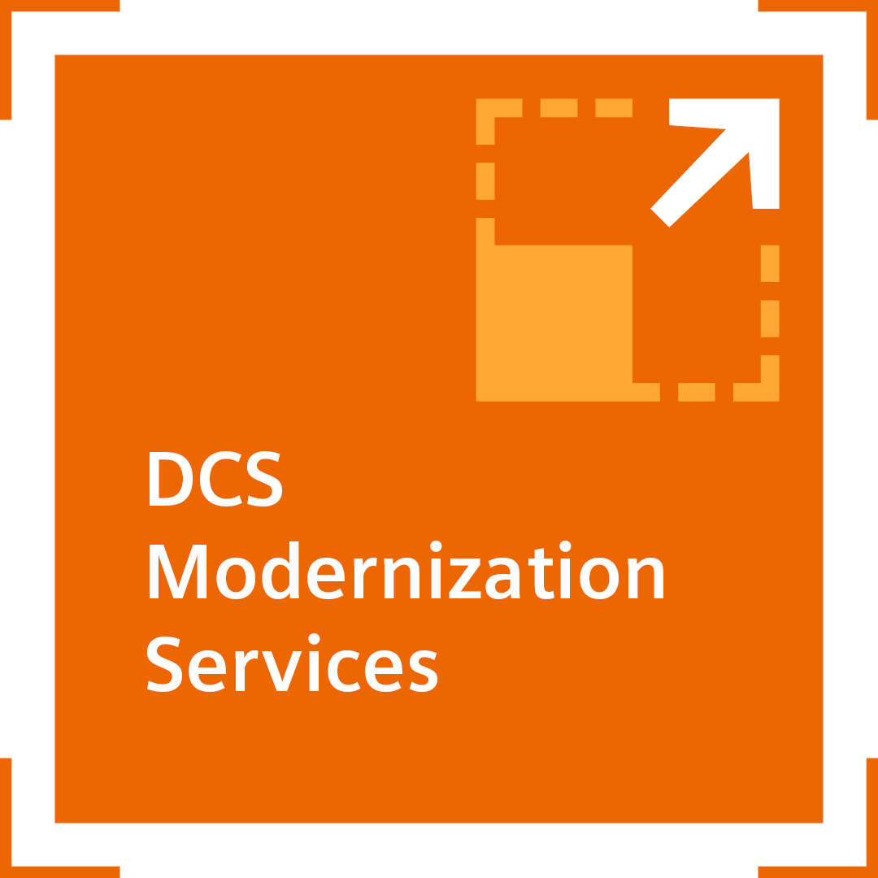
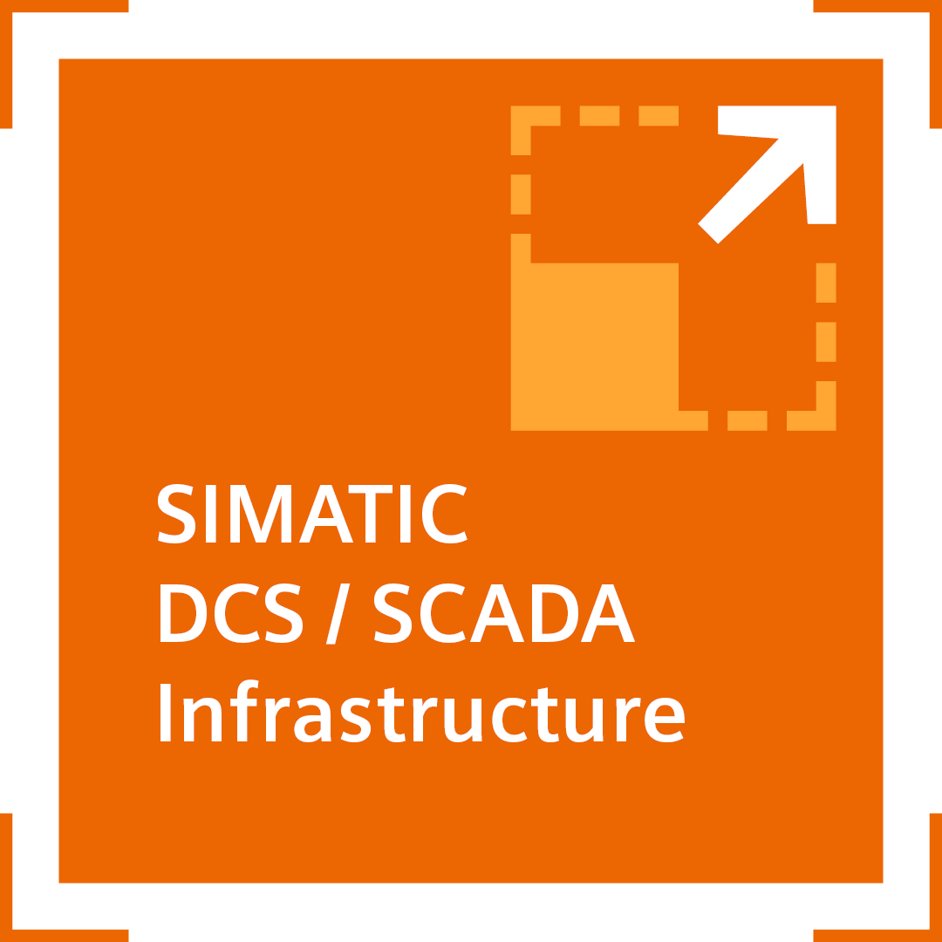
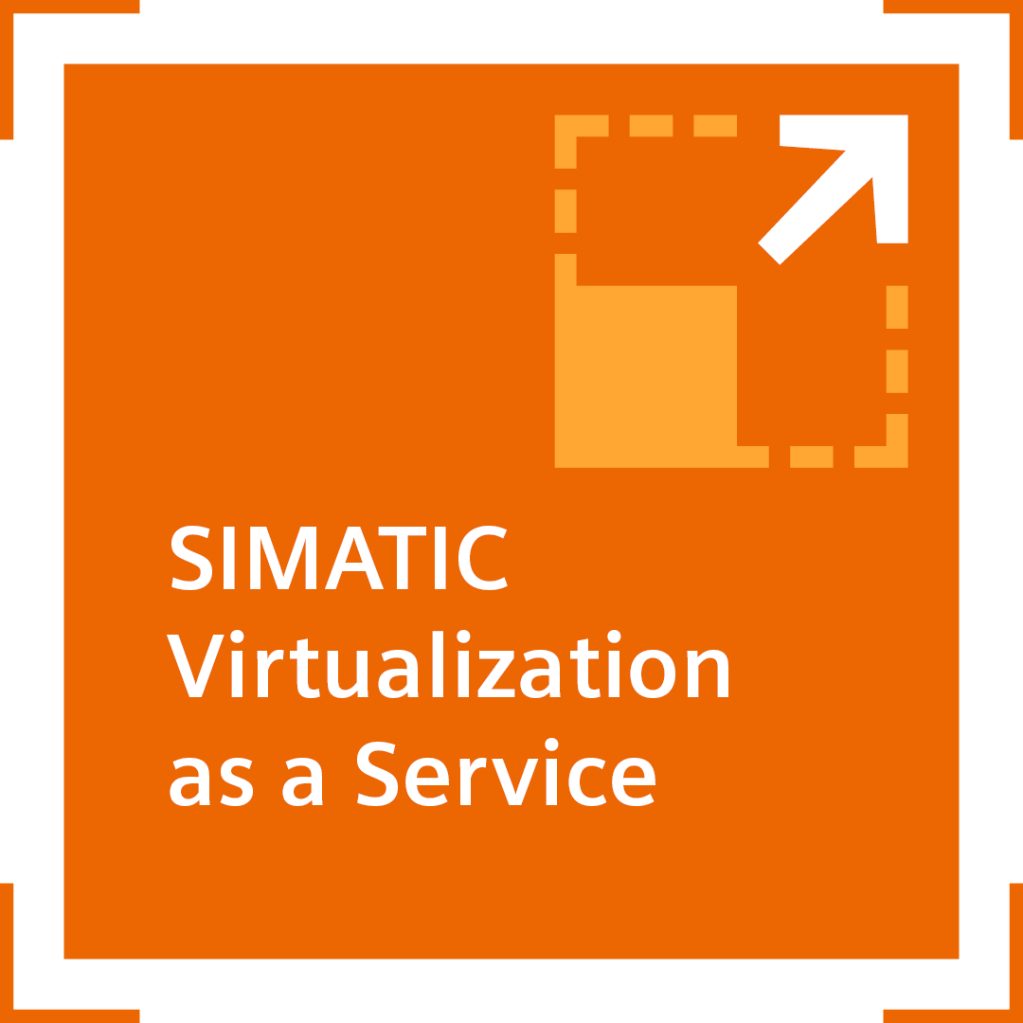


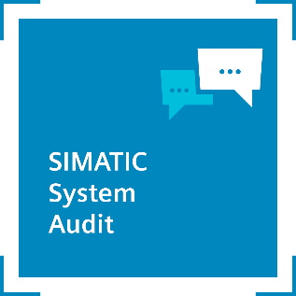

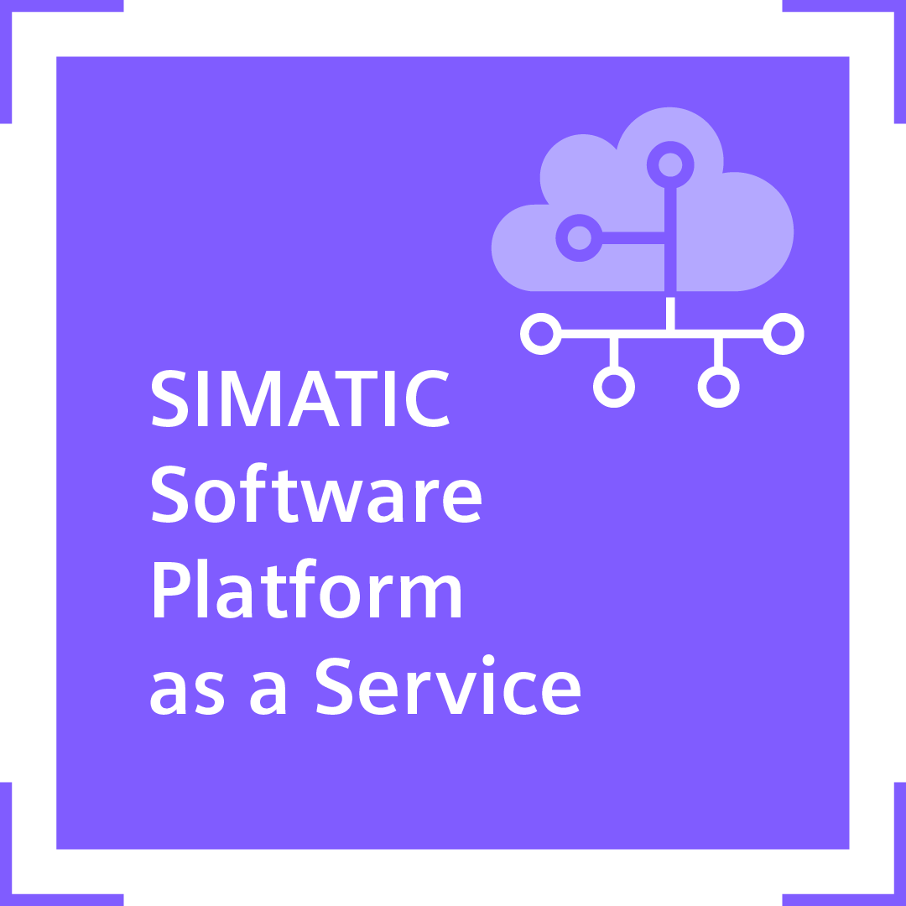

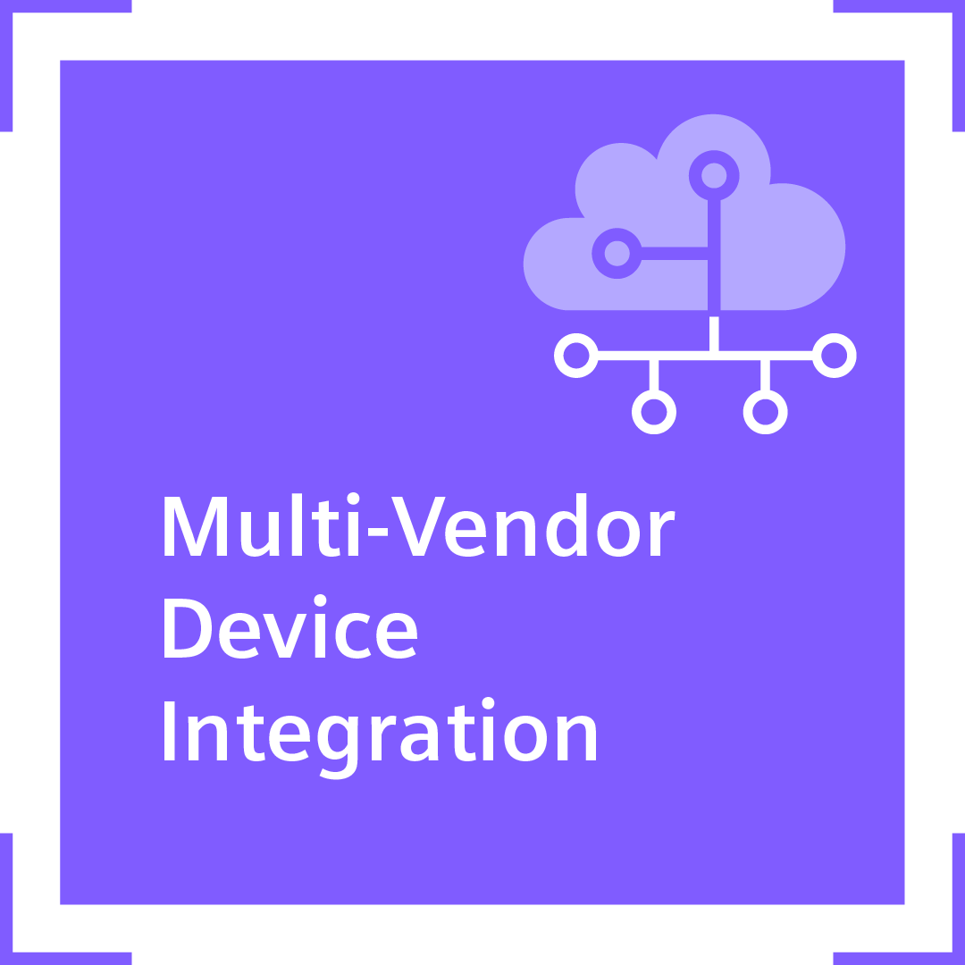

Process Historian Modernization
Positioning within the Modernization Portfolio
Legacy System
Standardized Modernization Portfolio Elements
State-of-
the-Art System
Service Contracts
Application Upgrade
XY
System Upgrade (z.B. SIMATIC PCS 7 Version X → SIMATIC PCS 7 Version Y)
Additional Package

Slide 6
Process Historian Modernization
Basic packages
In order to access the enormous amounts of data for plant optimization, you need a powerful archiving and reporting system. This is what the Process Historian offers.
It is important for the customer to ensure access to its historical process data after a modernization. This is ensured with this service.
Basic packages
Order options
PH Modernization
SIDSI
Information Server
Other options
PH Data Service 2014
New SIDSI PH Hardware
IS Data Service
2020
Redundancy Package PH
PH Data Service 2020
IS Data Service
2024
SIDSI PH
Hardware Update
PH-Services for
3rd-Party HW
PH Data Service 2020 Complete
SIDSI PH 2020 Ready
PH Data Service 2024
SIDSI PH 2024 Ready
Commissioning
PH Data Service 2024 Complete
SIDSI PH 2024 Ready w/o Win License
Commissioning
on site

Slide 7
Process Historian Modernization
Basic packages
Legend
PH Data Service 2014
PH Data Service 2024 Complete
PH data is upgraded to PH 2014 SP3 UPD 6
  PH data will be upgraded to the latest version of PH 2024 (combination of PH Data Service 2014 or PH Data Service 2020 & PH Data Service 2024)
PH Data Service 2020
New SIDSI PH Hardware
PH data is upgraded from PH 2014 SP3 UPD 6 to the current version of PH 2020
New SIDSI PH is offered together with our service
SIDSI PH 2020 Ready incl. Windows License
PH Data Service 2020 Complete
The existing customer SIDSI PH hardware and service agreement will be updated for the PH 2020 and Windows Server 2019 the Windows License isn’t already available in the Service Agreement
PH data will be upgraded to the current version of PH 2020 (combination of PH Data Service 2014 & PH Data Service 2020)
SIDSI PH 2024 Ready incl. Windows License
PH Data Service 2024
The existing customer SIDSI PH hardware and service agreement will be updated for the PH 2024 and Windows Server 2022 the Windows License isn’t already available in the Service Agreement
PH data is upgraded from PH2014 SP3 UPD 6 to the current version of PH 2024

Slide 8
Process Historian Modernization
Basic packages
Legend
IS Data Service 2020
SIDSI PH 2024 Ready w/o Windows License
IS data is upgraded from IS 2014 SP3 UPD 6 or newer to the current version of IS 2020
The existing customer SIDSI PH will be Updated for the PH 2024 and Windows Server 2022, the Windows License is already available in the Service Agreement
IS Data Service 2024
PH-Services for 3rd-Party HW
IS data is upgraded from IS 2020 or newer to the current version of IS 2024
If the customer does not use SIDSI PH HW we offer PH Data Service also for 3rd party HW (VMWare, Dell HW etc.)
Redundancy Package PH
Commissioning with data transfer on site
Service for setting up a redundant process historian
Corresponding PH or IS Data Service, which is performed at the customer's site.

Slide 9
Why should you choose
PH Modernization Services?
Modularity
High quality
Efficient Upgrades
Modular service by Siemens experts for the modernization of your SIMATIC Process Historian.
Through automated workflows and standardized hardware (SIDSI PH), ensuring the preservation of Historical Process Data.
Reduction of time and costs for upgrades.

Slide 10

Highlight from DI CS PA regarding
DCS Modernization Services
Chemical Manufacturer
The company opened in 2008 and expanded in 2015, this site manufactures high performance lubricant additives and synthetic base fluids for use in automotive and lubricants industry.
Customer objectives | Customer targets to reduce maintenance cost on the equipment Current SIMATIC PCS 7 hardware are aging, software is obsoleting in 2023 Customer targets to initiate cyber security measurement. No cyber security measure in current SIMATIC PCS 7 system
Solution and Service | Siemens DI CS and DI CS RC-SG team to initiate modernization analysis and offer the Upgrade Factory solution: AS/OS Analysis from DCS Library Services was done to have details on the project SIMATIC PCS 7 status audit to be conducted before the actual upgrade work All new SIMATIC Virtualization as a Services (SIVaaS) system All new SIMATIC DCS/SCADA Infrastructure backup & restore server and all new Process Historian (PH) using preconfigured SIMATIC DCS / SCADA Infrastructure (SIDSI) DI CS/ DI CS RC-SG technical experts to perform the entire upgrade using DCS Modernization Services from HQ with Factory Acceptance Test on original customer Hardware in Karlsruhe, Germany with handover to SIEMENS Singapore
Customer benefits | Reduced maintenance cost saving through the new SIVaaS system Avoid legacy system maintenance cost Higher level reliability and stability of system Achieve certain level of cyber security and flexibility to expand after the upgrade Short downtimes due to high quality of the upgrade

Slide 11
You want to
find out more?
Webpage
Siemens Contact Database
Flyer:
Upgrade ET 200M to ET 200SP HA

Slide 12
Disclaimer
© Siemens 2026
Subject to changes and errors. The information given in this document only contains general descriptions and/or performance features which may not always specifically reflect those described, or which may undergo modification in the course of further development of the products. The requested performance features are binding only when they are expressly agreed upon in the concluded contract.
All product designations may be trademarks or other rights of
Siemens AG, its affiliated companies or other companies whose use by third parties for their own purposes could violate the rights of the respective owner.

