Slide 1
Friction
[Friction] noun
The force resisting the relative motion of solid surfaces, fluid layers, and material elements sliding against each other.
MASS
Applied
force
Reaction force resisting motion
“FRICTION”
Unrestricted

Slide 2
Friction
Learning aims
Knowledge | Skills
Friction is a force which acts to resist movement Friction is a force which is affected by the surface materials Friction may be increased by load, and decreased by lubrication Where is Friction desirable, and where is it undesirable | Working collaboratively Selecting appropriately scaled instruments Using analogues force meters Reading linear scales Gaining confidence in practical skills Evaluating data quality

Slide 3
Friction – a force which resists movement
Applied
force
MASS
Microscopic irregularities in the surfaces cause the resistance to movement.
Reaction force
resisting motion
FRICTION

Slide 4
Friction is a Contact Force and it always arises as an Interaction Pair.
Driving Force
Friction Force
When the driving force overcomes the friction force movement occurs.
A by-product of friction is heat

Slide 5
Zero Driving Force
So there will be Zero Friction Force
Driving Force
As the Driving Force increases, the Friction Force also rises
Increased Driving Force
When Driving Force exceeds maximum Friction Force
movement will occur
Maximum
Friction Force
Notes:
Zero Driving Force results in zero friction force
<Click 1>
As the Driving Force increases the Friction Force also increases
<Click 2>
When the Driving Force exceeds the maximum Friction Force movement will occur.
Next Slide

Slide 6

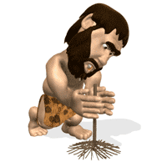
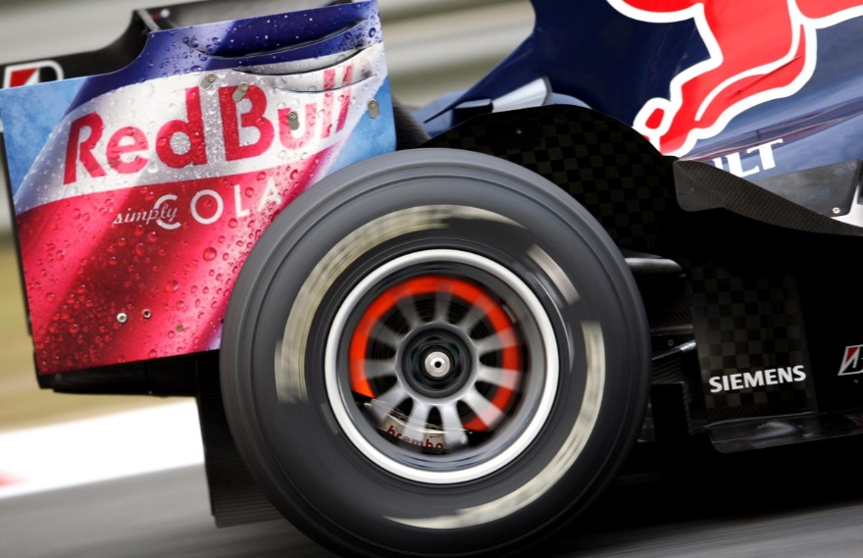
A by-product of friction is heat
Can you think of another example when heat caused by friction is useful?
Can you think of examples where heat caused by friction is undesirable?
Rubbing your hands together
to keep warm
Rubbing sticks together
to create fire
Brakes generate a lot of heat
due to friction
Notes:
Heat generated by friction is sometimes desirable
<click 1>
Rubbing your hands together generates heat and warms your hands.
<click 2>
Can you think of another example where heat caused by friction is useful?
<click 3>
Rubbing sticks together to create fire.
<click 4>
Can you think of an example where heat caused by friction is undesirable?
<click 5>
While the brake discs of a Formula 1 car need to be ‘up-to-temperature’ overheating significantly reduces their effectiveness and can set fire to parts of the car.

Slide 7
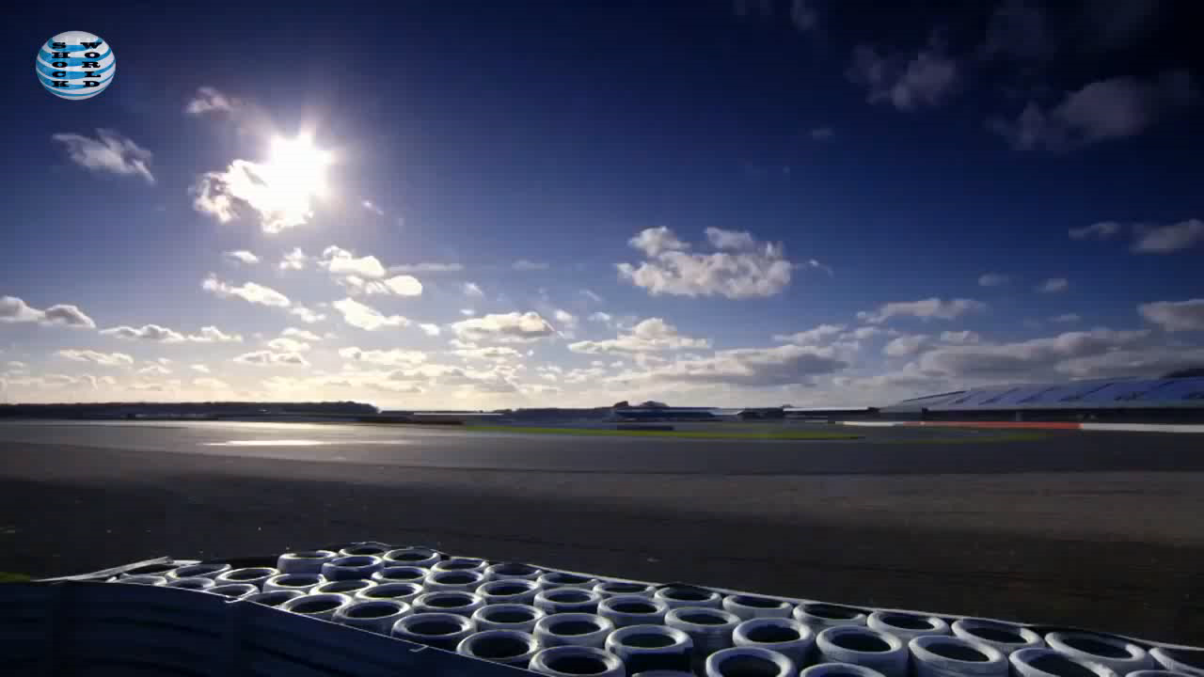
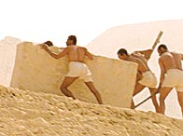
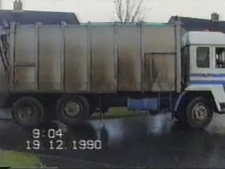
Friction – a force which resists movement
When is Friction useful?
When Friction is bad?
When is low Friction bad?
Notes:
<click 1>
When is Friction useful? (ask the class to give some examples).
<click 2>
This video shows a Red Bull Formula 1 car and a Tyco BMW Superbike braking from 100mph. After the video ask the class why the heavier Formula 1 car had a shorter stopping distance than the motorcycle.
<click 3>
When is Friction bad? (ask the class to give some examples).
<click 4>
Friction is a force that resists movement; whenever you’re trying to move something Friction is always there to make it difficult.
<click 5>
When is low Friction bad? (ask the class to give some examples).
Loss of Friction can be dangerous.
<click 6>
This video shows a refuse truck sliding on ice.

Slide 8
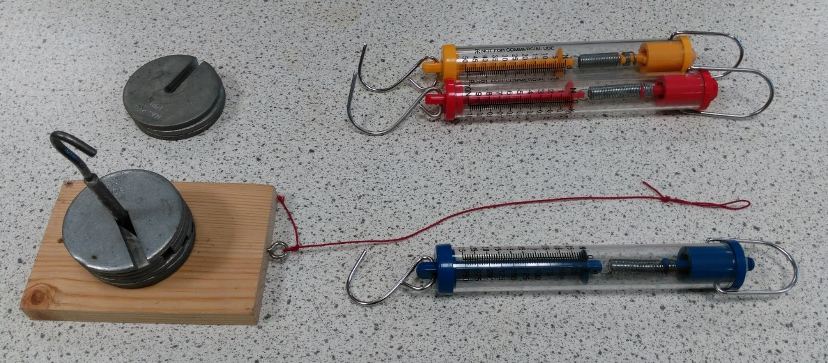
Masses
Spring Force Meter
Friction block
Table top or floor
Choose a pair of surfaces to investigate and measure how the load affects the friction force
The meters have different ranges and different scales. Choose the best ones for your circumstances

Slide 9
Think about suitable loads to test
Why do we want an average of several tests?
Material | Load (grams) | Sliding Friction Force (Newtons)
 |  | Test 1 | Test 2 | Test 3 | Average

Slide 10
Sample Results
10
Rubber
Wood
5
Maximum Friction Force (Newtons)
0
500
1000
Load (grams)

Slide 11
Advanced
Include range bars on your graphs to indicate spread
10
Use the variation in your results to allow you to plot a Line of Best Fit, plus indicate the range of confidence in your data
5
Maximum Friction Force (Newtons)
You can calculate 3 gradients: your best value +/- the limits.
For example: 2.4 (2.2 – 2.7)
0
50
100
Load (Newtons)

Slide 12
Advanced: Sample Results
10
Rubber
The friction force is directly proportional to the force applied to the surfaces:
Friction = μ x compression force
Where μ is the coefficient of friction
Wood
5
Maximum Friction Force (Newtons)
A high value of μ represents large friction. How could this value be reduced?
0
50
100
Load (Newtons)

Slide 13
Advanced
Compare the gradients from your graphs to these sample values
Surface 1 | Surface 2 | Coefficient of Friction
Car tyre | Dry Asphalt | 1.00
Car tyre | Wet Asphalt | 0.20
Ice | Wood | 0.05
Skin | Metal | 0.95
PTFE | PTFE | 0.04
Brick | Wood | 0.60
Note: the coefficient of friction has no units as it is the friction force (N)/surface force (N)

Slide 14
Advanced: Static vs Dynamic (or Kinetic) Friction
10
Starts to move
Once the surfaces start to move, the dynamic friction is usually lower than the static friction
5
Maximum Friction Force (Newtons)
0
50
100
Load (Newtons)

Slide 15
Small compressive force
Large compressive force
Large compressive force
Lubricant separates the surfaces

Slide 16
Advanced: Sample Results
10
Rubber
Wood
5
Maximum Friction Force (Newtons)
Wood plus lubricant
0
50
100
Load (Newtons)

Slide 17
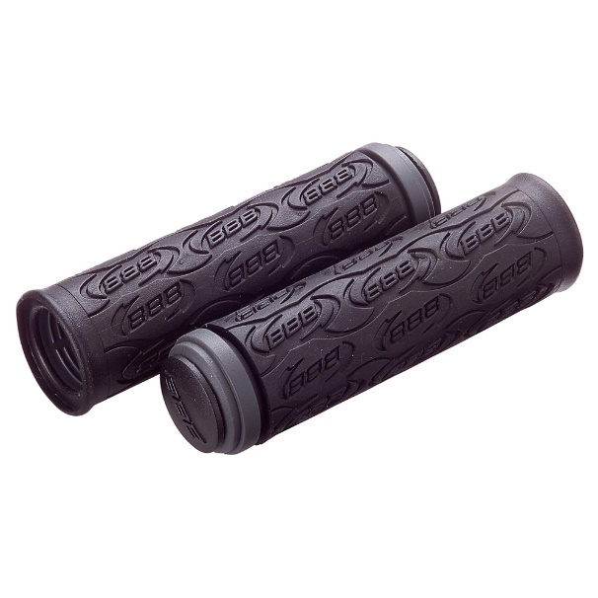
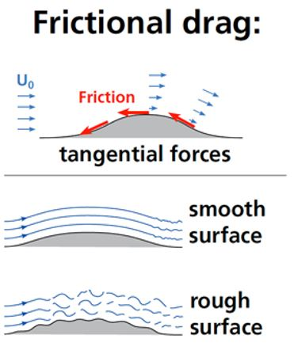

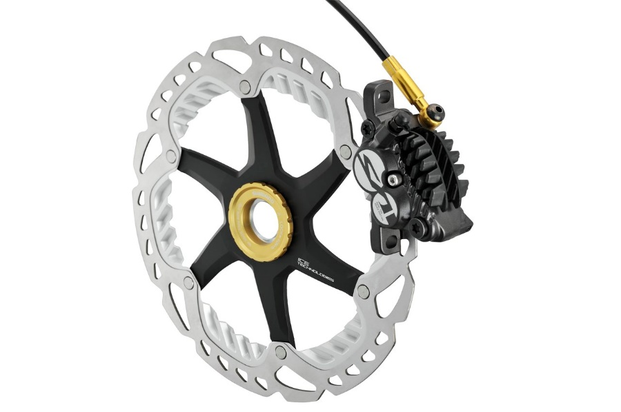
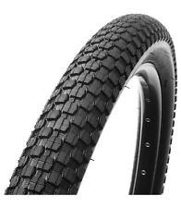
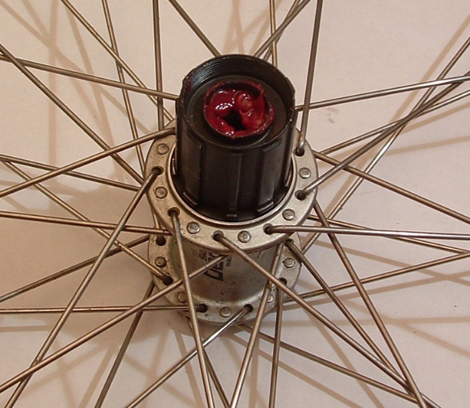
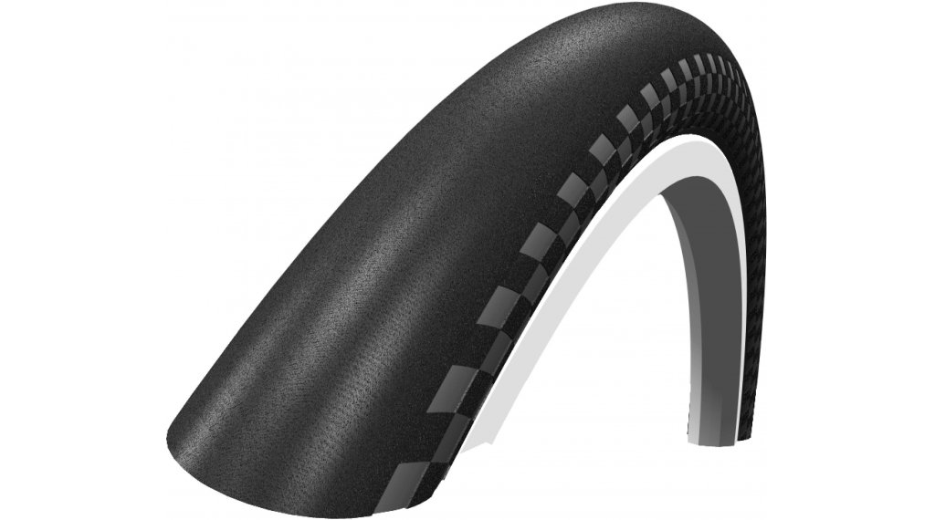
Friction
Good or Bad
Notes:
Now for a review of what you’ve learnt about friction. In the following examples where is friction good or bad and why.
<Click 1>
Handlebar grips: friction is good. The friction exists between your hands and the handlebar grips helping you keep control of your bicycle.
<Click 2>
Disc brakes (for either your bicycle or your Greenpower car. When the brake level is pulled the brake pads are forced in contact with the disc. The wheel is subsequently slowed due to the frictional force slowing down the rotation of the disc.
<Click 3>
Bicycle (or Greenpower car) tyre. The frictional force exists between the type and the road. One tyre has tread the other tyre has non (slick). Which tyre has see greatest frictional force with the road surface?
What happens if the road surface is wet? Which tyre would provide the bet grip and why?
<Click 4>
Ball-bearings in the wheel hub. The ball-bearings contact both the axle and the wheel-hub and reduce friction, why is it beneficial to provide the correct type and amount of lubricant?
<Click 5>
Friction also exists between the outside surface of a Greenpower car and the air it’s passing through. This type of friction is called “frictional drag”. Is the frictional drag low or high with a smooth surface or rough body surface.
The analysis of frictional drag can be done using a CAD model of a Greenpower car using CFD software (Computational Fluid Dynamics).
The following slide shows a CFD analysis of a Greenpower car. <Click 6>

Slide 18
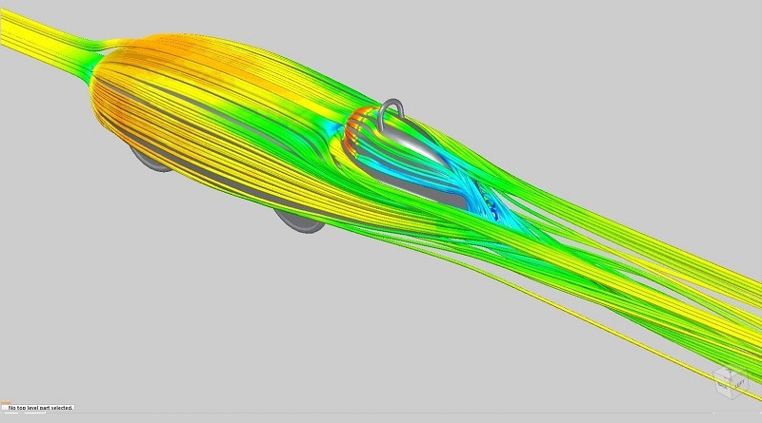

FloEFD for Solid Edge
CFD analysis of Jet II
Cullimore Racing
www.cullimoreracing.com/jetii

Slide 19
Friction
Learning aims
Knowledge | Skills
Friction is a force which acts to resist movement Friction is a force which is affected by the surface materials Friction may be increased by load, and decreased by lubrication Where is Friction desirable, and where is it undesirable | Working collaboratively Selecting appropriately scaled instruments Using analogues force meters Reading linear scales Gaining confidence in practical skills Evaluating data quality

