Slide 1
Digital Twin
Digital Solutions for the Water Industry
September 2021

Slide 2

Today’s Drinking Water business is facing many challenges
Water
quality
Variable
Electricity
tariffs
Water loss
/ NRW
less energy
/ less CO2
Aging
Workforce
Cost
Efficiency
Security
of supply
Critical
Equipment
Carbon
footprint
Standardi-
zation
Energy Audits
(ISO 50001)
Operational
Transparency
Cyber
security
Maintenance
& Upgrades
Legislation
Penalties
Bad
publicity
Notes:
There exist many challanges in the water industry which are derived from the current Megatrends like climate change, urbanisation demographic change and digital technologies.
The main task of water companies is to secure the supply of water:
Sometimes companies are not aware how much and where a substantial portion of water is lost through leaks in water networks (NRW)
The status of critical equipment and the knowledge about the probability to fail within a certain period of time is not known.
They have to ensure water quality on the way from the Water treatment plant to the end-user.
The introduction of computerised systems to the water industry over the past twenty years, has resulted in an abundance of valuable data that often sits unused or under-used, on disconnected systems.
Most of the challenges, which water transmission companies have been facing over the last decades can be mitigated or even overcome by applying state of the art data analytic technologies.

Slide 3
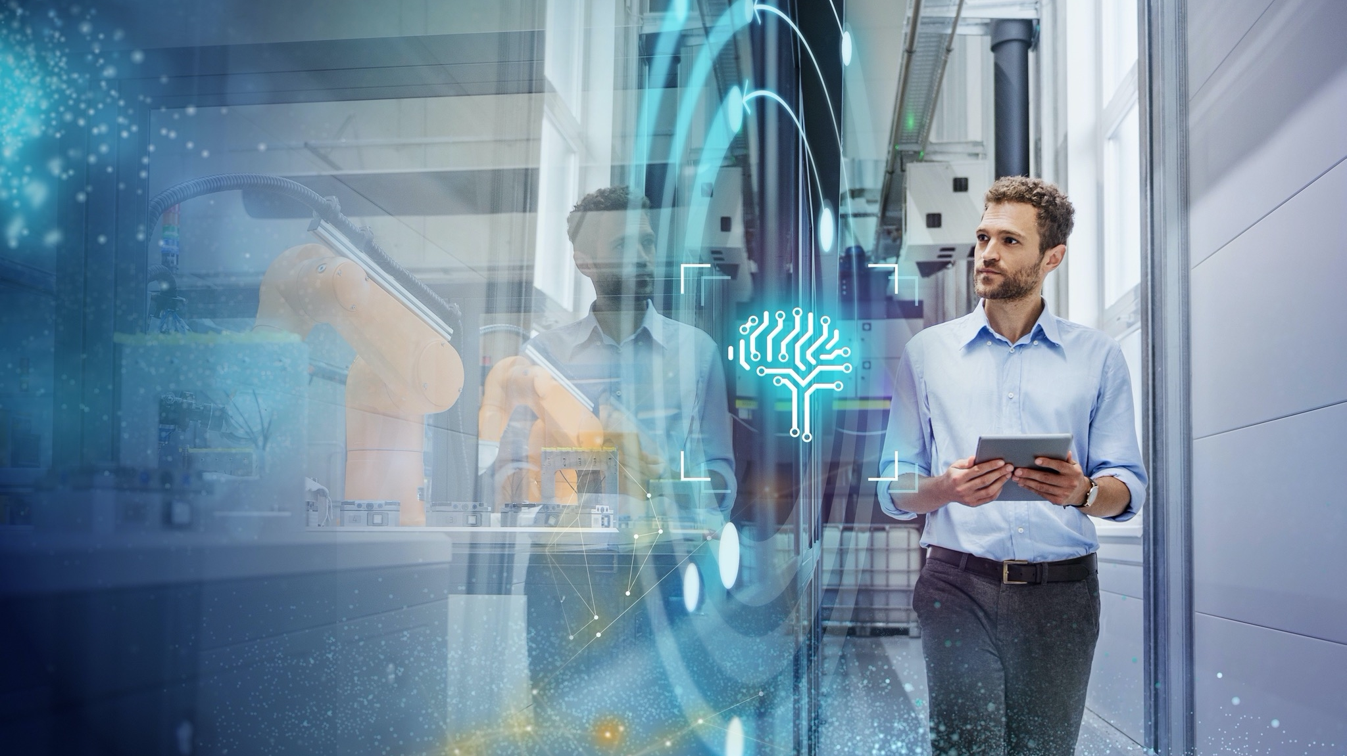
Missing capabilities in big data analytics means missed opportunities
Notes:
We want to support our customers to utilize their data and seize their opportunities.
And this can be achieved by Digital Twins.
Before we present you different kind of digital twin solutions we should have a look on the definition of a digital twin

Slide 4
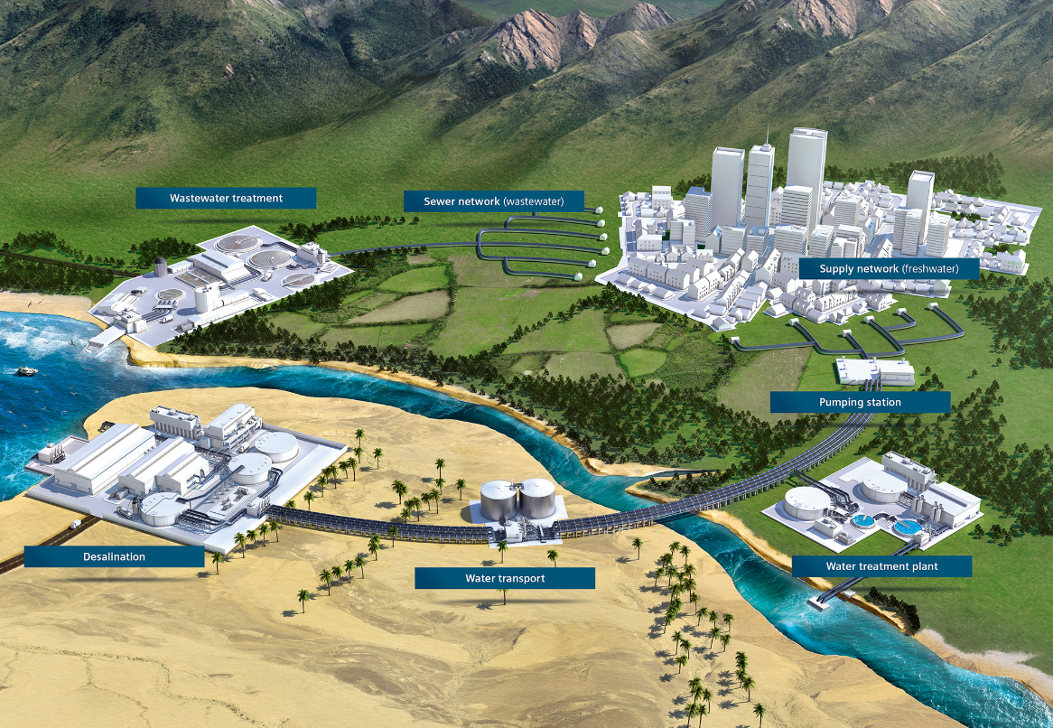
What is meant by a "digital twin“ ?
The digital twin shares 3 elements:
The real plant with real time data and operational data
The virtual twin with context and characteristic data
And an information model which is used to integrate the two
The digital plant twin is an image of the entire plant and is used throughout the entire life cycle.
digitale twin uses real data from the process
digitale twin is a component of the integrated Engineering
digitale twin is a component of Integrated Operation
The digital plant twin provides a decision support over the entire life cycle

Slide 5
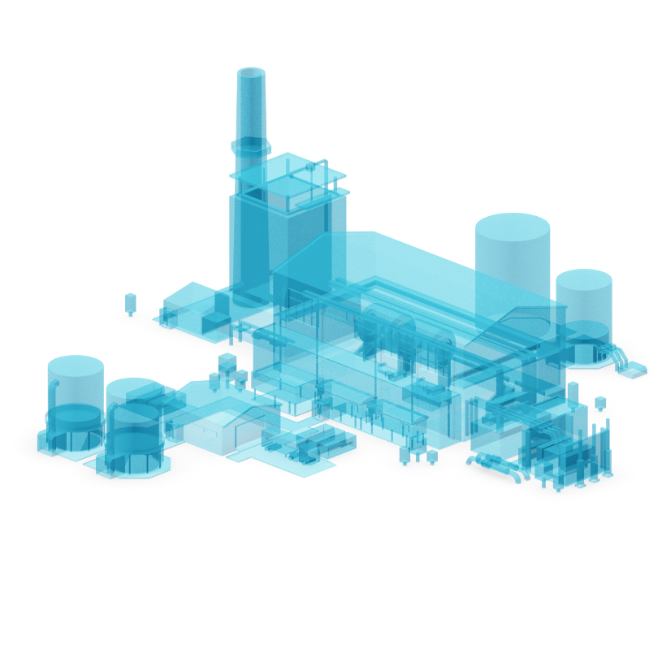
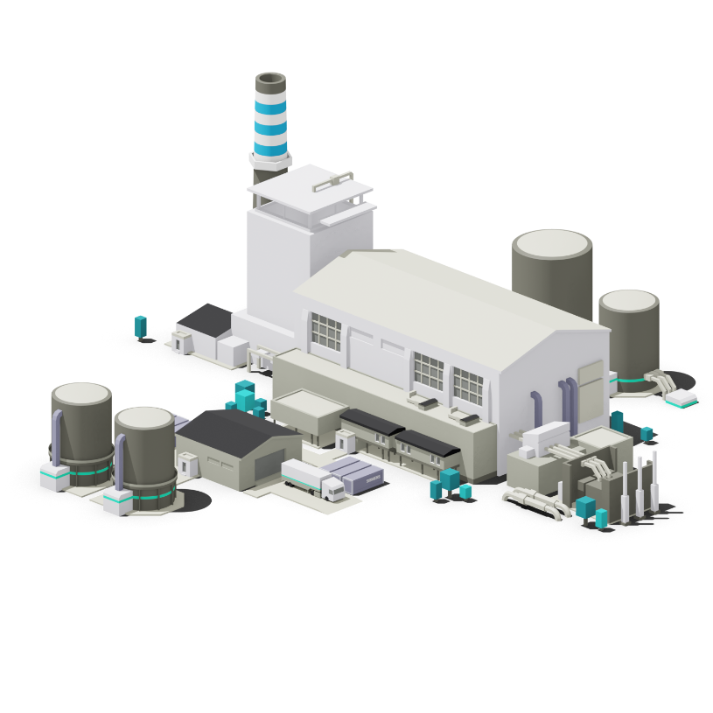
03
Digital Plant Twin
04
Digital Process Twin
05
Digital Performance Twin
06
Digital Asset Twin

Slide 6
Databases
Datasets from many different sources in the transportation process offer value that is not being fully realised
as of now.
Module packages
Cloud
Construction
Data
Excel
ERP
Laboratory Analytics
RTU
DCS/SCADA
systems
Water quality
Metering & Billing Systems
Enterprise Systems
Files
Notes:
Water transmission industry today is usually highly automated and generates an abundance of complex data that could be of huge value.
However, the data is scattered over disparate silos. So here you see a number of important systems, where tons of data are generated, which is sometimes difficult to retrieve and consolidate in a useful format.
Sometimes also complex customer organizations and the allocation of data responsibility to separate departments is aggravating the situation.
Collating and validating this data manually can be very time consuming and it happens that the data is either incorrect or quickly out of date.
In addition, the complexity of water transmission processes means that domain knowledge is essential to really understand the results.
→ Datasets from many different sources in the transportation process offer value that is not being fully realised as of now.

Slide 7

Challenges of our customers
How to manage
BIG Data?
Unstructured and untagged
data and documents
Different data storage locations
Where is the application?
Finding current and valid status
Notes:
Every plant or asset has documents and information which are scattered across various
platforms and are available in various formats. Its is hard to find and access specific information.
Besides the information being spread across silos, the relation between different pieces of information is not visible, this is what we call “unexploited data”.
Types of unstructured/unlinked data in different formats are: 1D (datasheets, lists, records), 2D (drawings, connectivity), and 3D (physical layout, geometry).
To solve this issue Siemens and Bentley Systems developed PlantSight which is an open, cloud-based solution
Plant Sight makes it possible to collect, connect, contextualize and validate and finally make use of this data, creating
a complete, reliable and updated digital twin of your plant.

Slide 8

A digital representation that provides an immersive view of reality
Identical
twins
Identical data for
all lifecycle phases
One data model on all levels, consistency in communications
Digital Twin
Real-World
Notes:
A complete and evergreen digital twin enables you to gain actionable insights and achieve a new level of collaboration across all disciplines and all levels.
Activities such as bad actor identification, reliability of critical assets, triggering of maintenance or modification activities, change management, and many
others, are then possible via a unique, real-time updated digital asset portal.
Plantsight creates a digital twin, with identical data for all lifecycle phases.
It is important that both, the digital twin and the plant in the real world use the same data model on all levels which provides consistency in communication.

Slide 9
PlantSight
Brings Together Virtual with Real Time Data
HANDOVER
PlantSight
INFORMATION DATA MODELL
Design Data
Alarms
Virtual
Plant
Real
Plant
Simulation Data
Real Time Data
1D/2D/3D Data
Historical Data
CHANGE MANAGEMENT
Notes:
PlantSight – A Cloud Solution Advantages of Software as a Service
Easy Enabler: Start to use the solution by accessing the solution with a web browser by the first day → Low starting costs without barriers
Scalable and Flexible
Considered over the life cycle of a project:
First phase "Design": Dealing with complex project requirements, short implementation time and strict regulatory requirements ( project management ).
With the help of the digital twin, the impact of different design alternatives can be explored and simulations and tests can be carried out to ensure that the project design meets the requirement.
Second phase "construction": the digital twin can help achieve better efficiency, quality and yield during construction.
Third phase "Operation (operate)":
The digital twin can be used to improve the availability and efficiency of processes.
In addition, the digital twin can be used for migrations / maintenance / expansions / conversions, e.g. for planning or the evaluation of expansion potentials.
The connection of the real and virtual world enables the analysis of data, problems can be detected at an early stage or in time, before errors arise.
Downtimes can be avoided. With the digital twin, scenarios can be created away from the actual plant in order to better plan conversions, expansions, etc..
Such scenarios can also be used to optimise operating sequences and processes before going into an expensive proof of concept.
Simulation for the engineering phase / commissioning phase
Simulation for optimising operating procedures
Simulation for planning extensions / conversions / maintenance and servicing

Slide 10
PlantSight
The scalable concept for the Digital Twin
Digital Enablement
Digital Reliability
Design Data
Digitalization
Brings these worlds of
information together
Quickly
Reliably
Consistently
Seamlessly
Origins of data and
access to visualization tools
should be transparent to the user
Alert Data
Simulation Data
Real Time Data
1D/2D/3D Data
Historical Data
Virtual
Plant
Real
Plant
Process Model Data
Optimization Data
Forecast Data
Equipment Data
Asset Data
eLog Data

Slide 11
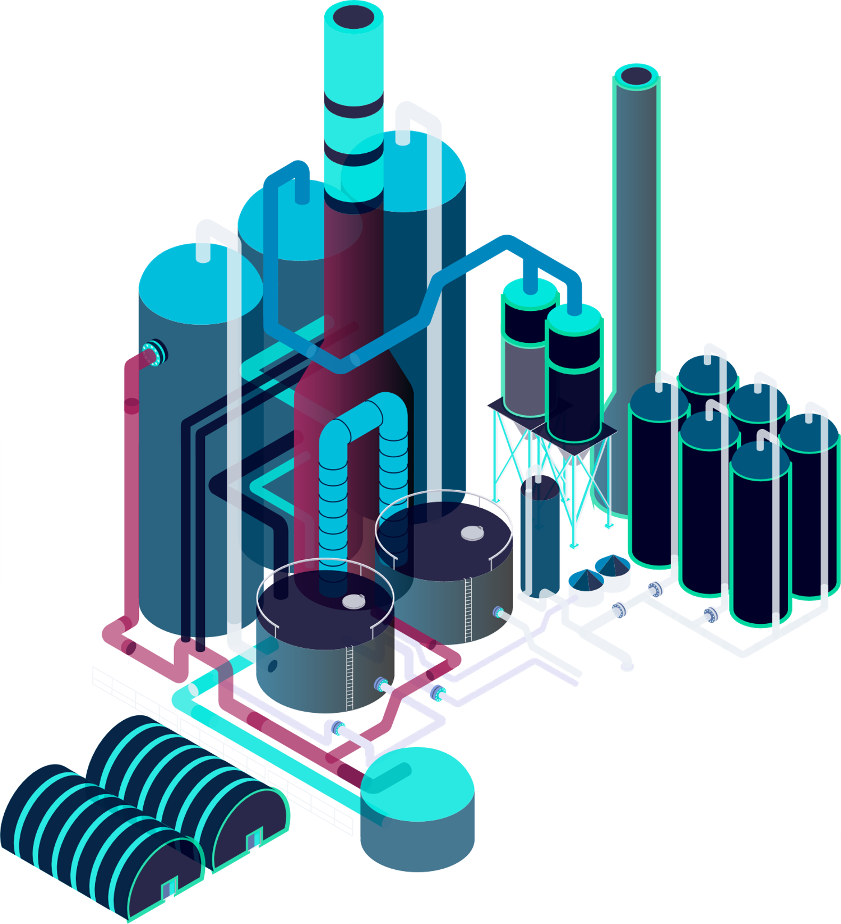
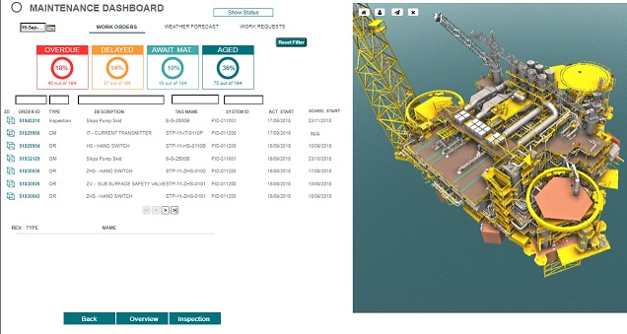
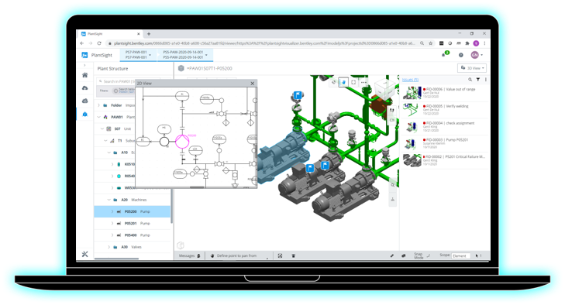

PlantSight
In a Nutshell
Challenges
today
Silos of data, hard to find,
validate, organize and use.
Unplanned downtime
Equipment and Process failures.
Inaccurate decisions causing loss
in safety, performance and quality.
Value Proposition
Consolidate
Controlled data handover to establish the Evergreen Digital Twin with aggregated, connected and contextualized information.
Collaborate
Asset web portal to access contextualized data from all relevant sources with embedded VR capabilities.
Gain insights
For fast and accurate decisions like
bad actor identification in context
with possible countify actions.
Static Data
Dynamic Data
1D
2D
4D
Plan
Time
Series
Docs
3D
5D
Costs
ERP
Benefits
Contextualized search and find – better and faster decisions at your fingertips
Increase asset availability
Improve workforce efficiency
Lower total cost of asset ownership
Reduction in environmental incidents
Reduction in injury rate
2.5%
5 – 10% improvement
across the lifecycle
2.5%
Increased safety and optimized production
8 – 20%
18%
39%

Slide 12
Siemens drives the Digital Enterprise for process industries –
Five main action fields and selected portfolio highlights
p
Real
world
Performance data
Integrated Engineering
Virtual
world
COMOS / PAA /
PCS 7 / SIMIT
Connectivity
Industrial Network Management and Cyber Security
Simulation
PSE¹
gPROMS
Realize and optimize
Future of Automation
Standardization
Plant Management System
Operator Assistant System
Operation Optimization
1 | PSE – a Siemens company
Application Suites
Unrestricted © Siemens AG 2021
Page 12

Slide 13

A Roadmap to success – Our Digital Transformation Journey drives scalability and customer value
Digitalize & Transform
Predict & Analyze
IIOT VALUE GENERATION
Connect & Monitor
IIoT out of the Box
IIoT Ideation
Start to investigate
opportunities of IIoT
for your business
Implement a
first IIoT Proof of
Value project
Scale a first IIoT Solution
to additional Assets and
start to generate value
Implement a tailored IIoT
solution for your specific
use case and scale
Maximize your value
add by digitally transforming
your industrial set-up
Consulting
Customer Value Co-Creation
Full Implementation & Scale Up
DIGITAL TRANSFORMATION JOURNEY
Notes:
How can your digital transformation journey look like?
It can only start with the awareness of the customer that something has to change
Siemens can offer help customers with the ideation process and investigate opportunities based on real use cases
Once low hanging fruits have been identified then we can start implementing the most promising use cases and do a proof of value
Based on the experience of the PoV a new digital landscape can be designed and a roadmap for rolling out the identified use cases can be created
Scaling up the first use cases to additional assets and carefully monitor the results. Extend use cases to further plants if applicable
Based on the success roll out of other use cases can be started
Review landscape and roadmap continually
Go and implement all use cases and maximize the value of your digital enterprise

