Slide 1
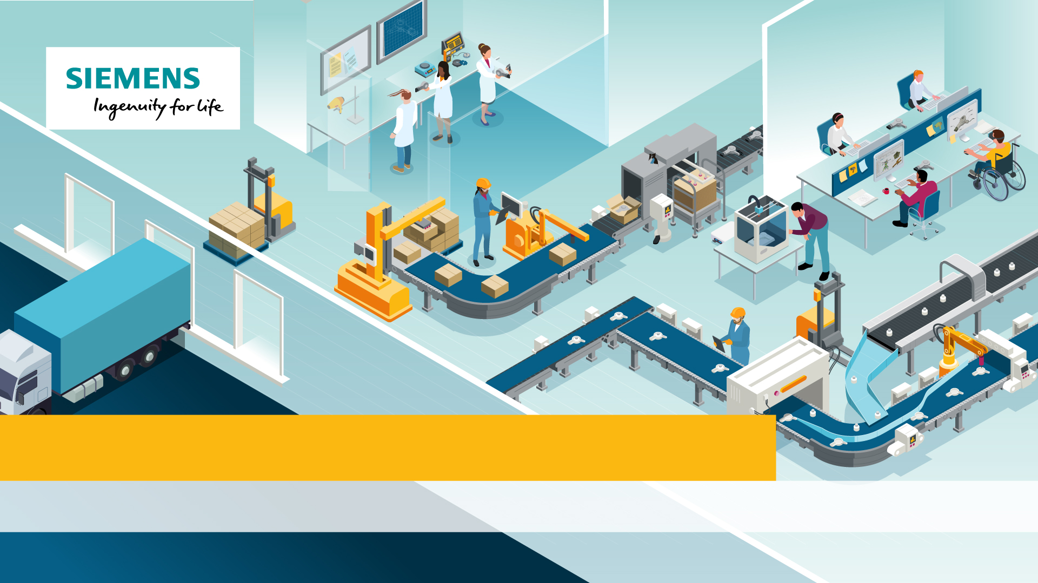
Siemens NX: Designing The Future
Episode 1: Where do Products Come from?

Slide 2
Objectives
This episode is designed to get you to understand:
    The product lifecycle of an everyday product
    The people involved in a product’s lifecycle
    How digital technologies such as Siemens NX and Product Lifecycle Management are beneficial to product development
Notes:
Introduce the learning objectives. This lesson examines Product Lifecycle Management in the context of the design, manufacture and distribution of a hairdryer.

Slide 3
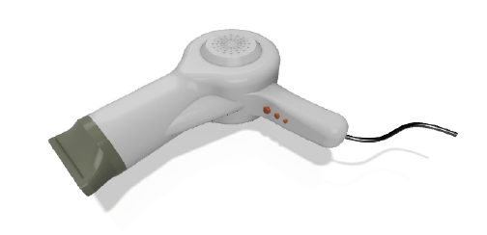
What are engineered products?
Engineered products are all around us. They are complex products with multiple precision made components that require several different processes to make them. For example:
Your hairdryer
      Where did it come from?
      How was it made?
      Who made it?
Notes:
Start students thinking about where products come from, and introduce the key questions for the lesson.

Slide 4
Where did it come from?
Like all engineered products, your hairdryer has been designed, manufactured and then distributed as part of it’s product lifecycle.
Challenge 1: The Lifecycle of a Hairdryer
    Cut out the boxes on your worksheet and arrange them into a flowchart.
    Which should come first?
Notes:
In this part of the session, students should try to work out the best order for the boxes from challenge 1. They could do this in pairs or individually.

Slide 5
Designing the Future Interactive
Use the Designing the Future Interactive to check your answers.
    Were you correct?
    Were there any surprises?
    What are the limitations of creating a flowchart to show the product lifecycle?
Notes:
Students should now check their answers against the Designing The Future Interactive. Question students on how the interactive effected their decisions and use the answer sheet feedback the correct order. For higher level students, question the limitations of a flowchart for Product Lifecycle. Ask students to assess whether product lifecycle is a linear process – they should be considering the iterative nature of the design, make and evaluate process. You could link this to their project work, or to everyday tasks where the aim is constant improvement in many cycles.

Slide 6
Product Lifecycle Management
Coordinating all of the processes and people involved in developing a product is a complex task. It requires a Product Lifecycle Management Strategy and specialist software and systems to implement it.
Challenge 2: Product Lifecycle Management
Using the Designing the Future Interactive and the worksheet information, answer the worksheet questions.
    Who uses PLM software?
    How does a PLM strategy improve sustainability?
Notes:
Students should now explore Product Lifecycle Management more deeply using the Designing The Future Interactive and answer the questions. Use the questions to initiate discussion about how PLM software allows for greater collaboration between professionals, with emphasis on how Teamcentre could enable collaboration between teams across different companies internationally. Also discuss each aspect of sustainability; economic, environmental and social. Feedback worksheet answers.

Slide 7
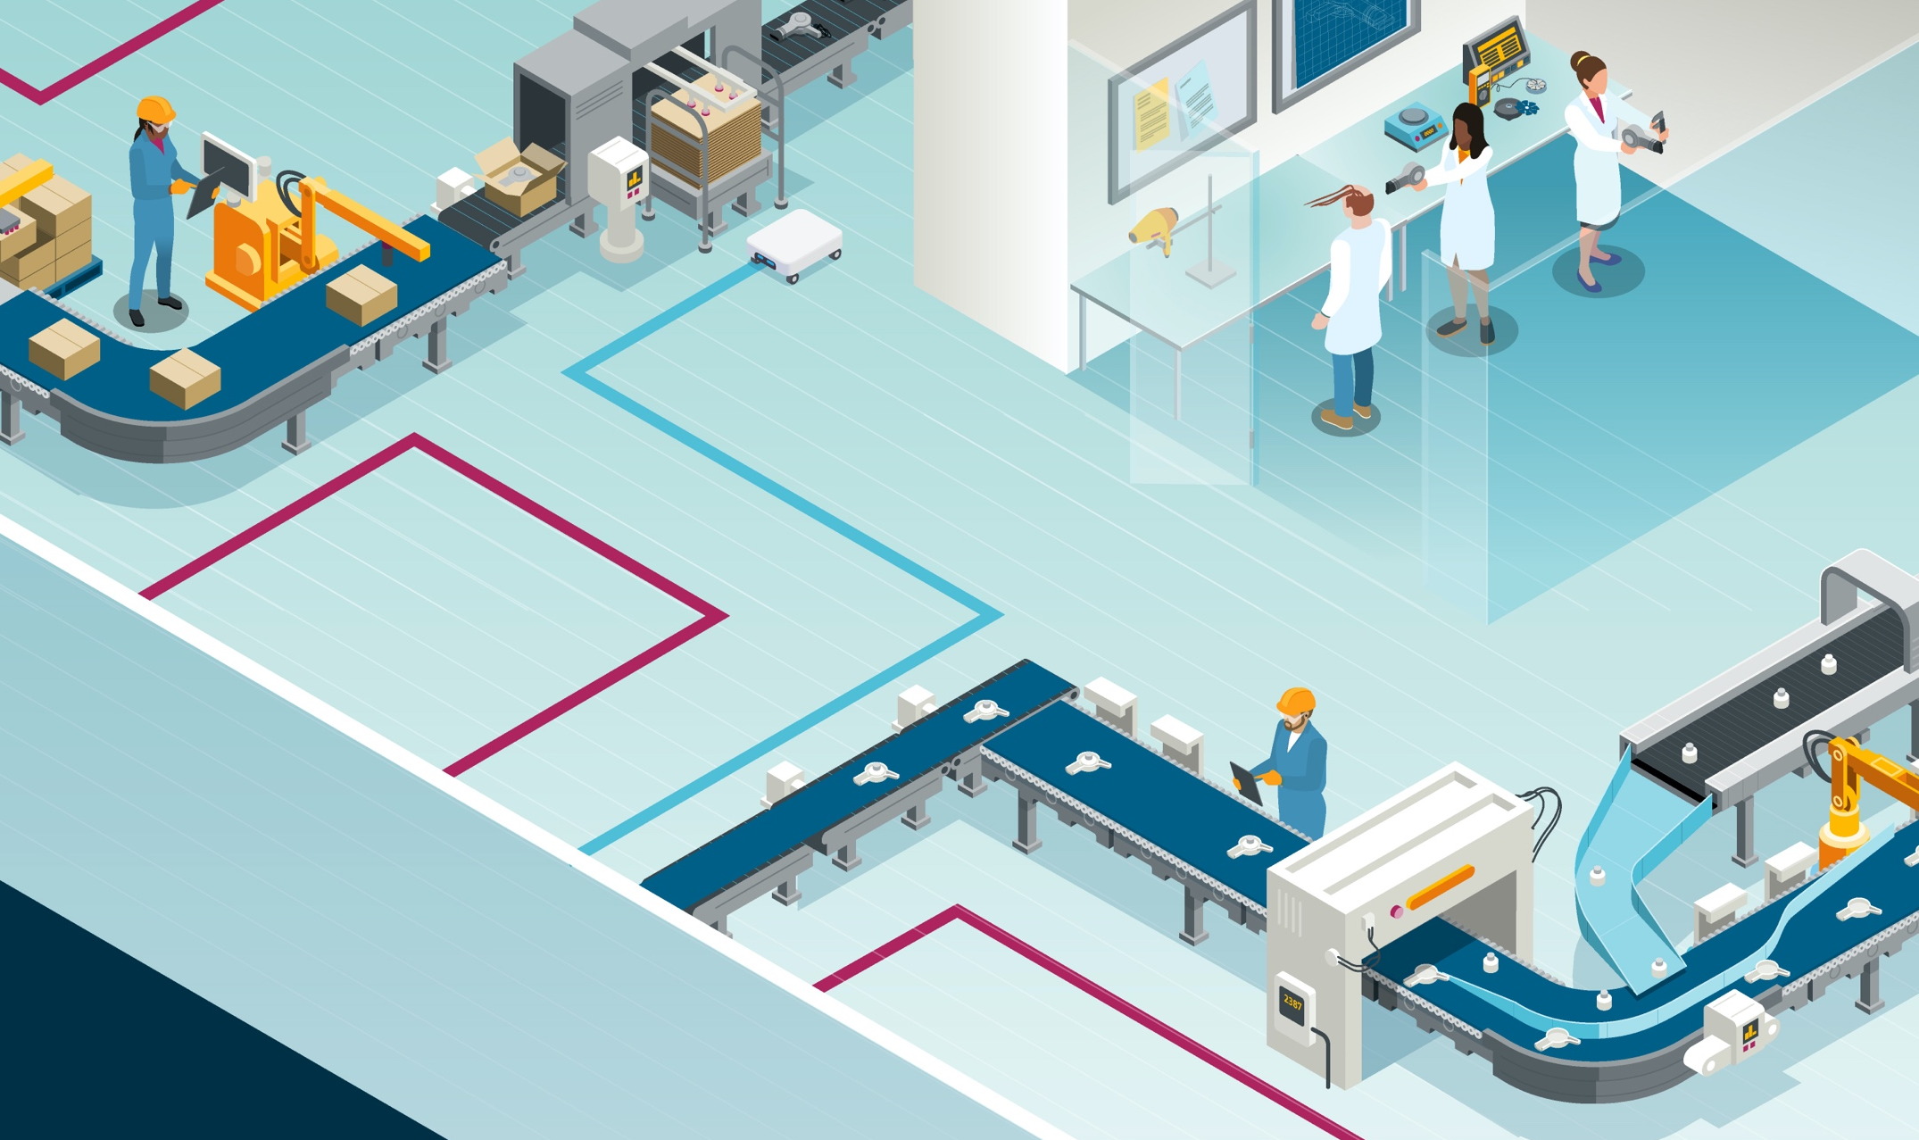
PLM and Industry 4.0
Digitally integrated systems such as PLM software are changing the way that industry operates. Our factories are becoming Smart Factories, where PLM systems interact with Internet of Things enabled machinery and where manufacturing processes use artificial intelligence.
Who benefits from these developments?
Notes:
Industry 4.0 refers to the Fourth Industrial Revolution. This is the age where industry is highly digitized and connected, and uses IoT and AI enabled machinery, as epitomised in the Smart Factory. Discuss the benefits in terms of professionals (safety and workflow), companies (efficiency and profitability), the product user (quality of product at a lower price), and all people due to the increased sustainability more broadly.

Slide 8
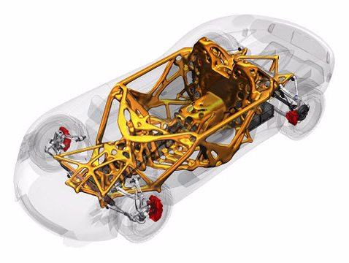
Siemens NX Software
Many engineered products that you will have encountered will have been modelled and engineered using Siemens NX – including cars, toy building blocks, construction machines, sports equipment and medical equipment.
As well as fully integrating with PLM and manufacturing, Siemens NX has powerful features such as generative design.
Notes:
Explain the features of Siemens NX and it’s application in industry. Siemens NX can integrate fully with PLM and is used across many industries including automotive and aerospace. The image shows an example of generative modeling, where advanced geometric models are generated digitally using constraint and material data, such as the chassis of the car shown above.

Slide 9
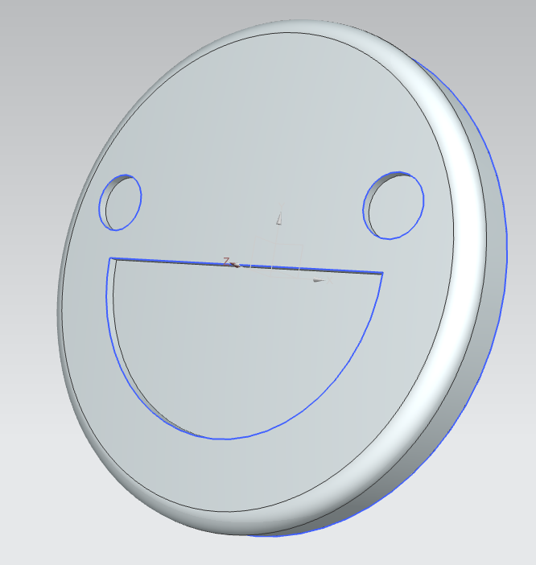
Siemens NX Challenge
Many engineered products that you will have encountered will have been designed and engineered using Siemens NX – just like the hairdryer in Challenge 1 and Challenge 2.
You can use NX to design and engineer your own projects. Follow the Step by Step in Challenge 3 to design your own emotion badge.
Notes:
This activity introduces students to the basics of CAD modeling, including sketches, extrusions and fillets. You will need Siemens NX education installed on your institution machines. If you have a 3D printer, you could get students to print their badges. If you 3D print in ABS, badge pins could easily be attached to the back surface using a cyanoacrylate adhesive, following all safety measures detailed on the adhesive instructions.

Slide 10
Siemens NX Reflection
    How did you find using the Siemens NX software?
    What are the advantages of using CAD packages such as Siemens NX?
    What were the challenges?
    Who benefits from the use of CAD?
Notes:
Challenge students to consider the advantages of CAD design.

Slide 11
Questions to think about
    How are engineered products made?
    Who is involved in making them?
    How do digital technologies such as PLM and NX software help this process?
Notes:
Plenary Questions: Use these questions to challenge students learning for the episode. Break each question into sub questions as you go, such as ‘Who does the designing? Or ‘Who plans the manufacturing’. Consider the benefits of PLM and NX for all stakeholders – the user, the designer, the manufacturer, the distributor and the impact on sustainability.

