Slide 1


Topic 10: Now hear this
www.siemens.co.uk/education
© Siemens AG 2012. All rights reserved.

Slide 2
Now hear this
Overall learning objectives:
Developing a sense of scale and proportion with regard to measurement
of frequency and loudness and how these can be represented graphically.
Understanding the process of hearing and the use of loudness and frequencies to compare sounds.
Identifying the key factors in a design brief and using a block diagram
to represent a system.
Introduction: Now hear this

Slide 3
Now hear this
Overall learning outcomes:
To explain how the human ear works and responds to sounds of different intensities and frequencies.
To describe how hearing loss might occur and the effects it might have.
To develop a design for a hearing aid, showing how it allows for a range
of design requirements.
Introduction: Now hear this

Slide 4



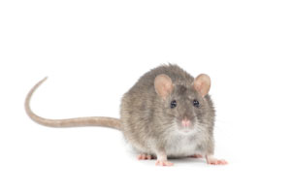

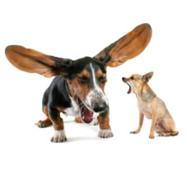
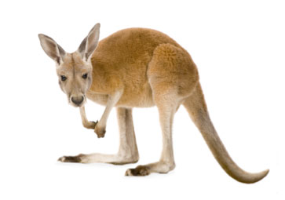
Now hear this
Now hear this
Episode 1: Now hear this
Notes:
Draw attention to the directional nature of sound and that some animals, such as cats, can direct their ears to pick up sounds from different directions.
Ask why some ears are small compared to the size of the animal whereas other animals have (relatively) large ears. Explain that large ears may confer a survival advantage (being able to detect predators or locate prey) but are vulnerable to attack and may be damaged. Point out the hairs and ask for ideas about the importance of preventing small objects from entering.

Slide 5
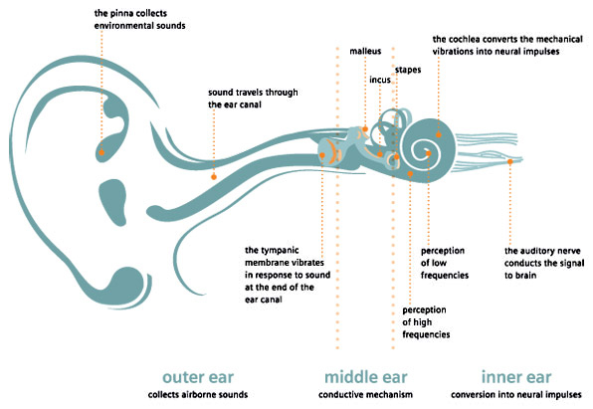
Now hear this
The inner and outer ear
Episode 1: Now hear this
Notes:
Explain the workings of the human ear:
The outer ear gathers sound waves and funnels them into the middle ear, thus concentrating the energy. They reach the ear drum and cause it to vibrate. Louder notes cause greater vibrations; higher notes cause more rapid ones.
The middle ear transfers those vibrations through three tiny bones (the smallest in the body). Their delicate structure means that they have to be protected by being within the skull; blows to the head or loud noises can damage them.
The inner ear includes the cochlea into which the vibrations enter; this has nerve endings around the spiral structure. Higher frequency notes travel further around the cochlea and are detected by nerves nearer the centre. The nerves convey impulses to the brain which indicate loudness and frequency.
The inner ear also contains the semi-circular canals which control balance.

Slide 6
Now hear this
How would hearing be affected by:
Having a large outer ear (more sensitive hearing).
Having an outer ear that could be directed (more directional hearing).
Having an ear drum that was perforated (hearing loss).
Having one of the bones in the middle ear knocked out of alignment (hearing loss).
Having an infection in the ear (hearing loss).
Episode 1: Now hear this

Slide 7
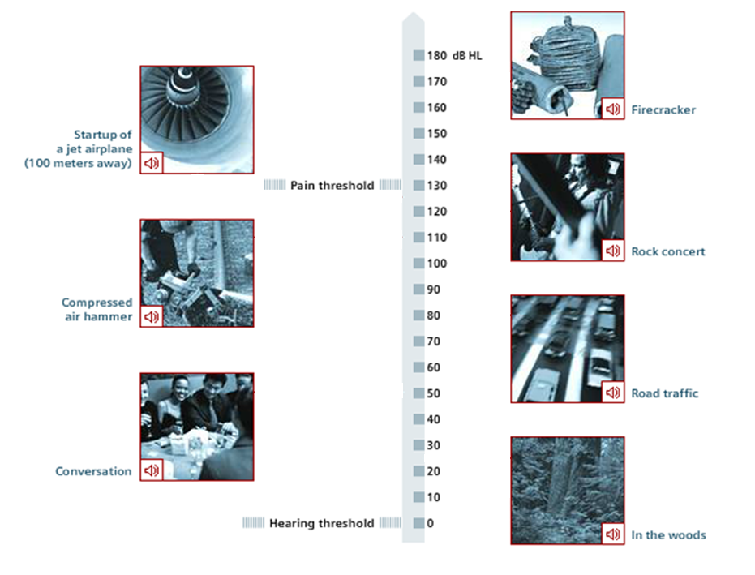
Now hear this
Scale of hearing
and pain threshold
Episode 2: Now hear this
Notes:
Explain that loudness is a term used by scientists to measure how loud a noise is perceived to be and is measure using the decibel.
Say that for example normal conversation is at around 50-60dB and that no sound is 0dB. Add that pain through loudness starts at around 130dB.
Use student support sheet 10A to present to students a scale of loudness with conversation and pain threshold marked in and ask them to place other examples on it.
Link to demonstration – How we hear to check responses. http://hearing.siemens.com/UK/en/hearing-loss/how-we-hear/how-we-hear.html

Slide 8
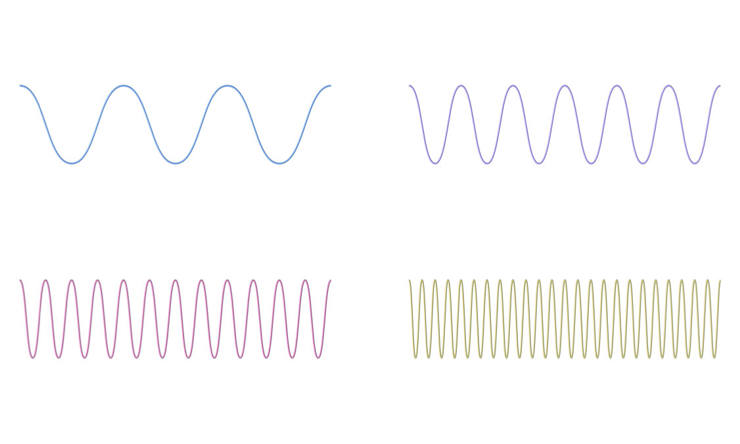
Now hear this
160Hz 84Hz 120Hz 300Hz
Waveforms and their frequency
Episode 3: Now hear this
Notes:
Explain that sound travels in vibrations and that we can think of these as waves. Like waves they have regular form.
Show students a number of waveforms and ask them to place them in order of frequency using student support sheet 10B. Then ask them to match them up with the frequencies and finally ask them to explain why the notes will all be as loud as each other. Take feedback.

Slide 9
Now hear this
Consider the various causes of hearing loss:
Exactly how that situation may cause hearing loss.
The nature of the effect on the person.
How this effect can be eliminated.
Episode 4: Now hear this
Notes:
Ask students to suggest various causes of hearing loss. Gather and display them.
Ask students to work in small groups to conduct research and summarise their findings.
Share ideas. Emphasise the importance of this task is not only to identify causes and preventative measures but also for the m to work efficiently and effectively to access information and present ideas.

Slide 10
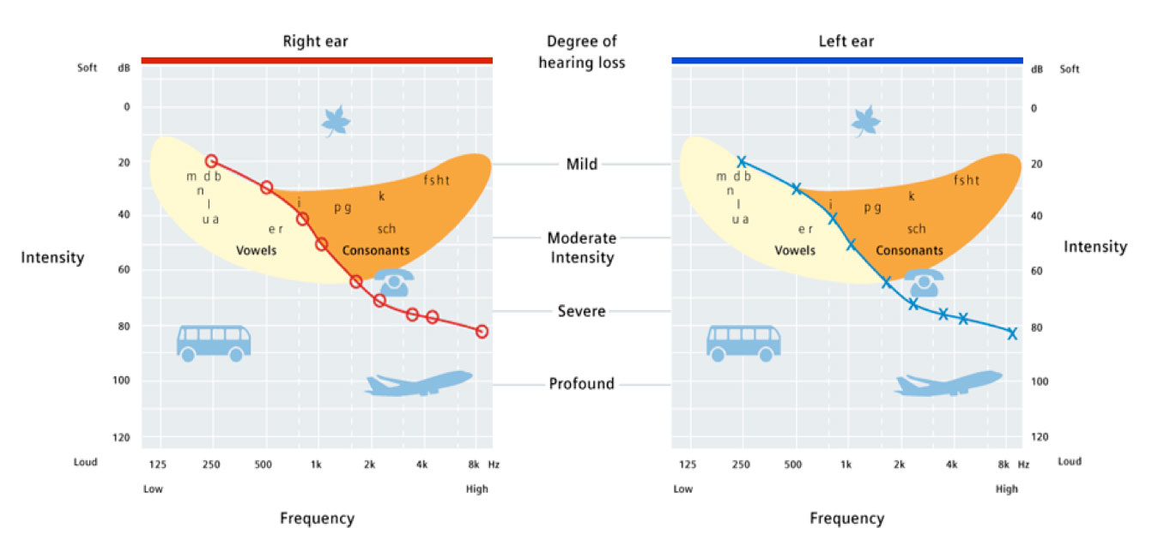
Now hear this
Degree of hearing loss
Episode 5: Now hear this
Notes:
Explain that you are going to run a hearing test. Say that the purpose of this is to show how hearing tests are set up, not to actually test their hearing. Explain that in order to do this they would have to be tested individually and use headphones so that each ear could be tested separately. Please use student support sheet 10B to illustrate this further.
http://hearing.siemens.com/UK/en/services/hearing-test/hearing-test.html
Ask students to reflect on the hearing test. Distribute student support sheet 10C and draw attention to the examples included such as the bus and aeroplane. Ask students to consider the groups of consonants and vowels provided and consider whether they are lower or higher frequency.

Slide 11
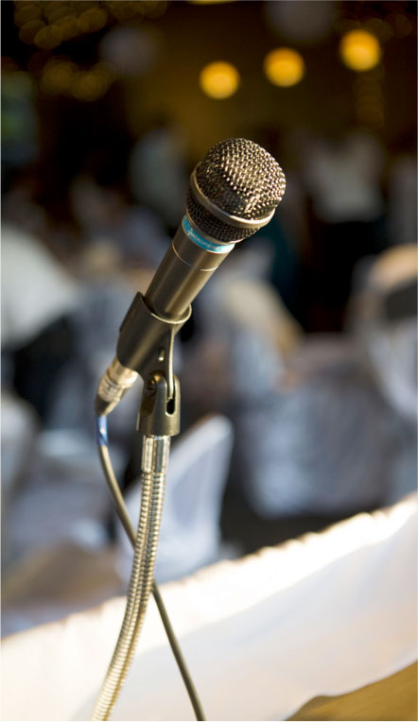
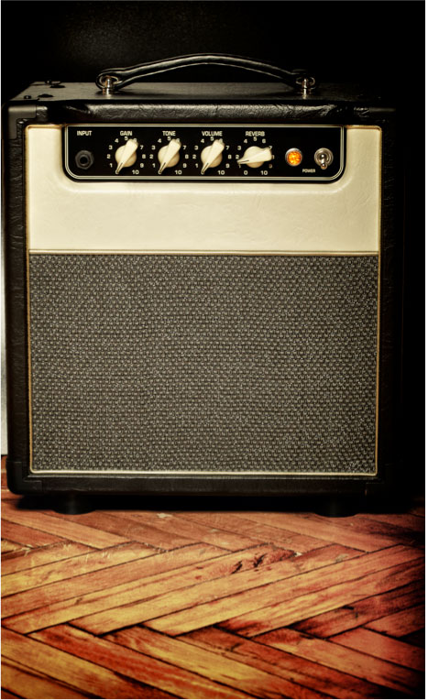
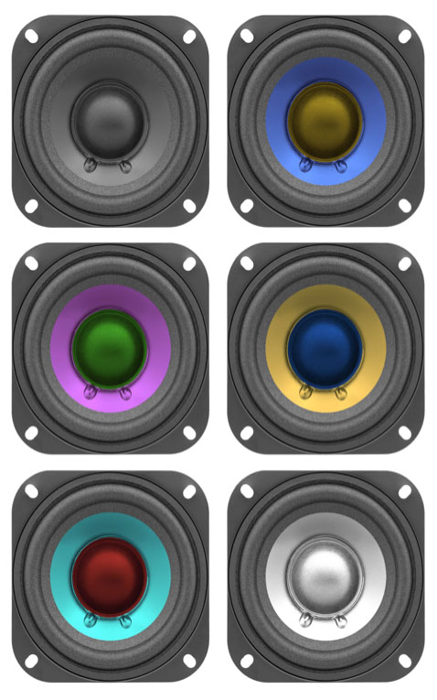
Now hear this
Microphone, amplifier, loudspeaker
Episode 7: Now hear this
Notes:
Show the students a picture of a PA system and ask them to identify the key components and suggest their purposes.
Draw out that the microphone is to pick up sound, the amplifier to increase the size of the signal and the loudspeaker to transmit a louder sound.

Slide 12
Now hear this
Input
Process
Output
The basic function of a hearing aid
Episode 7: Now hear this
Notes:
Explain that a way of representing this is to use a block diagram showing input, process and output and that this relates to the information, or signal.
Explain that the purpose of this system is to show what happens to the information, not the power. This applies to many other systems as well including:
TV
Computer
Radio
MP3 player

Slide 13


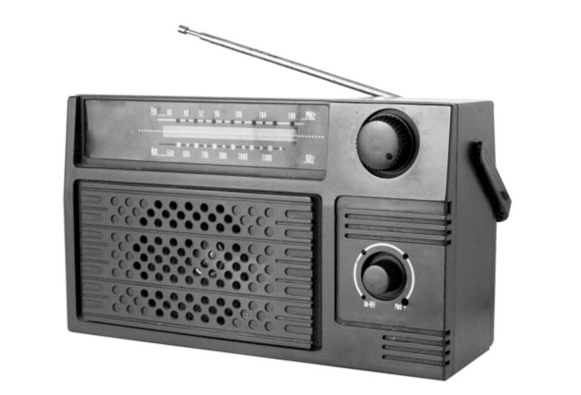

Now hear this
Identify input and output
Episode 7: Now hear this
Notes:
Explain that the focus at this stage is to identify the input and output rather than to understand the detail of the processor functions. Emphasise that the input refers to information and not to energy. The power supply is not a signal input (even though it is essential)
Point out that a hearing aid can be thought of in the same way as a large scale PA system –designers need to consider input, process and output.
Ask students to think about how, in design for a hearing aid, they might allow for the input, process and output. Ask students to work in small groups to develop some ideas about where these might be located and to reflect on other considerations as well including power supply and vanity.

Slide 14
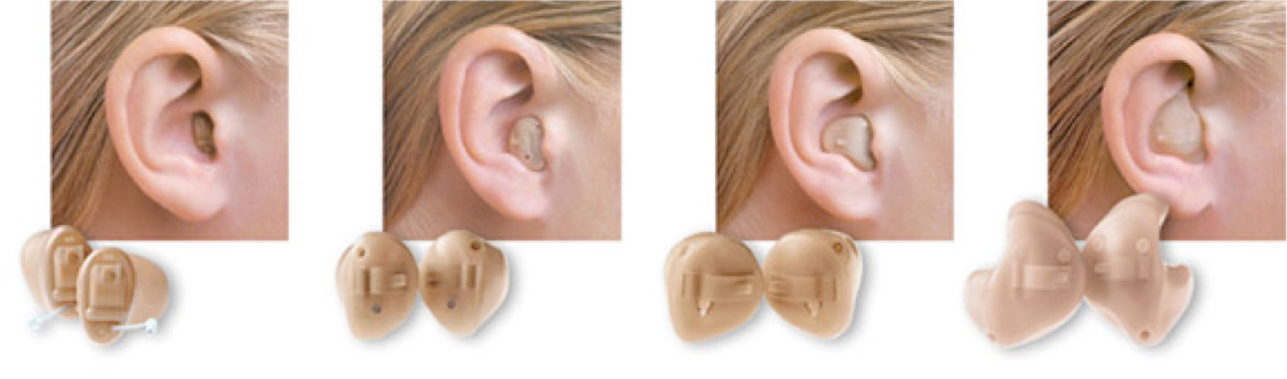
Now hear this
Different types of hearing aid
Episode 8: Now hear this
Notes:
Show students a model ear and explain that their task is to design a mock-up of a hearing aid that allows for various factors including:
Appropriate positioning of input device (microphone).
Space for processor.
Appropriate positioning of output device (small loudspeaker, as in earphone).
Power supply.
The need for the device not to be obtrusive.
Show examples of commercial solutions. Ask students to consider how these devices have allowed for the factors listed above.
Ask students to come up with more detailed design.

Slide 15

Engineering the future. Inspire and be inspired.
For further information about the Siemens Education website and all support the materials and downloads please visit us at
www.siemens.co.uk/education
© Siemens AG 2012. All rights reserved.

