Slide 1

Introduction to
SIWA Pump Guardian
Restricted © Siemens AG 2020

Slide 2
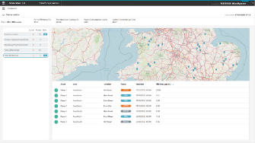
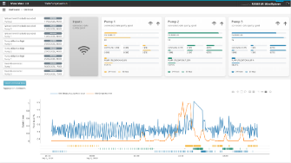
Solution
A secure retrofit IoT solution that prevents blockages and gives complete transparency to the performance of pumps and pumping stations
Key Features
Local deragging through Simocode to automatically remove blockages
Derived flow for the pumping station
Notifications based on rules and thresholds on raw data and KPIs E.g efficiencies, pump utilization, blockages or wet-well level, pump runs, energy consumption
Diagnostic toolkit to analyse issues by trending high-resolution asset data and enter comments / conclusions
SIWA Pump Guardian
OPEX & CAPEX
efficiency
Blockages
& Pollution
Unrestricted, © Siemens AG 2020

Slide 3
Full version

Slide 4



Siemens Industry Suite for Water & Waste Water
Sewer Network
SIWA Sewer
SIWA Blockage Predictor
Waste Water Treatment Plant
Distribution Network
SIWA Sewer: Sewage Network Management
Sewer - Pumping Stations
SIWA Pump Guardian
SIWA LeakPlus: Detecting Leaks
Transportation Network
SIWA Leak: Detecting Leaks
SIWA Burst: Detecting Burst
Pumping Stations
Water Source / Desalination
SIWA Optim Dynamics
Water Treatment Plant
Pump & Reservoir Management
Hide all
SIWA Optim: Optimizing pump schedule
Show all
Notes:
Transportation Network:

Slide 5
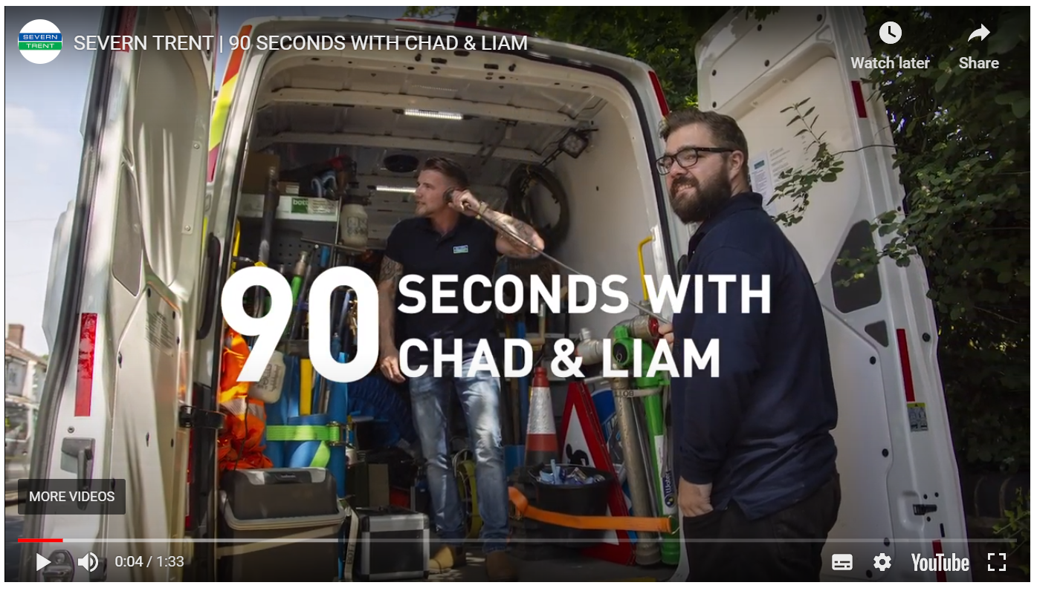


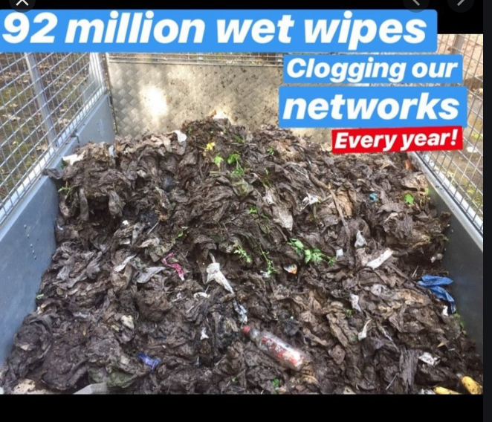

Blockages are a major challenge for all Waste Water companies
A driver of CAPEX, OPEX and risk in network operations
As an example the waste water handling utilities in the UK:
Blockages cause of 50% pollution incidents in Wessex Water;
and <50% of blockages are cause by Rag or Fat & Rag
Behavioural science and marketing campaigns necessary but not sufficient to deliver rate of improvement for AMP7
Rag
Fat & Rag
Roots
Debris
Other/unknown
Wessex Water data from webinar on Intelligent Sewers Competition, 21st October 2019
Thames Water data shown in Andy Brierley (Director, Lane Group) LinkedIn post 21 March 2020 showing data from Mar 2019 to Feb 2020
Notes:
Thames and Wessex data from 2020
Anglian in 2017 said 80% of all blockages due to fat & Rag and Rag and cause of nearly all pump failures
https://assets.publishing.service.gov.uk/government/uploads/system/uploads/attachment_data/file/630709/alex-plant-anglian-water-services-behavioural-economics-in-regulated-utilities.pdf
Northumbrian Water had 15,600 blockages in 2019, 64% were due to rag
https://www.chroniclelive.co.uk/news/north-east-news/northumbrian-water-wet-wipes-blockage-17646591

Slide 6


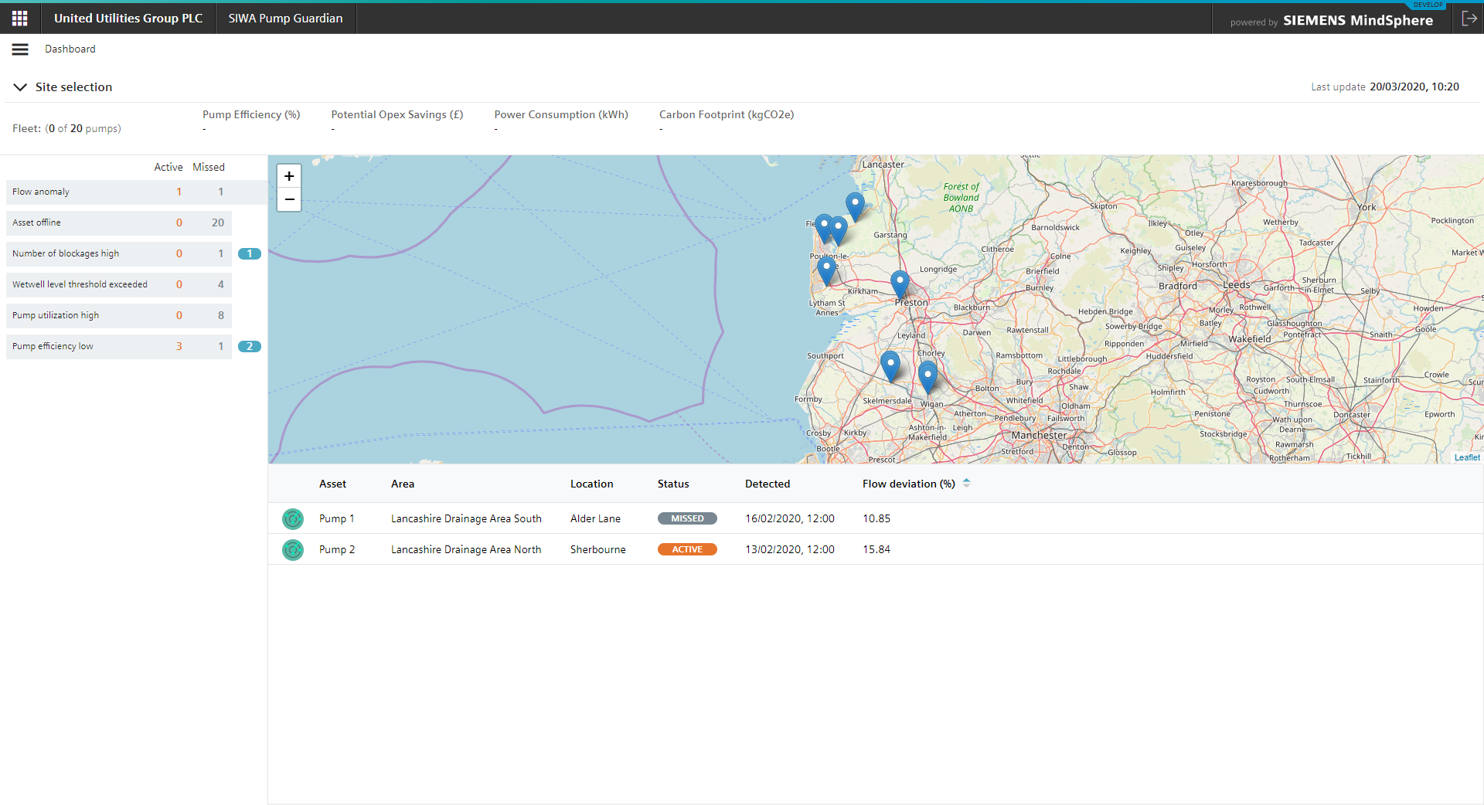

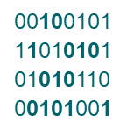



Automated deragging combined with bespoke SPS analytics
Designed for operational and optimization user groups
MindSphere
Blockage Prevention
Connectivity
Platform
SIWA Pump Guardian Application
De-ragging programme
in Simocode Motor Controller
Secure one-way connectivity to the cloud†
Data is stored in MindSphere
Data visualization, analytics and alerts
‡ The Siemens Simocode motor controller is installed in the MCC and automatically initiates a pump reversal when it detects a blockage and provides pump conditioning.
† Data from the Simocode (e.g. current, voltage, starts, run time, trips, energy, power) and from 4-20 mA (level and potentially flow or flow is derived)
Notes:
Why you need richer data than telemetry
Challenge of connectivity

Slide 7

Deragging: Automated at the edge
Anglian Water deployed ~400 SIMOCODE with <8mnth ROI
Proven deragging solution
A standard product installed on 1000s of pumps globally.
Locally run SIMOCODE programme, developed in the UK, manages the pump and integrates in to the existing control panel
Combination of proactive reversals to condition the pump and reactive reversals to high current

Slide 8
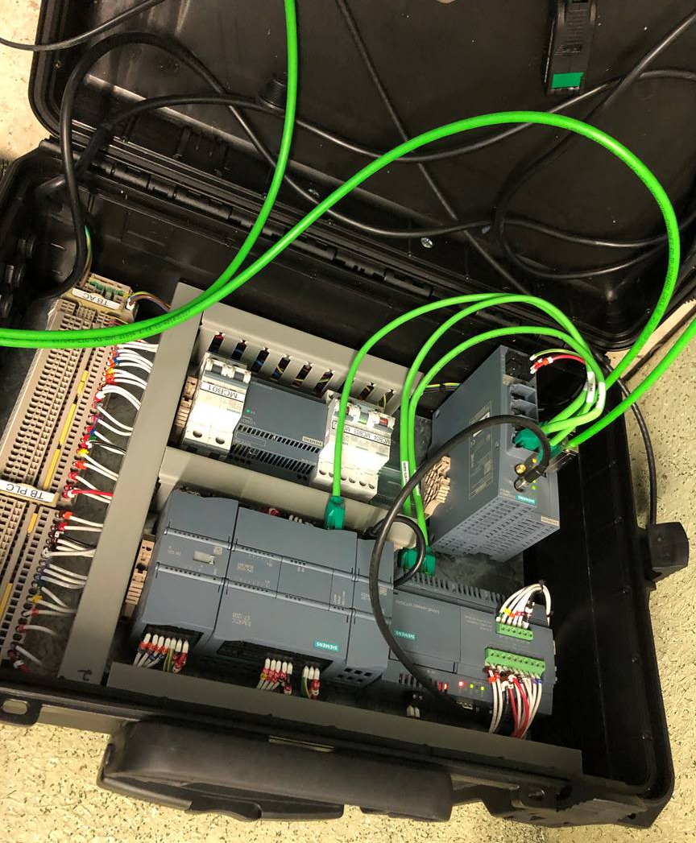

Connectivity: Secure one-way 256bit encryption
Direct connection to MindSphere from site
Simple to install onsite connectivity
Security designed for Industrial IoT
MindSphere follows industry standards of industrial automation and control system environments to meet the highest level of proven security: ISO27001 and IEC 62443-4-1
Separation of external and automation networks, supporting only outbound TLS v1.2 communication by the external network, read-only access to automation protocols, proxy support and off boarding.
  Conforms to NIST recommendations.
  Data is owned by YOU, the tenant
  owner

Slide 9

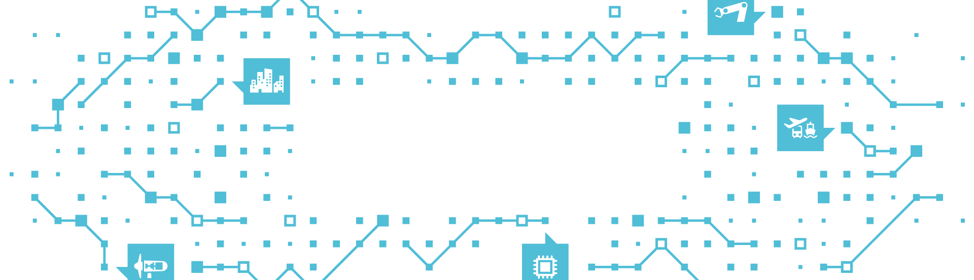



MindSphere: Industrial IoT Operating System
Open standards, secure, rich ecosystem for Applications
Applications
Powerful industry solutions
with advanced analytics
Develop robust industrial
IoT solutions faster
with global scalability
MindSphere
Edge Management
Edge Device Management,
Edge App Management,
and Edge App Store
Connectivity
Connect products, plants,
systems, machines and
enterprise applications
Edge Apps
Siemens, partner (OEM),
and 3rd-party Edge Apps
Edge Devices
Multiple enabled devices hosting
the Industrial Edge platform
EA
EA
EA
EA
E
E
E
E

Slide 10
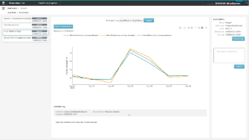
Pump Guardian: SPS specific analytics & visualisation
Data transparency and SPS specific analytics & notifications
Fleet (with hierarchy)
Pump Station
Pump
Selectable hierarchy for the relevant teams
Notifications to prioritise actions
Pump station operational status and connectivity
Enable comparison of pumps and dissect how the site is working
Comparison of operational parameters for detailed fault diagnosis
Longer term CAPEX optimisation and asset health analysis

Slide 11

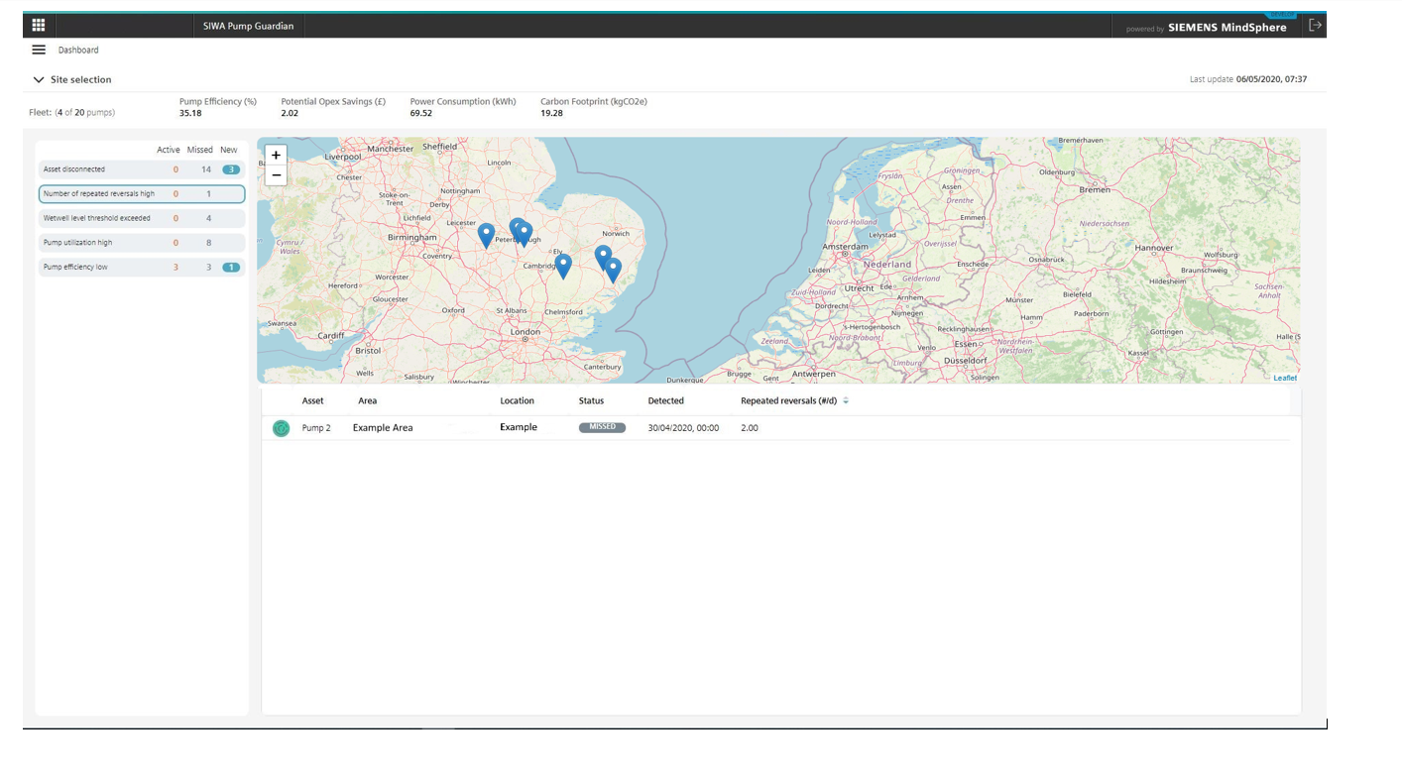
SIWA Pump Guardian: Fleet overview
Selectable hierarchy for the relevant team & Notifications
Shows
Location of all assets on dynamic map
Fleet and selected pump stations:
  Efficiency
  Power consumption
  Carbon footprint
Notifications, when triggered, of
  Pump Efficiency
  Low High pump utilization
  Number of blockages high
  Wet well Level Exceeded
  Assets offline
  Flow Anomaly detected
And allows access to
Data on each pump site (clicking on site)
Deep dive in to a notification (click on notification)

Slide 12
Fleet overview: Prioritisation of operational activities
Notification of issue (X), status of Stations and Pumps
Example
Value Case
Immediate identification of anomalies requiring attention
Summary of key fleet or sub-selection KPIs
Dynamic map show pump locations associated with alerts
Detailed listing of alert type, linked to asset detail contextualisation.
2
1
3
4

Slide 13
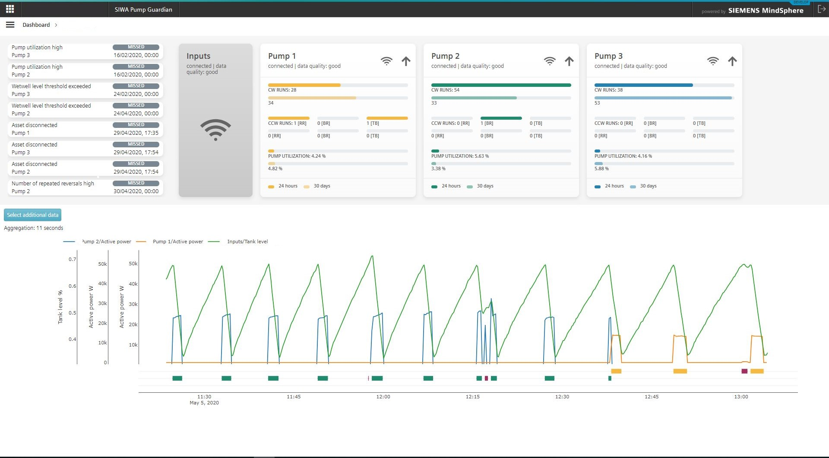
Pump Station overview
Station operational state, connectivity and health
Shows
Connectivity of pumps
Data quality
Pump status
Wetwell level trend
pump runs
blockage reversals
Compares
Historical and daily comparison of:
  utilisation across pumps
  Frequency of runs
  Blockage reversals
Directs
User to site based notifications

Slide 14
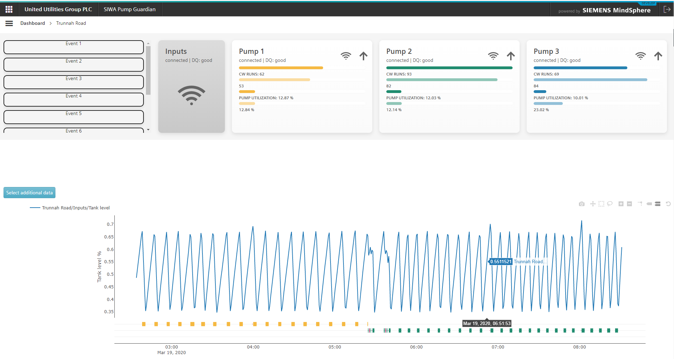
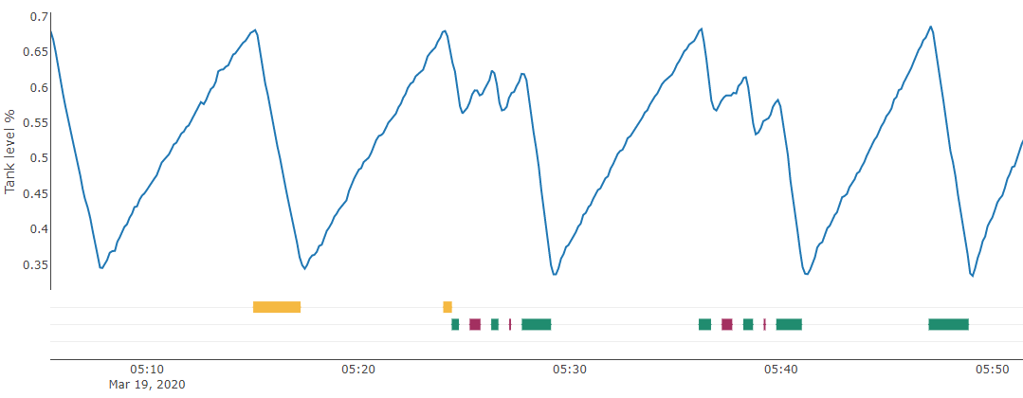
Site Example: Asset health and reversal in action
One pump with an issue (2), blockage identified and removed (3)
Example Station 1
Value Case
Can identify the PLC driving the operational logic of the pump station. As opposed to other sites, this site pumps with each pump a number of times before switching to the next pump.
Pump 3 is identified as having an average monthly utilisation of twice that of the other two pumps.
Zooming in on the level trend, it can be seen that pump two reverses four times, eventually clearing the blockage at 5:40am.
Application quickly identifies which pumps are connected, with good data quality as well as pumps with a healthy status.
4
8.32%
2
3
1

Slide 15
Site Example: Trending and overlaying data for insights
Immediate visualisation of utilisation of pumps on site (1, 2)
Example Station 2
Value Case
Can zoom out the trend, showing the past two days of more sporadic pump operation.
Both pumps have similar pump runs (clockwise starts) and utilisation, both for yesterday and for the past month, indicating healthy operation.
Other variables such as active power, Cos Phi or run hours can be trended to give context to the level and pump run trend.
2
3
1

Slide 16
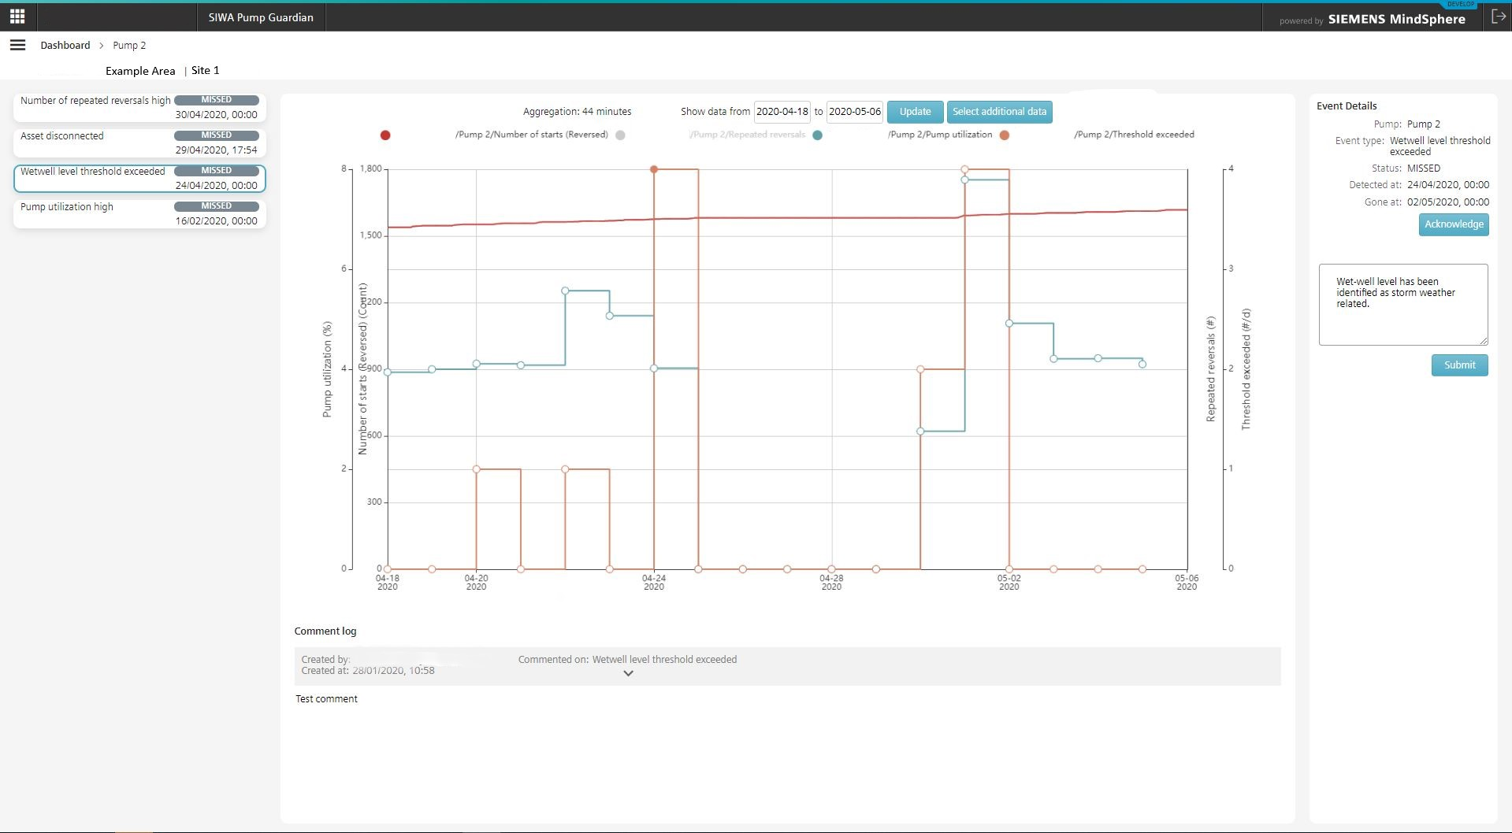
Pump overview
Comparison of operational parameters for detailed fault diagnosis
Compares
Contextualised data for each notification
  Pump Efficiency
  Utilisation, Status,
  Calculated Flow
  Pump Reversals
  High Level Incidents
Raw data such as wetwell Level, Power Consumption, Cos Phi and Operating Hours. These are trended as aggregated data and can be then analysed at greater resolution according to the timeframe selected

Slide 17
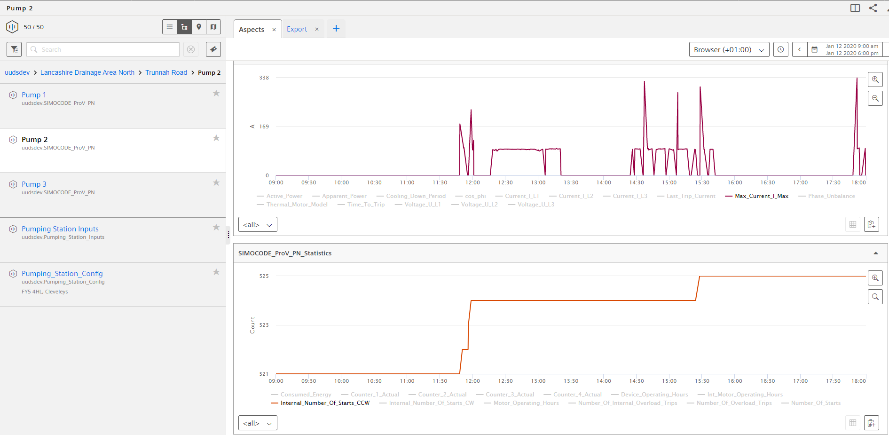
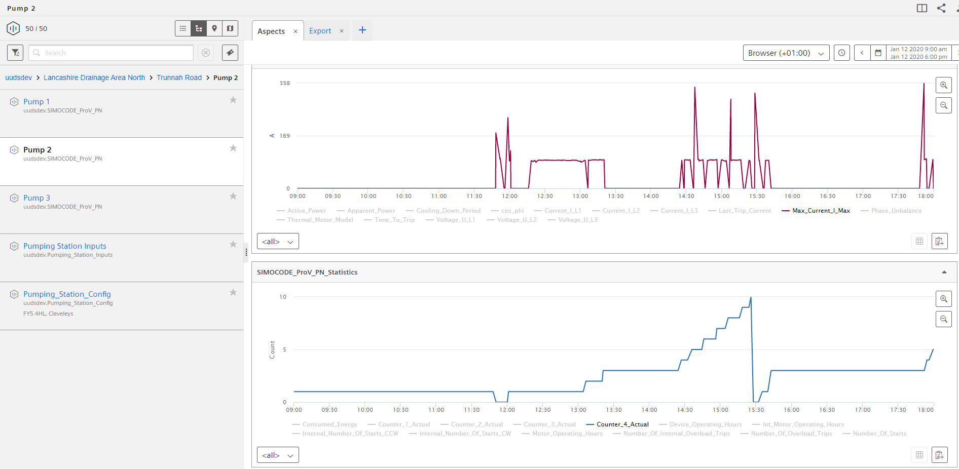
Pump analysis case study: Known problem site
Insights from raw data on the impact of automated reversal (i)
Problem Station, Pump 2
Value Case
Current
2a
A known problem site with three installed pumps. Pump 1 not in operation, Pump 3 on duty, Pump 2 (this slide, on standby)
Pump 2 is started onsite at 11:45
A high current (⎯) event (2a) is identified and pump automatically reversed (⎯ 2b).
A preventative reversal of the pump is actioned after the pre-defined 10 starts.
Insights: Pump 2 has maintained operation and reduced load by SIMOCODE initiating a high-current reversal as well as systematic time based reversals
Clockwise
Starts
1
Starts
3
2b

Slide 18
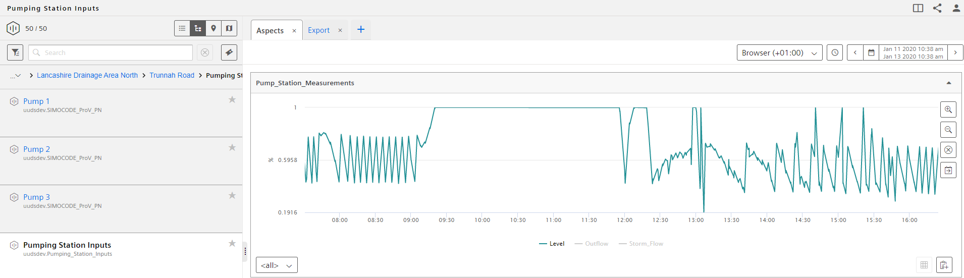
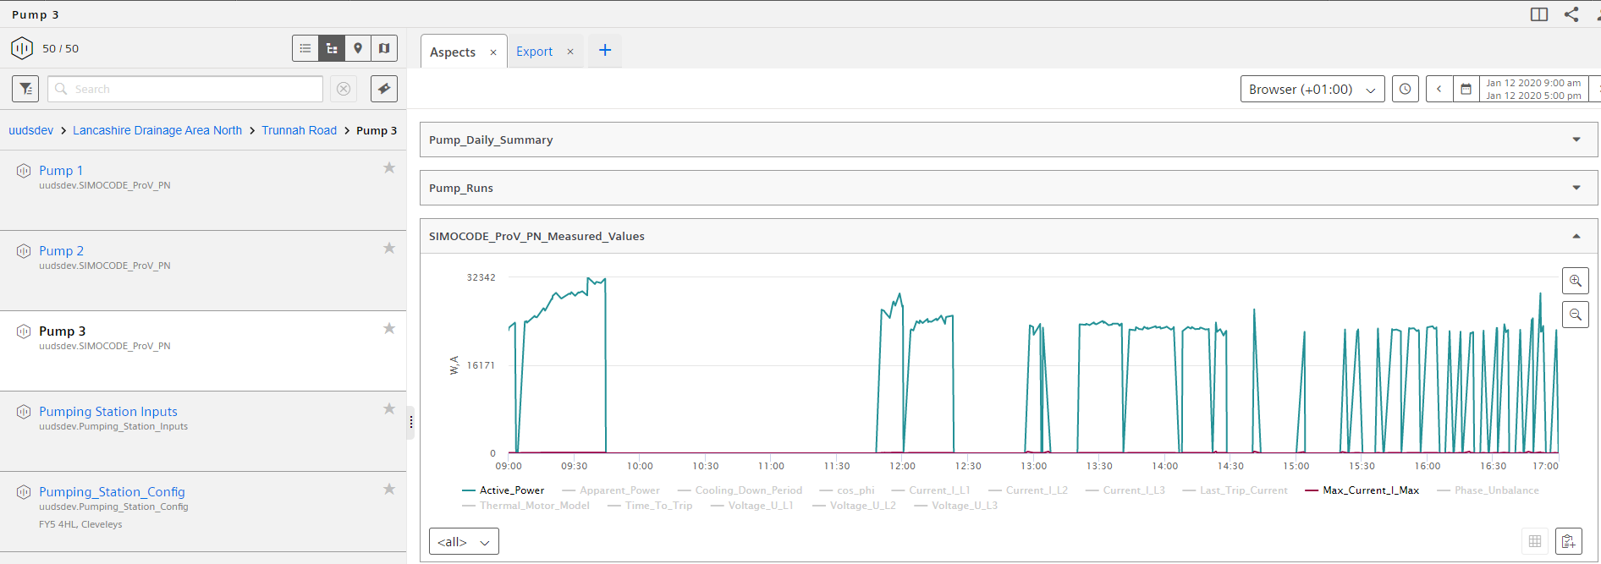
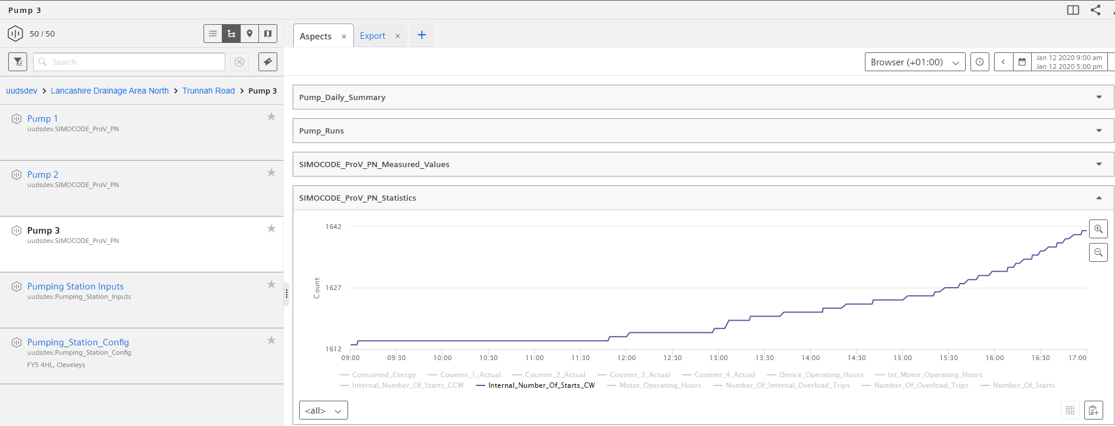
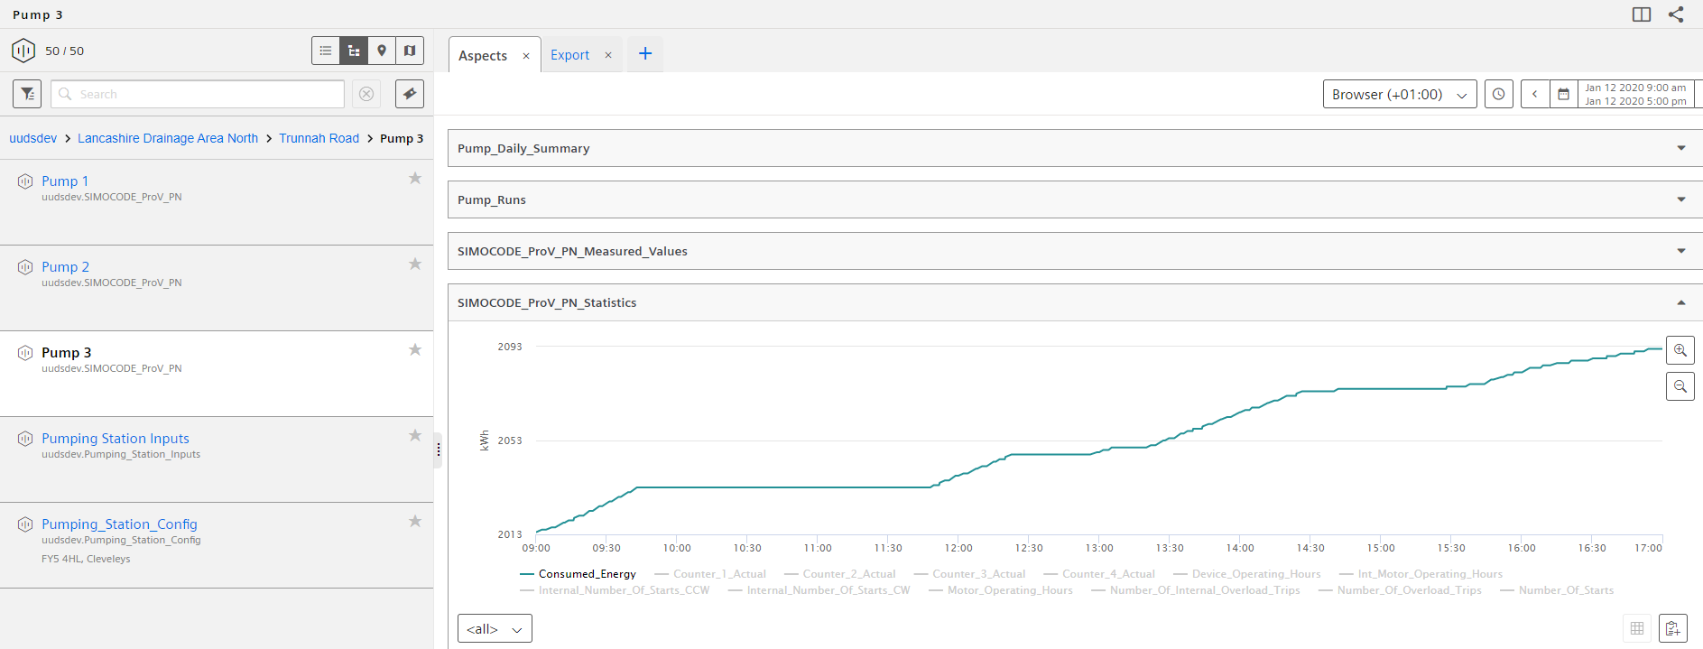
Pump analysis case study: Known problem site
Insights from raw data on the impact of automated reversal (ii)
Problem Station, Pump 3
Value Case
Level
Same site and timeframe, looking at Pump 3 which is not setup to reverse to clear blockages
Level shown to be increasing at 9:15am.
Increase in power consumption, pointing to possible blockage; operations continue for an hour while level over “100%” while current increases. Pump trips at 10:45am
Site visit has re-started pump twice. Power starts to reduce over time/starts. Pump 2 brought in to operation and reverses to help address blockage (previous side)
Insights: Pump 1 is isolated and Pump 2 is not called to start.
1
Power
52A
42A
2
Clockwise
Starts
3
Consumed Power

Slide 19
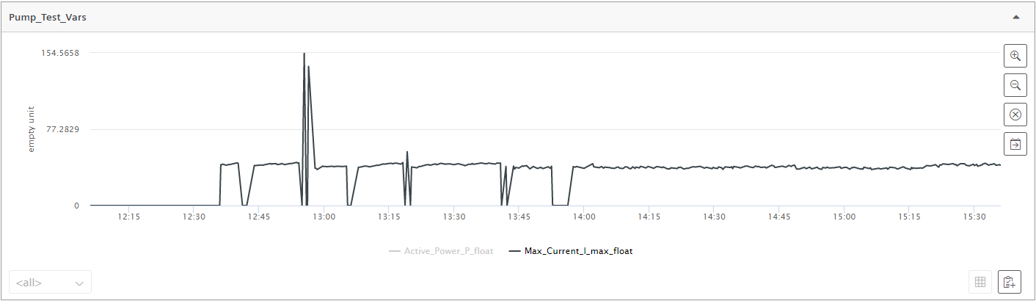
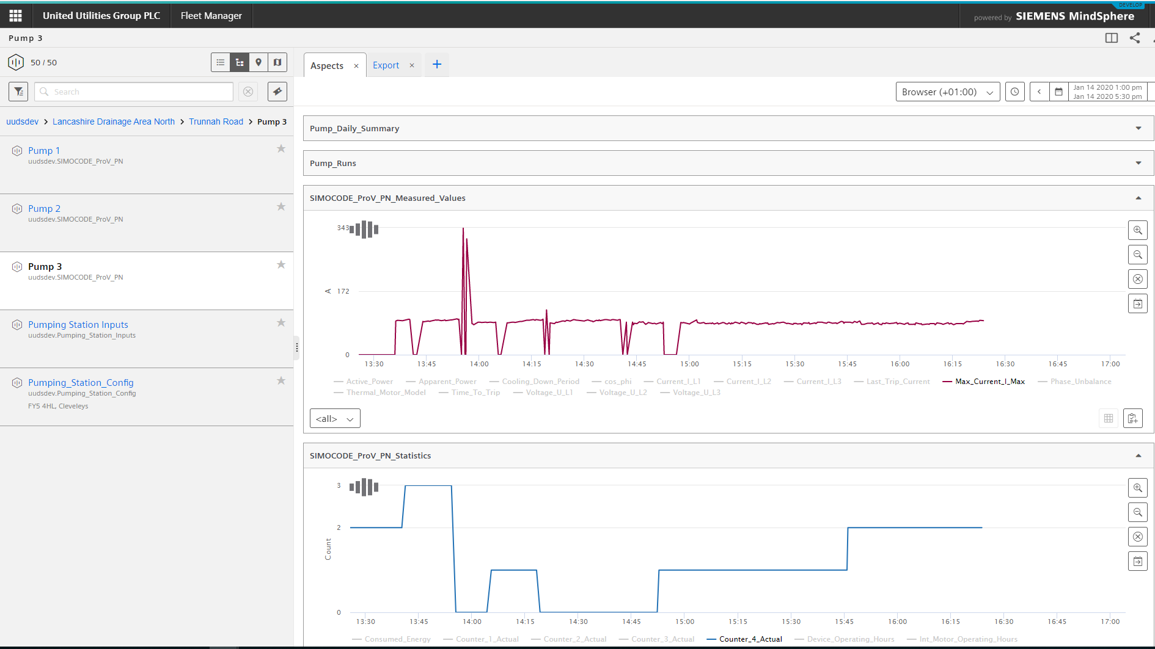
Pump analysis case study: Known problem site
Insights from raw data on the impact of automated reversal (iii)
Problem Station, Pump 3
Value Case
Current
SIMOCODE Reversal functionality installed on Pump 3
Current increasing up to 43A
Reversal functionality is now implemented, current returns to about 41A after reversal. Gradual increase back up to 42A
Second reactive reversal frees pump and current remains between 35-39A
Insights: Pump 3 has had it’s setup altered to ensure reversals on high current. The reversal has reduced the current and resulted in the pump remaining online.
43A
41A
42A
35-39A
1
2
3
1
Starts
2
3

Slide 20
Next Steps

Slide 21
NEXT STEP: A pilot project as a 5 months Discovery Phase
Enable technical/operational evaluation and test commercial model
What Siemens provides
Discovery Phase
What we need from you
Pump efficiency application through advanced analytics based on MindSphere¹⁾ cloud platform
Siemens SIMOCODE PRO V installation on all selected pumps incl. connection to MindSphere
Support in asset connectivity
5 months pilot incl. 1 months setup
Selection of up to 15 pump's²⁾ with following information provided:
  Wet well level gauge
  Wet well dimensions
  Discharge pipe length and internal diameter
  Flow meter present (not required)
  x,y,z locations of pumps
Engagement of the following end-user groups:
  Asset integrity manager
  Pump efficiency manager
  Innovation & technology team
  IT & OT support (electrical engineering)
  Connectivity support
  Data provision support
MindSphere
Install
Connect
Subscribe
Monitor
Final report on pump reversals based on live data
NEXT STEPS: Build on pilot for scalable solution to expand to the full network
If MindSphere access is not yet available to the customer, it will be provided free of charge for 3 months. Prerequisite: Understanding of architecture of current data movement and storage and agreement to MindSphere terms and conditions
Internet connection has to be available on pump's site, but can be provided by Siemens on request; selection of three different pump sizes (S,M,L) is recommended

Slide 22


Commercial options for Discovery Phase
Potential to test novel business model for at-scale deployment
Analytics as a Service
Outcome-based
1
2
Monthly flat fee
£8,000 pcm
(total £40,000)
Based on number
of reversals
(up to max £40,000)
You pay a flat monthly fee in return for access to insights generated by the pump blockage prediction solution
The cost of all connectivity, software and installation is included within this monthly fee
You choose how to react to the insights generated
Advantages:
  Cost certainty through a flat fee
  You free up time to concentrate on your core business
You pay a flat up-front fee of £40,000, which is based on a set-up fee and a total number of pump reversals each worth a value.
At the end of the trial, a true-up will determine the actual number of pump reversals. If there are fewer, Siemens will credit you the number of reversals under this amount. If there are more than 40, Siemens will accept the risk and not charge you.
Advantages:
Capped-risk option as the total fee cannot exceed £40,000
Variable payment is directly linked to the reversals the solution undertakes
Charging Model
Charging Model
T&C's
We propose standard Model Form 1 (MF/1) terms and conditions contract for the supply and installation of electrical, electronic or mechanical plant, for both solutions.

Slide 23







SIWA Pump Guardian Value Proposition
Realising strategic and operational value
1
2
3
4
Improved environmental compliance and reduction of pollution incidents
Reduce unconsented spills leading to pollution incidents & avoid associated penalties
Reduce risk of internal and external flooding and improve Ofwat penalties/reward outcomes
Reduce sewer blockages & associated penalties and maintain sewer network function
£
Increase operational efficiency by remote pump reversal, resulting in fewer service visits to site
Optimise asset base investment by reducing reliance on over scoping CAPEX investment
Lifecycle extension to assets by identifying & servicing inefficient pumps
Access dynamic view of network performance to better manage risks

Slide 24
John Doe
Job title
Group / Region / Department XY
Street 123
12345 City
Phone: +49 123 45 67 89
Fax: +49 123 45 67 89
Mobile: +49 123 45 67 89 0
E-mail:
john.doe@siemens.com
siemens.com

Slide 25

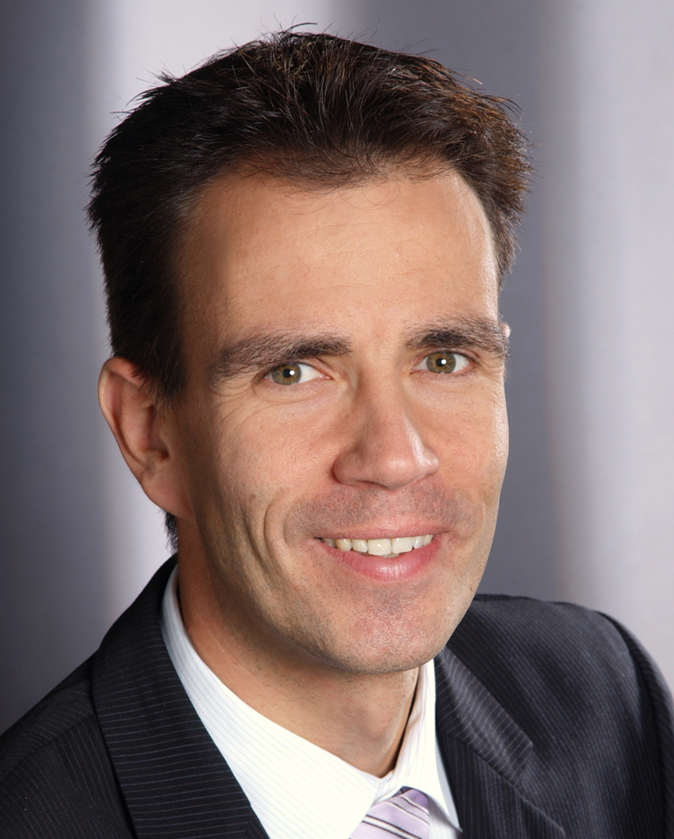

SIWA Pump Guardian team
Axel Fronek
Business Owner Digitalisation
Responsibility for DI VSS W&WW
Digital Applications
axel.fronek@siemens.com
+49 (172) 5746101
Timothy Costello
Product Owner
Responsible for App roadmap;
Over a decade delivering pumping
solutions in oil and gas
costello.timothy@siemens.com
+49 (152048) 67357
Paul Graham
Technical Specialist
15 years maintaining and operating
Waster water pumping stations
paulgraham@siemens.com
+44 7921 242378

