Slide 1


Topic 3: Water, water, everywhere?
© Siemens AG 2012. All rights reserved.
www.siemens.co.uk/education

Slide 2
Water, water, everywhere?
Overall learning objectives:
Gathering data, manipulating it to support analysis and applying it to justify arguments.
Understanding and applying concept of solubility and developing understanding of separation techniques and their application.
Applying scientific concepts to solve technological problems.
Devising and improving technical solutions, developing criteria for, and using them to judge product quality.
Introduction: Water, water, everywhere?

Slide 3
Water, water, everywhere?
Overall learning outcomes:
Apply ideas, understanding and skills to develop a simple water purification system.
Test the product of the system against criteria.
Understand the nature of the challenge in terms of supplying clean water that is fit for drinking.
Introduction: Water, water, everywhere?

Slide 4
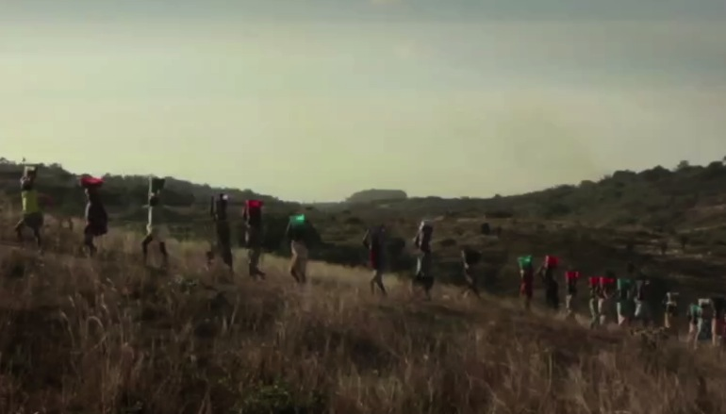
Water, water, everywhere?
‘Waiting for Water’
Episode 1: Water, water, everywhere?
Notes:
Show a video clip of, ‘Waiting for Water’

Slide 5
Water, water, everywhere?
Why was it a problem for the orphanage when the pump in the water kiosk failed?
What kind of problems might arise from using river water?
What do you think might be included in ‘waterborne diseases’?
Episode 1: Water, water, everywhere?
Notes:
Take feedback and draw out the following points:
If there is no clean water, people have to revert to other sources such as river water.
River water incudes a number of pollutants, some of which can cause illnesses
Waterborne diseases include cholera and typhoid, although the presence of contaminated water can give rise to a range of other diseases.

Slide 6
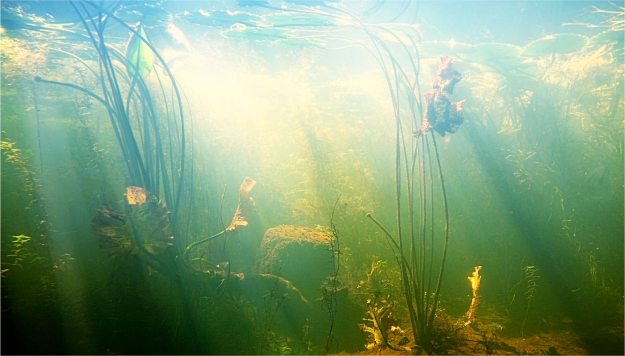
Water, water, everywhere?
What’s in the water?
Page 6
Episode 2: Water, water, everywhere?
Notes:
Explain that there are several ways in which water may be considered unclean:
There may be soluble substances in it e.g. chemicals that have dissolved.
There may be insoluble substances in it e.g. things that won’t dissolve.
Ask students to work in groups to suggest ways of removing salt, sand and silt from water.
Take feedback and draw out that:
Insoluble substances can be removed by filtration (as long as the filters are fine enough).
Soluble substances need another process, such as evaporation and condensing.

Slide 7

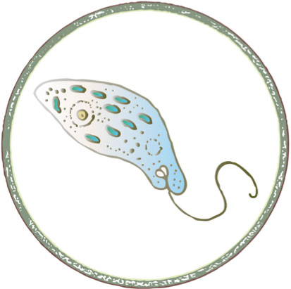

Water, water, everywhere?
‘Waiting for water’
Microorganisms in water
Episode 3: Water, water, everywhere?
Notes:
Explain that as well as chemicals, pond and river water can also contain microorganisms and that in this lesson there are going to be ways used of seeing what these are like.

Slide 8
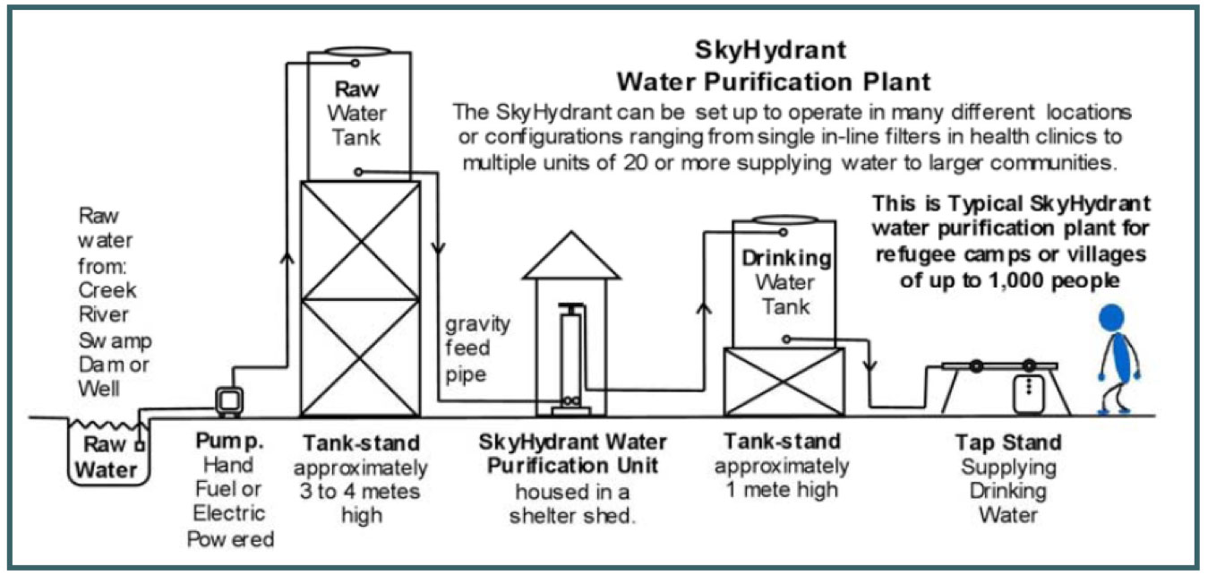
Water, water, everywhere?
‘Waiting for water’
Water purification plant
Image courtesy of Skyjuice Foundation Inc.
Page 8
Episode 4: Water, water, everywhere?
Notes:
Explain that the clean water kiosk in the video was fitted with a SkyHydrant filtration system. Like all manufactured equipment this comes with information that specifies what it will and won’t do. Students are going to use this to evaluate the equipment.

Slide 9
Water, water, everywhere?
Water purification plant
Why is a pump needed?
Why is the raw water tank on a tank stand?
Why does the water not need pumping from the purification unit to the drinking water tank?
Why store the drinking water in a tank rather than have people take it straight from the purification unit?
Episode 4: Water, water, everywhere?

Slide 10
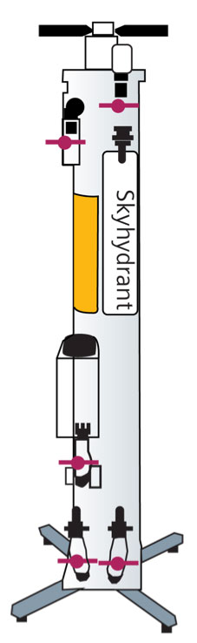
Water, water, everywhere?
What does ‘gravity fed’ mean?
Is this an advantage of disadvantage?
How much water per hour can one unit filter?
What will it remove?
What will it not remove?
Why are three different figures given for its weight?
Filtration unit
Episode 4: Water, water, everywhere?
Notes:
Issue students with the SkyHydrant specification sheet, student support sheet 3B and the SkyHydrant fact sheet, student support sheet 3C . Explain that they include a number of points that these will help them to answer the above questions.

Slide 11
Water, water, everywhere?
Why would it be important to test the water before installing this unit and using it to supply people with drinking water?
What are WHO (World Health Organisation) standards?
The filters are cleaned using a process called backwash. How do you imagine this might work?
Madam Elizabeth and her fostered children can safely drink the water after it has been through this filtration process. What does this suggest about the water before it goes into the filtration unit?
Filtration unit…
Episode 4: Water, water, everywhere?
Notes:
Issue students with the SkyHydrant specification sheet, student support sheet 3B and the SkyHydrant fact sheet, student support sheet 3C . Explain that there are a number of points that will l help them to answer the above questions.

Slide 12
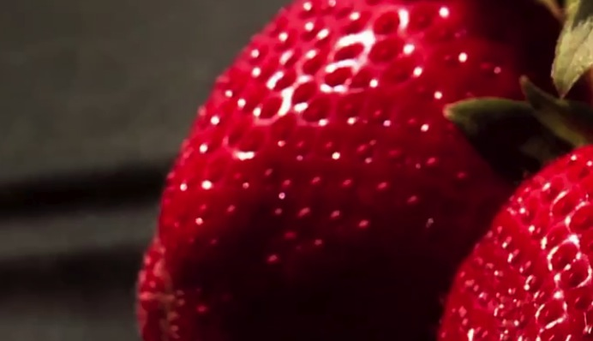
Water, water, everywhere?
‘Thirsty Strawberries’
Episode 5: Water, water, everywhere?
Notes:
Show a video clip of, ‘Thirsty Strawberries’ the video provides a different context and compares the demand for water in one of the most prosperous areas (Southern California) with that seen previously in Africa.
Ask students to think about the differences in situations.

Slide 13

Water, water, everywhere?
Group discussion
Episode 7: Water, water, everywhere?
Notes:
Ask students to work in groups to design a filtration system that will produce as clean water as possible. They will need to think about what could be used to filter the water (materials may need to have been selected and requested in advance).
Set the test rigs up and gather water.
Then ask students to test the water supplies, using the agreed procedures.

Slide 14

Engineering the future. Inspire and be inspired.
For further information about the Siemens Education website and all support materials and downloads please visit us at
www.siemens.co.uk/education
© Siemens AG 2012. All rights reserved.

