Slide 1
Module 2
Engineering

Slide 2
Module Summary
In this module, you will be learning all about the 'Engineering Design Process', a series of steps that engineers use to solve problems.
Learning Objectives
Learn about and practice applying the engineering design process.
Develop the essential skill of Problem Solving.
Session Length:
1 hour
Resources:
SIP Portfolio
Pens/Pencils
Access to the internet

Slide 3
"Hi there!
My name is Sarah. I am a Solutions Energy Engineer in the Smart Infrastructure team at Siemens.
David tells me that we are going to be working through the engineering design process today.
The engineering design process is a tool that engineers use to approach and solve all problems, but you learn more about it later.
I've also got a really fun exercise where you can apply the engineering process but we'll get to that.
In the meantime, have fun learning and get flexing those problem-solving skills!"

Slide 4
Skills Builder Partnership

Slide 5
In this module we will be focusing on building the essential skill - Problem Solving.
The Skills Builder Universal Framework defines Problem Solving as: The ability to find a solution to a situation or challenge.
This skill includes...
Finding extra information or advice if you need it
Being able to explore a problem in more detail
Create and evaluate a range of solutions to a problem
Take a look at the Skills Builder Passport in the back of your Portfolio and review the 10 steps to build your problem-solving skills.
When have you used this skill before?
Want to build this skill? Have a look at the Skills Builder Universal framework.

Slide 6
Warm Up Task
Imagine that your colleague Ben has sent you the following message...
Hi! I am really worried about this end of month report. It is due on Monday morning and I don't think I'm going to finish in time - I'm only half way through! It's Thursday morning now and I have some meetings this afternoon and tomorrow that will take up some time. What should I do?
Use the space in your Portfolio to answer the following questions:
What further details or information do you need to help Ben with his problem?
What is a possible solution to Ben's problem?
What are the pros and cons of this solution?

Slide 7
Project Task 1: The Engineering Design Process

Slide 8
"Great, you're back! I hope you feel warmed up and ready to go.
So, as I mentioned before, the engineering design process is a set of steps that engineers use to solve a problem.
There are loads of different types of engineers: civil engineers, aeronautical engineers, electrical engineers, energy engineers...
...but these engineers have one thing in common - they all use the engineering design process.
I'd like you to watch the following video about the engineering design process.
While watching, fill out the Engineering Design Process Table in your SIP Portfolio."

Slide 9
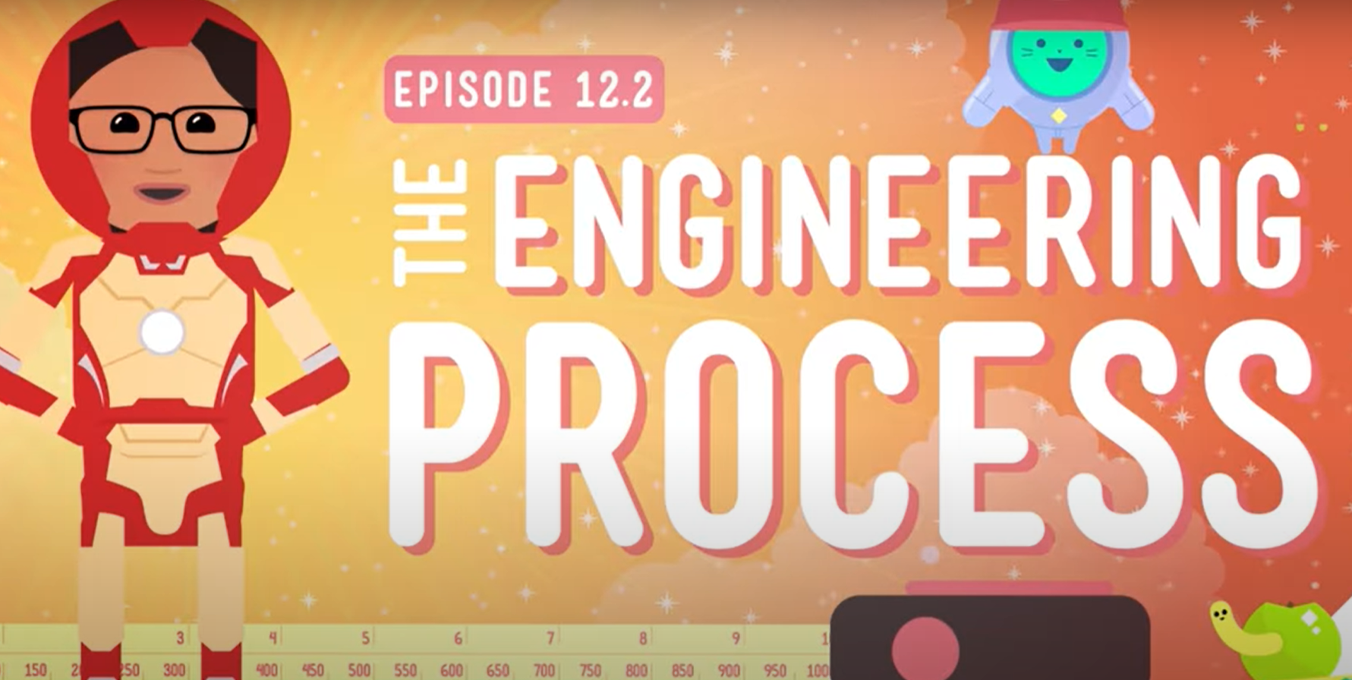
Click here to watch!

Slide 10
Project Task 2: Siemens Energy Island

Slide 11
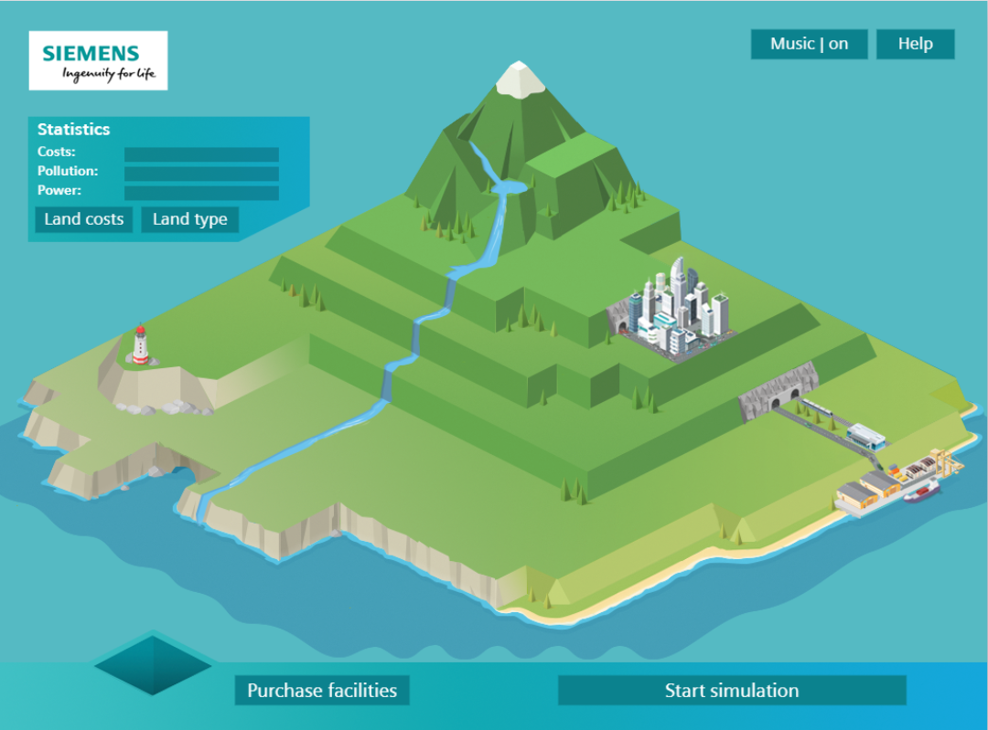
"Fantastic!
Now that you're familiar with the engineering design process I'd like you to apply it to a project we are working on.
We are looking into providing an energy supply solution to Siemens Energy Island but we haven't quite worked out the best way of doing it yet.
There are lots of different ways we can supply power to the island over a 24-hour period but we can't run out of money or damage the environment.
I would like you to use the engineering design process to develop some possible solutions for powering Siemens Energy Island.
Explore the island and test out a possible solution. For your second attempt, use the experience of the engineering design process to develop a more successful solution. Explain how you are applying each step of the engineering design process during this task by filling out the table under Project Task 2 in your Portfolio."
Explore the problem and create a solution by clicking on this link: http://siemens.zincmediadev.com/energy/island/index.html

Slide 12
Quiz and Reflection
Put your knowledge to the test and complete the ‘Welcome to Siemens’ quiz in your Student Portfolio!
The correct answers can be found in the back of your Portfolio but no peaking…

Slide 13
Time to reflect...
Go to your Skills Builder Passport at the back of your Portfolio and look at the steps for Problem Solving.
Pick one or more steps that you think you have developed during this module.
For each of your chosen steps, write an example of where you have demonstrated this skill while working through this module.

Slide 14
Congratulations! You have completed Module 2 - Engineering!

