Slide 1
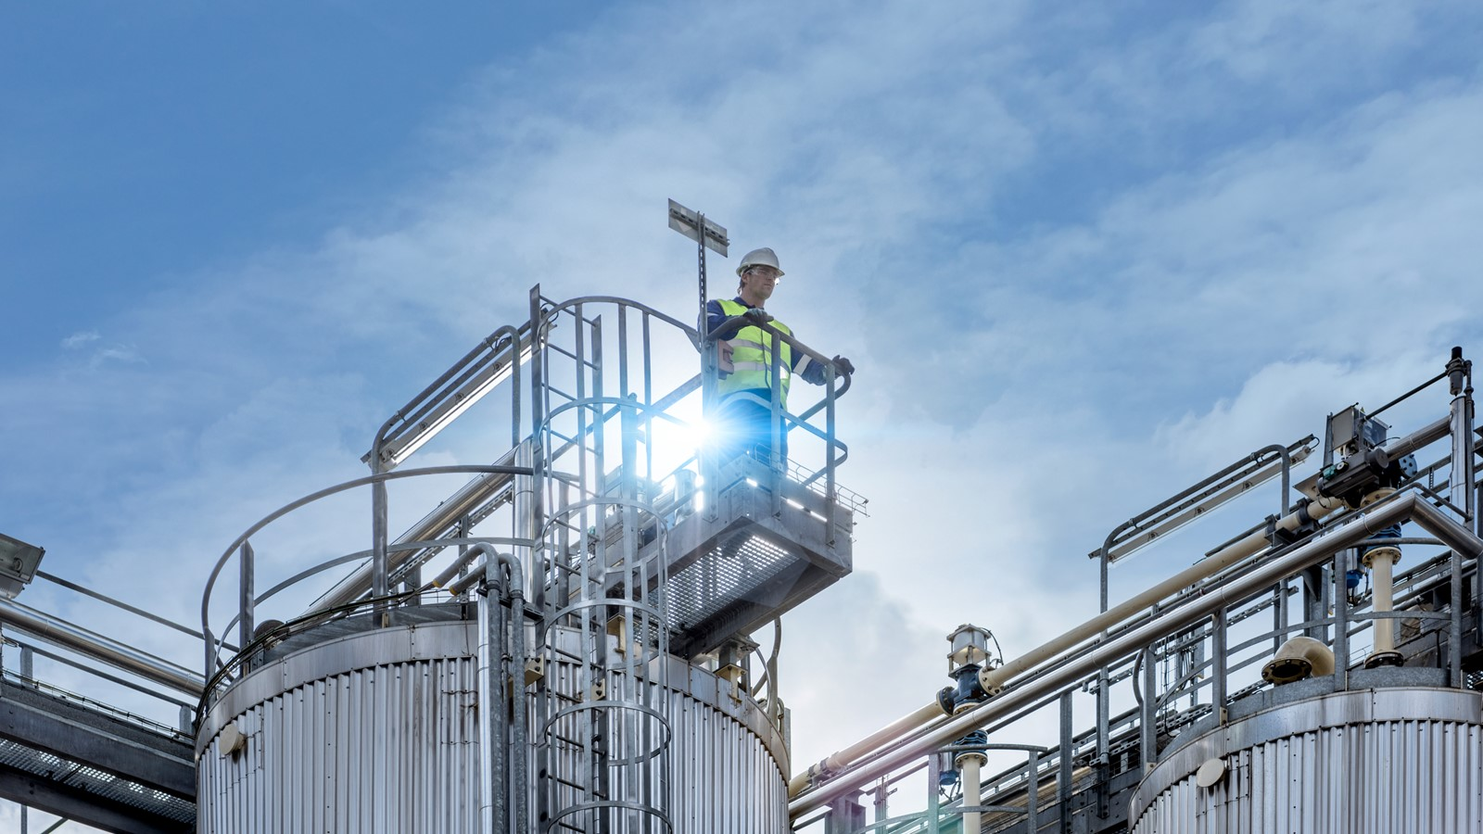
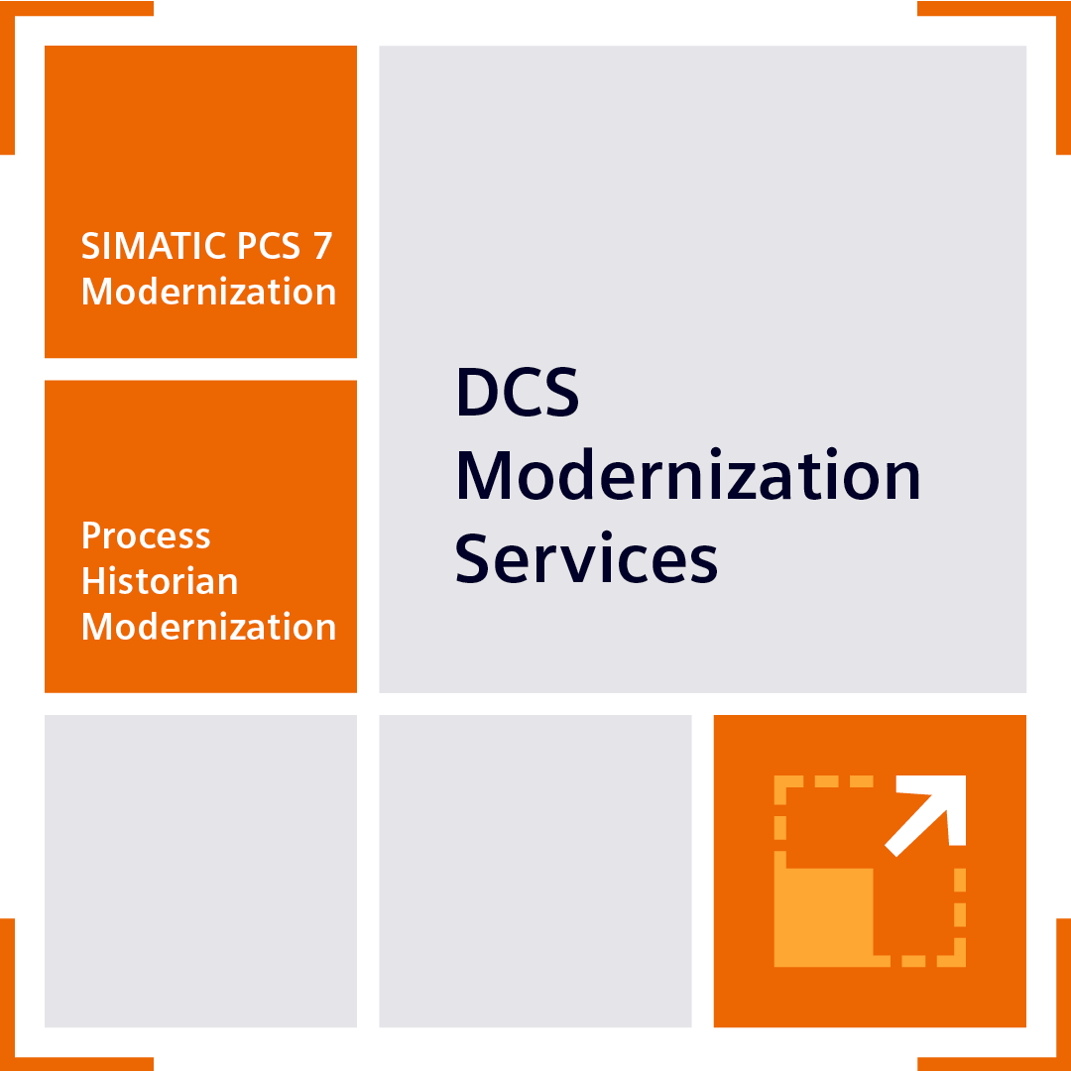
SIMATIC PCS 7 Modernization
Sales Slides

Slide 2
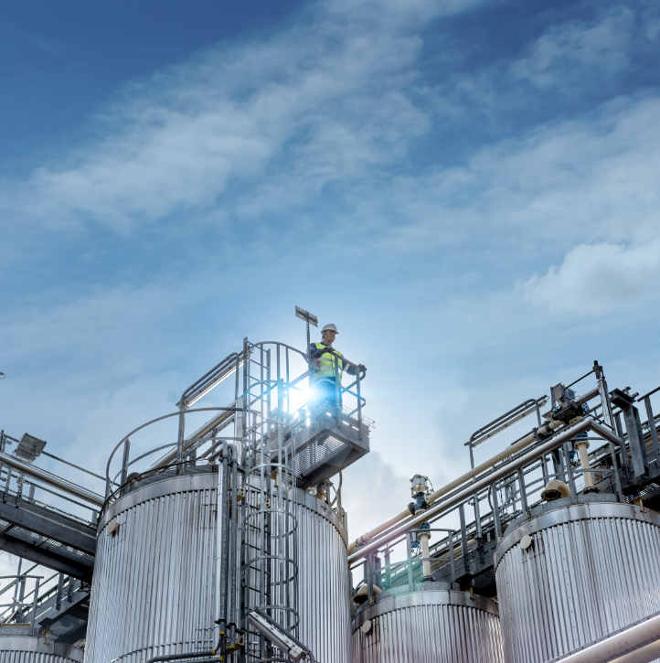
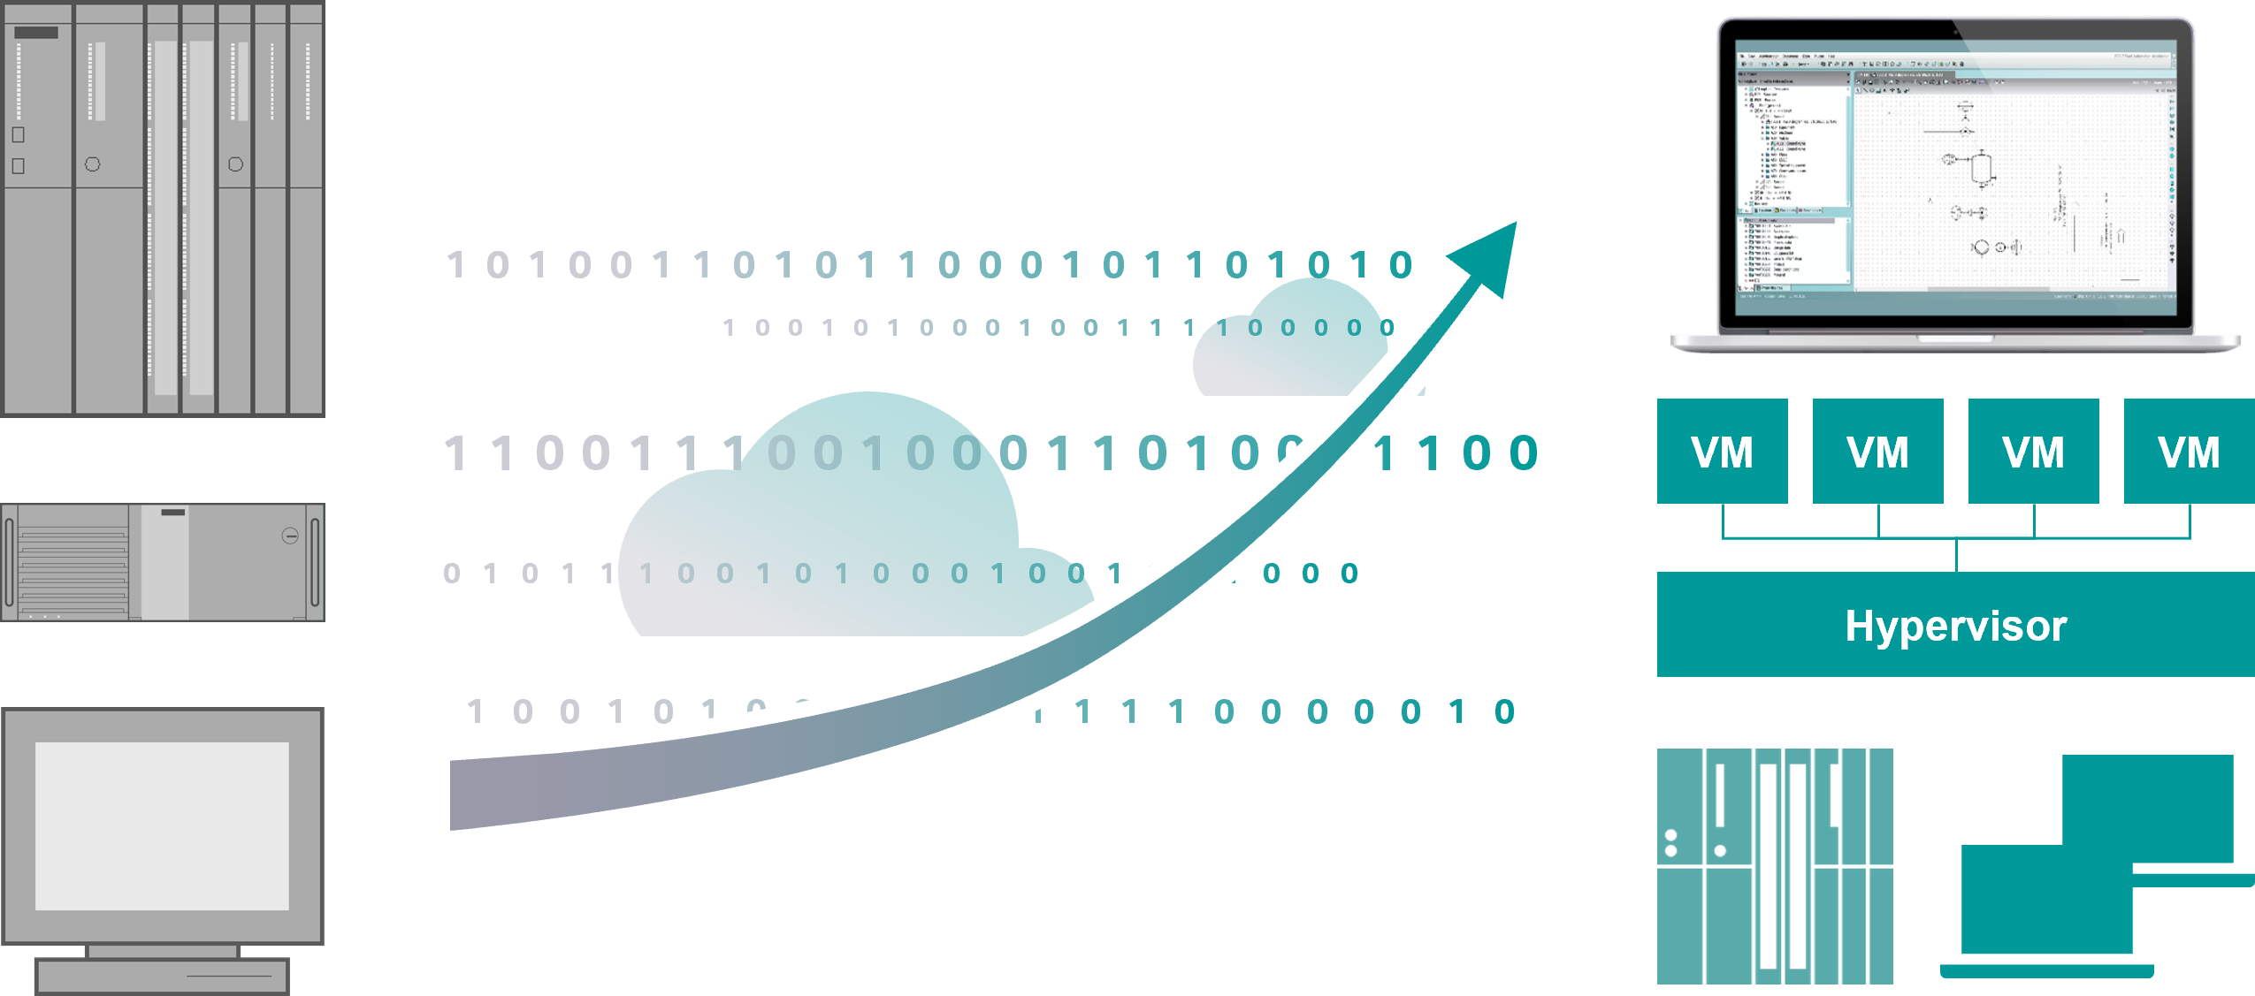
Modernize your SIMATIC PCS 7 System with SIMATIC PCS 7 Modernization
Solution and Service
Your value
    According to the customer priorities, different solutions are possible for our DCS Modernization Service:
    Project execution at HQ with experienced lead engineer
    Conversion to the current state with additional options
    Minimal risk (extensive HQ FAT in advance, simulation)
    Cost-effective conversion (without new functions)
    Partial services
High quality of the upgrade and thus short stop times
    DCS Modernization Services provide holistic and tailored support for the modernization
    of DCS systems and the preparation for upgrading to SIMATIC PCS neo.
    To ensure continued operational excellence and leverage the latest technological advancements, SIMATIC PCS 7 Modernization is a crucial step for future-proofing your industrial processes.
    Clear responsibilities and many years of modernization expertise
    Benefit from greater future-proofing by preparing for future systems

Slide 3
Challenge
Are the SIMATIC PCS 7 hardware and operating systems outdated?
How can we effectively address the challenges of ensuring continuous and safe operation for a modernized SIMATIC PCS 7 system over its full operational lifespan?
How can we overcome the challenges of ensuring ongoing serviceability and technical support for SIMATIC PCS 7 systems after a modernization?
How can current cybersecurity standards be effectively integrated and continuously maintained during and after a modernization of SIMATIC PCS 7?
How can long-term investment protection and future-proofing for a SIMATIC PCS 7 modernization project be secured?

Slide 4

Modernize your SIMATIC PCS 7 System with SIMATIC PCS 7 Modernization
Solution and Service
    According to the customer priorities, different solutions are possible for our DCS Modernization Service:
    Project execution at HQ with experienced lead engineer
    Conversion to the current state with additional options
    Minimal risk (extensive HQ FAT in advance, simulation)
    Cost-effective conversion (without new functions)
    Partial services

Slide 5
More than 20 years of Microsoft Windows
Comparison of SIMATIC PCS 7 versions and appropriate Windows versions
Legacy System Service PCS 7 End of Support 31.12.27
Microsoft Support available
V10
Microsoft Extended Support ends
(*Januar 2027)
V9.1
No support available
V9.0
Windows 10 Enterprise
LTSC 20219 /
LTSC 2021 (IoT)
Windows Server 2019/
Windows Server 2022
V8.2
Windows 10 Enterprise
LTSC 2019
Windows Server 2019
V8.1
Windows 10 Enterprise
LTSB 2015
Windows Server 2016
V8.0
Windows 10 Enterprise
LTSB 2015
Windows Server 2012
V7.0
Windows 7 Ultimate
Windows Server 2008
V6.0
Windows 7 Ultimate
Windows Server 2008
Windows XP
Windows Server 2003
Windows XP
Windows Server 2003
1997
2003
2007
2011
2014
2016
2017
2021
2025
Source and more information: https://support.microsoft.com

Slide 6
Modernization of SIMATIC PCS 7 Systems
    <Insert Key visual for Sales Module (L3)>
SIMATIC PCS 7 Modernization
The modernization will be carried out jointly with Siemens Region
Possible work packages:
Project analysis
Installation and setup of the new HW (IPC or virtual)
Project upgrade SIMATIC PCS 7 to current status
Library exchange to APL (Ready for SIMATIC PCS neo)
Standardization (preparation for lifecycle service contract)
HQ-FAT ¹ at own test installation also remotely
Commissioning support
Options:
Image adaptations for widescreen monitors with new resolution – SIMATIC PCS 7 OS PDL’s
Conversion to new curve design – SIMATIC PCS 7 OS / Trends
Conversion and standardization of CFC structures to CM/ CMT² – SIMATIC PCS 7 Engineering
SIMATIC Process Historian / Information Sever upgrade
¹ Head Quarter Factory Acceptance Test; 2 Control Modul/ Control Module Type

Slide 7
Modernization of SIMATIC PCS 7 Systems
    <Insert Key visual for Sales Module (L3)>
SIMATIC PCS 7 Modernization offer...
Upgrades of older SIMATIC PCS 7 versions to the current version
Optional preparation for future conversion to SIMATIC PCS neo
Preparation of the system for a lifecycle service contract
Support for the modernization of TELEPERM M systems
SIMATIC PCS 7
V6.1
SIMATIC PCS 7
V7.1
SIMATIC PCS 7
V8.2
SIMATIC PCS 7
V9.1
V10
Library exchange
to APL
SIMATIC PCS 7
V9.1
V10
Possible priorities
Conversion to the current status with all available options.
Cost-effective conversion (without new functions)
Minimal technical risk (extensive testing in advance)
Short or no downtimes

Slide 8
One-stop Service
    <Insert Key visual for Sales Module (L3)>
Additional services
    Library exchange to APL¹
    Virtualization with SIVaaS²
    Process Historian upgrades with SIDSI³
    Advanced project processing with HQ- FAT⁴
According to the customer priorities
different solutions are possible
    Project execution at HQ with experienced lead engineer
    Conversion to the current state with additional options
    Minimal risk (extensive FAT in advance, simulation)
    Cost-effective conversion (without new functions)
    Partial services possible
1 Advanced Process Library; 2 SIMATIC Virtualization as a Service;
3 SIMATIC DCS/SCADA Infrastructure; 4 Head Quarter Factory Acceptance Test

Slide 9
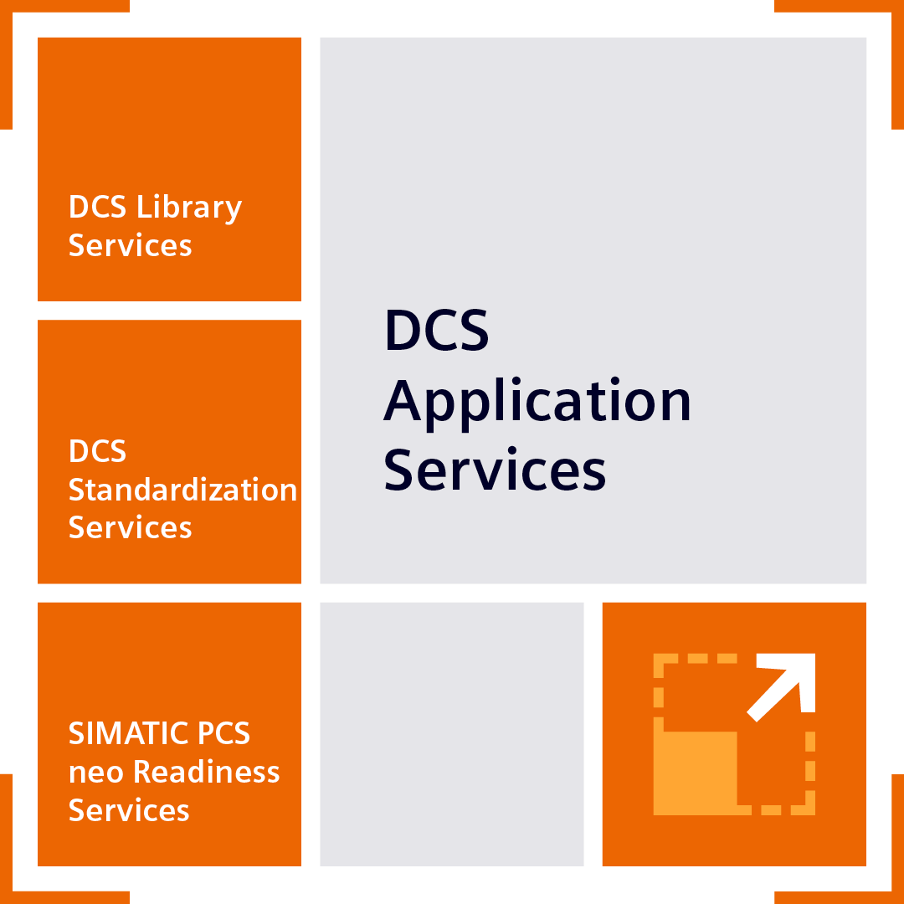

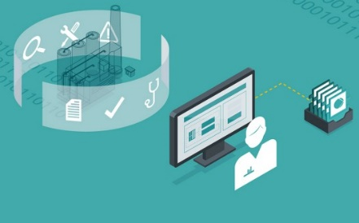
SIMATIC PCS 7 Modernization
DCS Application und DCS Modernization Services
Modernization
Software Upgrade
e.g. SIMATIC PCS 7 V6/7 → SIMATIC PCS 7 V10, Process Historian (PH) Data Services
Application Modernization
e.g. SIMATIC PCS 7 Library → APL¹
Legacy
DCS System
State-of-
the-Art DCS System
State-of-
the-Art DCS System with APL
XY
1 APL: Advanced Process Library

Slide 10
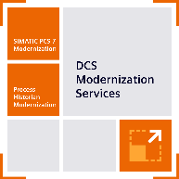
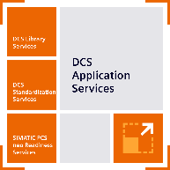
DCS Application & Modernization Services
Modular Modernization approach –Evolution path from PCS 7 to PCS neo
SIMATIC PCS 7
Software
Library
CPU
Periphery*
PCS neo
SIMATIC PCS neo
1
2
3
4
Starts with readiness
Software upgrade to SIMATIC PCS 7 V9.1/V10
Library upgrade on SIMATIC PCS 7 APL/CMT
Controller upgrade on SIMATIC CPU 410
Periphery upgrade from SIMATIC ET 200M to SIMATIC ET 200SP HA*
Upgrade to PCS neo
Standardize & get PCS neo ready
Be PCS neo!
Evolution Path
*While this step is not critical for the overall evolution, it is recommended to ensure a long-term plant lifecycle.

Slide 11

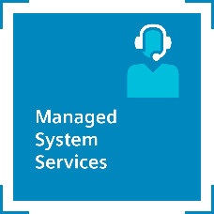
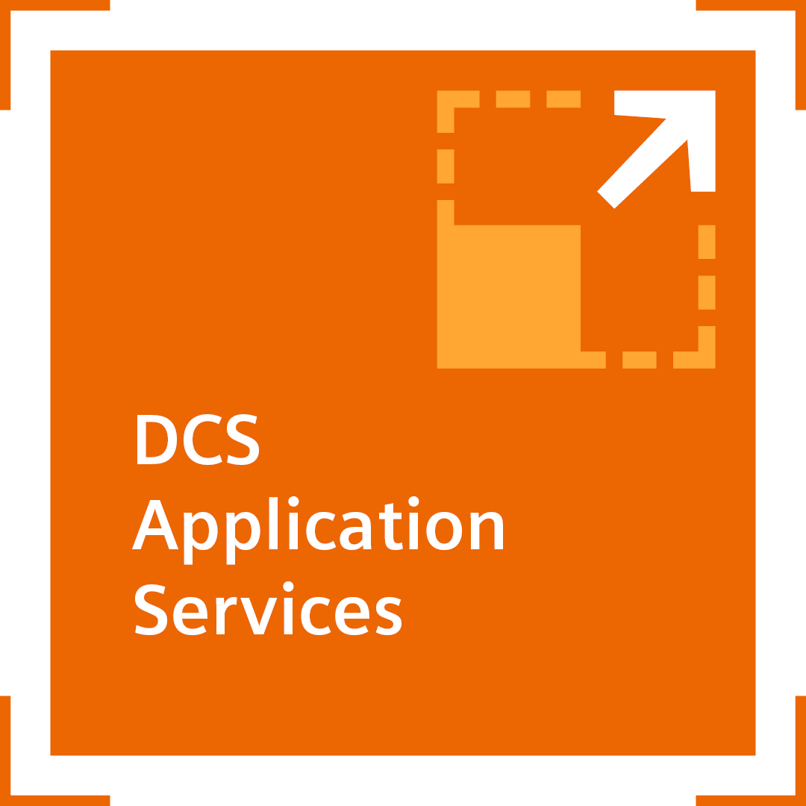
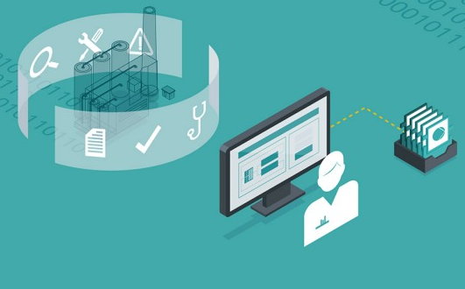

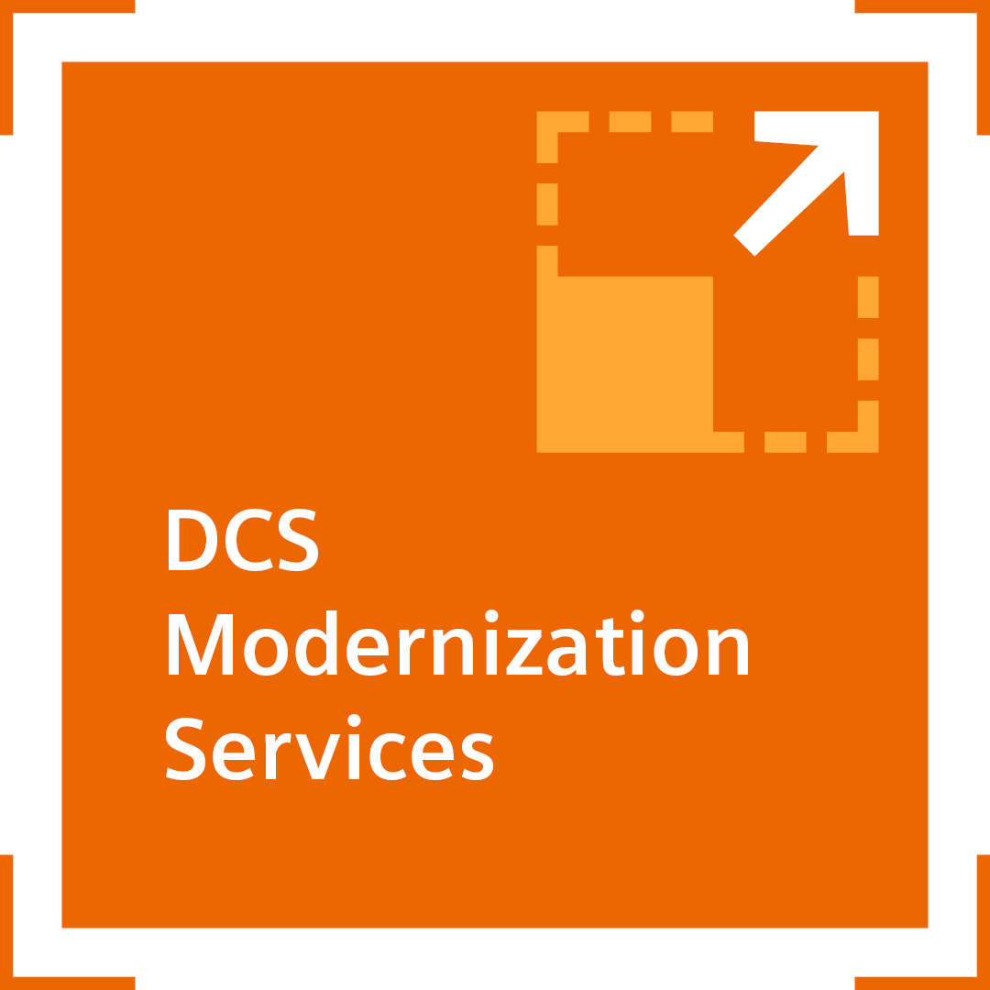
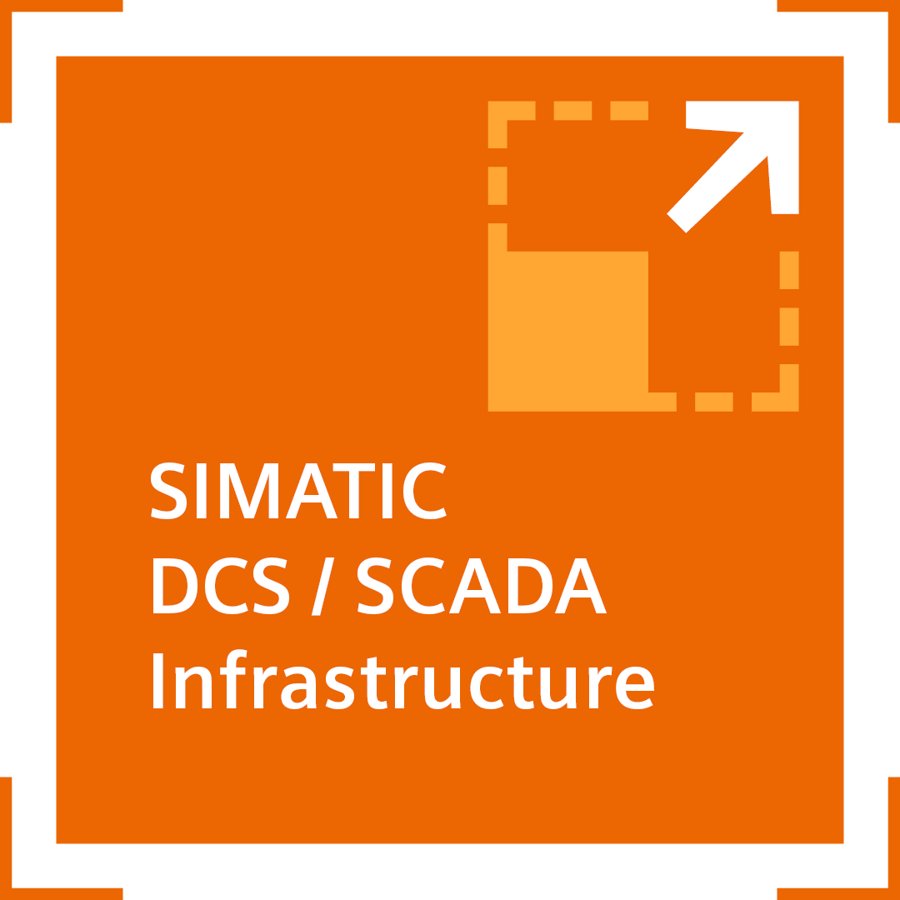
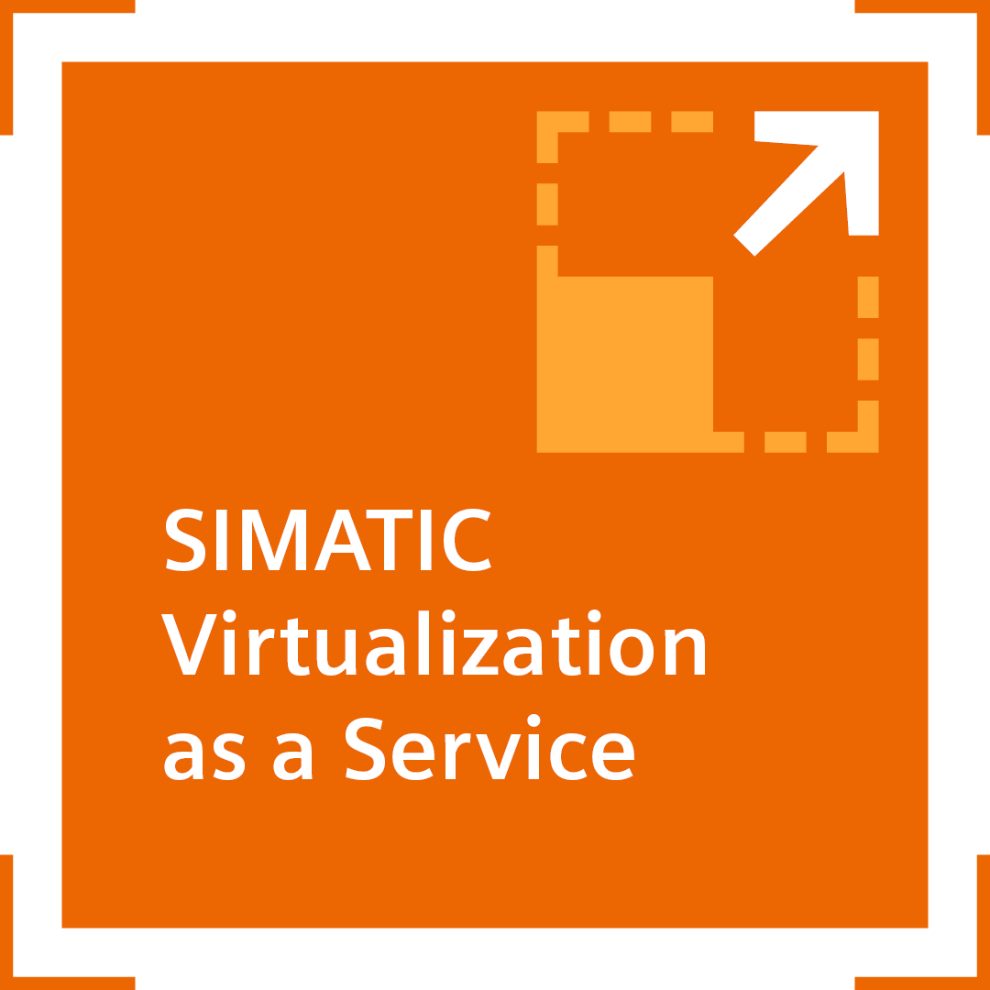
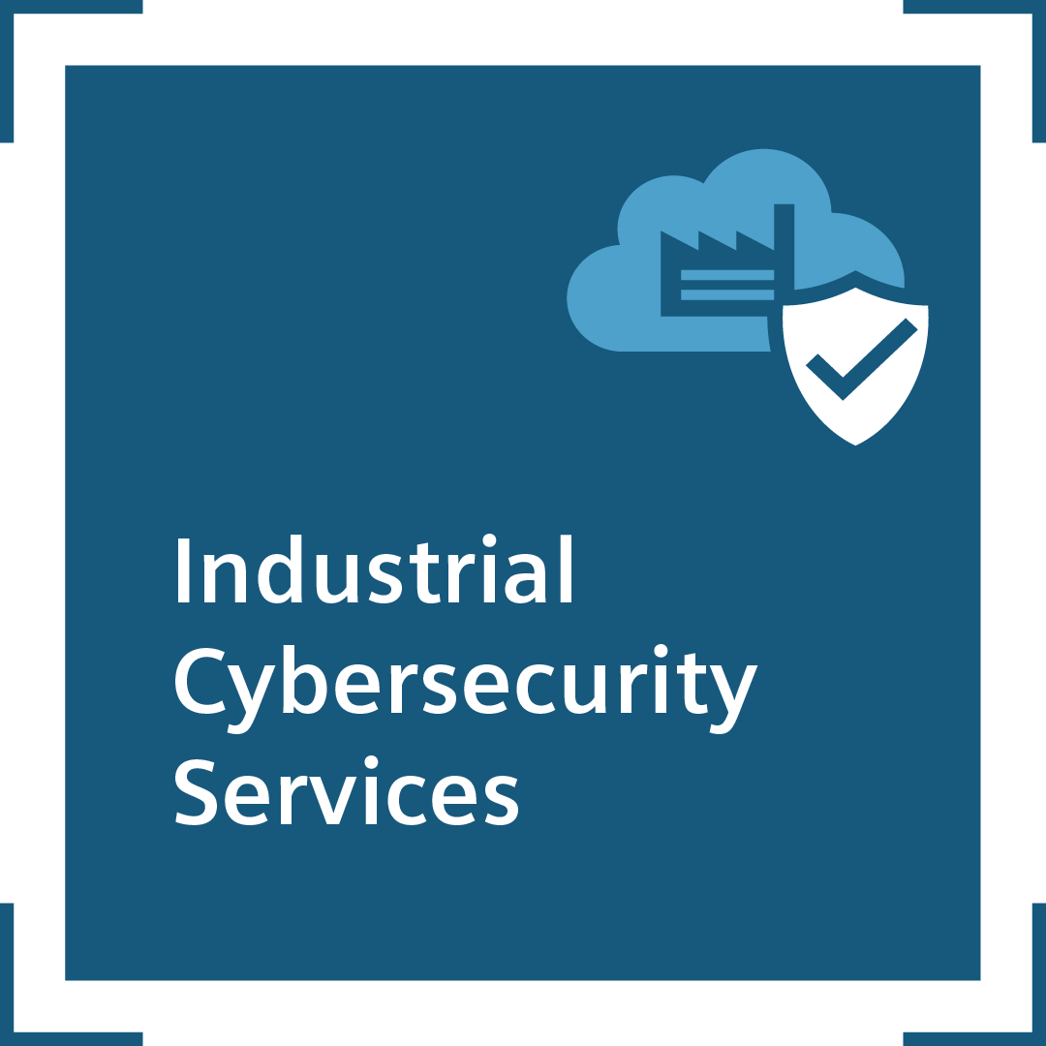
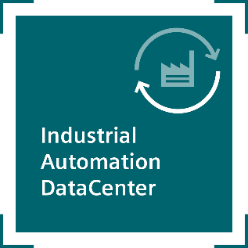
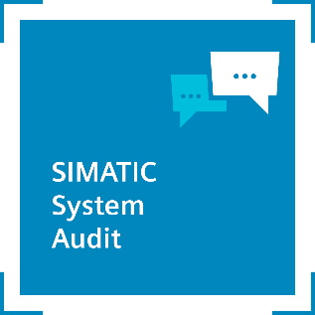
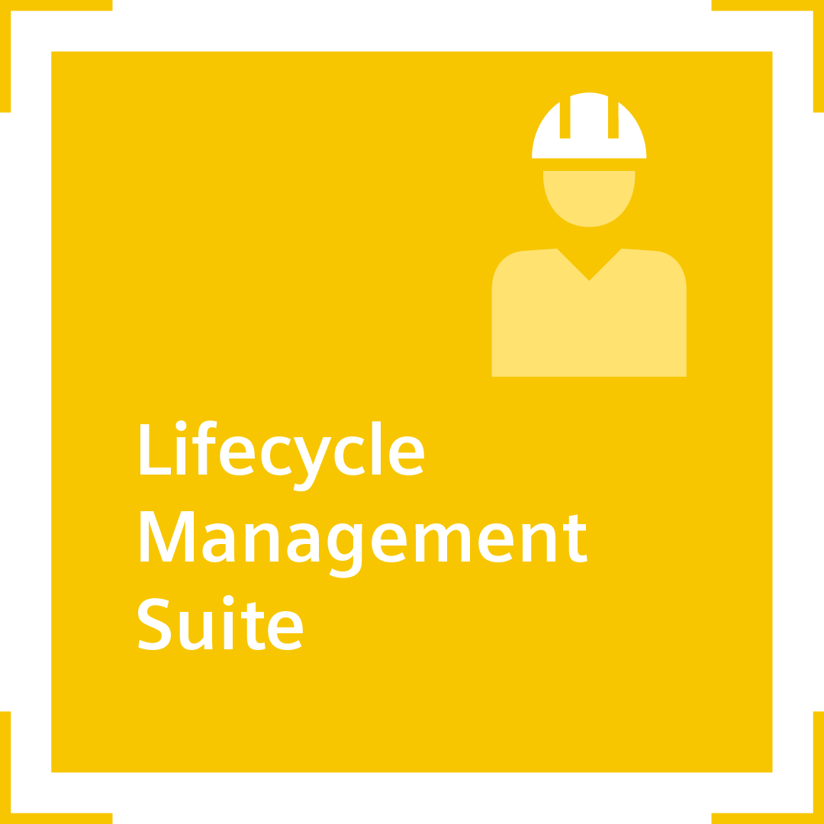
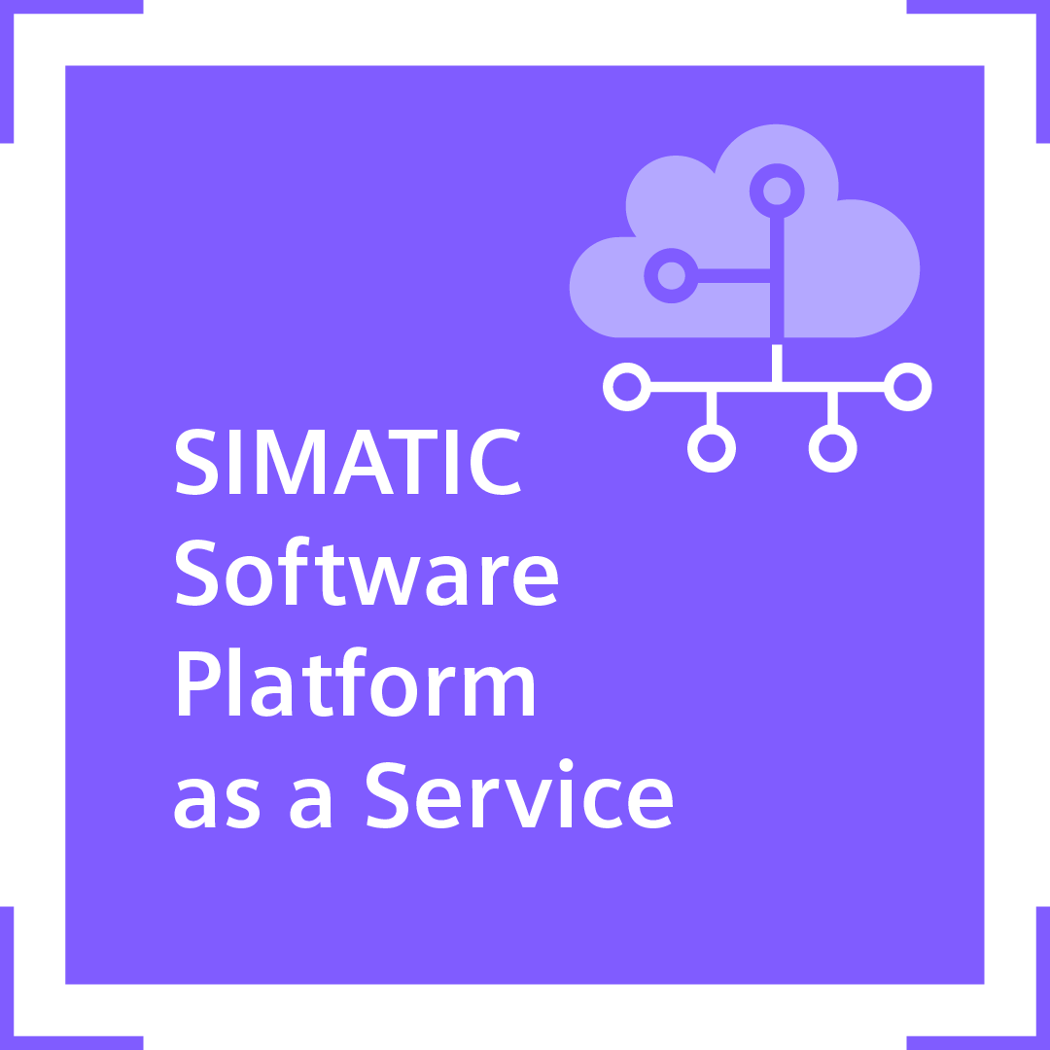
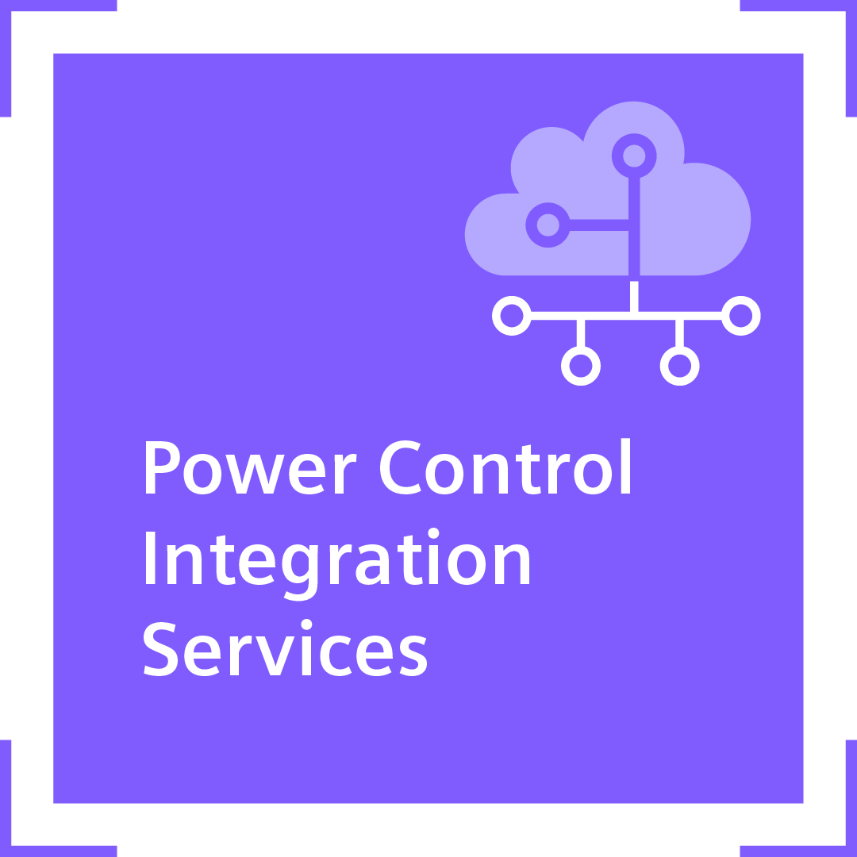
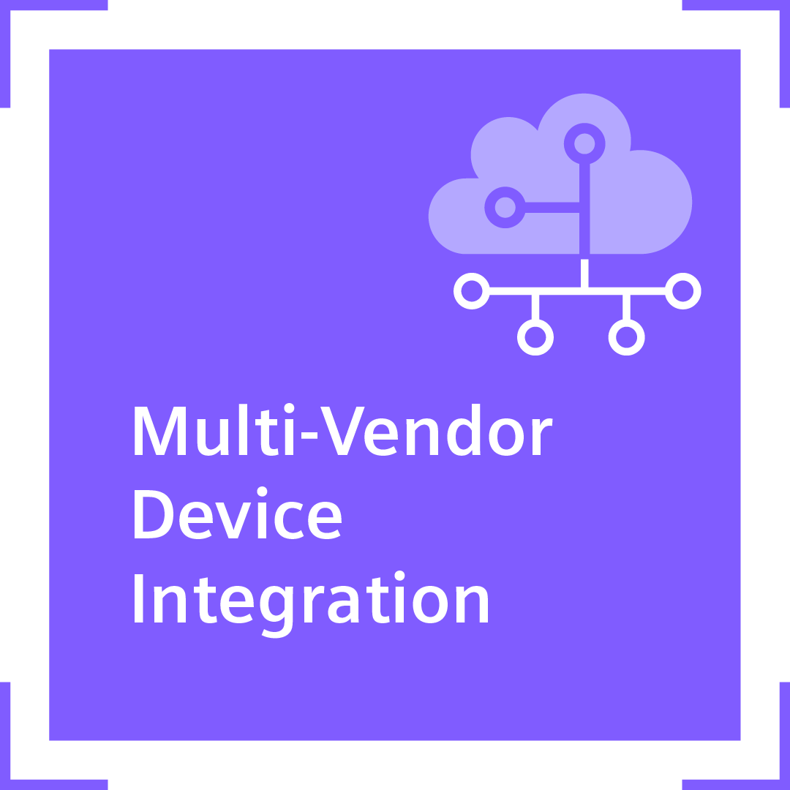
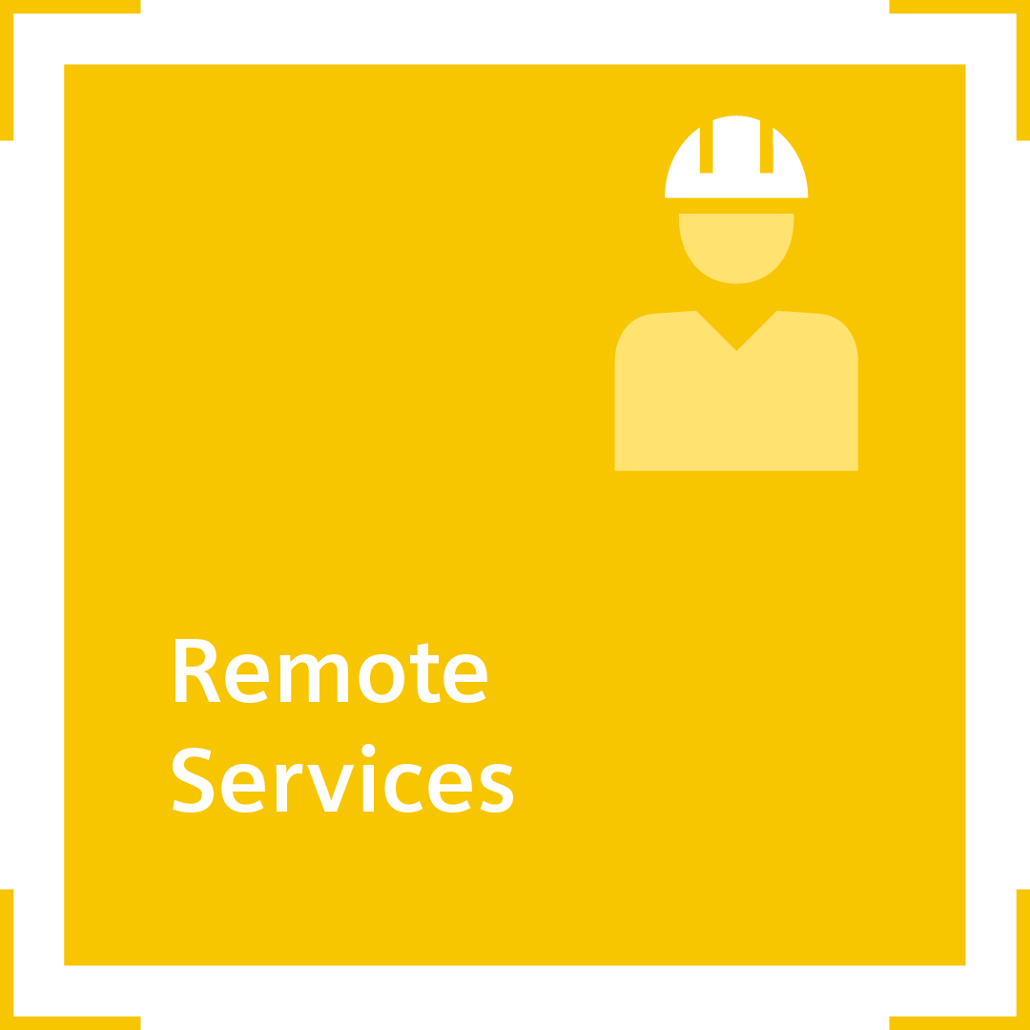
SIMATIC PCS 7 Modernization
Positioning within the modernization portfolio
Legacy System
Standardized Modernization Portfolio Elements
State-of-
the-Art System
Service Contracts
Application Upgrade
XY
System Upgrade (z.B. SIMATIC PCS 7 Version X → SIMATIC PCS 7 Version Y)
Zusatzpakete

Slide 12
Why should you choose
SIMATIC PCS 7 Modernization?
Proven Services from one single source
Automated Workflows
Secured long-term investment protection
Ensuring high quality, driven by the innovative use of current and future DCS technologies.
Benefit from a comprehensive modernization expertise for clear responsibilities and minimized downtimes of your plant.
By reducing time and costs associated with future system upgrades.

Slide 13
Highlight from DI CS PA regarding
DCS Modernization Services
Petrochemical Company
This consortium (formed by three companies) is a pioneer in industrial development within a key region, focused on fostering private investment in the petrochemical sector.
Customer objectives | Reduce maintenance costs for equipment - the current SIMATIC PCS 7 hardware is outdated, and the MFL library is no longer supported. Initiation of cybersecurity measures, as the current SIMATIC PCS 7 system does not include cybersecurity measures.
Solution and Service | Siemens local DI CS SA team cooperate with Siemens DI CS HQ team DI CS Upgrade Factory portfolios were used throughout the project: AS/OS Analysis for details of the project Library exchange from MFL to APL using DCS Library Services (DCS Application Services) Changeover to SIMATIC Virtualization as a Service (SIVaaS) system DI CS HQ/ SA technical experts to perform the entire SIMATIC PCS 7 Upgrade using DCS Modernization Services from HQ with Factory Acceptance Test on original customer Hardware in Karlsruhe, Germany with handover to SIEMENS SA
Customer benefits | Reduced maintenance costs through hardware modernization with the new SIVaaS system Prevention of maintenance costs for legacy systems Increased reliability and stability of the system Achieving a certain level of cybersecurity and flexibility to expand after the upgrade

Slide 14
Highlight from DI CS PA regarding
DCS Modernization Services
Utility and Energy Company
This publicly listed, European-headquartered company is a leader in essential utility and environmental solutions, including water, waste, energy, and transport. It employs approximately 171,000 people globally.
Customer objectives | The Company wanted to migrate the plant to SIMATIC PCS 7 to ensure plant operation and to modernize the software and hardware. Later, upgrading to the current version and replacing the library was important to regain serviceability and remain innovative.
Solution and Service | 2008: Modernization of Teleperm to SIMATIC PCS 7 V7.0 2020: Phase 1: Upgrade SIMATIC PCS 7 V7.0 > V9.0 SP2 DCS Modernization Services, SiVaaS, SIDSI (Backup & Restore, PH) 2021: Phase 2: Library replacement to APL (DCS Library Services) 202x: Phase 3: Replacement of coupled S5 with SIMATIC PCS 7 integrated solution (in bidding phase)
Customer benefits | High quality of the upgrade and thus short stop times due to standardized procedure for the upgrade and structured and documented test work. By using APL and current SIMATIC PCS 7 version, the plant is serviceable again.

Slide 15
You want to
find out more?
Webpage
Siemens Contact Database
Flyer: ​
Upgrade ET 200M to ET 200SP HA

Slide 16
Disclaimer
© Siemens 2026
Subject to changes and errors. The information given in this document only contains general descriptions and/or performance features which may not always specifically reflect those described, or which may undergo modification in the course of further development of the products. The requested performance features are binding only when they are expressly agreed upon in the concluded contract.
All product designations may be trademarks or other rights of
Siemens AG, its affiliated companies or other companies whose use by third parties for their own purposes could violate the rights of the respective owner.

