Slide 1
Siemens and The Wildlife Trusts
Restricted © Siemens AG 20XX
July 2017
In partnership with

Slide 2
Lesson 1 - Carbon
In partnership with

Slide 3
Learning Objectives
To understand what greenhouse gases are, what they do, and how they affect the natural world
To understand the atmospheric cycle and how this affects global warming
To gain an understanding of the impacts of climate change
To identify how we can reduce our carbon footprint in everyday life
In partnership with

Slide 4
Learning Outcomes
To understand how greenhouse gases work
To identify the effects global warming will have
To understand how we can reduce our carbon footprint
In partnership with

Slide 5
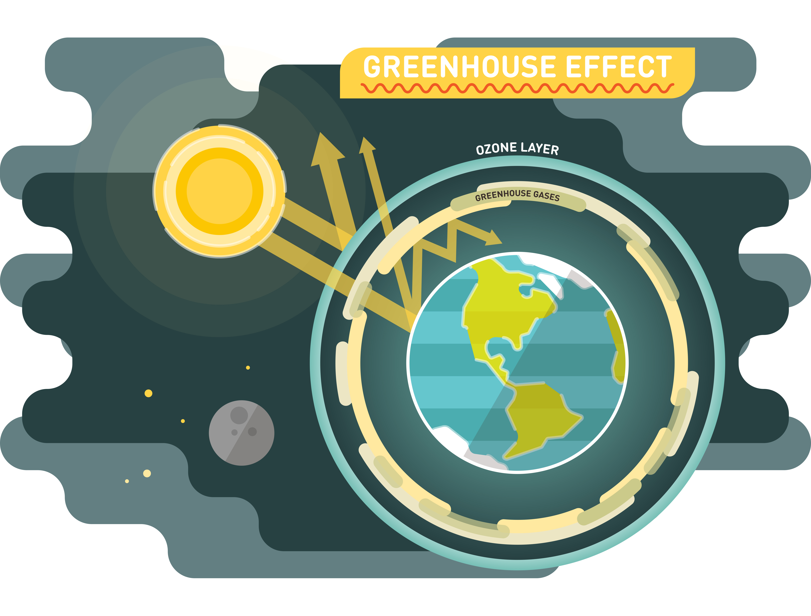
How does the Greenhouse effect work?
3
1
Sunlight passes through the atmosphere and warms the Earth
Infrared radiation (IR) is given off by the Earth. Most IR escapes to outer space and cools the Earth
But some IR is trapped by gases in the air and this reduces the cooling effect.
1
2
2
3
In partnership with
Notes:
Activity Notes:
It is important to understand the difference between climate change and global warming and to understand how man made influences are exacerbating the issue.

Slide 6
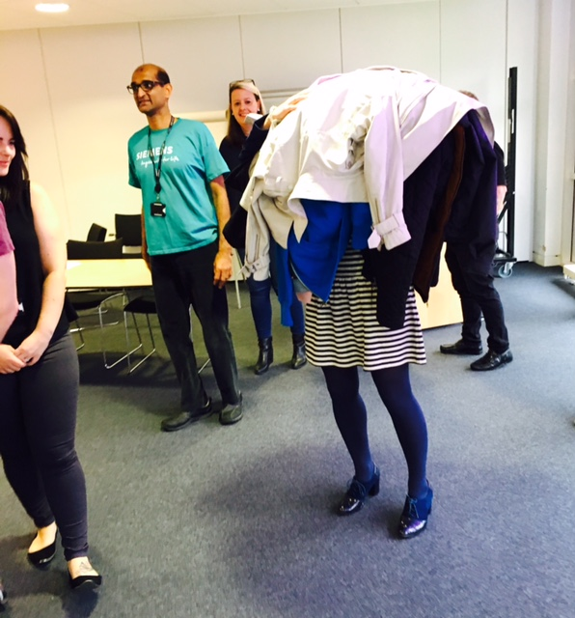
We can model this using the Greenhouse Effect Coats Game
The game is played with one person in the centre of a circle (the Earth) and other people in a circle outside with their coats (the GHGs).
In partnership with
Notes:
The game is played with one person in the centre of a circle (the Earth) and other people in a circle outside with their coats (the GHGs).
Use the following script to talk about the effect of greenhouse gasses on the earth while playing the coats game:
“Some gases in the Earth’s atmosphere stop heat radiating into space from the Earth. They include methane, water vapour and carbon dioxide. This is called the greenhouse effect and the gases involved are called greenhouse gases. An increased greenhouse effect can lead to global warming and climate change. Electromagnetic radiation at most wavelengths from the Sun passes through the Earth’s atmosphere. The Earth absorbs electromagnetic radiation with short wavelengths and so warms up. Heat is radiated from the Earth as longer wavelength infrared radiation. Some of this infrared radiation is absorbed by greenhouse gases in the atmosphere, warming up the atmosphere.”

Slide 7
How does the Greenhouse effect work?
Climate change is a large-scale, long-term shift in the planet's weather patterns or average temperatures. It is a natural process that would happen irrespective of human interference.
Global warming is the measured increase in average temperature of the planet's surface – Average temperature has risen by 0.89C from 1901 to 2012.
The rate of temperature’s rise since the Industrial Revolution is extremely high compared to any other period in History. This is believed to be caused by man made Carbon Emissions from various sources such as Hydrocarbon Fuels like Coal and Natural Gas.
In partnership with

Slide 8
Global Warming’s Effects
Retreating ice cover
Ice sheets occur at the poles, and have been shrinking over the last 100 years. Arctic sea ice reaches its minimum each September and is now declining at 13.2% per decade, comparative to the 1981 to 2010 average.
Glaciers all over the world - in the Alps, Rockies, Andes, Himalayas, Africa and Alaska - are melting and the rate of shrinkage has increased in recent decades.
This isn’t the case for all glaciers however. A few have actually grown, receiving greater snow fall due to changing weather patterns.
In partnership with
Notes:
Activity Notes:
Discuss how melting of ice sheets and glaciers has happened – clue burning of fossil fuels, build up of greenhouse gases in the atmosphere

Slide 9
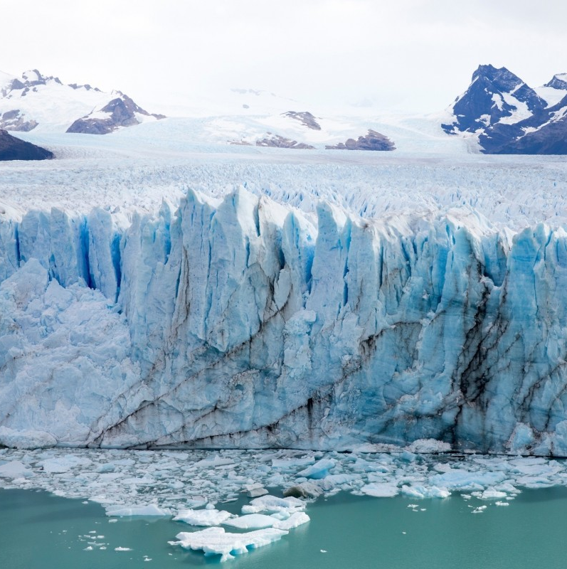
The Impacts of Climate Change on Wildlife
Watch the video to learn more about retreating ice
Did you know…… Eric Larsen and Ryan Waters’ 2014 expedition from the northern tip of Canada’s Ellesmere Island to the geographic North Pole, may be the last time anyone can walk from land to the Pole, because the extent of Arctic sea ice has decreased so dramatically!
In partnership with
Notes:
Extension activity: Discuss how the albedo effect worsens global warming
The ice albedo effect is simply a name for how ice and snow reflect solar radiation, rather than absorbing it like the oceans and land do, and thus help keep the Earth cool. Since a cool Earth also tends to have more ice and snow, the ice albedo effect is an example of a positive climate feedback. As our Glaciers and ice sheets retreat we have less ice cover to reflect solar radiation, so temperatures increase.

Slide 10
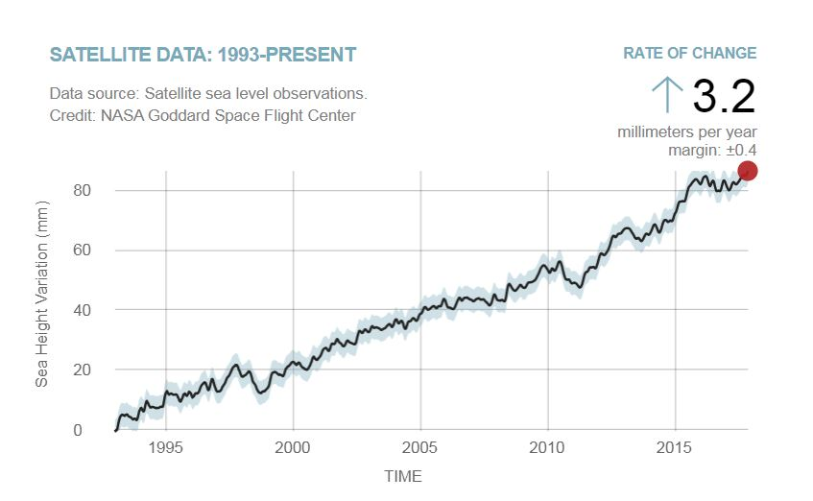
Global Warming’s Effects
Sea level rises
Rising sea levels are mostly caused by the thermal expansion of sea water, due to increasing temperature. Increasing melted water from ice sheets and glaciers also adds to the problem but to a lesser extent.
This graph shows the change in sea level since 1993 as observed by satellites.
In partnership with
Notes:
Liquid water is densest at 4 °C and becomes less dense as the water molecules begin to form hexagonal crystals as it becomes ice when the freezing point is reached.
This is why ice floats.

Slide 11
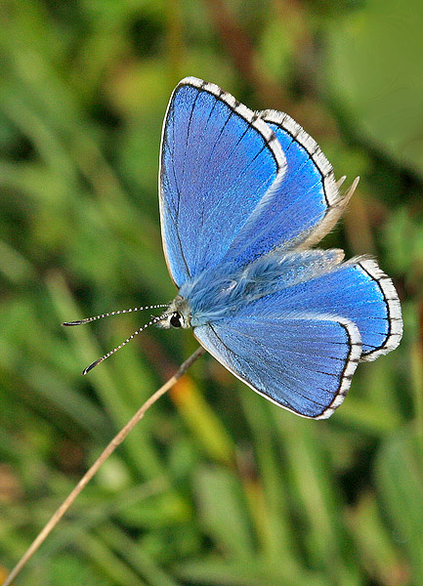
The Impacts of Climate Change on Wildlife
There is strong evidence that climate
change is already affecting our UK
biodiversity. Many species are occurring
further north and at higher altitudes
(e.g. the Adonis blue butterfly pictured) than in previous decades.
Although a warmer climate will benefit some
species, this is likely to be countered by
negative impacts for others and extreme
weather events. The same goes for
some of our most iconic landscapes
and habitats, including wetland, heathland and some types of woodland.
www.wildlifetrusts.org
In partnership with

Slide 12
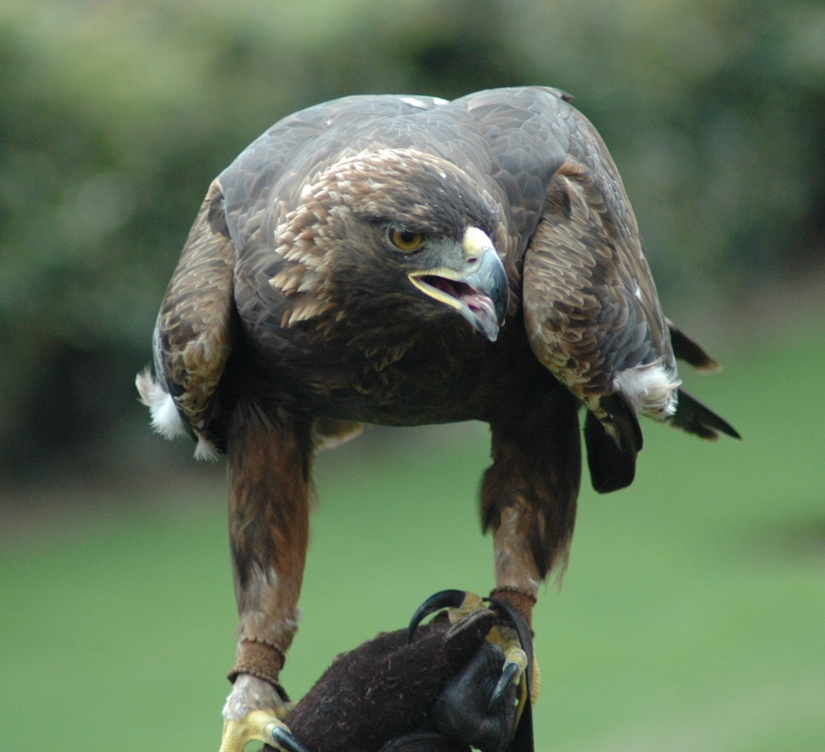
The Effects of Climate Warming on Wildlife
High spring rainfall, for example, can negatively impact on birds, causing reproductive failures and poor chick condition. In west Scotland, golden eagle populations declined by 25% when there was a significant increase in May rainfall.
Flooding has a negative impact on almost all mammals, except bats, when large areas of land are inundated with floodwater during spring and summer, nests and burrows are flooded causing the young to drown or die from cold.
www.wildlifetrusts.org
In partnership with

Slide 13
Global Warming’s Effects
What does this mean for the UK
Rainfall has increased in the mid-latitudes of the northern hemisphere since the beginning of the 20th century. There are also changes between seasons in different regions. For example, the UK's summer rainfall is decreasing on average, while winter rainfall is increasing. There is also evidence that heavy rainfall events have become more intensive, especially over North America.
Effects on humans include flooded houses, lost road links, people running out of food and reduced access to medical support. Effects on nature include submerged land, isolated wildlife and food shortage.
Preventative measures include flood defences, planting trees, canalising rivers, drainage planning, porous pavement, decarbonising energy.
In partnership with
Notes:
Activity Notes:
Discuss:
how flooding could be prevented e.g. flood defences, planting trees, canalising rivers, drainage planning, porous pavement, decarbonising energy, reducing energy use and car travel. It is important to note total rainfall is not always the issue but the intensity of rainfall, that will lead to flooding
Brainstorm:
the damaging effects on humans and nature of flooding here in the UK
Human effects- flooded houses, lost road links, people running out of food, no access to medical support.
Effects on nature – submerged land, isolated wildlife, food shortage

Slide 14
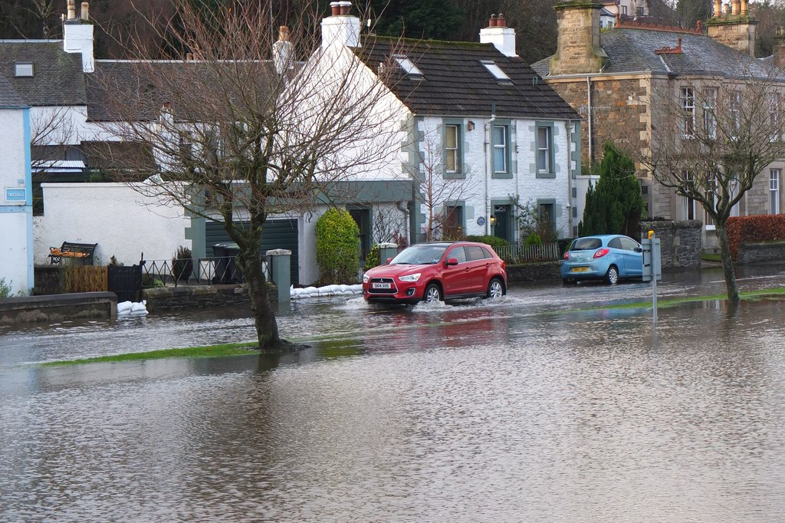
Global Warming’s Effects
Case study Manchester, Lake District Floods
Follow the link in the image to watch Helicopter footage showing the scale of the 2015 Cumbria floods.
Helicopter footage reveals the scale of widespread flooding in Cumbria as flood water reach their peak in the wake of Storm Desmond.
Hundreds of homes have been flooded and more than 1,000 people evacuated in Cumbria and the Scottish Borders
In partnership with
Notes:
Activity Notes:
Discuss:
how flooding could be prevented e.g. flood defences, planting trees, canalising rivers, drainage planning, porous pavement, decarbonising energy, reducing energy use and car travel. It is important to note total rainfall is not always the issue but the intensity of rainfall, that will lead to flooding
Brainstorm:
the damaging effects on humans and nature of flooding here in the UK
Human effects- flooded houses, lost road links, people running out of food, no access to medical support.
Effects on nature – submerged land, isolated wildlife, food shortage

Slide 15
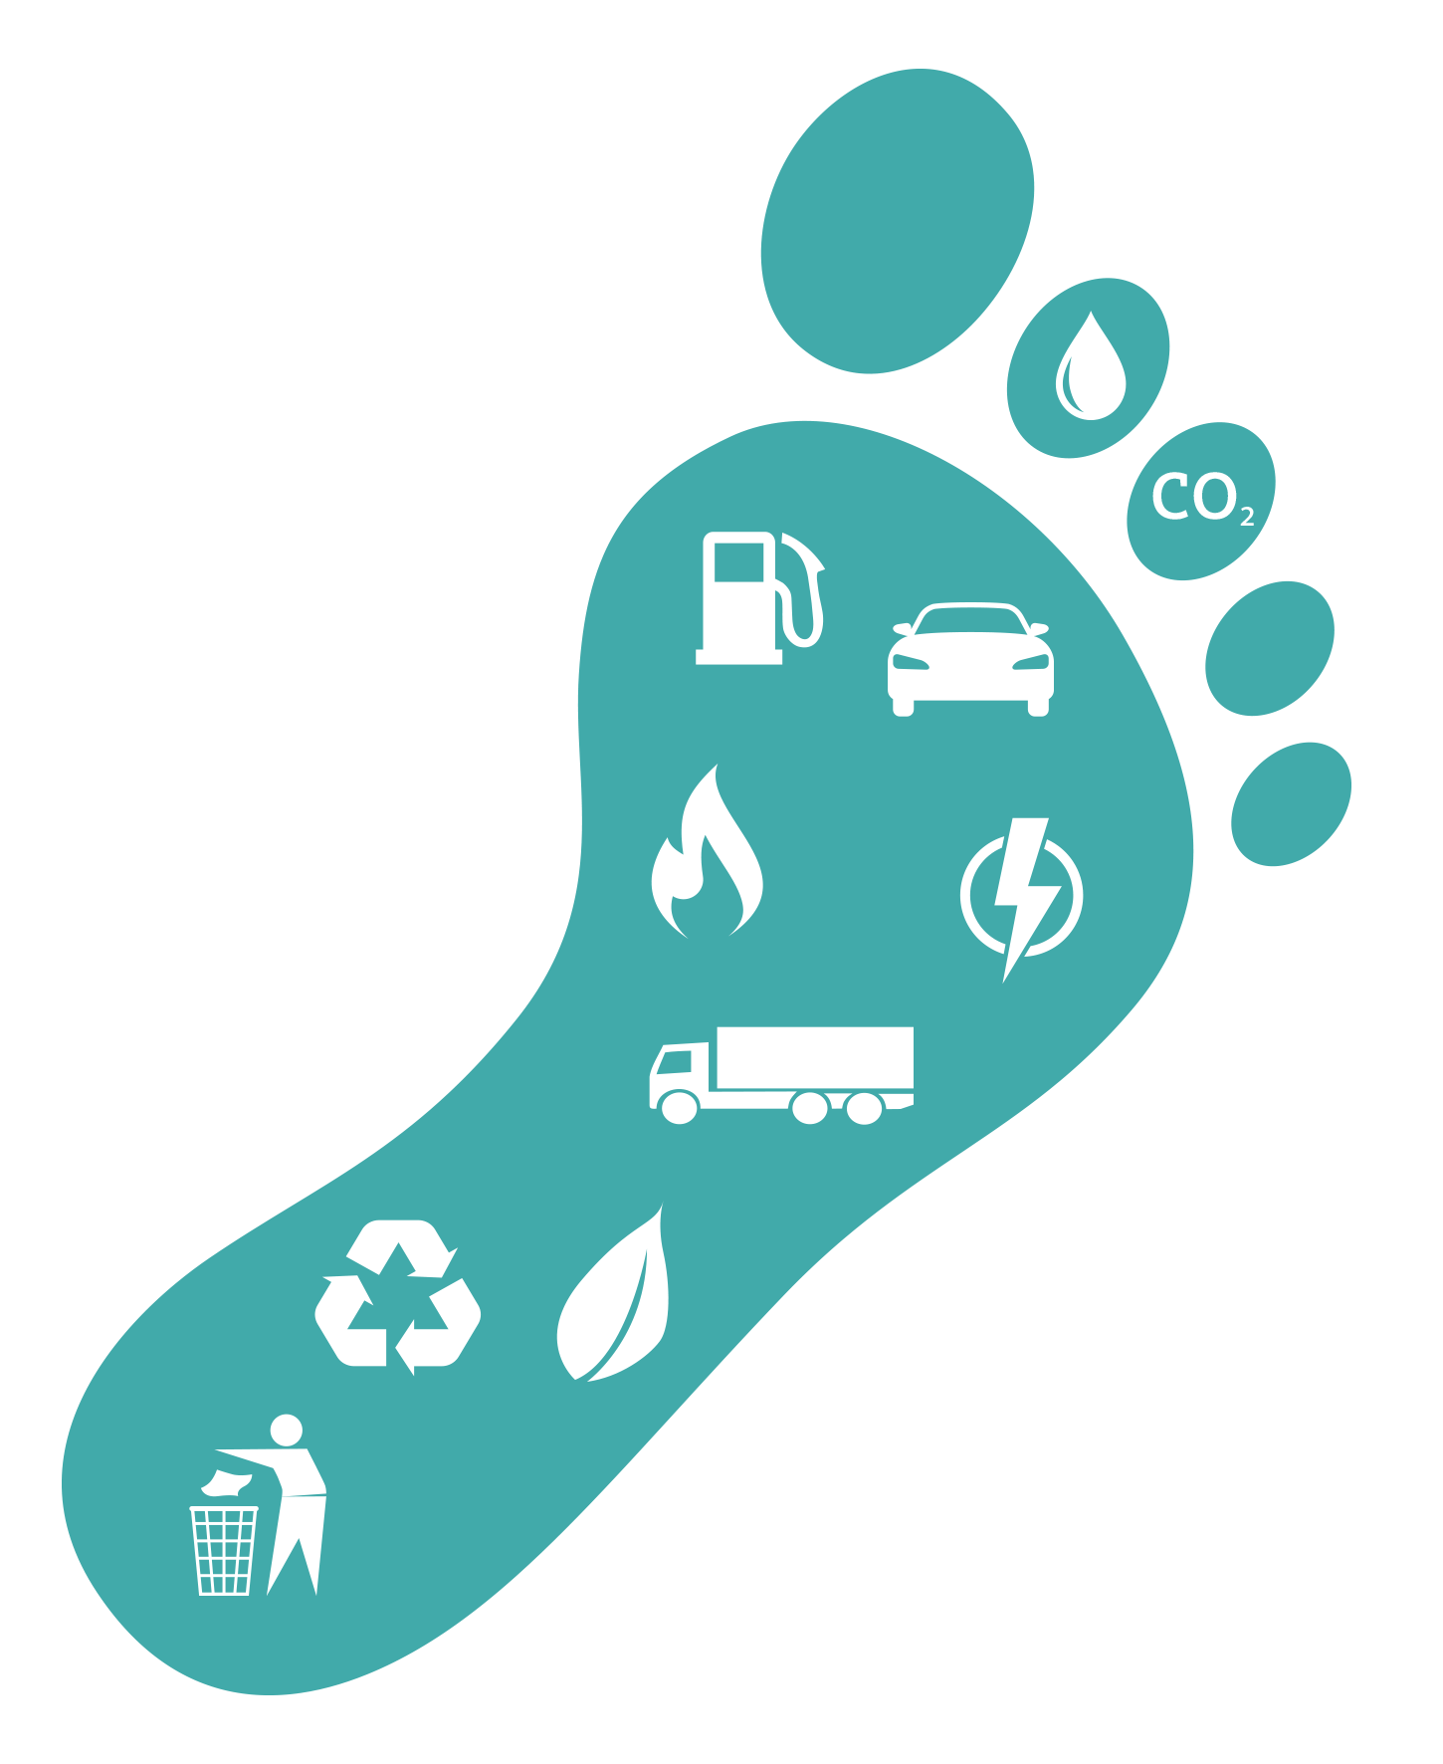
Your Carbon Footprint
Water
Watch this video: www.youtube.com/watch?v=8q7_aV8eLUE
Use the worksheet to find out the number of pounds of carbon dioxide per year you use. The lower the number, the fewer greenhouse gases are emitted into the atmosphere
Emissions
Fuel
Personnel
Gas
Electricity
Recycling
Transport
Offsets
Waste
In partnership with
Notes:
Activity Notes:
Watch a short video on the carbon footprint
Ask the students to calculate their carbon dioxide usage using the worksheet provided.
Find out which student has the lowest emissions in the class.
Discuss:
other ways in which the students could reduce carbon dioxide at school and at home

Slide 16
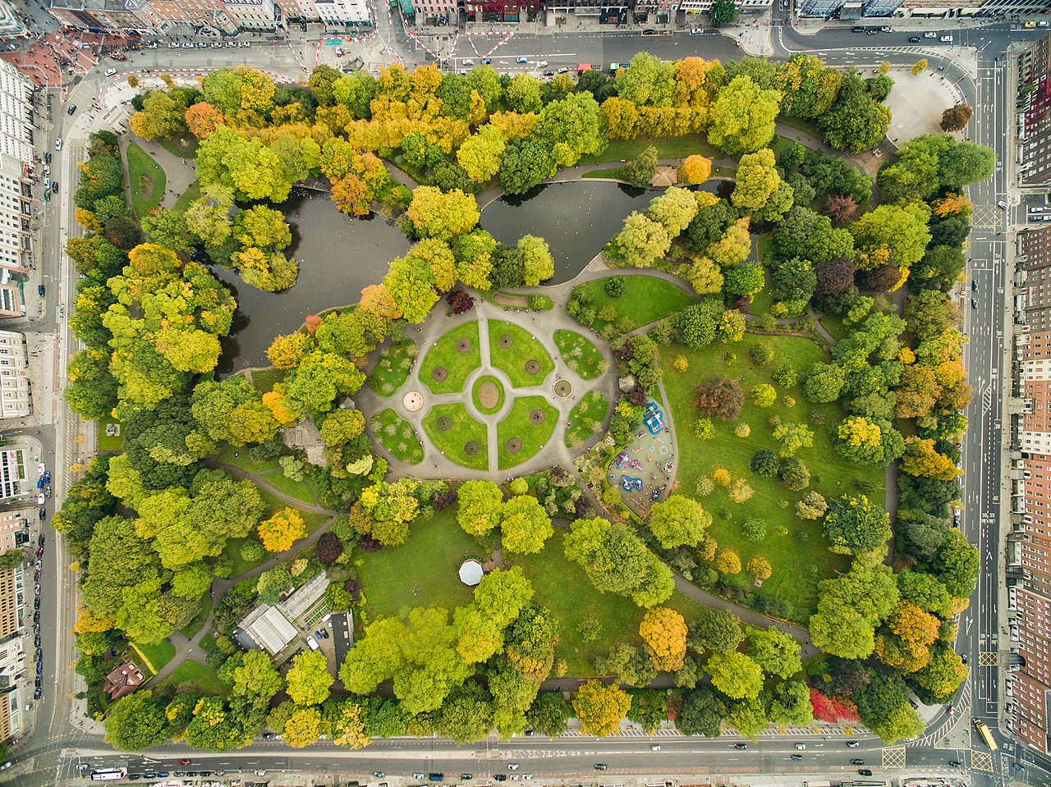
The Impacts of Climate Change on Wildlife
A satellite survey by a research team at the University of Leicester found that between 2006 and 2012, 54,000 acres of green space was converted to synthetic surfaces, mostly housing. 14,000 hectares of woodland was concreted and 1,000 hectares of wetland was drained to make way for urban extension.
Urban parks contribute to environmental benefits. This is because parks and open spaces that include protected natural lands, ecological reserves and wetlands are critical to providing healthy habitats for humans, wildlife and plants in densely built up areas.
Dronepicr CC
In partnership with
Notes:
Discuss how reducing green space may affect us personally – parks are good for bodily and mental health. Use exercise, dog walks, biodiversity and free activity space as examples of the benefits of green spaces.
Further information on the wellbeing elements of the topic can be found here
http://www.wildlifetrusts.org/living-landscape/nature-health-and-wild-wellbeing

Slide 17
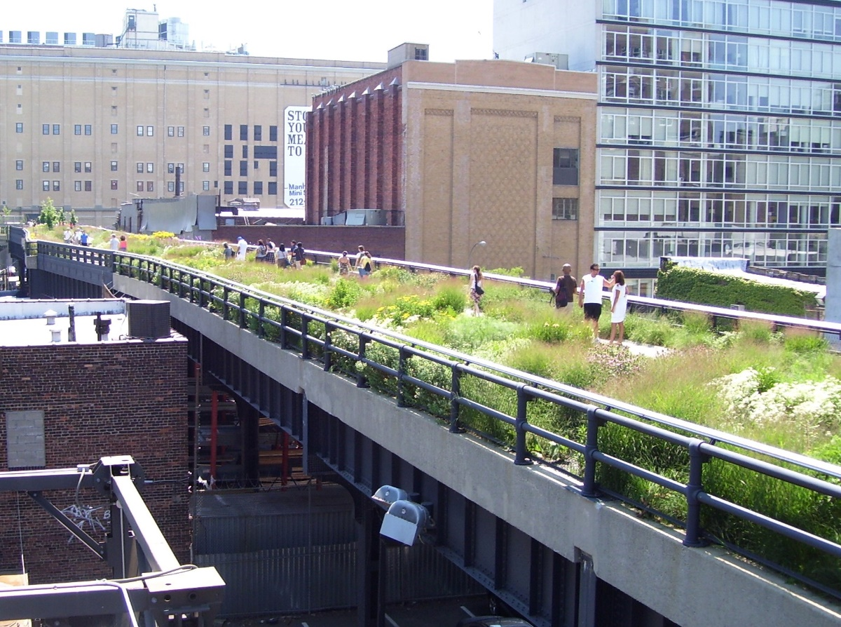
The Impacts of Climate Change on Wildlife
Parks can also help create energy efficient cities to slow global warming, as plants absorb CO2 and NO2 emissions via leaf stomata or the plant surface. Open spaces make compact living attractive and feasible. Trails link individual parks making it easier for people to bike and walk. Additionally old rail lines can be transformed into greenways.
Beyond my own Ken photography CC
In partnership with
Notes:
Discuss how reducing green space may affect us personally – parks are good for bodily and mental health. Use exercise, dog walks, biodiversity and free activity space as examples of the benefits of green spaces.
Further information on the wellbeing elements of the topic can be found here
http://www.wildlifetrusts.org/living-landscape/nature-health-and-wild-wellbeing

