Slide 1
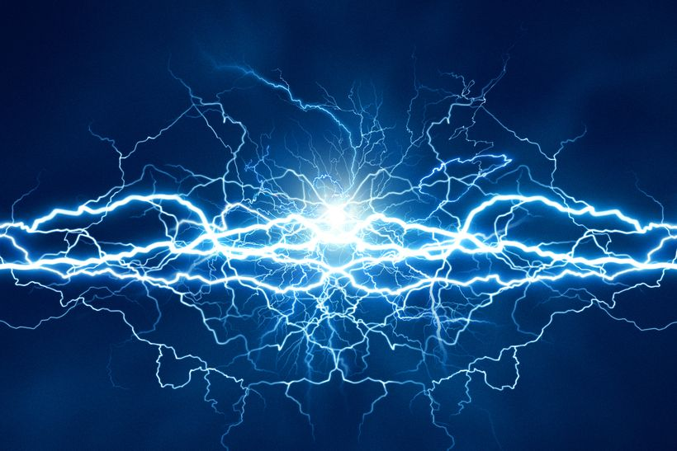
Electrical Conductors
[Conductivity] noun
In general, conductivity is the capacity to transmit something, such as electricity or heat.
An electrical conductor is a substance in which electrical charge carriers (usually electrons) move easily from atom to atom with the application of voltage.
Unrestricted

Slide 2


Electrical Conductors
Learning Aims
Knowledge | Skills
Understand the difference between an electrical conductor and insulator. Understand related scientific terminology Understand different materials have different resistance to the flow of current Cross sectional area, length, and material are key factors in the resistance of a component. Suitable design can reduce energy losses. | Working collaboratively Selecting appropriate functions on a multimeter Reading digital scales Using Analogue micrometer Reading micrometer scales Using standard form in calculations and presenting figures

Slide 3
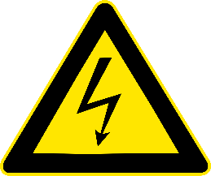


Some materials let electricity pass through them easily, these materials are known as electrical conductors.
The SI unit of measure for electrical conductivity is the siemens (S) and is measured in siemens per metre (S/m), represented by the Greek letter sigma (σ).
The electrical resistance of an electrical conductor is a measure of how difficult it is for an electrical current to pass through the conductor.
The SI unit of measure for electrical resistance is the ohm and represented by the Greek letter omega (Ω).
Some materials do not allow electricity to pass through them, these materials are known as electrical insulators.
Notes:
What is an electrical conductor?
<click 1>
Some materials let electricity pass through them easily, these materials are known as electrical conductors.
The International Standard (SI) unit of measure for electrical conductivity is the siemens, named after Ernst Werner von Siemens (the founder of the Siemens company), and is measured in siemens per metre (S/m) and is represented by the Greek letter sigma (lower-case).
<click 2>
The electrical resistance of an electrical conductor is a measure of how difficult it is for an electric current to pass through the conductor.
The SI unit of measure for electrical resistance is the ohm, named after the physicist Georg Simon Ohm, and represented by the Greek letter Omega (upper-case).
<click 3>
Some materials don’t allow electricity to pass through them, these materials are known as electrical insulators.

Slide 4
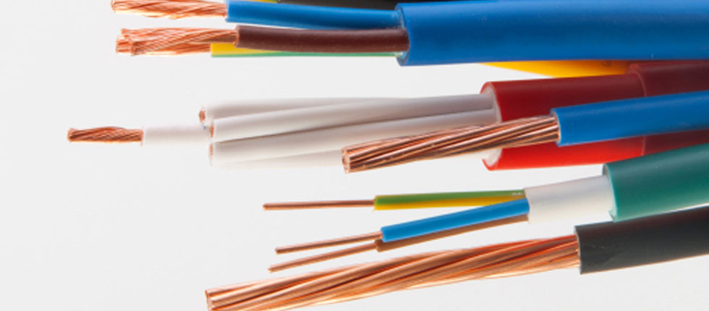
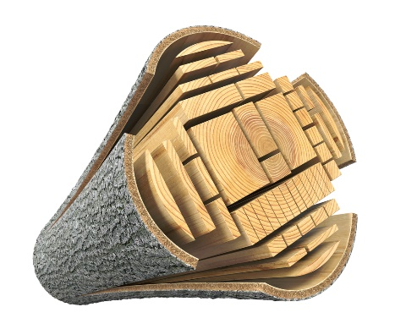
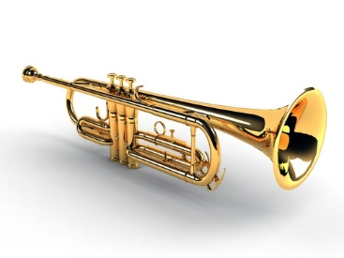
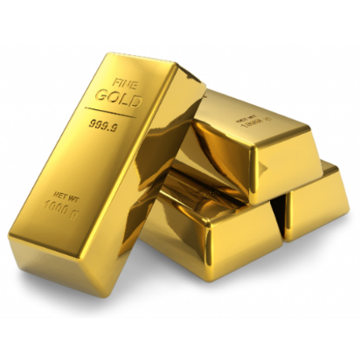
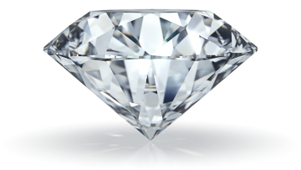
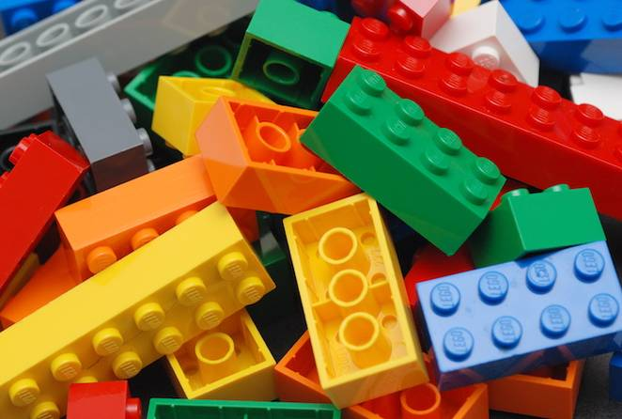

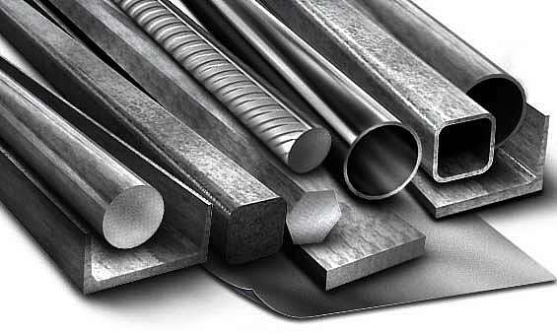
Good conductors are important for the efficient transmission of electricity
Material Conductor Insulator
Copper (Cu)
✓
30
Zn
Zinc (Zn)
✓
Zinc
65.38
Brass
✓
Wood
✓
Diamond
✓
Gold (Au)
✓
Plastic
✓
Rubber
✓
82
Pb
Lead (Pb)
✓
Lead
207.2
Steel
✓
Notes:
Note to teacher: This slide builds.
Which materials are electrical conductors and which material are insulators?
<click 1>
Copper, (the periodic table symbol for cooper is Cu). Is it a conductor of electricity or an insulator?
<click 2.
It’s a conductor. Cooper is one of the most widely used metals for conducting electricity.
<click 3>
Zinc, (the periodic table symbol for Zinc is Zn). Is it a conductor of electricity or an insulator?
<click 4>
It’s a conductor. Zinc is widely used in the production of dry cell batteries, the type of battery you use to power flashlights etc.
<click 5>
Brass is a metal alloy made of cooper and zinc. Is it a conductor of electricity or an insulator?
<click 6>
It’s a conductor.
<click 7>
Wood. It grows on trees… Is it a conductor of electricity or an insulator?
<click 8>
It’s an insulator. It does not conduct electricity.
<click 9>
Diamonds are a crystalline form of pure carbon, the hardest naturally occurring substance. Is diamond a conductor of electricity or an insulator?
<click 10>
It’s an insulator. It does not conduct electricity.
<click 11>
Gold, a precious metal, (the periodic table symbol for Gold is Au). Is it a conductor of electricity or an insulator?
<click 12>
It’s a conductor.
<click 13>
Plastic. Is it a conductor of electricity or an insulator?
<click 14>
It’s an insulator.
<click 15>
Rubber. Used to make wellies and rubber-gloves, but is it a conductor of electricity or an insulator?
<click 16>
It’s an insulator.
<click 17>
Lead, (the periodic table symbol for Lead is Pb). Is it a conductor of electricity or an insulator?
<click 18>
It’s a conductor.
<click 19>
Steel, an alloy made form iron and carbon. Is it a conductor of electricity or an insulator?
<click 20>
It’s a conductor.
Materials that typically conduct heat very well also conduct electricity well, because both processes transport energy using electrons.

Slide 5
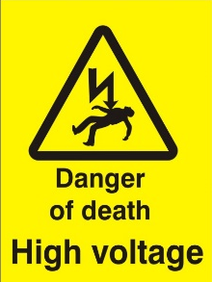
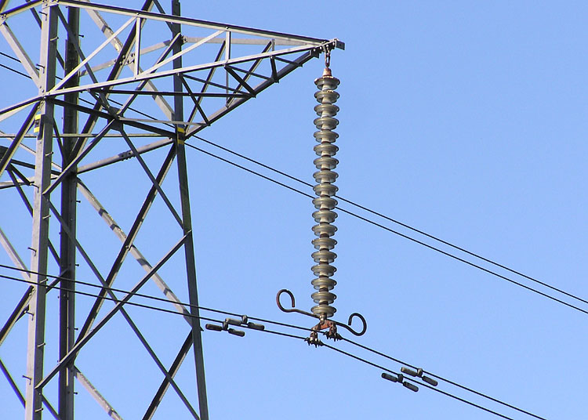
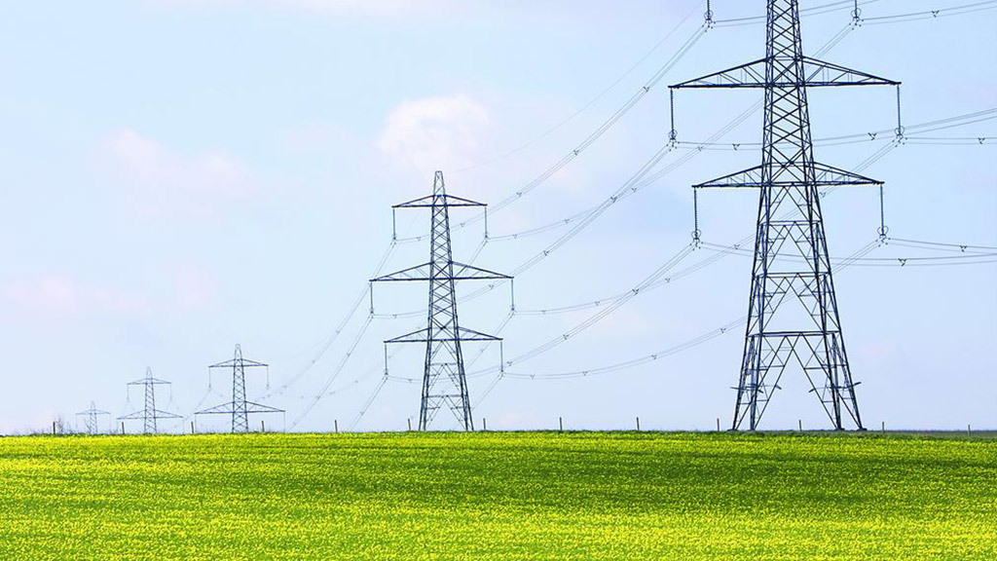
Good conductors are important for the efficient transmission of electricity
Aluminium powerline (with steel reinforcement)
carrying electricity at voltages exceeding 765,000 volts
Glass
or ceramic
insulators
Steel
Notes:
As metal is a good electrical conductor it’s used to manufacture high-voltage transmission cables. These cable are typically made form aluminium reinforced with steel.
The structures used to hold these high-voltage powerlines (referred to as pylons) are also made of steel. How do they stop the electricity in the powerlines from passing into the pylons?
<click 1>
The powerlines are suspended from the pylons under glass or ceramic insulators.
The following YouTube video is on Siemens Power Transmission Technology: https://www.youtube.com/watch?v=TVtlEqMrc1w

Slide 6
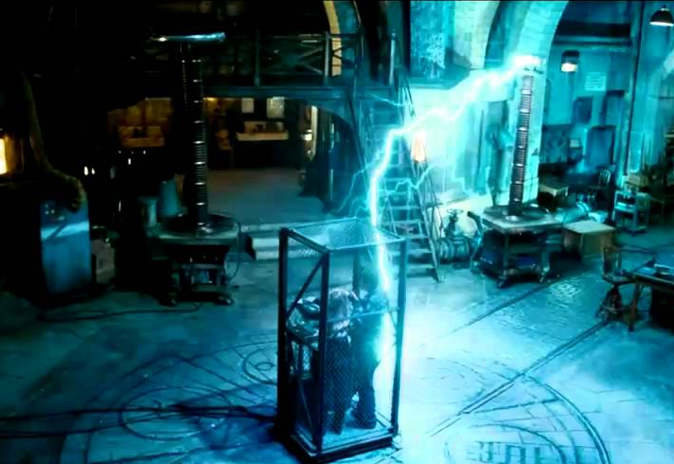
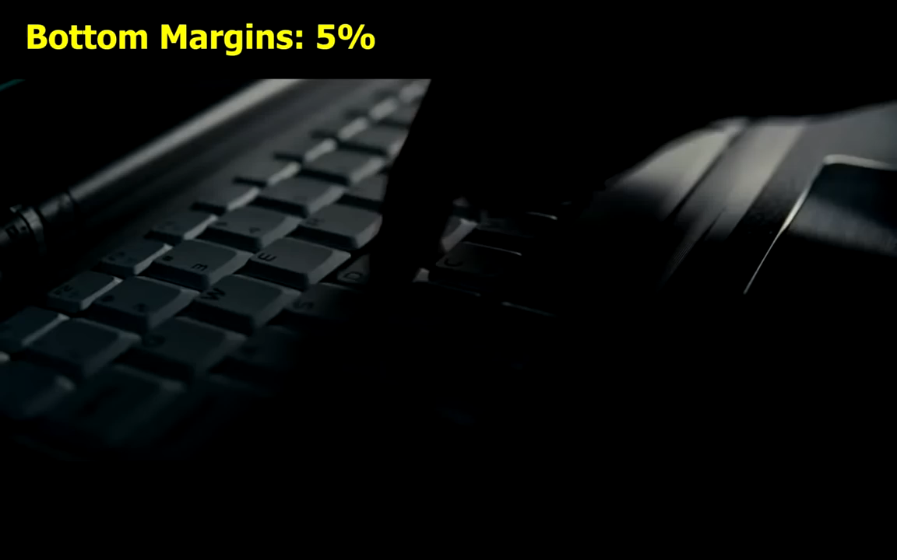
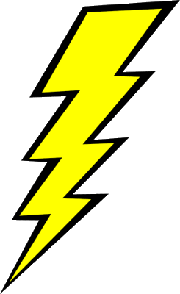

Question: is a Faraday cage made from an electric conductive material or an insulator material?
The Faraday Cage
Tesla coil
Tesla coil
Source of High Voltage
“The Sorcerer’s Apprentice” (2010) Disney © YouTube video
Notes:
This slide is optional.
Faraday cage https://en.wikipedia.org/wiki/Faraday_cage
A Faraday cage is an enclosure used to block electric fields. It’s formed by a conductive material.
The embedded video is a YouTube clip from the Disney film “The Sorcerer’s Apprentice” (2010) and gives an excellent example of a Faraday cage. <Click 1> removes the image then please click the video to start the video.
Alternatively the video clip can be access from YouTube:
https://www.youtube.com/watch?v=RFclcSOiqww
The following YouTube videos show the same but in real life and shows the previous video wasn’t movie special effects
https://www.youtube.com/watch?v=BTysjWDl-SI
https://www.youtube.com/watch?v=fLiji1YgDGU

Slide 7

Electrical resistance (R)
While all metals are electric conductors some are better than others. Electrical resistance is a measurement of how a material impedes the flow of electricity.
The scientific symbol for electrical resistance is the ohm:
Each metal has a different resistivity; a measure of the
resisting ability of a material to the flow of electricity.
The symbol for resistivity is the Greek letter rho:
Ω
$$ρ$$
Notes:
The electrical resistance of an electrical conductor is a measure of the difficulty to pass an electric current through that conductor. Electrical resistance shares some conceptual parallels with the notion of mechanical friction. The SI unit of electrical resistance is the ohm (Ω), while electrical conductance is measured in siemens (S).

Slide 8
Most non-metals are poor conductors of electricity (insulators).
All metals conduct electricity, some better than others.
But which of the following metals is the best electrical conductor?
Stainless Steel
(An alloy of Iron and Chromium)
Hardness = 6/10
Price = US $ 1500
Density = 8 grams per cubic centimetre
Brass
(An alloy of Copper and Zinc)
Hardness = 3.5
Price = US $ 1500
Density = 8.5 grams per cubic centimetre
Copper (Cu)
Hardness = 2.75
Price = US $ 4500
Density = 9 grams per cubic centimetre
Aluminium (Al)
Hardness = 2.5
Price = US $ 1500
Density = 2.7 grams per cubic centimetre
Prices are $ (US Dollars) per metric tonne (2016). Hardness is from the Mohs Scale (0-10, from talc to diamond)
Notes:
Different metals can be used to conduct electricity. This slide in the start of a classroom activity to find out which material is the best conductor of electricity and then consider the cost-benefits when applied to specific requirements.
Price is always an important consideration in design, especially when large amounts of the material is required. The metals market can be quite volatile so these figures may require regular updates.
Mohs Scale - https://en.wikipedia.org/wiki/Mohs_scale_of_mineral_hardness

Slide 9


Which metal is the best conductor of electricity, and which is most resistant to current flow?
Electrical resistance depends upon the dimensions of the conductor and the resistivity of the material:
$$Resistance (R) =\frac{coefficient of Resistivity x length}{cross sectiona Area}$$
R$=\frac{ ρ l}{A}$
The coefficient of Resistivity (ρ) is a fixed property for each material
So $ρ =\frac{R A }{l}$
Notes:
Note – all values must be converted into metres.

Slide 10
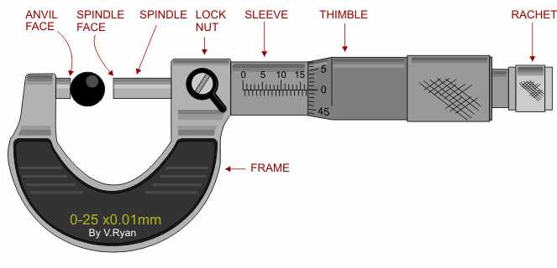
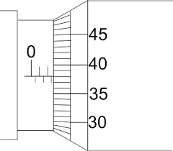

Calculating cross sectional area
To determine the cross-section area you will need to measure the diameter of the wire with a micrometer screw gauge. The Area can then be calculated using A = $π r^{2}$
2mm
0.38mm
0.5mm
2 + 0.5 + 0.38 = 2.88mm
Notes:
Students should be made aware of the importance of using the ratchet to avoid damage to both the instrument and the material being measured.

Slide 11
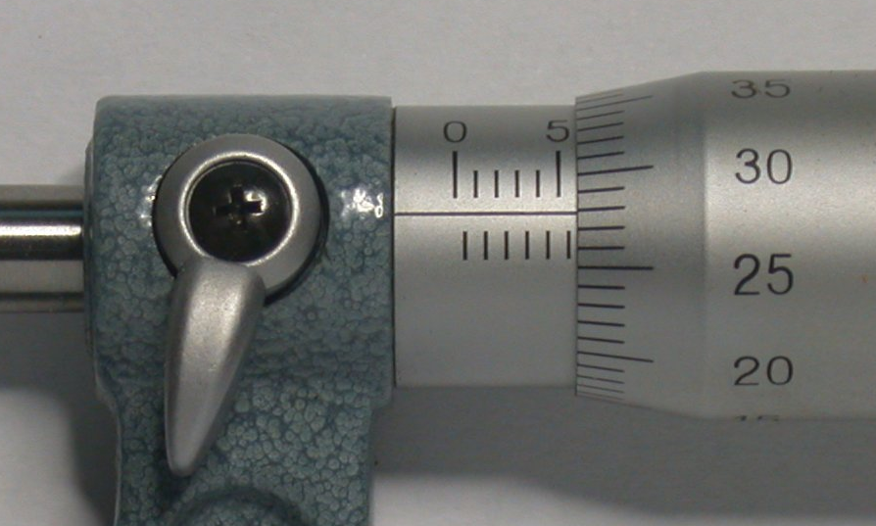
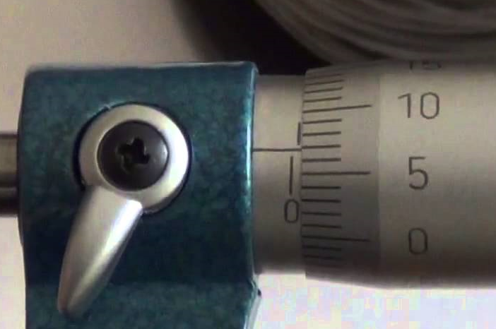
Try These micrometer readings
5mm + 0.5 + 0.28 = 7.78mm
Or more precisely
7.779mm by estimating between the thimble graduations
0mm + 0.5 + 0.07 = 0.57mm
Or more precisely
0.569mm by estimating between the thimble graduations

Slide 12
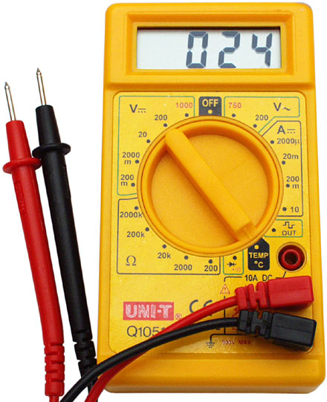
Measuring Resistance in Ohms (Ω)
The probes make a contact with the material being tested. Make sure there is a firm contact, but use the rounded edges so you do not damage soft materials like aluminium or copper
A multimeter can measure voltage, current or resistance over a wide range. We will want to measure resistance over a range of 0-200 Ohms (Ω)

Slide 13


For each wire:
Measure the diameter (mm)
Measure the length you will test
Measure the RESISTANCE for that length
Calculating Resistivity:
Convert the diameter (mm) into radius (metres) and then calculate cross section area (m²)
Use the formula
Where ρ is the coefficient of resistivity (Ωm)
R is the resistance (Ω)
A is the cross section area (m²)
$l$ is the length (m)
$ρ =\frac{R A }{l}$

Slide 14
With your new information, can you explain why many overhead powerlines are made from Aluminium rather than Copper?
Stainless Steel
(An alloy of Iron and Chromium)
Hardness = 6/10
Price = US $ 1500
Density = 8 grams per cubic centimetre
Brass
(An alloy of Copper and Zinc)
Hardness = 3.5
Price = US $ 1500
Density = 8.5 grams per cubic centimetre
Copper (Cu)
Hardness = 2.75
Price = US $ 4500
Density = 9 grams per cubic centimetre
Aluminium (Al)
Hardness = 2.5
Price = US $ 1500
Density = 2.7 grams per cubic centimetre
Prices are $ (US Dollars) per metric tonne (2016). Hardness is from the Mohs Scale (0-10, from talc to diamond)

Slide 15
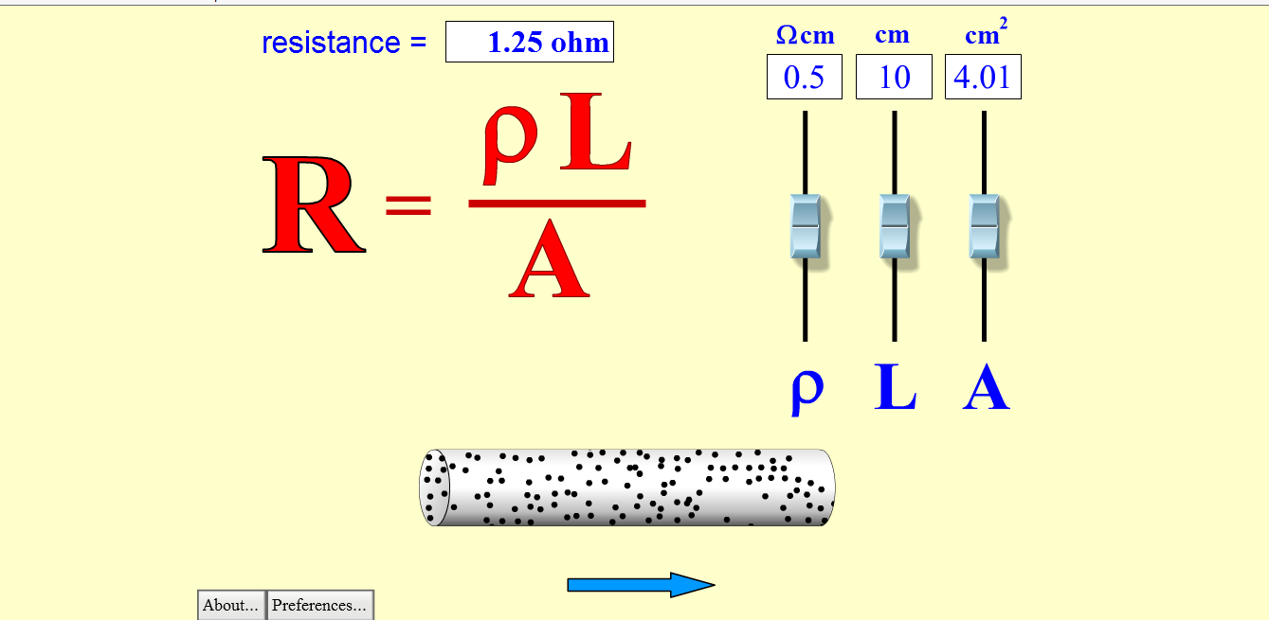
Design Challenge!
Make a conductor which has a resistance of 30 Ohms from the material provided.
The black putty has a coefficient of resistivity of 600 Ωm
Click on this link to see a Visual Equation Editor which lets you explore the equation
Notes:
The size of the conductor created is open – some may choose to make a very small cylinder such as a domestic cartridge fuse. Others may prefer to go much larger. This could lead on to discussion about the current carrying capacity of the various designs created.
To run the link your computer must support at least a Flash Player 8.

Slide 16
Electrical Conductors
Learning Aims
Knowledge | Skills
Understand the difference between an electrical conductor and insulator. Understand related scientific terminology Understand different materials have different resistance to the flow of current Cross sectional area, length, and material are key factors in the resistance of a component. Suitable design can reduce energy losses. | Working collaboratively Selecting appropriate functions on a multimeter Reading digital scales Using Analogue micrometer Reading micrometer scales Using standard form in calculations and presenting figures

