Slide 1


Topic 9: Picture this
© Siemens AG 2012. All rights reserved.
www.siemens.co.uk/education

Slide 2
Picture this
Overall learning objectives:
Developing a sense of scale and proportion with regard to measurement
of frequency.
Understanding of concepts of sound and ultrasound with use of wave model.
Use of frequencies to compare waves.
Assessing the advantages of a particular technology.
Introduction: Picture this

Slide 3
Picture this
Overall learning outcomes:
To explain what ultrasound is and how it can be used to form images.
To explain how these images can be applied to medical diagnostic situations.
To use images and other evidence to form ideas and conclusions.
Introduction: Picture this

Slide 4
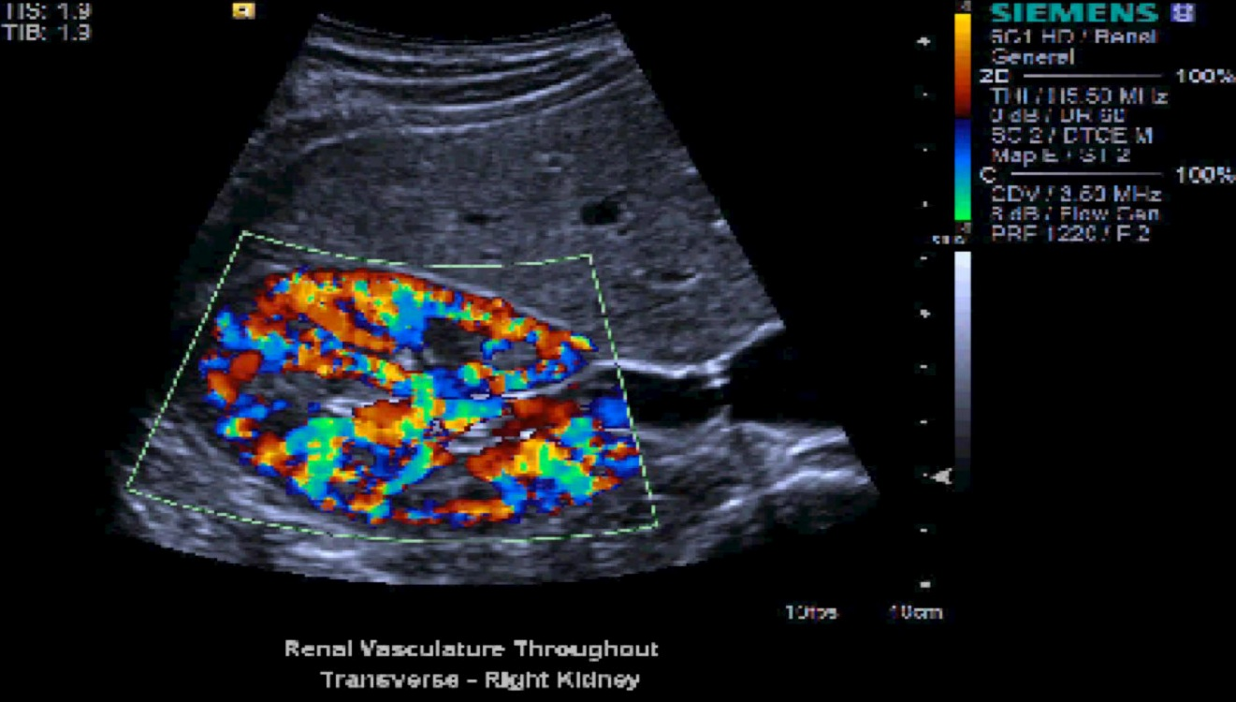
Picture this
Images to aid diagnosis
Episode 1: Picture this
Notes:
Ask students to consider if they have been in a situation when they had symptoms which needed skilled diagnosis or have known someone who has and explore the possible causes for these complaints.
Ask students to work in groups to answer:
What questions might be useful for the doctor to ask?
What other evidence might the doctor want to gather?
How might imaging have a role to play in this?
Draw together ideas about the medical imaging and what a useful image should show if it is to aid diagnosis. Record this and display for future reference.

Slide 5
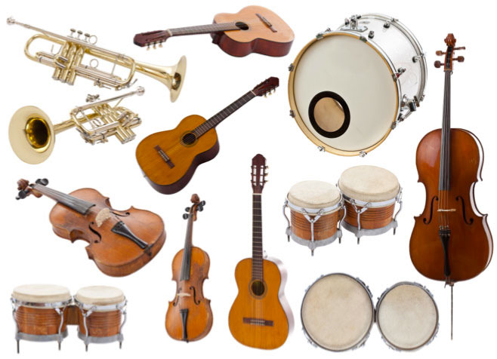
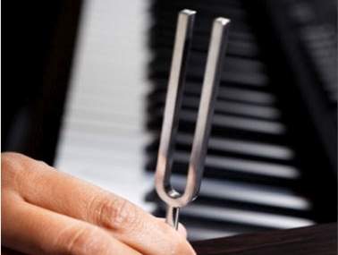
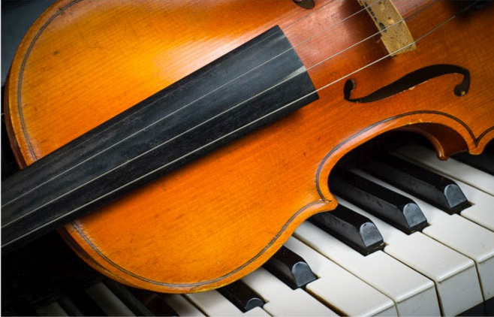
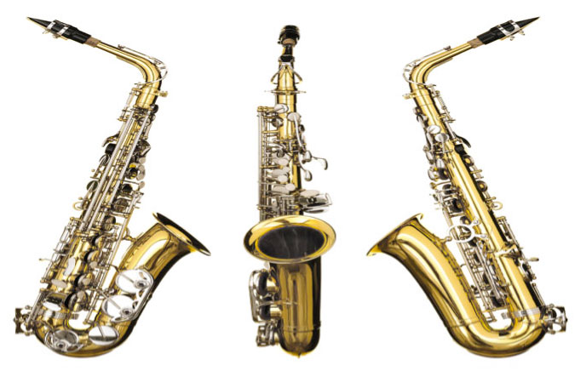
Picture this
How do these make sound?
Images to aid diagnosis
Episode 2: Picture this
Notes:
The nature and detail of this episode may need to be judged be careful questioning and recognition of prior learning. A good starting point is to ask students to suggest how sound is made. It is useful to have a variety of objects that make a noise, but do so in different ways. Some of them may be musical instruments, but they shouldn’t all be. You might include, for example, a guitar, a penny whistle, a drum, a tuning fork, a box (to be hit) and a conical flask half full of water (which can be tapped and also blown across the top of).
Ask for suggestions about how each of them makes a noise and then ask for generic characteristics.
Draw out that a noise is made when a pressure wave travels through air. Something that makes a continuous sound produces a series of such waves.

Slide 6
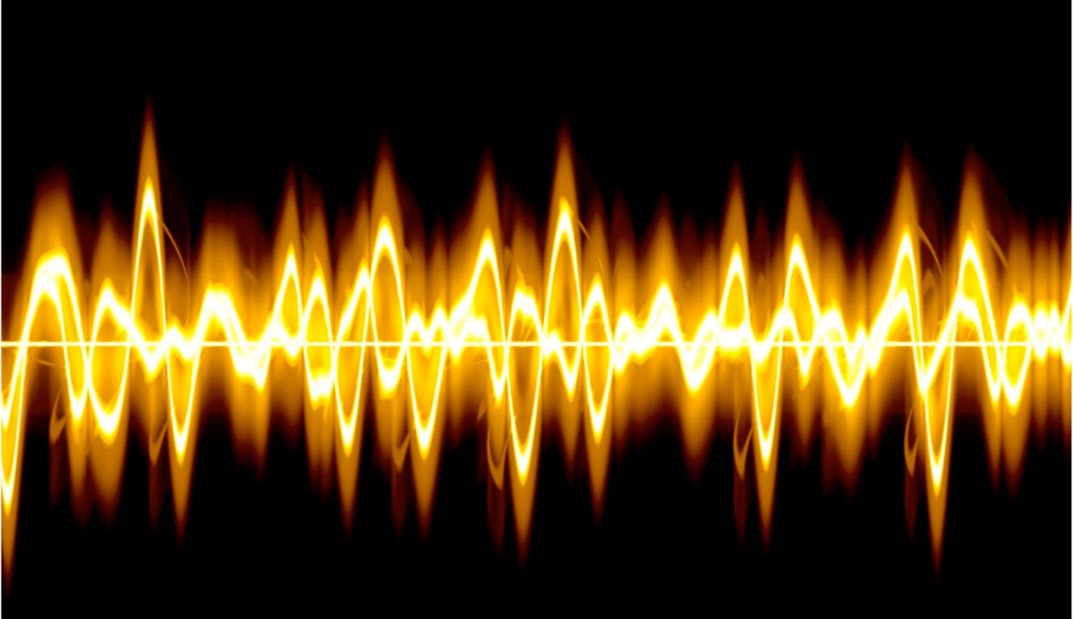
Picture this
Representing sound
Episode 2: Picture this
Notes:
Ask for ideas about how sound can be displayed.

Slide 7
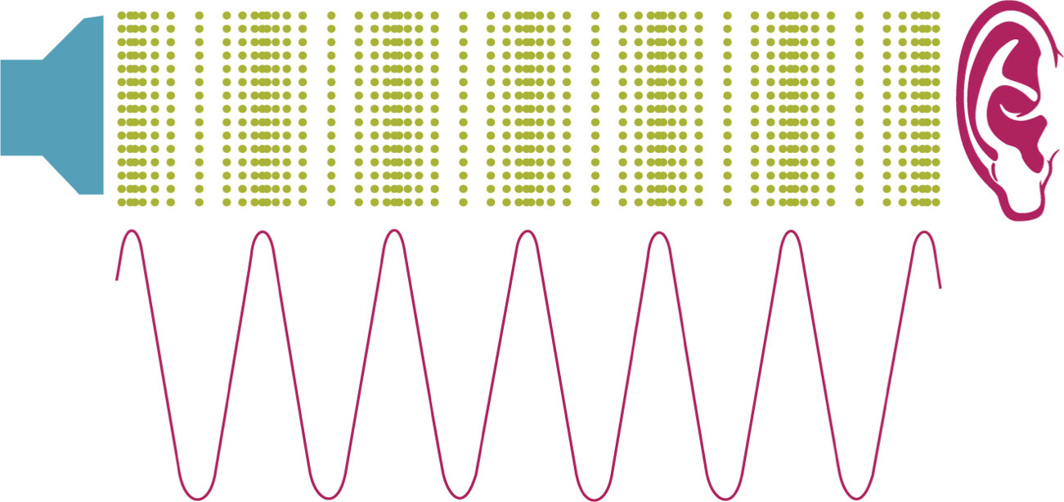
Picture this
Representing sound
Episode 2: Picture this
Notes:
It is important to explain that the waveform is a representation rather than a picture of a sound wave (it could usefully be included that sound is a compression wave and these images are of transverse waves; nevertheless they are useful because of the information they show).
Explain that by using a waveform like this, measurements can be made that are useful.
Explain that the horizontal distance between one peak and the next is called the wavelengthv and that this indicates the pitch of the note. A shorter wavelength indicates a higher pitch.
Say that sound can be explained by thinking of it as a series of vibrations.
The more energy is put into each vibration the louder it will sound.
The more frequently the vibrations arrive (the more waves per second) the higher the note sounds.

Slide 8
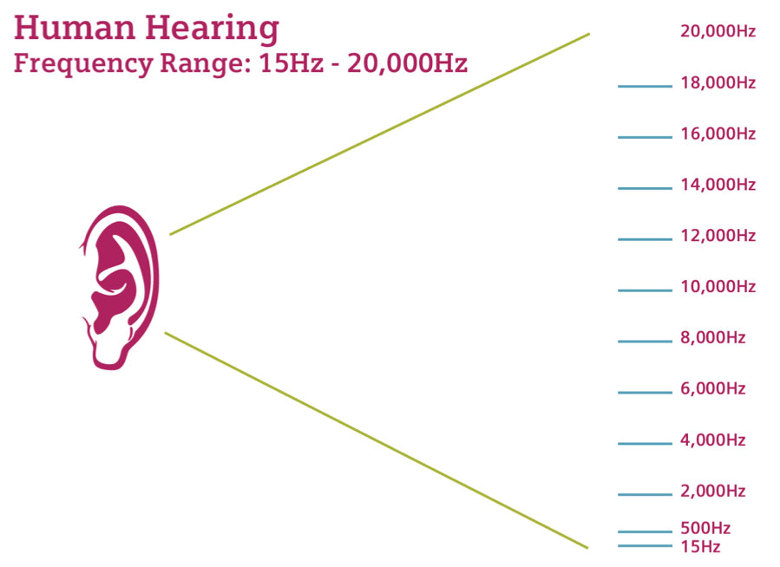
Picture this
Audible range of humans
Episode 3: Picture this
Notes:
Remind students about ideas from the previous episode about frequency.
Explain that this is measured in Hertz (Hz) and that a frequency of 1Hz is one wave per second. Say that ‘Middle C’ has a frequency of 256Hz; 256 waves arrive every second. More than that and it is a higher note, fewer and it is lower. Illustrate this using equipment such as a signal generator and CRO. Add that 1,000 Hz is 1 kilohertz (1kHz).

Slide 9
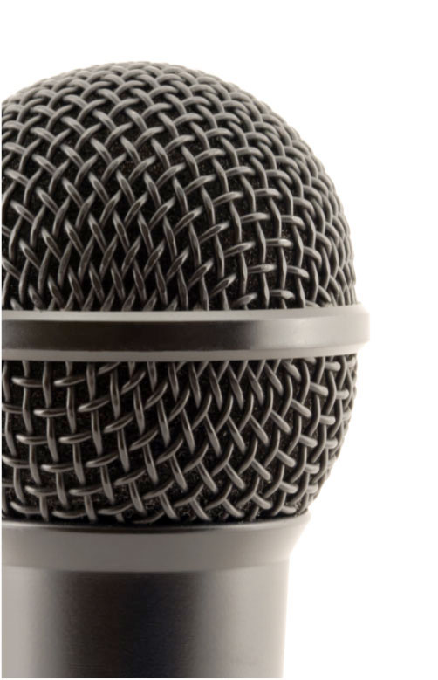
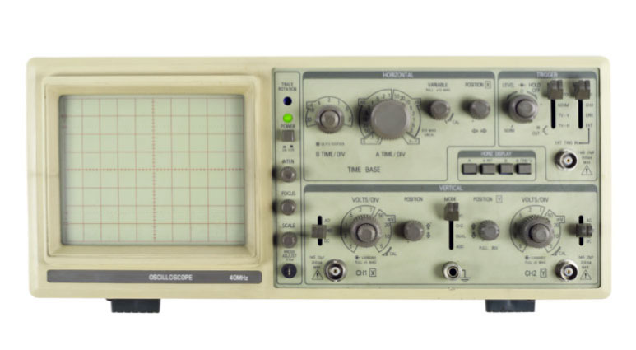
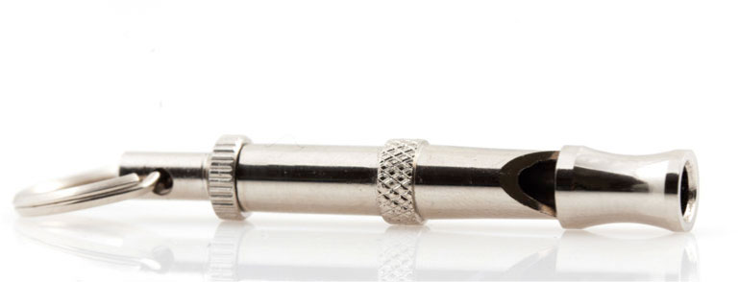
Picture this
Humans can hear up to 20kHz
Episode 3: Picture this
Notes:
There is an upper limit to the frequency we can hear and that it is around 20kHz. This can be demonstrated by using the signal generator and CRO and further illustrated using a dog whistle, microphone and CRO. The whistle can’t be heard, though it will be clearly displayed.
Then explain that there is an upper limit to the frequency we can hear and that it is around 20kHz. Emphasise that although our audible range is around 50Hz – 20kHz other animals have different ranges.

Slide 10
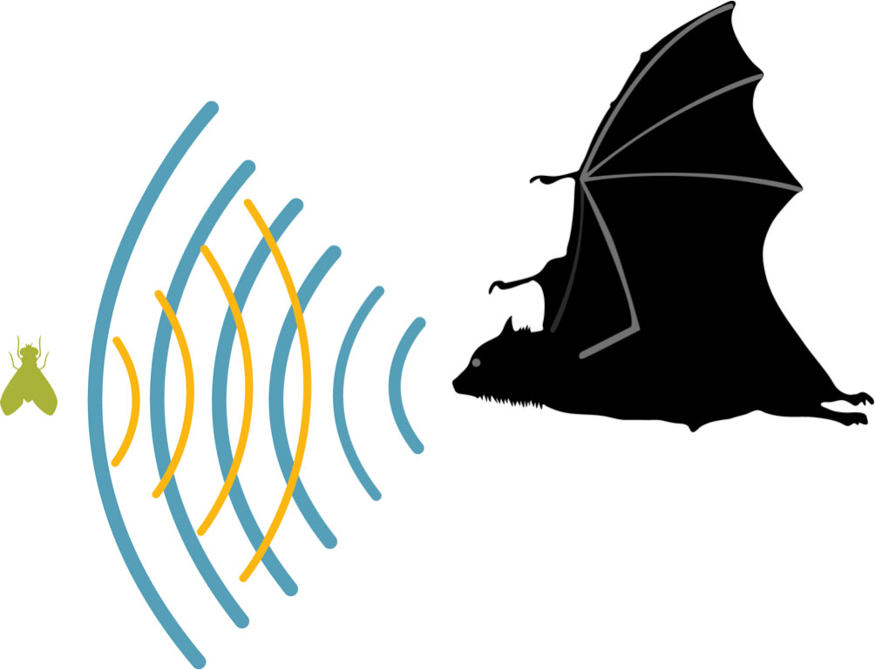
Picture this
Bats use high frequency sound to locate their prey
Episode 4: Picture this
Notes:
Explain that bats use high frequency sounds to locate their prey in pitch darkness. The sounds are usually above frequencies that humans can hear. Say that students are going to find out and present ideas about how this works.

Slide 11
Picture this
Which frequency do bats use?
How does this help them to find their prey?
Why does this give the bats an advantage over other predetors?
Introduction: Picture this
Notes:
Ask students to work in groups to prepare a poster to answer the questions. Allow access to books and the internet.
In the plenary draw out key points about:
The frequencies going up to 100kHz and beyond.
The bats detecting prey by comparing the strength of the returning signal with that of the outgoing signal.
Bats are able to hunt in conditions which most other predators would not be able to compete.

Slide 12
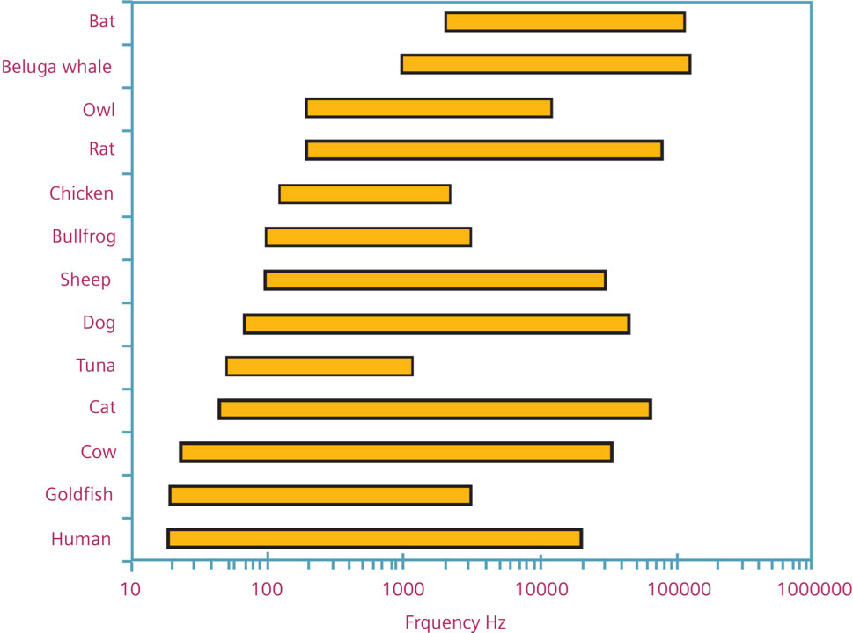
Picture this
Audible range of various animals
Episode 3: Picture this

Slide 13
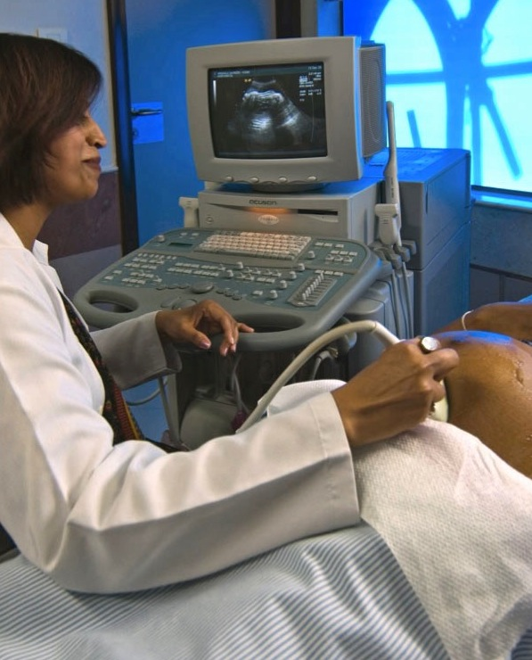
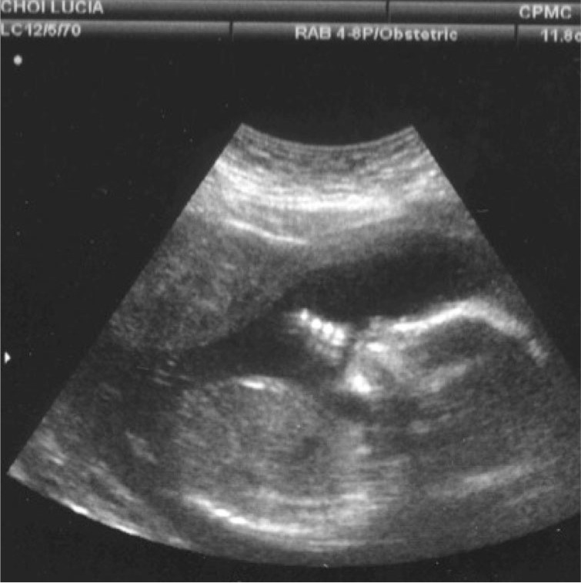
Picture this
Using ultrasound to produce medical images
Episode 5: Picture this
Notes:
Remind students about bats finding moths by releasing high frequency sounds and listening for the echoes.
Explain that the reflection took place when there was a change in density; the moth is more dense than the air so the sound bounces off it.
Explain that the same principal is used in ultrasound imaging.
Show students an image of an ultrasound being used to produce images and point out that different parts of the body have different densities. Explain that when the ultrasound reaches a part with a different density some of the waves are reflected. The amount of the waves that are reflected and the direction from which they are reflected are used to produce the image.
Use student support sheet 9 to provide a summary of the key point and to consolidate learning.

Slide 14
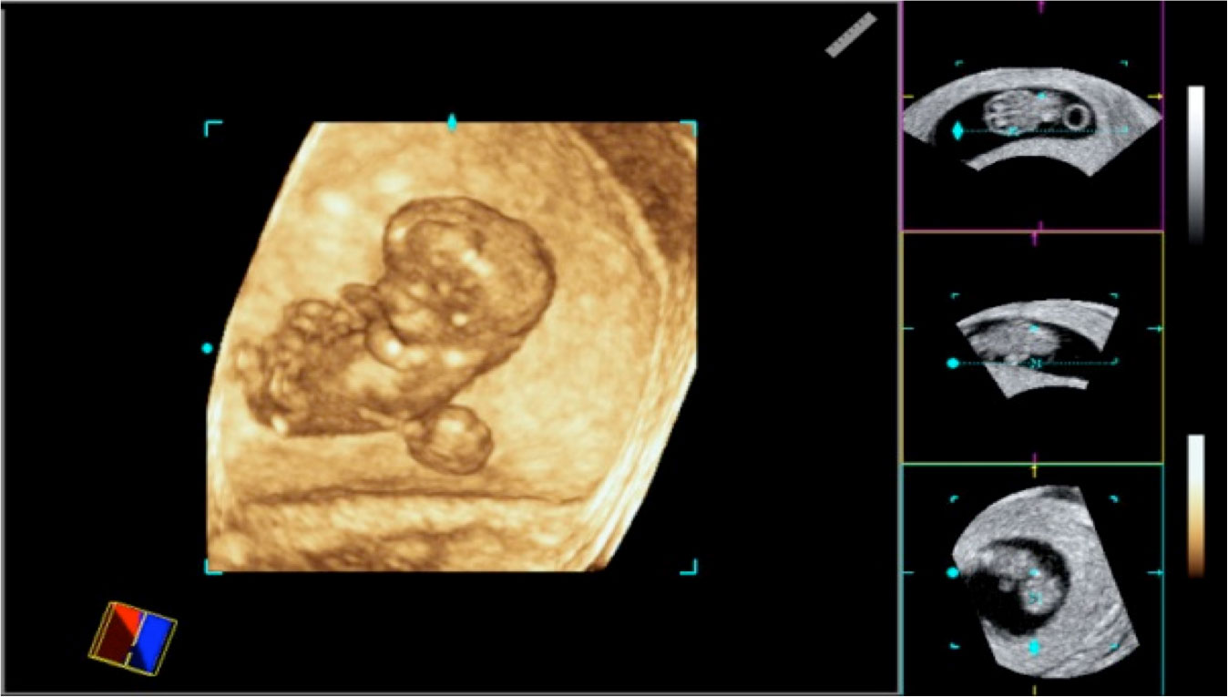
Picture this
First trimester foetus and yolk sac
Episode 6: Picture this
Notes:
Explain that pregnancies are divided in time into three equal parts, called trimesters. Ultrasound causes no ill effects to the mother or the foetus and can be used to monitor growth rates, identify some types of medical issue and help with the bonding between parent and child.

Slide 15
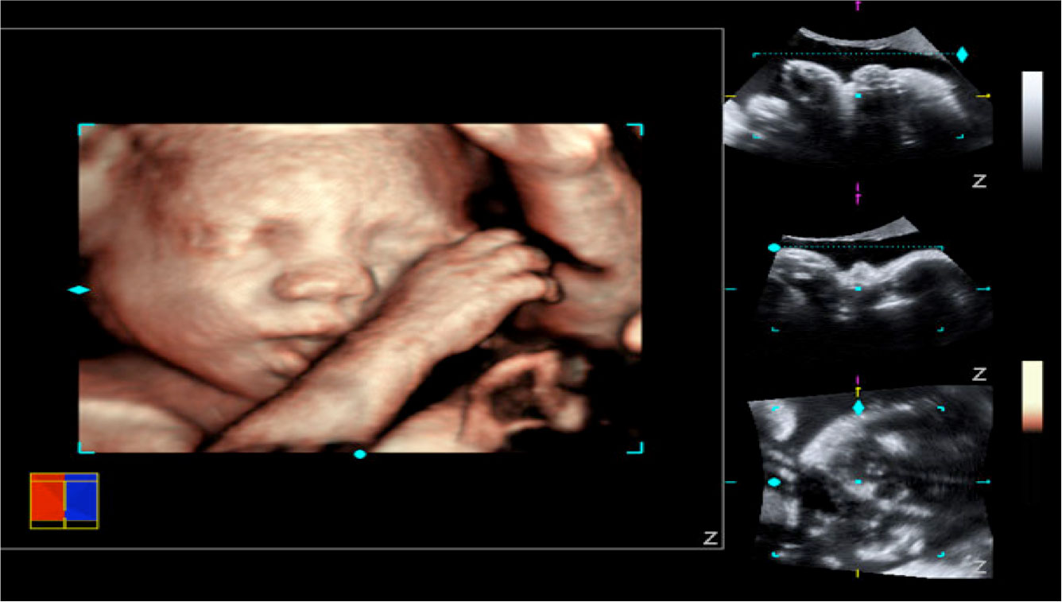
Picture this
Second trimester foetus
Episode 6: Picture this
Notes:
Explain that the ultrasound scanner takes a cross sectional view; in other words, turning the scanner produces an image in a different plane. The individual images are shown on the right but can then be combined to form the ‘3D’ view in the main part of the picture.

Slide 16
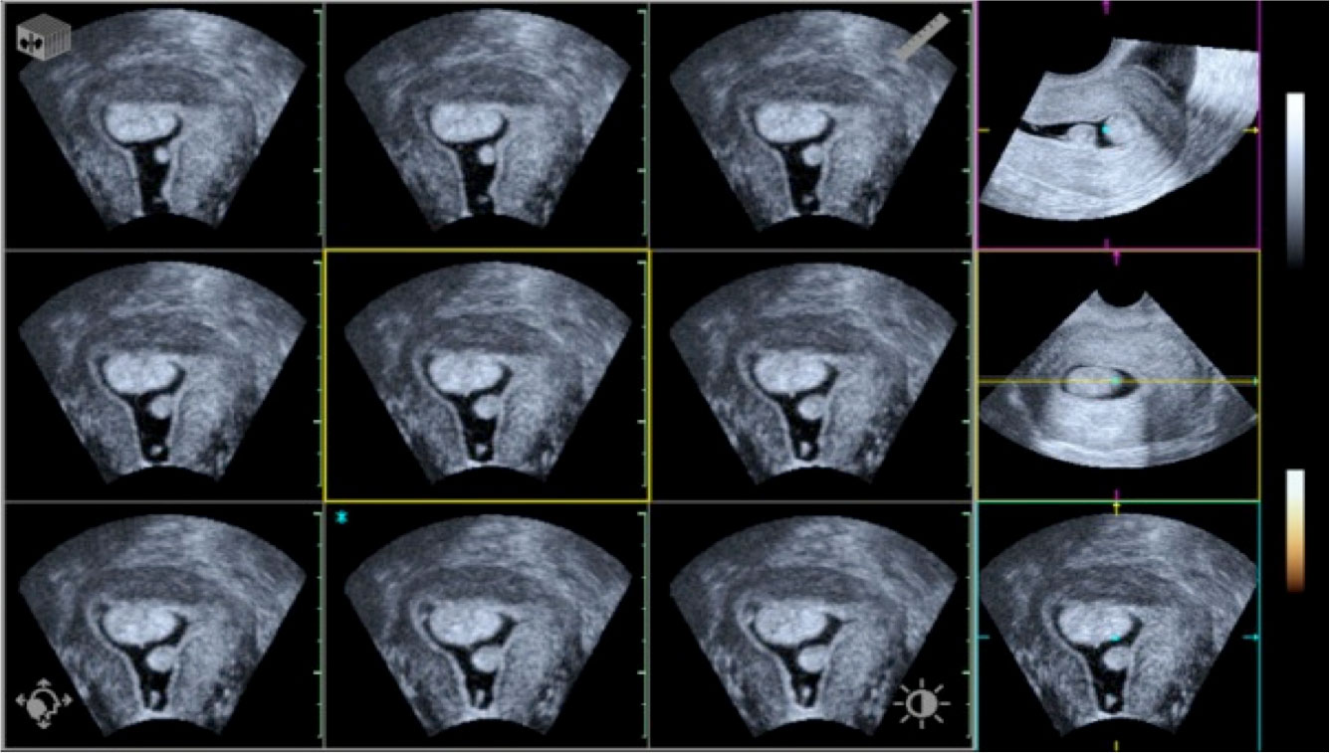
Picture this
Uterine polyp
Episode 6: Picture this
Notes:
Then show the image of the uterine polyp and explain that this is a growth in the uterus. They may cause abnormal bleeding and occasionally become cancerous. The images clearly show the position and size of the polyp; they have been taken in two different planes and provide a doctor with a wealth of information to draw upon to make a diagnosis.

Slide 17

Picture this
Group discussion
Episode 7: Picture this
Notes:
Ask students to work in small groups to identify key points about the use of ultrasound in medical imaging using these sub headings:
What ultrasound is.
How it can be used to form images?
Why this is useful in medical diagnosis?

Slide 18

Engineering the future. Inspire and be inspired.
For further information about the Siemens Education website and all support the materials and downloads please visit us at
www.siemens.co.uk/education
© Siemens AG 2012. All rights reserved.

