Slide 1
Topic 2: Let there be light
Siemens Education

Slide 2
Let there be light
Overall learning objectives:
Understand how creative thinking and scientific ideas can be harnessed to solve problems and improve quality of life
Understand how natural resources can be used to provide useful services
Apply ideas about generating and using electricity to powering circuits

Slide 3
Let there be light
Overall learning outcomes:
To explain how electricity can be produced and used
To suggest advantages it offered
To apply ideas about circuits to solve problems and develop solutions

Slide 4
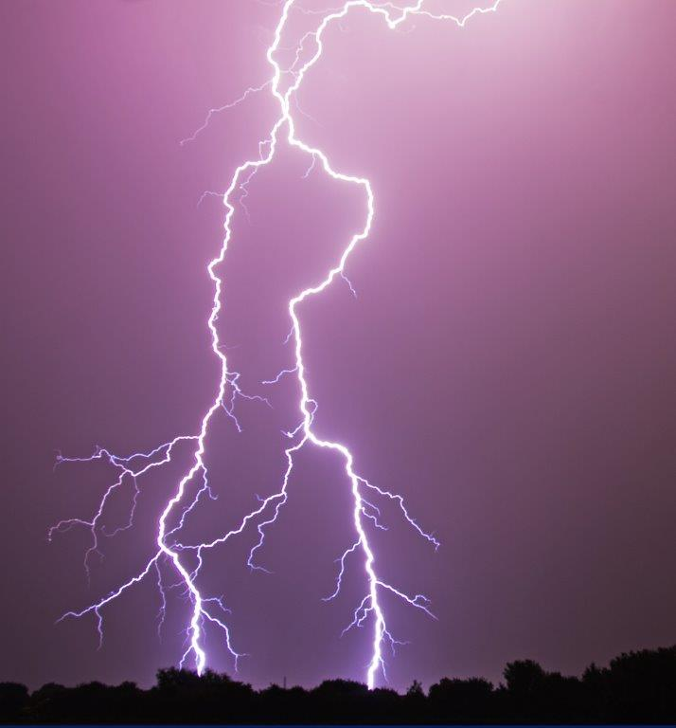
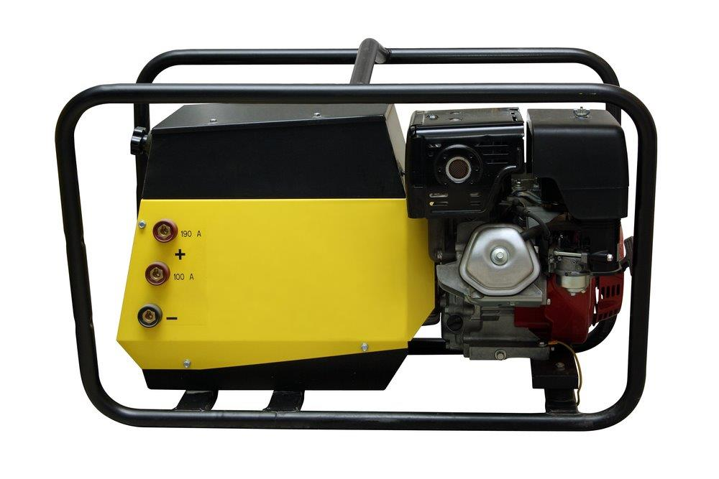
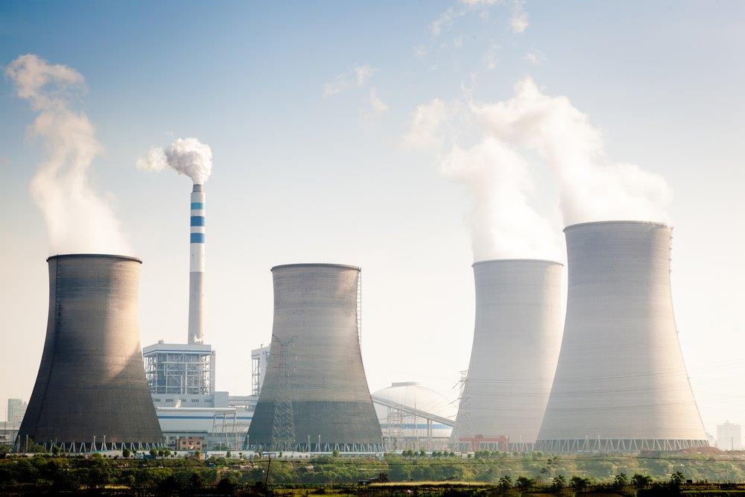
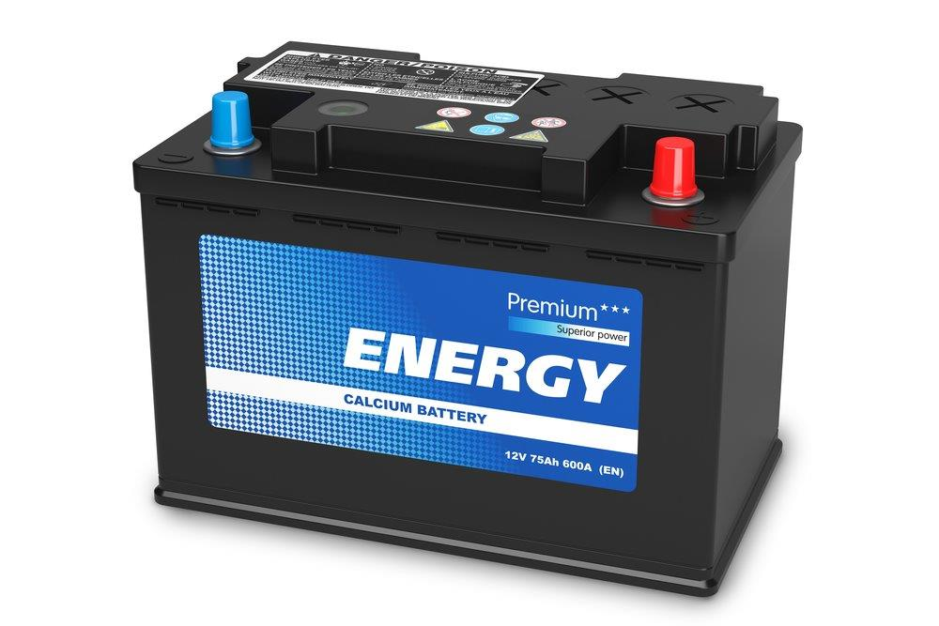
Let there be light
How could you make electricity?
Notes:
Ask pupils if they think it is possible to make electricity and encourage participation. Write their responses on the board.
Responses might include:
Lightning
Generating a static charge, such as rubbing your feet on a nylon carpet
Using a battery
Setting up a petrol generator
Building a power station.
Then ask which of these might be useful if you were stranded a long way from anywhere and needed electricity to produce light.

Slide 5
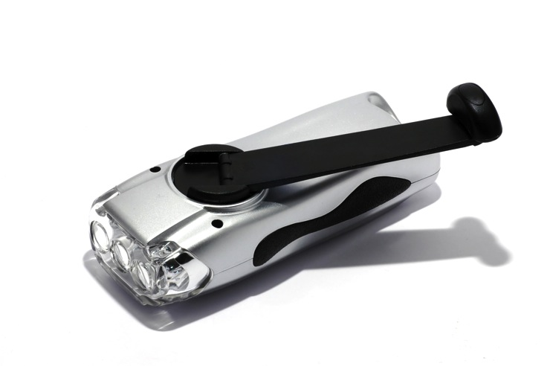
Let there be light
Turn to make light
Notes:
Show pupils an image of (or preferable a real) hand crank torch and explain how it works.
Ask what is being turned into what and draw out that movement is being turned into light.
Say that this is only practical for devices that use a relatively small amount of electricity (i.e. devices that might otherwise be battery powered).

Slide 6
Let there be light
Sketch your ideas for other items that could work using a hand crank method
Other ways of using this idea
Notes:
Ask for suggestions as to what else could have a ‘hand crank version’. Ask pupils to come up with ideas and sketch them.
Display the sketches around the room and ask pupils to go round and look at them.

Slide 7
Let there be light
Advantages
Disadvantages
Notes:
Ask students to identify advantages and disadvantages of ‘hand crank technology’ and summarise these in a table.

Slide 8
Let there be light
Recall the advantages and disadvantages. Is there another solution?
Could we get electricity from this?
Notes:
Show the hand crank torch again and ask pupils to recall the advantages and disadvantages of this technology. Two of the limitations are that it gets quite tiring to repeatedly squeeze and relax a handle and that it doesn’t actually produce much electricity.
On click:
Show a picture of (or, preferably, demonstrate) a stream of water from a tap and ask for ideas about how the force of water falling could be used to produce electricity. Draw out that a water wheel is a good way of doing it as it changes the direction into rotation.

Slide 9
Let there be light
Design, construct and test simple water wheels
Could we get electricity from this?
Notes:
Ask pupils to design, construct and test simple water wheels.
Resources required:
plastic cotton reel
an axle (knitting needles are good but plastic rod is safer).
plastic card
plasticene.
This can be done in various ways but one of the easiest is as follows:
Each group will need a plastic cotton reel and an axle (knitting needles are good but plastic rod is safer). They will also need plastic card and plasticene. The idea is for the plastic card to be cut up to make the paddles and attached to the cotton reel using plasticene. Corrugated plastic (often known as corriflute) is good for this.
This activity can be made more challenging if pupils can decide how large to make the paddles, though thought needs to be given as to how cutting can be achieved safely. The activity is even better if each group has a set area of plastic and has to decide how to divide it.
Water wheels should then be tested in the stream of water.

Slide 10
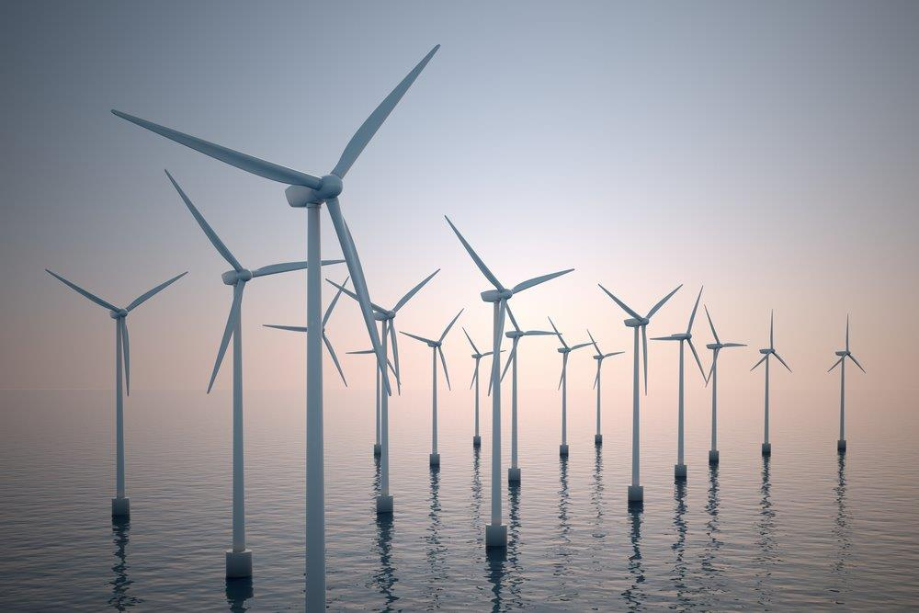
Let there be light
Could we get electricity from this?
Notes:
Show the image of the turbine and explain that this can produce electricity.
Then ask for ideas about how a steady flow of water, large enough to turn a big water wheel and power a large generator might be achieved. Show picture of Craigside, point out the raised lake and explain that this was the first place ever to be powered using falling water, turning a while and driving a generator.

Slide 11
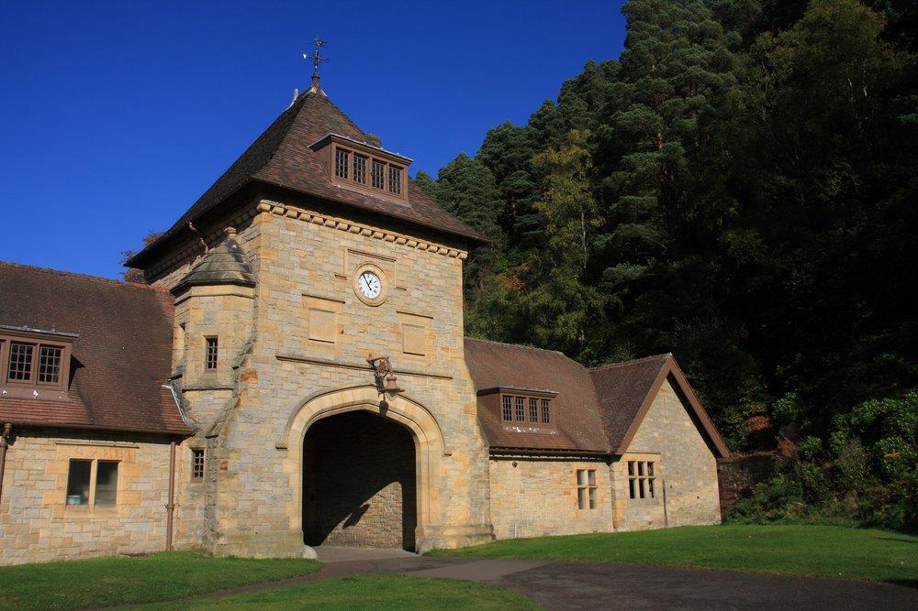
Let there be light
Craigside: The first house to be lit by electricity
Notes:
Show a picture of Craigside and say that this as possible because the owner of the house was wealthy and also knew how to use scientific and technical ideas (Sir William Armstrong was a major shipbuilder on the River Tyne). The next step was to make electric lighting available to ordinary people.

Slide 12
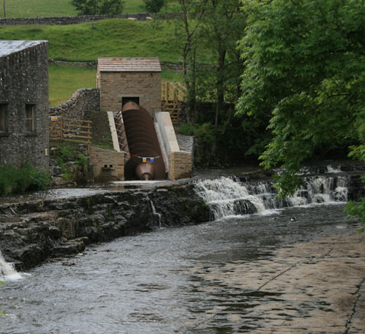
Let there be light
Craigside: water running from the upper lake to the lower one turned the water wheel
Notes:
Say that in the 1870s street lighting consisted of gas lights. These had to be lit as it went dark, turned out at the end of the night and needed cleaning. Electricity didn’t need any of these. In 1881 Godalming became the first town to have electric street lighting, using water wheels and a Siemens alternator.

Slide 13
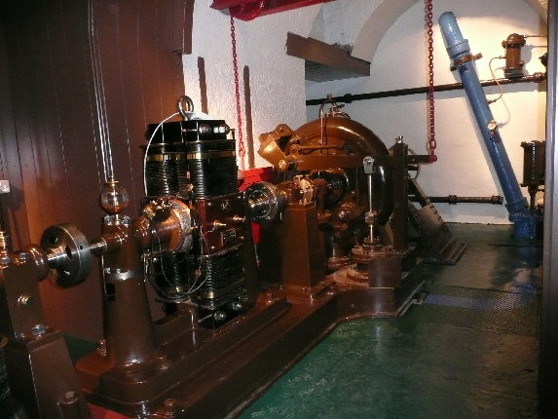
Let there be light
Craigside: The turning water wheel drove a generator
© Henrietta Heald

Slide 14
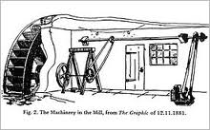
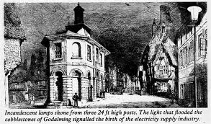
Let there be light
However, when lots of bulbs are joined to one supply, something rather odd can happen
Godalming: The first town with electric street lighting
Notes:
Investigate what happens if more and more bulbs are linked to one power supply. As more are added, they all become dimmer.

Slide 15
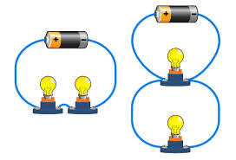
Let there be light
Godalming: The first town with electric street lighting
The difference between series and parallel circuits
Notes:
Introduce the idea of parallel circuits and show how bulbs connected in parallel are all ‘fully bright’, irrespective of how many are connected.
Pupils can now work in table groups to set up circuits and see how a parallel arrangement enables several bulbs to be lit at once.
This activity can be developed (equipment allowing) by asking pupils to bring in cardboard boxes (or other such container) and decorate them to represent houses. Each house can then be fitted with a light and several houses powered from one source.
Pupils should record the arrangement using circuit diagram conventions, including symbols.

