Slide 1
Monte Rosa Mountain Hut
Sustainable Energy & Infrastructure

Slide 2
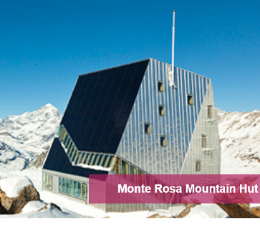
Monte Rosa Mountain Hut
Sustainable Energy & Infrastructure
This is the Monte Rosa mountain hut, high up in the mountains. Its purpose is to provide a comfortable shelter for people exploring the glaciers. Many miles from other settlements it has to cope with hours of direct sunshine, snow and freezing temperatures. Energy has to be conserved and the conditions inside maintained at a steady level.
Suggest how a building like this could make good use of sunlight.
Suggest how it should be designed to cope with very low temperatures.
Look at the design of the windows. Suggest reasons why this has been done.
Why is it especially important in a building like this to manage energy effectively?
Electric Cars vs. Petrol

