Slide 1
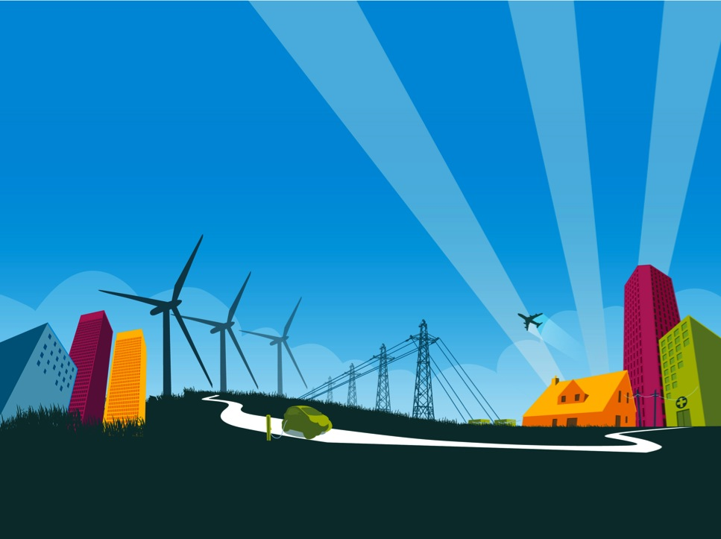

Topic 11: Green Racer
www.siemens.co.uk/education
© Siemens AG 2012. All rights reserved.

Slide 2
Green Racer
Overall objectives:
Interpret data presented in various ways to provide evidence to evaluate a system and support a cost benefit analysis.
Apply concepts of energy transfer and storage to understand and evaluate a system.
Apply concepts of efficiency and streamlining to develop ideas about how a system can be improved.
Produce and modify designs to meet a design brief and study solutions to learn how other designers have manipulated materials to meet a design brief.
Introduction: Green Racer

Slide 3
Green Racer
Overall outcomes:
A clear explanation of the key features of a Greenpower Challenge car.
Developed ideas about the design and production of a suitable body.
Production of a well structured and effectively argued case for involvement in the Greenpower Challenge.
Introduction: Green Racer

Slide 4
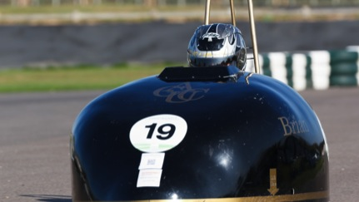
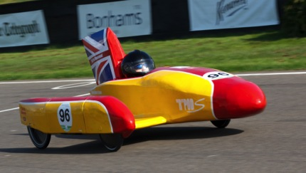
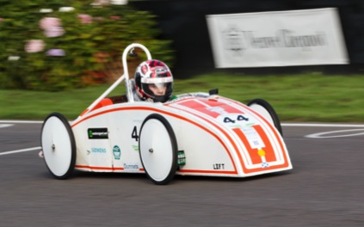
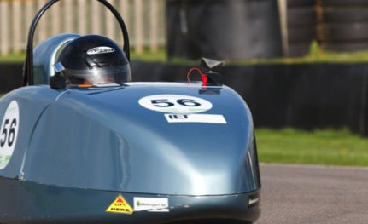
Green Racer
Previous Greenpower Challenge contestants
Episode 1: Green Racer
Notes:
Start by showing students pictures of entrants in the Greenpower Challenge and ask for suggestions as to what the activity might be about. More examples are found on the Greenpower website, here: http://www.greenpower.co.uk/racing/galleries?g=f

Slide 5
Green Racer
The Challenge:
Teams finishing in the top three in a heat qualify for the National Final, along with cars that have completed the most miles in any race, with three ‘wild cards’.
The events are four hour endurance races at motorsport venues. All teams have the same motor and six 12V batteries used in pairs. During the race at least five team members must drive, and up to six further members act as pit crew.
In this topic we’ll assume the use of a kit car, though teams may design their own.
All cars must follow strict regulations but a variety of designs compete.
Episode 1: Green Racer
Notes:
Explain that it is a competition that many schools enter, that it involves students in building an electric car, designing a body for it and competing in endurance races. Explain that the cars are powered by rechargeable batteries (rather larger and more powerful than the kind of battery that would be used in, say, a camera or mobile phone), that the cars are similar in terms of technical design and that to win a team has to keep going the longest (rather than to be the fastest).

Slide 6
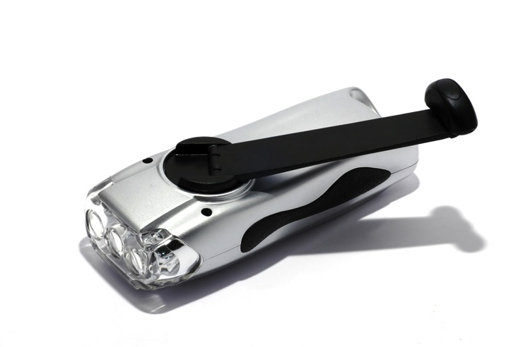
Green Racer
A wind up torch
Topic 2: Green Racer
Notes:
Show students a wind up torch and ask them for an explanation as to how it works. Draw out contributions and develop the following points:
There is a charge process, which involves the handle and the battery. In this process energy is transferred from the person, via the hand crank, to the battery, where it is stored.
There is a discharge process, which involves the battery and the bulb. In this process the energy is transferred from the battery to the bulb, where it is transferred to the environment as light and heat.

Slide 7
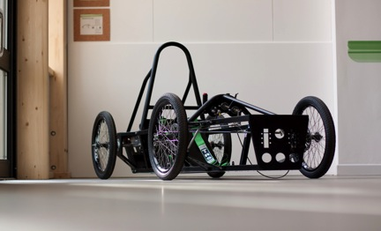
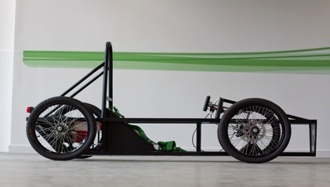
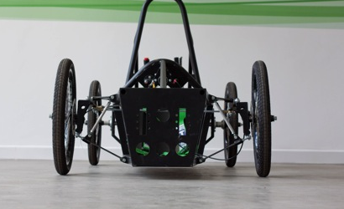
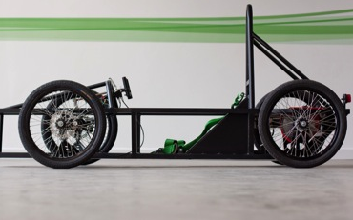
Green Racer
Greenpower kit car
Episode 2: Green Racer
Notes:
Show a picture of a Greenpower car, explain that it is battery powered and ask students to identify the energy transfers taking place. Draw out that some of these are useful, such as motion, and others are not useful, such as heat from friction in moving parts. Use student resource sheet ‘Thinking about Energy’ to reinforce these points and to use a Sankey diagram to represent the transfer of energy to useful and wasteful outputs.

Slide 8
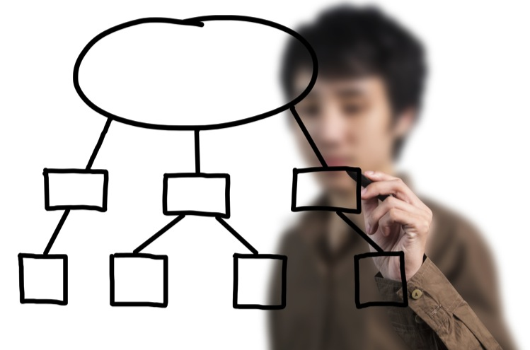
Green Racer
Prepare a presentation
Episode 3: Green Racer
Notes:
Students should be encouraged to do a rough draft of their presentation first and to compare it with the criteria before embarking on the main piece of work.

Slide 9
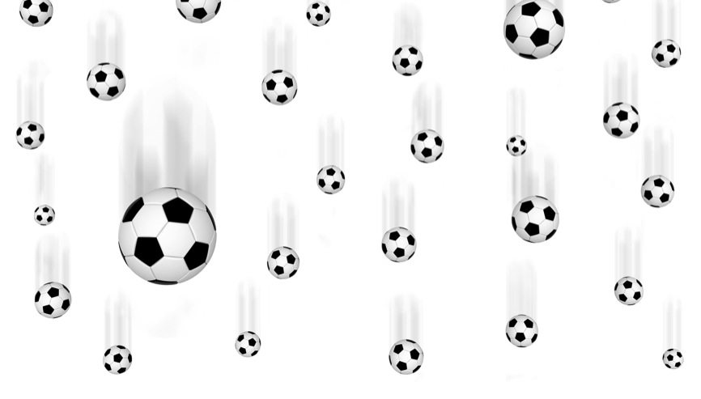
Green Racer
Which force is at work here?
Episode 4: Green Racer
Notes:
Take an object such as a ball, hold it in the air and allow it to fall. Ask students to suggest what forces are acting on the ball, the direction in which they are acting and what is happening to the speed of the ball.

Slide 10
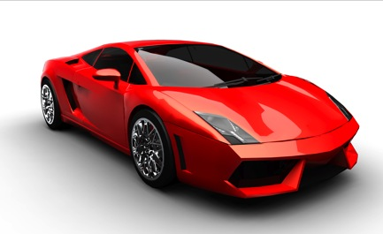
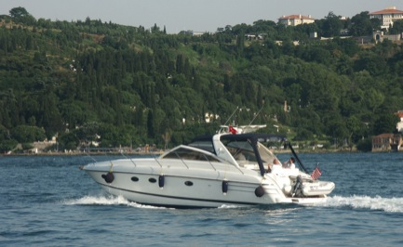
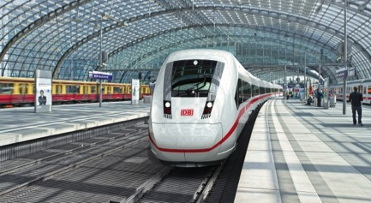
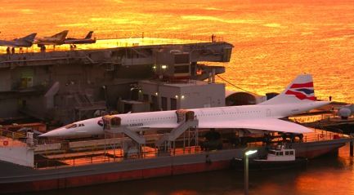
Green Racer
Sleek design
Episode 5: Green Racer
Notes:
If necessary, revisit the characteristics of effective body designs for Greenpower Challenge cars to ensure that students are familiar with the design factors they are working to.
Sports car
Speedboat
Railway locomotive
Concorde aircraft

Slide 11
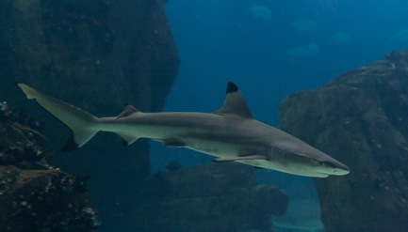
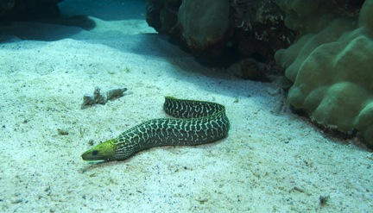
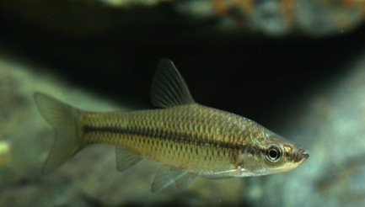
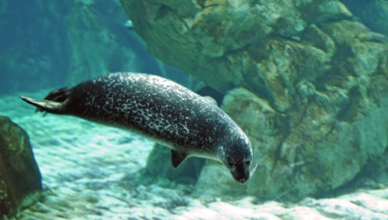
Greenpower Challenge
Designed for speed
Episode 5: Greenpower Challenge
Notes:
If necessary, revisit the characteristics of effective body designs for Greenpower Challenge cars to ensure that students are familiar with the design factors they are working to.
Show students pictures of marine animals. These include:
Shark
Seal
Minnow
Eel
Ask students to suggest how movement through water is different to water through air. Draw out that it is the same idea and that a streamlined shape reduces energy loss.

Slide 12
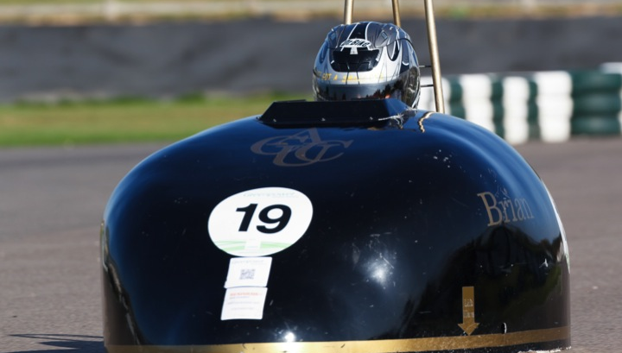
Green Racer
‘Brian’
Aerodynamic teardrop shape with carbon fibre honeycomb
Episode 6: Green Racer
Notes:
Chassis is made from carbon fibre honeycomb glued together with epoxy. The bodywork is made from carbon fibre reinforced with Styrofoam strips. The aerodynamic teardrop shape was created by manufacturing a female mould made from MDF ribs, filled with expanding foam and over coated with plaster and filler.

Slide 13
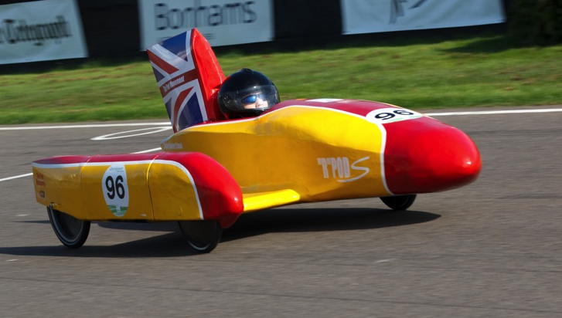
Green Racer
Aerofoil shape and fibreglass tape stitching method
Episode 6: Green Racer
Notes:
Constructed by finding an aerofoil shape on Google images and printing it out full size on lots of A4 sheets! It is constructed with the fibreglass tape stitching method.

Slide 14
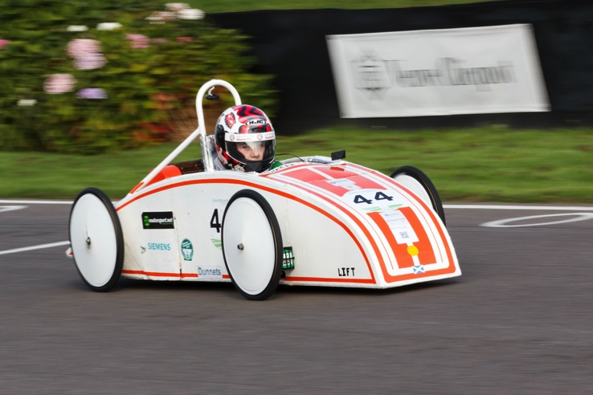
Green Racer
Fully recycled from a gate made
from aluminium
Episode 6: Green Racer
Notes:
A challenge vehicle made from a fully recycled gate made from aluminium.

Slide 15
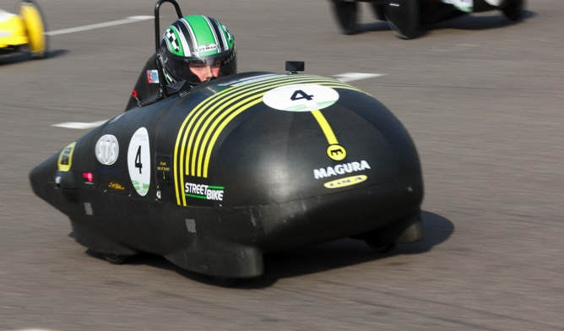
Green Racer
An aluminium honeycomb chassis and carbon fibre bodywork
Episode 6: Green Racer
Notes:
An aluminium honeycomb chassis and carbon fibre bodywork.

Slide 16
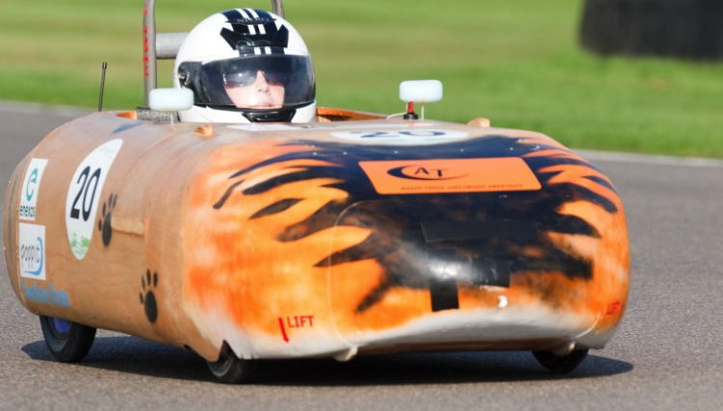
Green Racer
Softwood and monocoque construction
Episode 6: Green Racer
Notes:
Plywood and local sourced softwood. It is a monocoque construction although all the running gear can be unbolted and reused or modified.

Slide 17
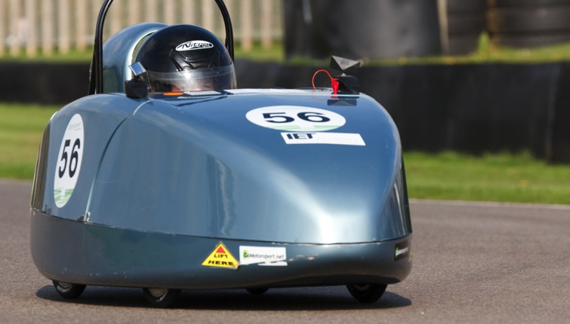
Green Racer
Solid wheels to reduce drag
Episode 6: Green Racer
Notes:
Made from a moulded and painted fibre glass chassis and has a 3 dimensional aerofoil shape (using) helmet aerodynamics design and solid wheels to reduce drag.

Slide 18
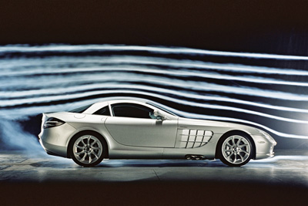
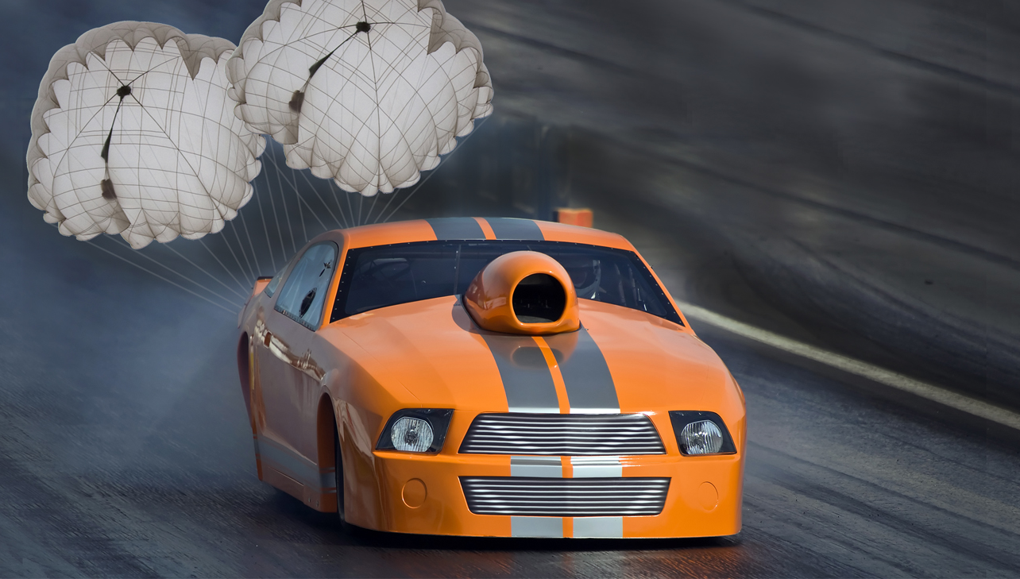
Green Racer
What roles do streamlining and drag have here?
Episode 7: Green Racer
Notes:
Show students video clips with drag cars deploying drag chutes.
Explain that the cars are designed to be able to accelerate quickly (with very little drag) but the chutes slow them down (by having a lot of drag).
Show a picture of a car being tested in a wind tunnel and draw attention to the lines of smoke showing how easily the car is slipping through the air.
Introduce Worksheet - Investigating Streamlining and Drag and ask students to select a shape to construct a small model of a car and time it descends through the liquid, thus representing a car travelling through air.

Slide 19

Engineering the future. Inspire and be inspired
For further information about the Siemens Education website and all support the materials and downloads please visit us at
www.siemens.co.uk/education
© Siemens AG 2012. All rights reserved.

