Slide 1
Cybersecurity
Data Analytics & AI

Slide 2
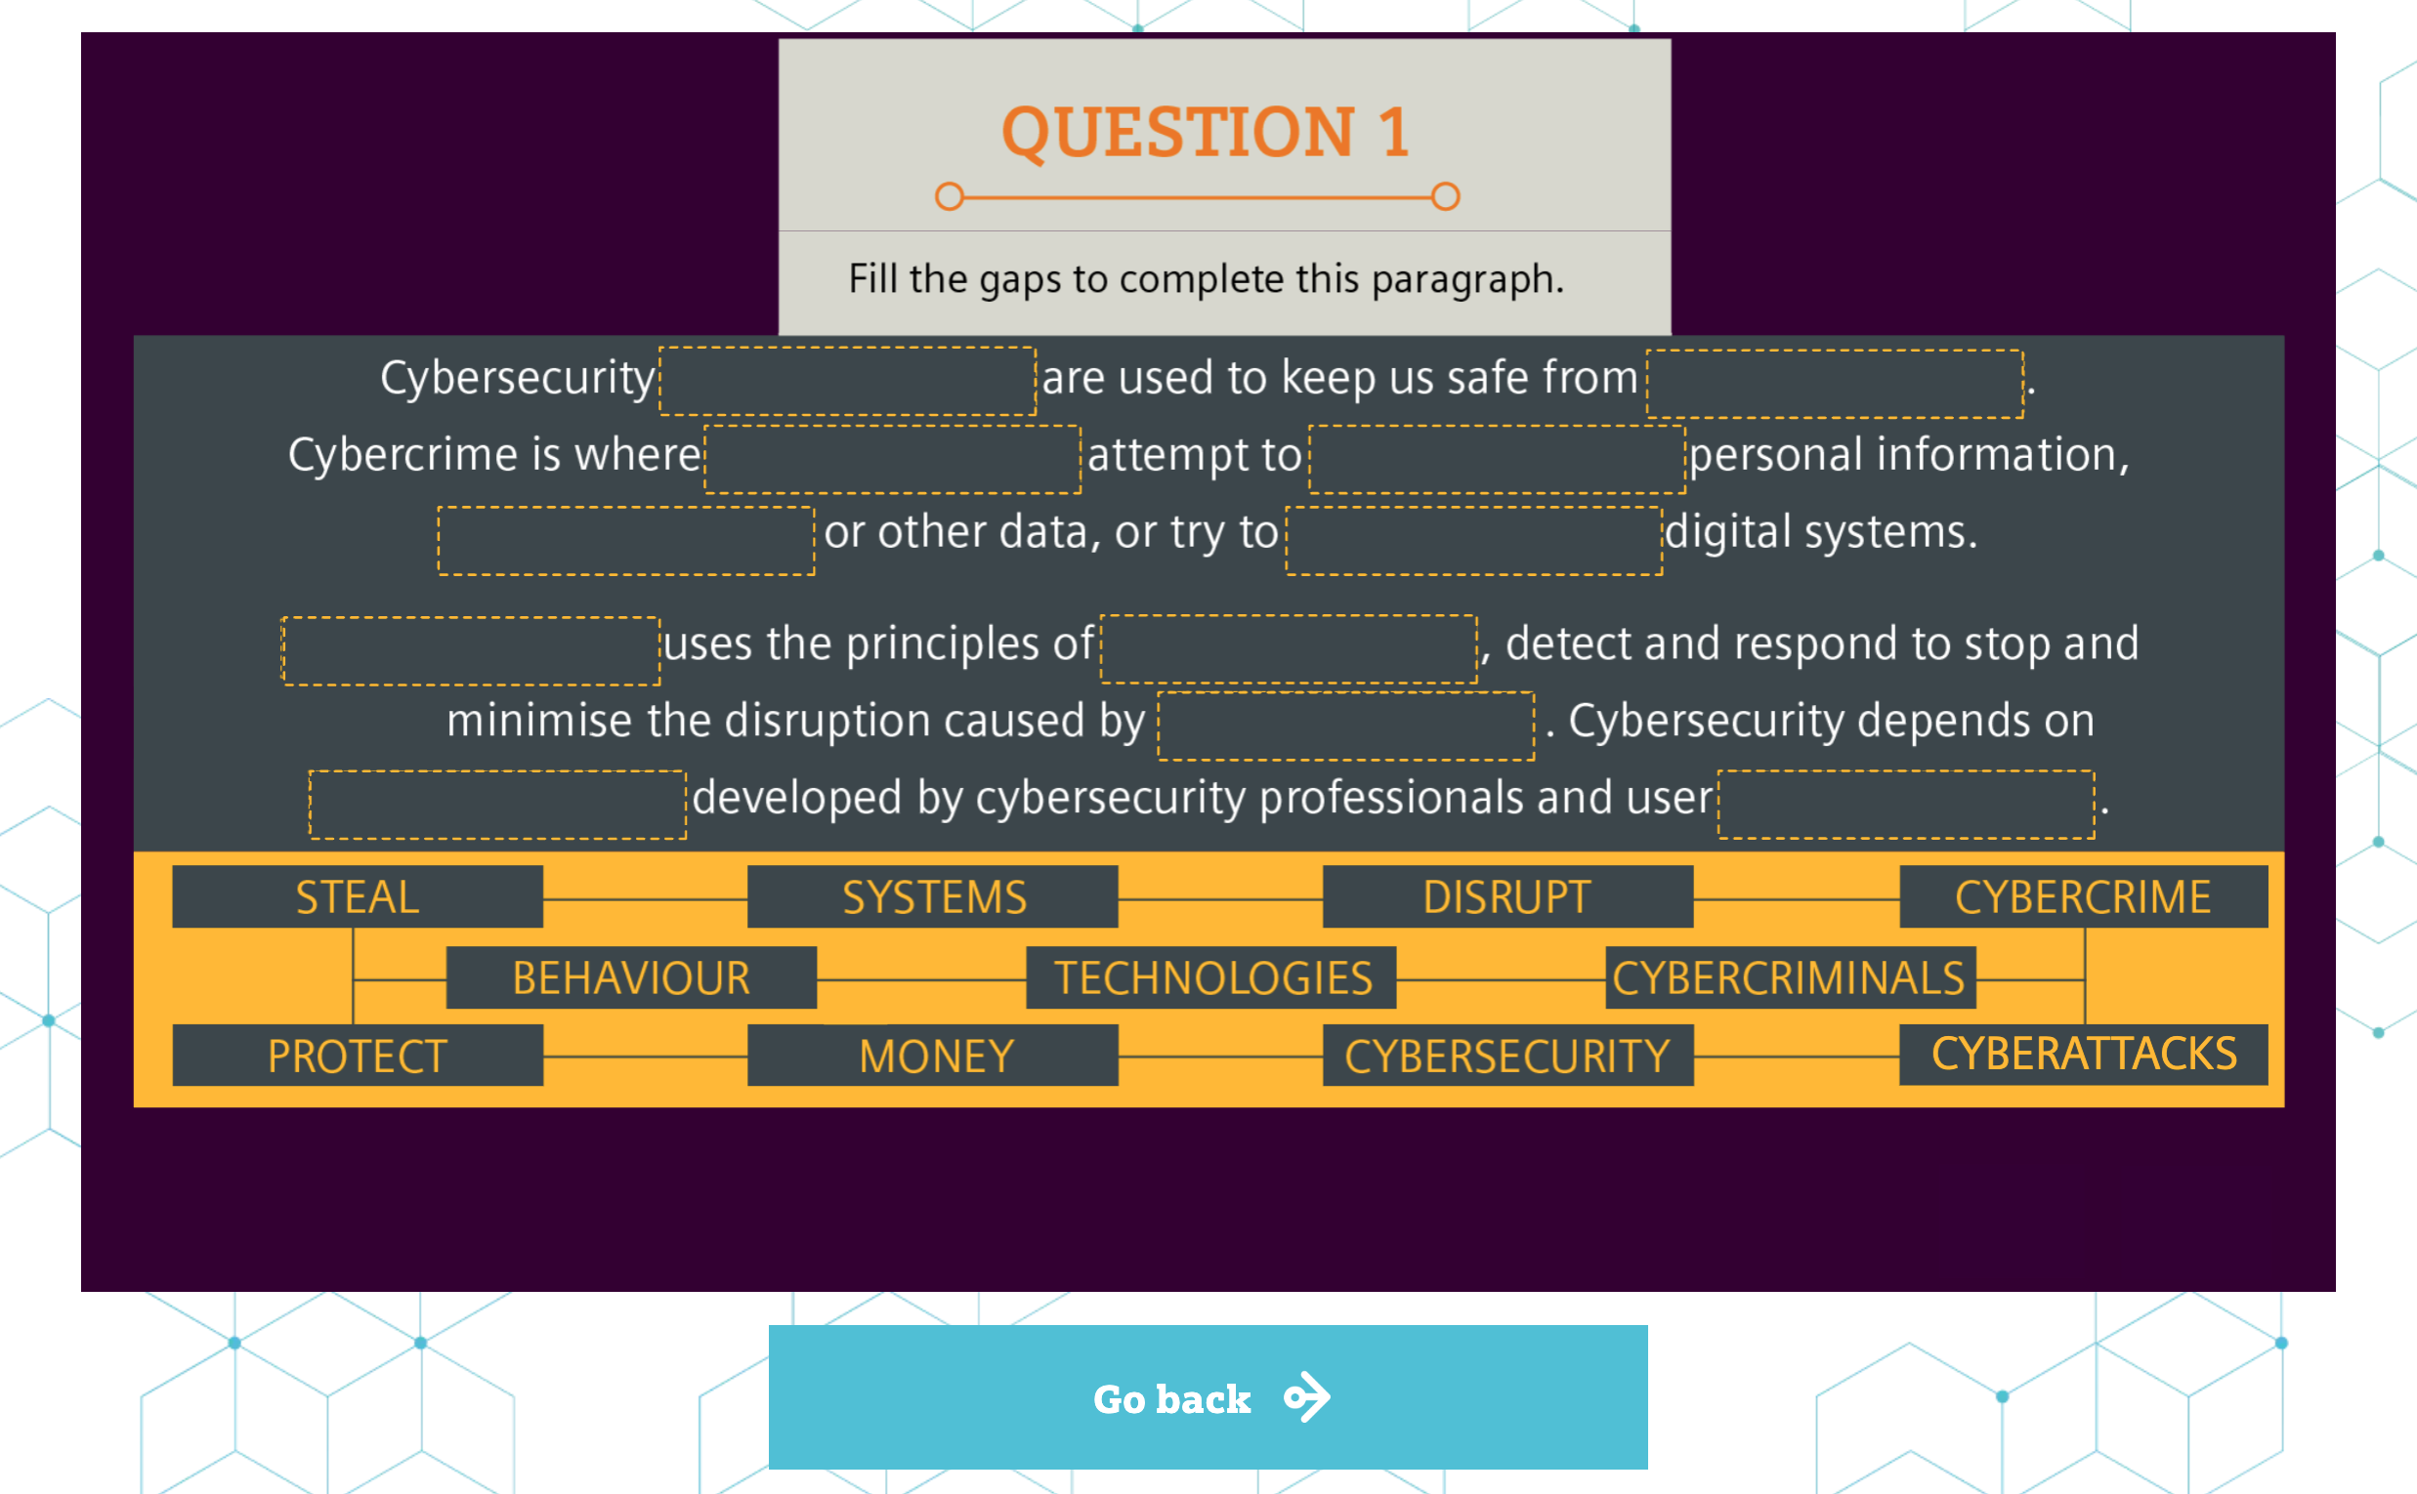
Cybersecurity
Data Analytics & AI
A student is attempting the quiz in the Cybersecurity activity. This is how far they have got.
Q1. What do you think
cybersecurity is?
Q2. Give an example of cybercrime.
Q3. Look at the words they have put
in so far. Does this look right
to you?

