Slide 1


Here comes the sun
© Siemens AG 2012. All rights reserved.
© Siemens AG 2012. All rights reserved.
www.siemens.co.uk/education

Slide 2

Here comes the sun
Overall learning objectives:
Gathering and tabulating data, monitoring it to support analysis and applying it to justify arguments.
Understanding the process of energy transfer, explaining the operation of internal combustion and photovoltaic cells and applying understanding to propose how clean technologies can be promoted.
Understanding technical and social systems, comparing alternative solutions and evaluating their fitness for purpose.
Introduction: Here comes the sun

Slide 3
Here comes the sun
Overall learning outcomes:
Gathered evidence and justified recommendations for different energy supplies.
Propose how a move to the use of more sustainable energy sources can be encouraged.
Introduction: Here comes the sun

Slide 4
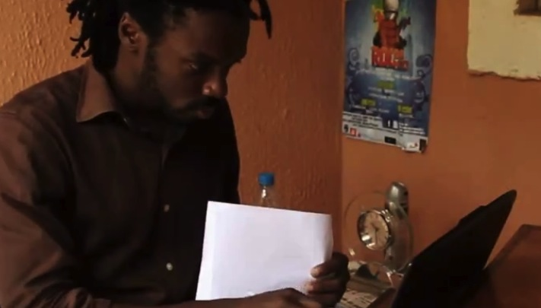
Here comes the sun
‘Abuja – My City’
Episode 1: Here comes the sun
Notes:
Show a video clip of, ‘Abuja – My City’
This video has been made by a young man named Buma. He made this video to say something about his life and one of the key decisions he has to make.
Encourage students to consider the dilemmas he faces.

Slide 5
Here comes the sun
Abuja – My City
Why does Buma need to consider alternative energy supplies?
What are the advantages and disadvantages of the petrol generator?
What are the advantages and disadvantages of the photovoltaics?
What would you do in his place, and why?
Episode 1: Here comes the sun

Slide 6
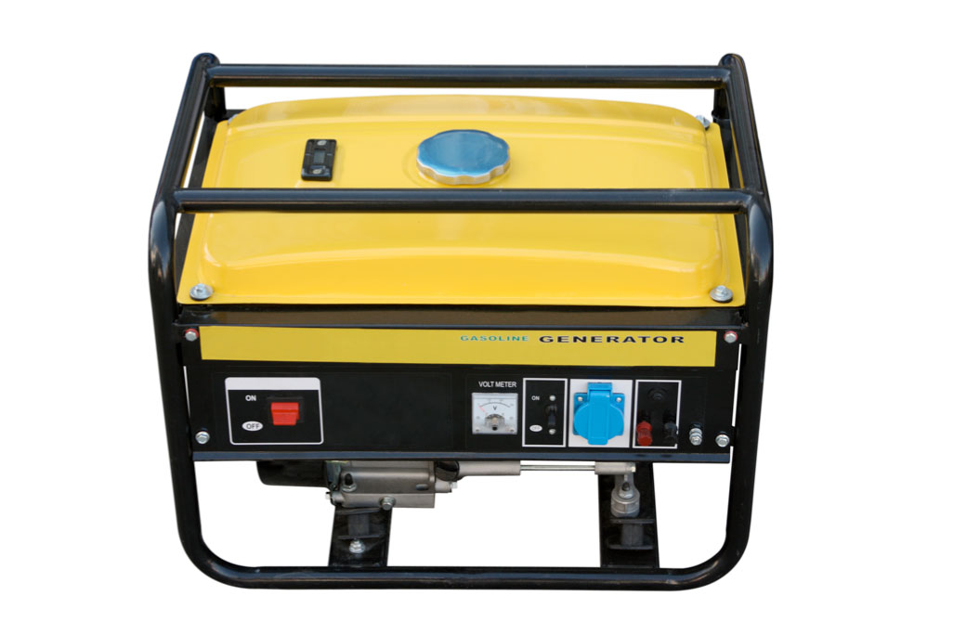
Here comes the sun
Buma’s choice
Episode 2: Here comes the sun
Notes:
Ask students to work in groups to consider what the key factors are that have influenced Buma to prefer a petrol generator.
Ask students to consider what might influence his choice and encourage him to use solar cells instead.

Slide 7
Here comes the sun
Buma’s choice
Episode Here comes the sun
Notes:
Using student support sheet 2A and (ideally) a demonstration or (alternatively) a video clip. Students should understand the fuel is burned and energy transferred as kinetic energy to drive a generator, which produces electricity. It is portable and reliable but releases polluting gases.
Ask students to consider the key factors in using a petrol generator and draw out the following:
Cost of the generator
Cost of fuel
Fuel consumption
Start-up time
Power output
Waste produced
Noise level

Slide 8
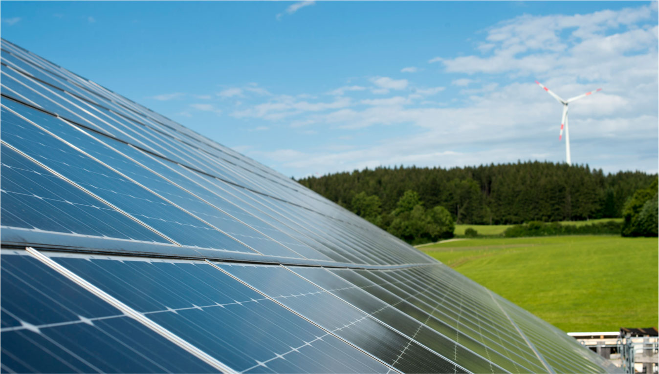
Here comes the sun
Photovoltaic cells
Episode 3: Here comes the sun
Notes:
Present students with challenge – whether and how Buma should be persuaded to abandon his petrol generator in favour of sets of photovoltaic cells.
Using student support sheet 2B and an experiment to investigate, use one or more solar cells and a voltmeter to show that a potential difference is produced when light falls on it.
Students should understand that energy from light is converted to electrical energy and that the output is related to the amount of light and the area of the cells. This can be shown by altering the intensity of the light and the number of cells.
Ask students to consider the key factors in using photovoltaic cells and draw out the following:
Cost of purchase
Area
Power output

Slide 9
Here comes the sun
Storing energy
How is energy stored in a petrol generator? How effective is this and how safe is it?
How could energy from a photovoltaic cell be stored and how practical is this in terms of powering a laptop and a mobile phone?
How could this work if the system is scaled up to run appliances such as room heaters?
Episode 5: Here comes the sun
Notes:
Take feedback and draw out the following:
Petrol is a practical way of storing energy but there are safety considerations.
Photovoltaic cells could be used to store rechargeable batteries, which can then be used to power devices such as laptops and mobile phone.
Room heaters need a higher voltage and considerably more power. The batteries would need to much larger and would take up a lot of space.

Slide 10
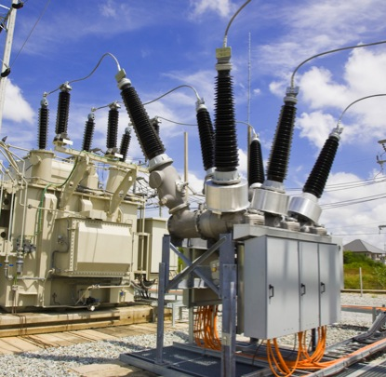
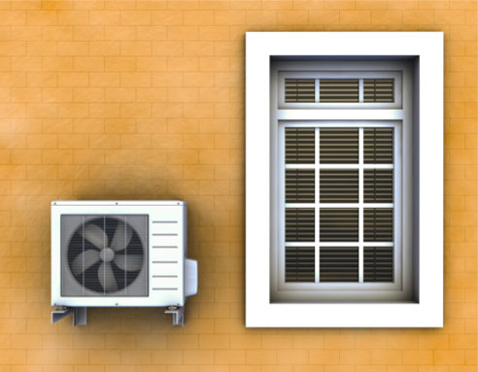
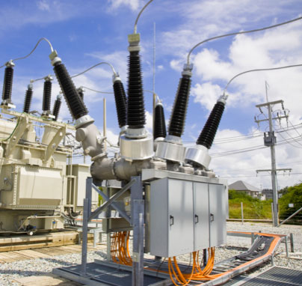

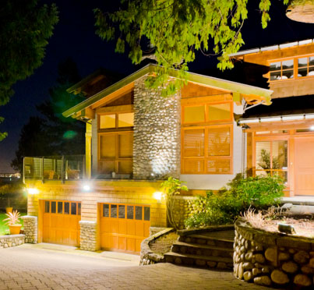
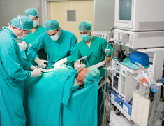
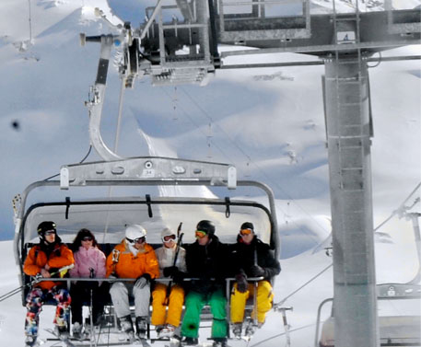
Here comes the sun
How should electricity be produced?
Episode 6: Here comes the sun
Notes:
Explain that photovoltaic cells have a more immediate and obvious application in some contexts than others.
Ask students to work in groups to suggest how electricity should be produced, either; mains supply, petrol generator, or photovoltaic cells for the following:
Remote weather station
Running washing machine on a remote island with no mains supply
Garden lighting
Hospital operating theatre back-up system
Heating system for a marquee
Funicular railway
Take feedback and draw out:
Proximity to mains supply
Amount of energy needed
Impact of certain methods, such as noise and exhaust
Reliability

Slide 11
Here comes the sun
How should electricity be produced?
Working in groups, identify:
The advantages offered by photovoltaic cells.
The kinds of situations in which they are particularly useful.
How they could be used more widely in situations such as Abuja.
Episode 6: Here comes the sun

Slide 12
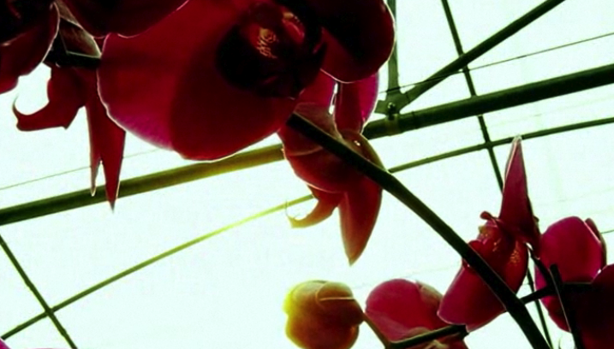
Here comes the sun
‘The Last Flower’
Episode 7: Here comes the sun
Notes:
Show a video clip of, ‘The Last Flower’.
Ask students to work in groups to suggest whether the provision of petrol generators in this situation is an over-reaction.

Slide 13
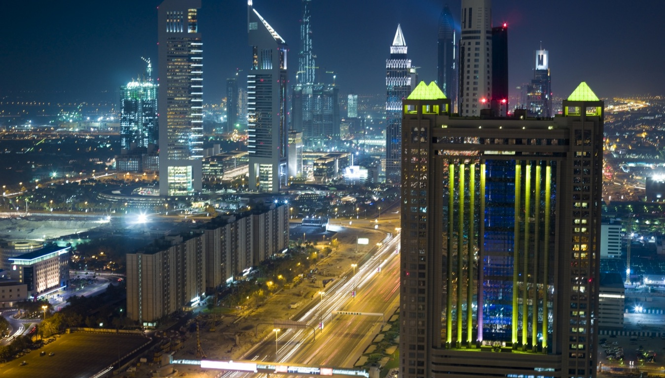
Here comes the sun
‘Photovoltaics’
Episode 7: Here comes the sun
Notes:
Show a video clip of, ‘Photovoltaics’. https://www.youtube.com/watch?v=FUOkouh5Mws
Ask the students to suggest how this might alter their perspective on the potential role of photovoltaic cells in large scale energy provision and whether they are ever likely to be a total solution.

Slide 14

Here comes the sun
Group discussion
Episode 8: Here comes the sun
Notes:
Ask students to work in groups and identify:
The advantages offered by photovoltaic cells.
The kinds of situations in which they are particularly useful.
How they could be used more widely in situations such as Abuja.
Now ask students to prepare a presentation, lasting no more than 60 seconds, which could be used to persuade people such as Buma to give photovoltaic cells a greater role.

Slide 15

Engineering the future. Inspire and be inspired.
For further information about the Siemens Education website and all support materials and downloads please visit us at
www.siemens.co.uk/education
© Siemens AG 2012. All rights reserved.

