Slide 1
Module 7
A Future in Engineering

Slide 2
Module Summary
There are lots of different ways to become an engineer at Siemens. In this module, you will consider the different routes available and the steps that you can take to progress along a chosen route.
Learning Objectives
Develop awareness about the routes into an engineering career at Siemens
Develop the essential skill of ‘Aiming High’
Understand what makes a good CV
Create a practice CV for an example work experience opportunity at Siemens
Session Length:
1-2 hours
Resources:
SIP Portfolio
Pens and pencils
Access to the internet

Slide 3
"Hey there, great to see you again!
And congratulations - you’re on to the seventh module, 'A Future in Engineering'! I hope that you've enjoyed programme so far.
There are lots of different ways that you can become an engineer at Siemens. In this module we will consider your future career as an engineer and the steps and skills you will need to get there, including building a great CV!
Along the way you will also develop your essential skill of ‘Aiming High’ which is crucial for setting and achieving clear career goals.
Let's get started!"

Slide 4
Skills Builder Partnership

Slide 5
In this module we will be focusing on building the essential skill - Aiming High.
The Skills Builder Universal Framework defines Aiming High as: The ability to set clear, tangible goals and devise a robust route to achieving them.
This skill includes...
Being able to identify what doing well looks like for you
Setting goals and organising yourself to achieve them
Working with care, pride and a positive approach
Take a look at the Skills Builder Passport in the back of your Portfolio and review the 10 steps to build your aiming high skills.
When have you used this skill before?
Want to build this skill? Have a look at the Skills Builder Universal framework.

Slide 6
Warm Up Task
What does it mean to be successful?
Take a minute to think about this question. What you think success looks like might be very different to what your friend or parent thinks success looks like!
Use the box in your Portfolio to brainstorm your ideas and pick out key words or elements that you think are really important.

Slide 7
Project Task 1: Routes into Engineering

Slide 8
"There are loads of different routes into engineering at Siemens. This means that you can find a way into a successful career as an engineer no matter what your strengths or learning styles are!
Today, I would like you to research the different routes into engineering at Siemens and consider which route you like best.
Have an explore of the Siemens 'Early Careers' website by going to www.siemens.co.uk/jobs and clicking on Early Careers. While you're having a look around this site, use your Portfolio to make some useful notes.
When you've got all your information together, use the box provided to create your own 'Career Pathway Diagram' to map out the various routes you might take to get from where you are now to being an engineer at Siemens."

Slide 9
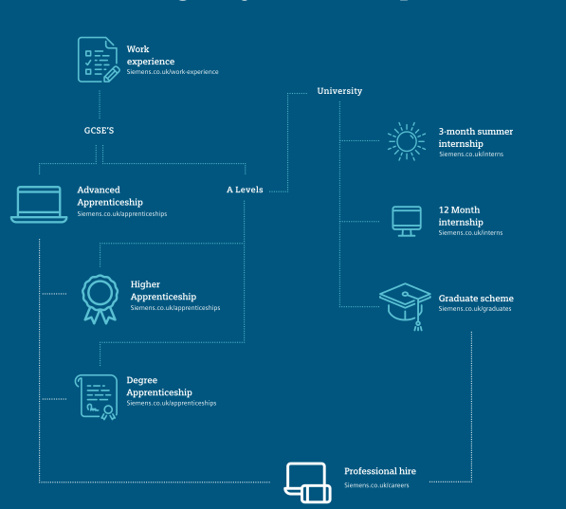
"Well done!
Have a look at your Career Pathway Diagram
It might look a little bit like this one..."

Slide 10
"Now that you have researched the different routes available, I want you to think about which route you would like the most and why.
In your Portfolio, use the boxes to write down which career path you like the best and set out the steps you will take to get to that career path and/or move along it.
This exercise will help you to break down your overall goal into smaller, achievable steps.
By putting these steps into a logical order of what needs to be achieved first, you will also practice prioritising - a really useful skill in my job! "

Slide 11
Project Task 2: Building a CV

Slide 12
What is a CV?
A CV, or 'curriculum vitae' is a document, no longer than a page or two, that you create to showcase your skills and experiences to a potential employer.
Employers will ask to see you CV when you apply for a job.
In a CV you want to include...
Your contact details. This includes your full name, your home address, email address and mobile number.
A brief personal statement, about 100 words long. This will help you stand out from the crowd by summarising your most impressive skills, experiences and your career aims.
Your education history. Here you want to list your education history, with any qualifications or achievements you have gained. Start with the most recent at the top.
Your experience and your skills. This is the most important part. In this section you want to highlight all the things you have done and all the skills you have developed that make you a brilliant candidate for the role you are applying for. You can either separate this section into two parts, one for your experiences and one for your skills. Or, you can keep them together, highlighting for each experience the skill or skills that you have developed.
Your interests. You don't always have to include a section on your interests or hobbies, but including your interests does help the employer to get to know you a little better. Just make sure they are relevant to the job!

Slide 13
CV Top Tips!
Tailor your CV to the job you are applying for!
When applying for a job, carefully read the sorts of skills and experiences the employer wants to see in a candidate. Make sure that your CV shows exactly how you are the perfect candidate.
You can use your hobbies or your extra-curricular activities as evidence of skills and experience.
For example, you might have learnt about teamwork from playing in your school's football team or shown dedication by getting to Grade 5 on the clarinet.
Remember to Aim High!
Writing a CV is about recognising your own strengths, skills and experiences. Building a great CV is a crucial step in working towards your career goals.

Slide 14
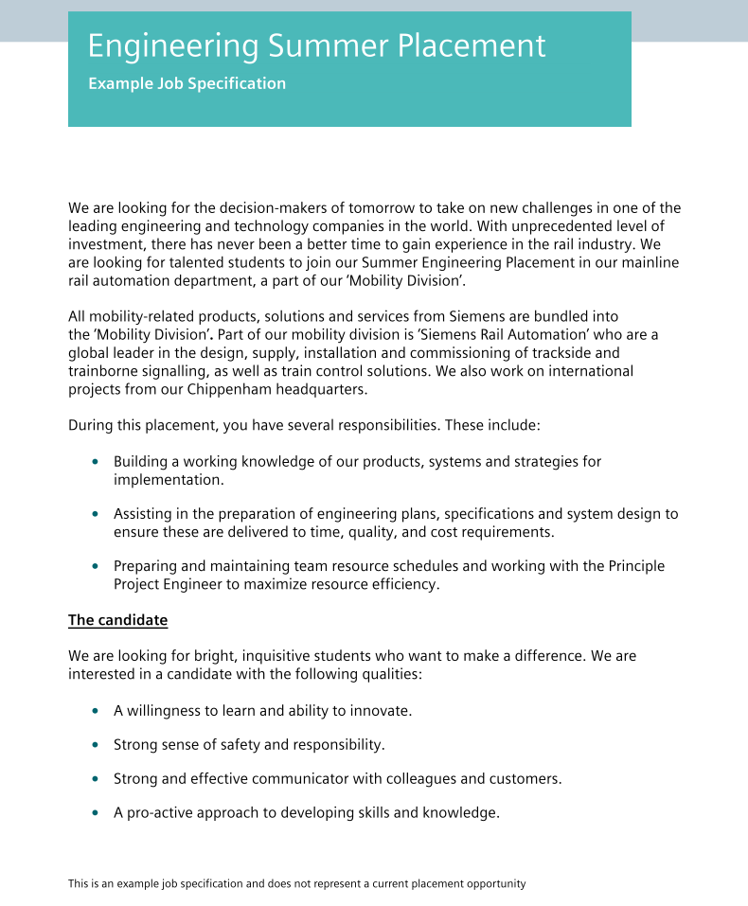
"Now its you're turn!
Using the template in your Portfolio, have a go at creating a CV for the following summer engineering placement opportunity...
Remember that this is just a practice! Approach this task with care, pride and positivity."

Slide 15
Quiz and Reflection
Put your knowledge to the test and complete the ‘Welcome to Siemens’ quiz in your Student Portfolio!
The correct answers can be found in the back of your Portfolio but no peaking…

Slide 16
Time to reflect...
Go to your Skills Builder Passport at the back of your Portfolio and look at the steps for Aiming High.
Pick one or more steps that you think you have developed during this module.
For each step, write an example of where you have demonstrated this skill while working through this module.

Slide 17
Congratulations! You have completed Module 7 – A Future in Engineering!

