Slide 1
Topic 14: Underwater energy
Siemens Education

Slide 2
Underwater energy
Overall learning objectives:
We are learning to:
Assimilate and interpret key information about an emerging technology
Understand the potential of tidal energy as part of an overall solution
Use key features to evaluate the contribution tidal energy might make

Slide 3
Underwater energy
Notes:
Introduce the context by showing video (www.youtube.com/watch?v=ZPi9HeDgN58)
Ask the students to research, from resources provided and wider searches, how tidal power stations work.
Ask students to work in small groups to gather their ideas using a technique such as a spider chart and then to contribute to a discussion about the potential and the constraints of this technology.

Slide 4
Underwater energy
Energy from the sun and wind are likely to be part of the solution to the energy crisis…
…but are unlikely to meet all of our future energy needs.

Slide 5
Underwater energy
Extracting energy from the tide
By placing rotors underwater, the movement of the water by the ebb and flow of the tides makes the blades turn.
Notes:
1. Remind students of the key features of a tidal power station:
The power of the tides represents a nearly untapped source of clean energy.
The energy yield of an ocean power plant is highly precisely predictable so can enhance the planning security in electricity output, as tidal currents are determined by the gravity of the moon and the sun.
Therefore ocean power plants can be installed wherever ebb and flood generate strong currents
2. Challenge students to discuss and identify what is needed from a location in order for this technology to be viable.

Slide 6
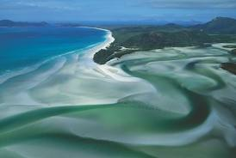
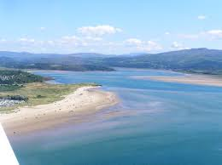
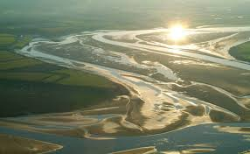
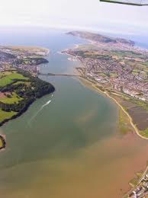
Underwater energy
Location, location, location
Notes:
Draw out points including:
The shape of the location needs to cause the water to flow in and out as the tides rise and fall - the sea beds need to be on a gradient (the gentler the better). River inlets work well.
The machinery can interfere with other activities, such as shipping
Proximity to centres of population and industry.

Slide 7
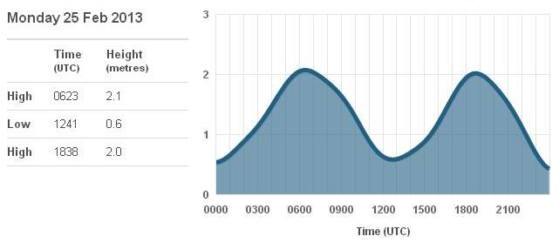
Underwater energy
Understanding tides
The blades turn more quickly when the water level is altering at a greater rate.
When will most energy be available on this date?
How well will this coincide with the times of greatest energy need?
Can you work out when the high tides for Tuesday 26th February would have been?
Notes:
Using the information above, ask students to consider these questions:
Going through a cycle from high tide to low tide and back to high tide, at which point is the water flowing more quickly through the blades?
At what times (from the sample data) will this be?
How well is this going to meet with periods of peak demand for electricity?
What are the implications of this?

Slide 8
Underwater energy
“…the tides provide an infinite supply of clean energy…?”
“…ocean power is a promising contributor to a clean and efficient energy mix for the future…?”
Tidal energy – a significant source?
Notes:
Summarise or ask students to summarise key points gathered.
Ask students to consider the assertions, and form responses:
“…the tides provide an infinite supply of clean energy….?
“…ocean power is a promising contributor to a clean and efficient energy mix for the future…?”
Use this as a way of getting the student to summarise their understand and their views.

