Slide 1

Welcome to the Siemens Press Conference @ ACHEMA 2024
Press kit: scan the QR code or access via
siemens.com/press/achema24

Slide 2

ACHEMA 2024
Transforming the process industries for a sustainable tomorrow
Axel Lorenz, CEO Digital Industries Process Automation, Siemens AG
June 11, 2024 | Frankfurt am Main, Germany

Slide 3
Challenges for the process industries grow at an extreme rate
Efficiency
Faster innovation cycles
Quality
Resilience
Adaptability
Glocalization
Supply chain disruptions
Sustainability
Ageing societies
Lack of talent
Complexity
Scalability
Cybersecurity
Safety
Individualization
Circular economy
Flexibility
Health
Integration
Cost pressure
Notes:
All industries are facing fast-changing market demands.
It’s crucial to navigate those challenges fast and flexibly.
More flexible production, greater productivity, and the development of new business models are all possible to-day thanks to digital solutions.
But the future of industry offers even more potential: Cutting-edge technologies will create new opportunities for both discrete and process industries to fulfill their customers’ individual requirements and to do more with less.
While our resources are finite, data created in the Industrial Internet of Things (IIoT) are infinite and need to be collected, understood, and used. The Digital Enterprise is doing exactly this by combining the real and the digital worlds. As a result, the infinite amount of data allows us to use our finite resources efficiently and with that make the industry more sustainable.

Slide 4

The Gamechanger
Combining the real and digital worlds
Notes:
But how to master those challenges?
In a nutshell it comes down to consequently combining the real and digital worlds in order to
get you the information that you need to make the best decisions, based on information,
and that with confidence.
Siemens has consequently since 2007 been combining the real world and the digital worlds enabling in this way a continuous loop of optimization.

Slide 5
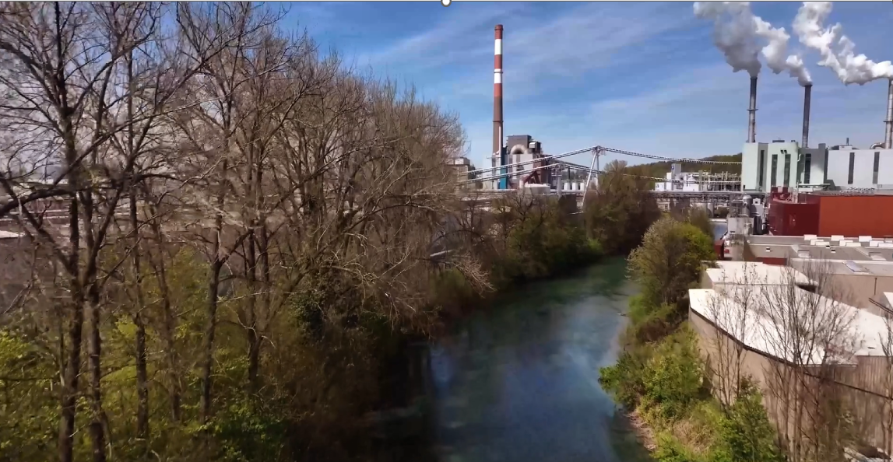
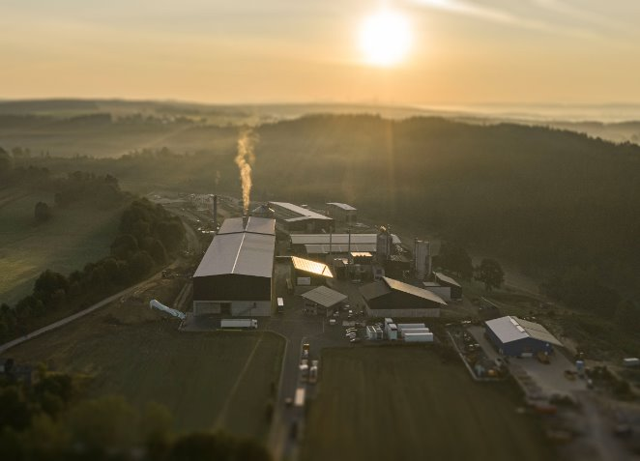
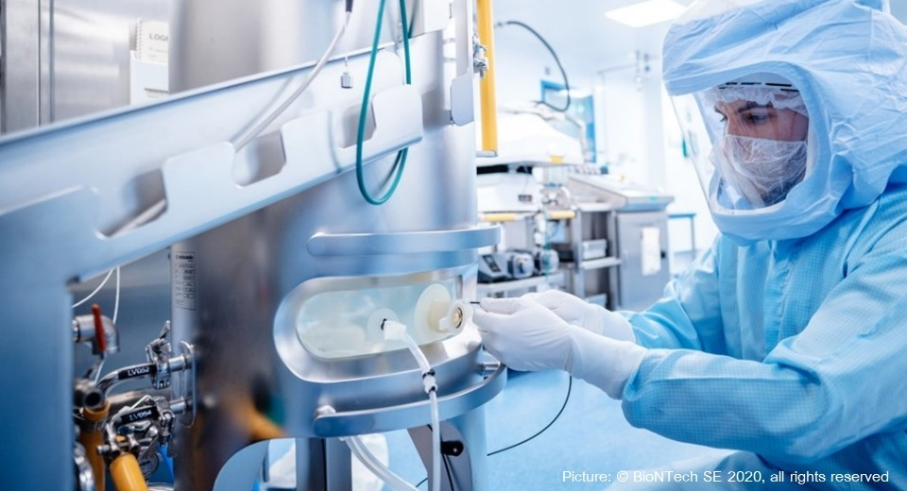
…helping customers in process industries to overcome their most pressing challenges
Chemical
Decarbonizing the chemical industry based on digitalization
Hydrogen
Accelerating hydrogen production with GenAI
Pharmaceutical
Maximizing operational efficiency for faster time-to-market in the pharmaceutical industry
Notes:
Mastering the challenges by combining the real and the virtual world means:
Helping our customers in process industries to overcome their most pressing challenges.
For Chemicals: Decarbonizing the chemical industry based on data-driven decisions
For Hydrogen: Accelerating hydrogen production with GenAI
For Pharmaceuticals: Maximizing operational efficiency for faster time-to-market in the pharmaceutical industry

Slide 6





Decarbonizing the chemical industry
From wood to textile: Lenzing revolutionizes cycle processes with Digital Twin
Data reuse across tools shortens project times
< 5 months for planning and commissioning of production
Remote troubleshooting minimizes times on site and traveling
Notes:
About the Technological Partnership with Siemens :
The Lenzing Group, headquartered in Upper Austria, has established itself as a leading supplier in numerous business-to-business markets, especially in the cellulose fiber sector.
With over 70 years of experience in fiber production, Lenzing is not only known for its innovative products, but also for its commitment to the environment.
A large part of the Lenzing portfolio is based on the renewable raw material wood from sustainable forestry. The fibers are compostable and biodegradable. Following nature’s example, it is the vision of Lenzing to put the circular economy approach into practice.
Raw materials are recycled for as long as possible in order to minimize waste and maximize the service life of products.
The Lenzing Group strives to lead the textile industry towards a comprehensive circular economy, relying on partnerships and innovative solutions.
Challenges:
Centralized monitoring of production plants
Standardization across sites
Digitize legacy documentation
Creating a digital twin with unified documentation
Solution
Digital Twin as unified data source
Simulation to predict behavior (SIMIT)
Central engineering data hub (COMOS)
AI-supported digitalization
Accelerated automation engineering and improve usability for operators (SIMATIC PCS neo) --> with the help of our process control technology, the black color für dyening the Lenzing “EcoVero fiber” is made possible - with lower CO2 emissions and reduced water consumption.
Benefit
Data reuse across tools shortens project times
< 5 months for planning and commissioning of production
Remote troubleshooting minimizes times on site and traveling

Slide 7


Slide 8

Software-defined Process Automation is the way the industry will evolve from classic automation pyramid to a user-oriented architecture
neo Collaboration
Multi-user web engineering
IT
neo System Access
Connection via IT encryption
OT
Object-oriented
Data Management
Consistent information
Field (sensor/actor)
Support of
open MTP* standard
Modularization for flexible plant design
IT – OT convergence
with SIMATIC PCS neo in one system
* Modular Type Package (MTP)
Notes:
Software-defined Process Automation is the direction for us at Siemens. Moving away from traditional automation pyramids, which are becoming obsolete, we are shifting to more dynamic architectures. This means moving past hierarchical-driven thinking and enabling seamless data flow between layers.
Today, customers are already leaning towards plant architectures that facilitate better data exchange between different layers and systems, integrating the benefits of IT systems into the OT world.
So, a further convergence of IT and OT is the next logical step. This shift empowers our customers to decide how and where they will consume automation and engineering services, with an intelligent field underneath that allows for real-time process optimizations, even remotely.
This digital transformation will make manufacturing much more user-centric, giving operators a holistic view of their plants and empowering them through data and information.
And the good news: Today with our DCS SIMATIC PCS neo, we don't just talk about software-defined process automation, we already deliver a software-defined process automation system as we are the first DCS provider capable of offering a seamless IT/OT integration solution with our web-based technology. We easily connect global engineering teams and simplify plant operations with our highly innovative user interface.
Highlight new at Achema: PCS neo in the cloud
We are also demonstrating here how easy it is to setup an engineering environment in the cloud – that’s opening a completely new level of global collaboration, working in parallel and … you don’t need a dedicated, fixed and locally installed engineering system anymore. You can use every office PC with a state-of-the-art browser to work jointly in a project. And the best: you only pay for what you use!

Slide 9
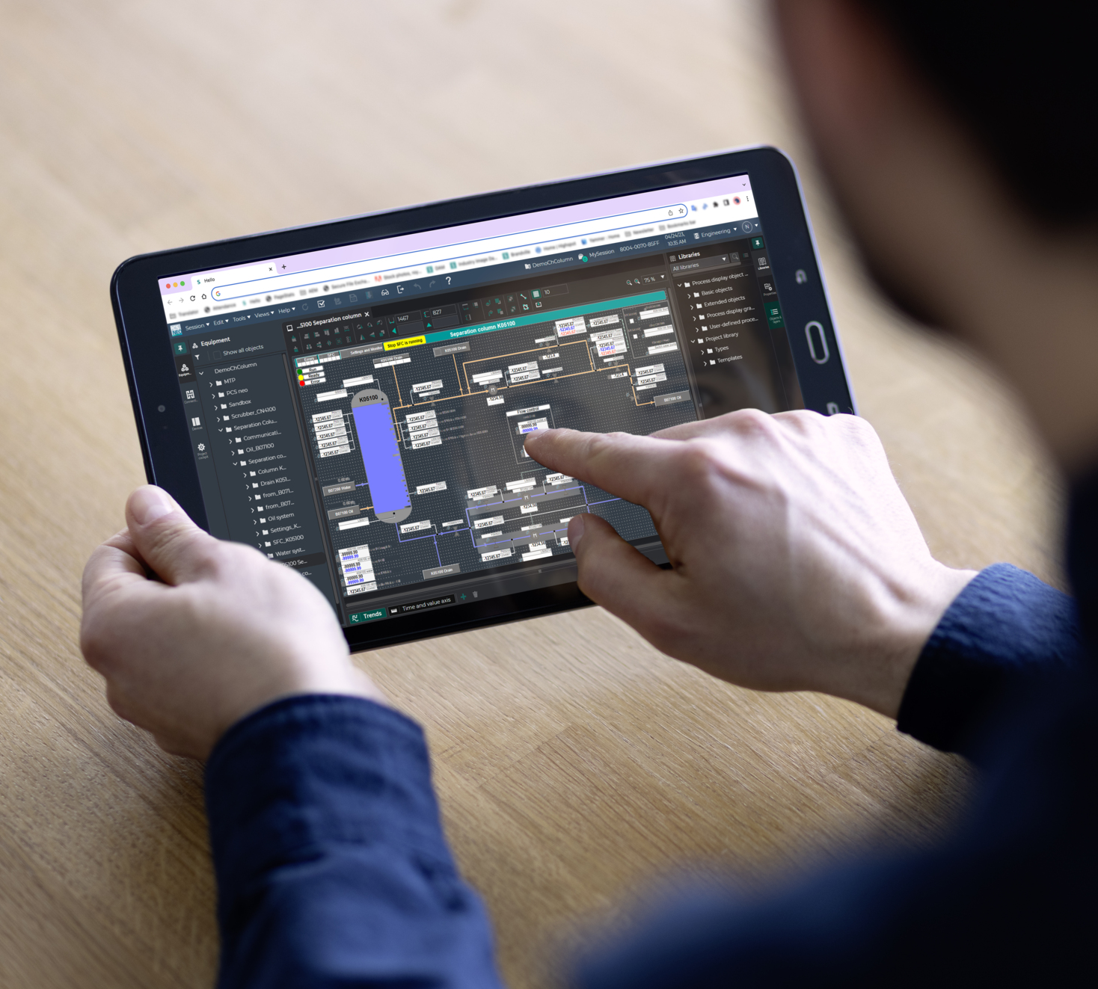

New Product
SIMATIC PCS neo
GenAI SFC Generation
Automated creation of Sequential Function Charts (SFCs) within SIMATIC PCS neo
Visual representation of the process logic, allowing to manage complex workflows with ease
Notes:
SIMATIC PCS neo
GenAI SFC Generation
SFC Generation as a module within SIMATIC PCS neo to automate the creation of Sequential Function Charts (SFCs).
Visual representation of the process logic, allowing to manage complex workflows with ease
This is currently a proof of concept. At present, SFCs can be edited in PCS neo using GenAI.
Simple interactions: 'Add the step Warmup after "IsStarting".
Complex interactions: 'Add the step "PumpStop" before all Ventil Zu steps.
Create an entire SFC from a process description.
In the long term, all aspects of PCS neo engineering should be enabled with GenAI, including CFC, hardware configuration, signals, and HMI screens.
As a vision, it is also planned not only to manipulate engineering programs but also to align and validate them. For example: 'Here is a process description and the industry standards. Does my SFC plan conform to the specifications?

Slide 10
New Product
Accelerating hydrogen production GenAI based Hydrogen Plant Configurator
Powered by Large Language Models (LLMs)
Precise plant unit layouts and interconnections
Instant access to critical metrics,
e.g. electricity consumption, heat generation
Notes:
Our new Hydrogen Plant Configurator is an intelligent chatbot based on generative artificial intelligence which enables users to create plant designs for hydrogen production.
In an iterative process, the configurator is fed with the desired design characteristics of a production plant.
The AI then creates seamless block flow diagrams up to precise layouts of the system units and connections.
The data can then be transferred to engineering and simulation software such as Comos and gProms, for example, to automatically create the piping and instrumentation diagrams.

Slide 11
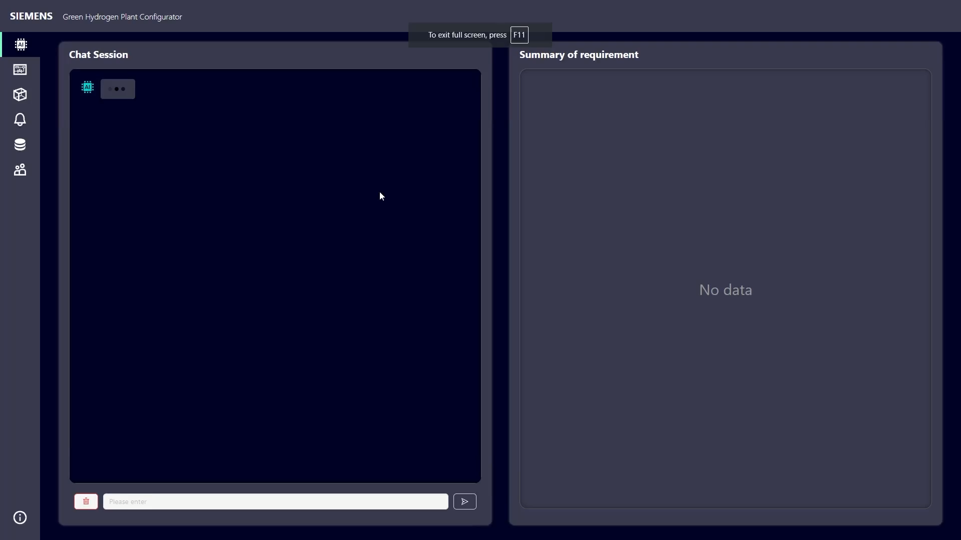
Notes:
The configurator will start with an AI assistant to guide users for configuration
Users can type their replies in the user message box
A summary of the user’s input is given to check on the right-hand side in case of long conversations
Users can type the options they would like to have answered
It is recommended that users type their answers with units if multiple units possible
However, the AI will confirm with users which unit they refer to if not submitted
A list of optional questions is shown for users to choose from once all mandatory questions are answered
If users choose to answer optional questions, the AI will guide them through the chosen questions one by one
Minor typos are not a problem, you can also go back and correct your input, the Chatbot takes care of modifications
After all questions are answered, the AI starts configuration upon users confirmation
As a result, a block flow diagram of the plant is created including needed process units and key material flows
A legend on the right-bottom explains the diagram
There are two types of material flow information shown:
Full load average scenario, at the top of lines
Maximum daily capacity at beginning of life, at the bottom of lines
On the left-hand side, a list of key data of the plant is provided
Finally, you can export the diagram as a PDF file

Slide 12
Siemens Xcelerator to accelerate the digital transformation of our customers – easy, fast & scalable
A comprehensive, curated portfolio that includes digital and IoT-enabled offerings from Siemens and qualified sellers
A continuously growing, powerful ecosystem
A marketplace to explore, educate and exchange with a community of customers, sellers and developers, and to purchase products, solutions and services
Notes:
Both the Hydrogen Plant Configurator as well as SFC Generation will be available on the Siemens Xcelerator Marketplace later this year and beginning of next year respectively

Slide 13
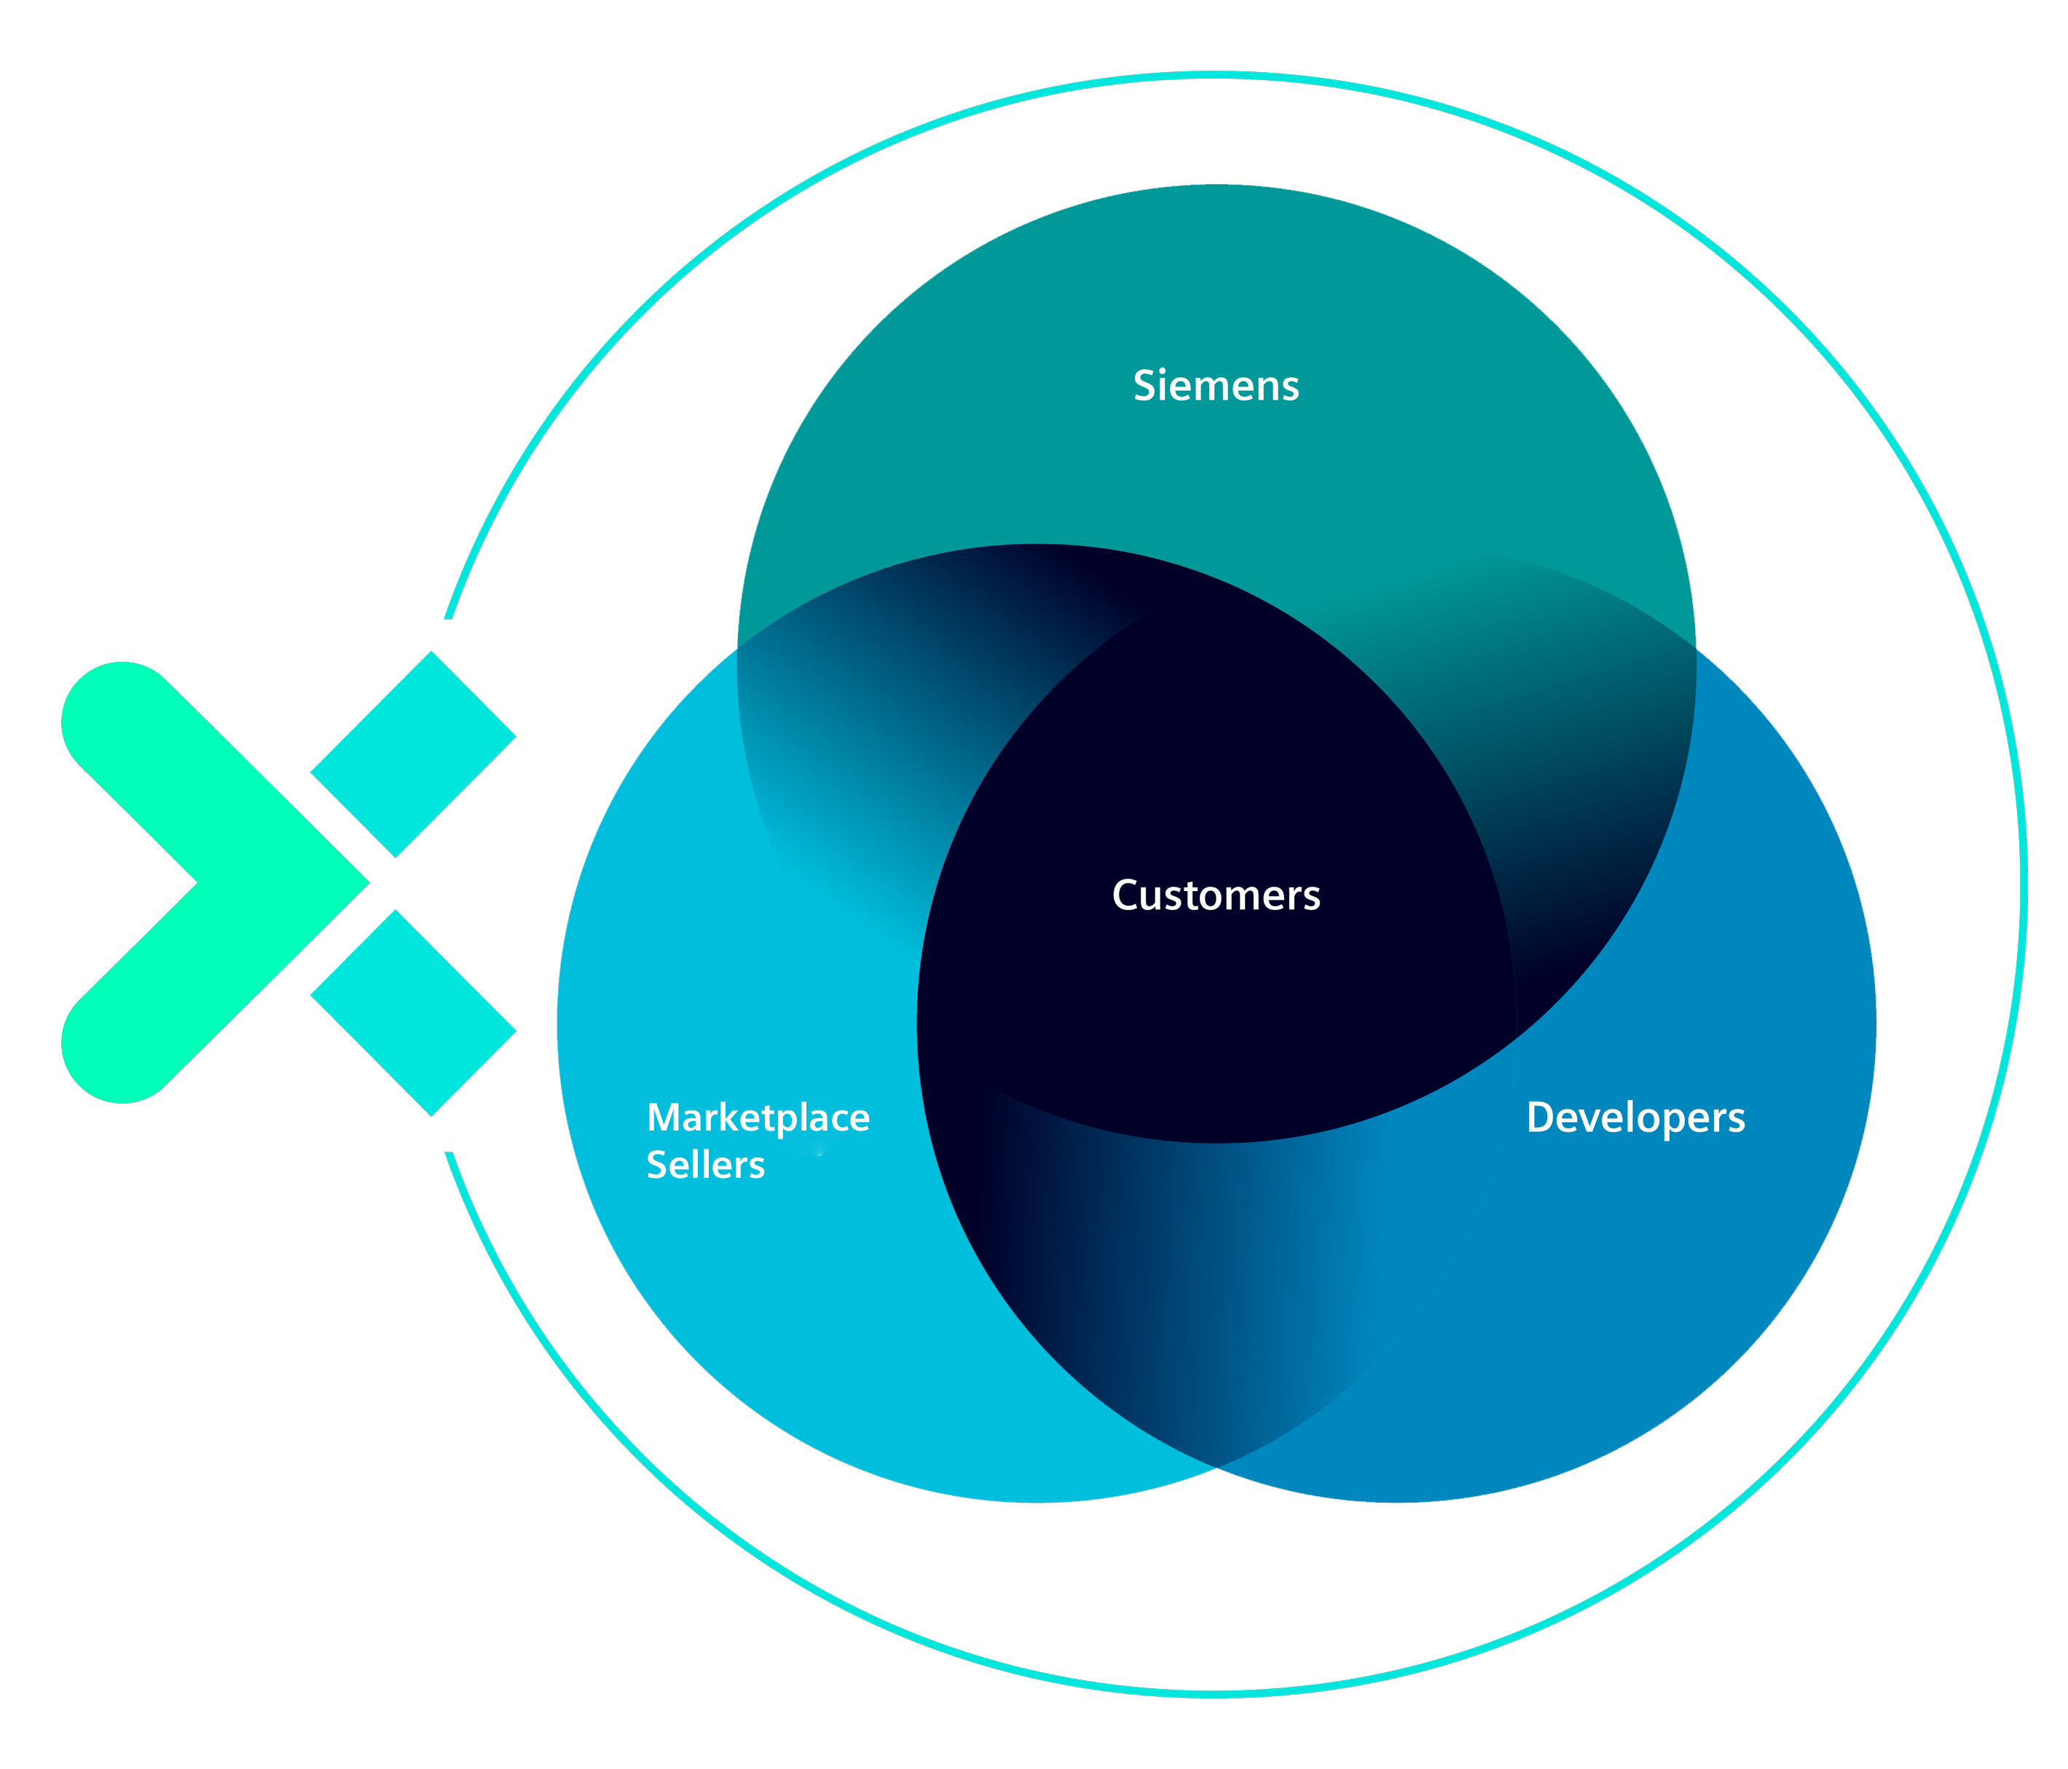
The Siemens Xcelerator Ecosystem consists of a wide set of stakeholders which contribute to the growth and value of the platform
Siemens Xcelerator Ecosystem
tackles customer challenges
Siemens Xcelerator Ecosystem
is characterized by
OPENNESS
INNOVATIVENESS
DIVERSITY
COLLABORATION

Slide 14
Digital and Modular
Siemens BioNTech
Innovation Partnership
Dr. Sierk Poetting
COO BioNTech SE
ACHEMA, Frankfurt
June 11, 2024

Slide 15


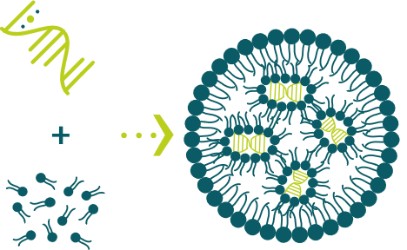
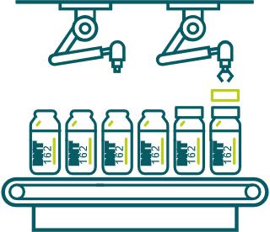

The process for mRNA vaccine production
1
2
3
4
mRNA
production
mRNA purification &
concentration
Drug product
formulation
Filling &
packaging
15

Slide 16
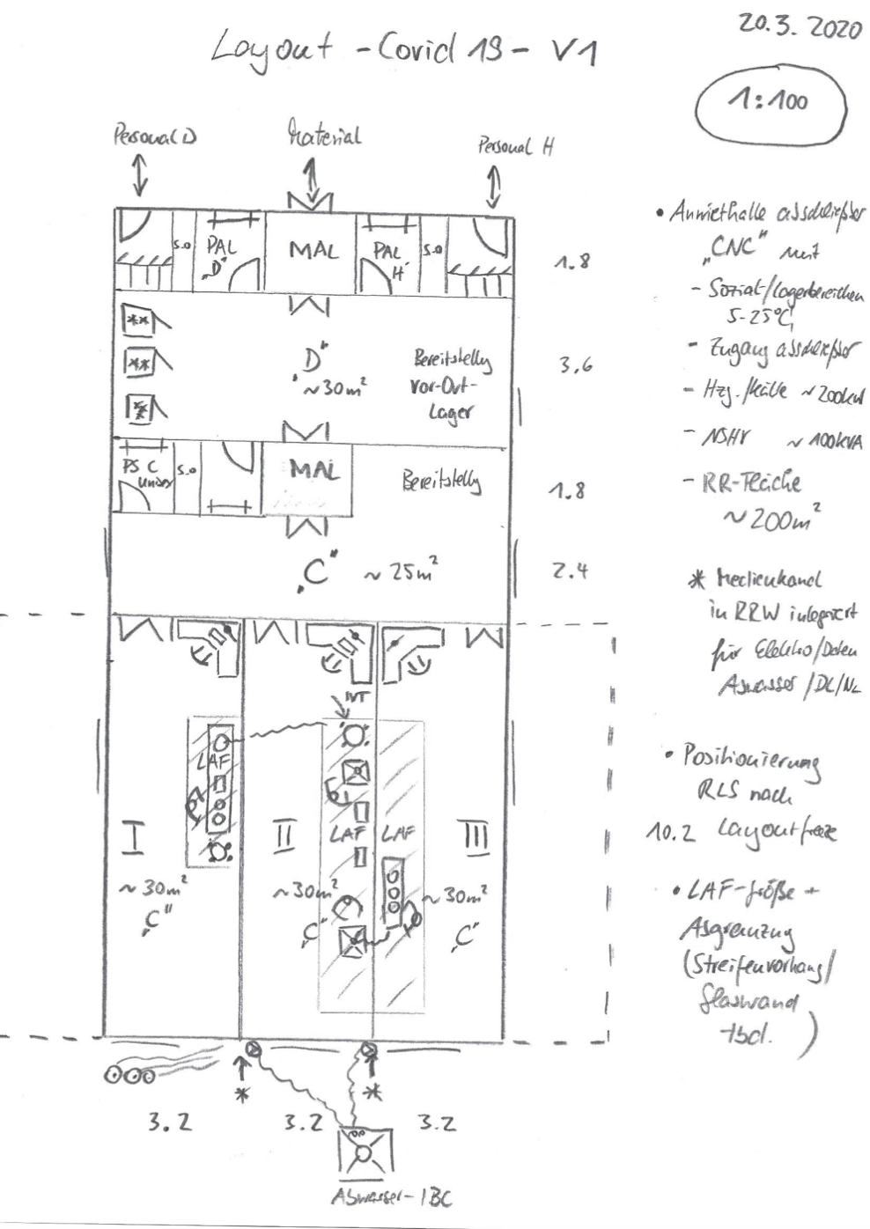
The “Napkin Moment”
16

Slide 17
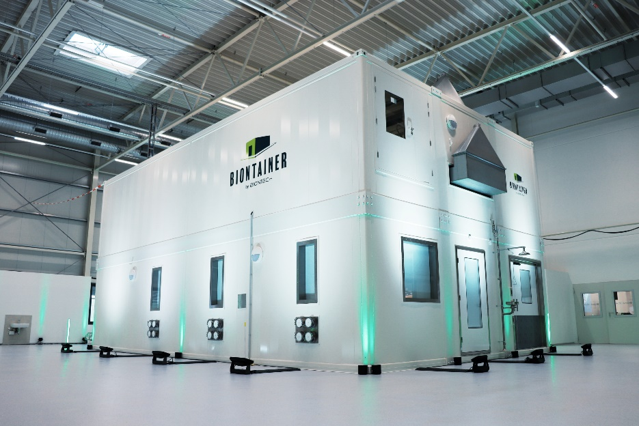
BioNTainer: A platform for localized and sustainable mRNA production
The challenge
The solution
Establishing GMP production of mRNA is complex and requires overcoming challenges at many levels
Turnkey package that includes modular production units, GMP-compliant setup and personnel training
17

Slide 18

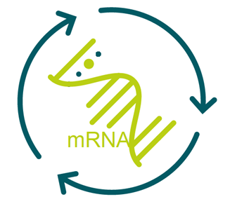

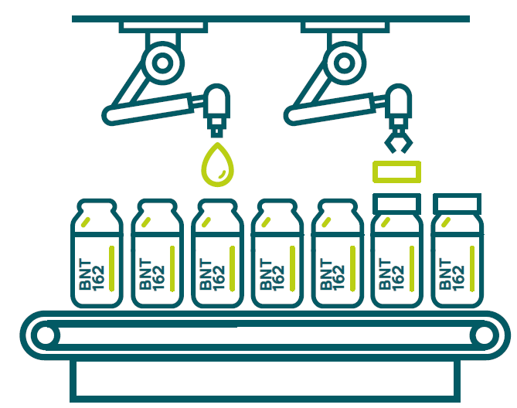
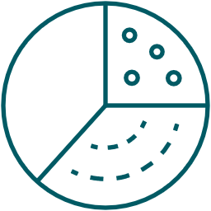






Developing BioNTainer Configurations for Commercial and Clinical Applications …
Overview configurations
Two Light House Projects
Process visualization
Commercial-scale BioNTainers starting with Comirnaty production
Clinical-scale BioNTainers paired with R&D production in order to establish RNA ecosystem with academic institutions and local biotechs
Process steps
Drug Substance (DS)
Drug Product (DP)
Fill & Finish (F&F)
Application
Commercial
DS BioNTainer
(6-container)
DP BioNTainer
(8-container)
CMO
Clinical
Clinical DS/DP BioNTainer (8-container)
F&F BioNTainer

Slide 19
Capabilities are “building-blocks” that span platforms and can be flexibly applied to differing use cases
"Building blocks" include processes, equipment, software and facilities
Building blocks can be assembled with a goal of speed, cost-effectiveness and international scalability
Example use cases spanning R&D production through clinical and commercial manufacturing
  Rwanda: Set-up of commercial manufacturing facility
  Australia: Set-up of R&D production lab followed
  by clinical manufacturing capability
Illustrative Example of Building Blocks In Development or on innovation roadmap
Processes
Equipment for each scale
Buildings
Software
Ordering tool for R&D production
F&F equipment
Digitalization blueprint
Individualized mRNA manuf. process
BioNTainer for
GMP production
R&D production process for mRNA
Cell therapy process
MES
BioNTainer production hall
Process automation
Clinical mRNA manuf. process
1mg, 100mg, 1g and 40g production scale
Auxiliary
services building
Commercial mRNA manuf. process
Modular QC lab
Cell therapy Equip.
Modular R&D lab
LNP/LPX formulation processes
Indiv. RNA Equip
Filling process

Slide 20



Capabilities are “building-blocks” that span platforms and can be flexibly applied to differing use cases
Building blocks can be assembled in support of our internal and external ambitions with a goal of speed, cost-effectiveness and international scalability
Example use cases spanning R&D production through clinical and commercial manufacturing
  Rwanda: Set-up of commercial manufacturing facility
  Australia: Set-up of R&D production lab followed
  by clinical manufacturing capability
MES & Process
Automation
Digitalization Blueprint
Xg production scale
with filling
Formulation
processes
Auxiliary services
building
Clinical mRNA
manuf. process
BioNTainer
production hall
Fill & finish process
MES & Process
Automation
BioNTainers for GMP
production
Digitalization Blueprint
Ordering tool for R&D
production
40g production scale
R&D production
process for mRNA
Frmulation
processes
Auxiliary services
building
Xmg
production scale
Commercial mRNA
manuf. process
BioNTainer
production hall
Modular R&D lab
BioNTainers for GMP
production
Modular R&D lab
Rwanda
Australia

Slide 21
ACHEMA 2024
Transforming the process industries for a sustainable tomorrow

Slide 22
Welcome to the Siemens Press Conference @ ACHEMA 2024
Press kit: scan the QR code or access via
siemens.com/press/achema24

