Slide 1
Topic 13: Ringing true
Siemens Education

Slide 2
Ringing true
Overall learning objectives:
We are learning to:
Explain where the timing of the wheel bearing replacement is critical
Understand the key features of the RailBAM process
Communicate key points and ideas to a target audience

Slide 3
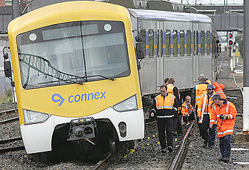
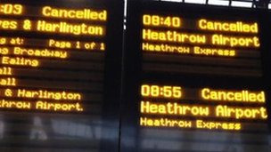
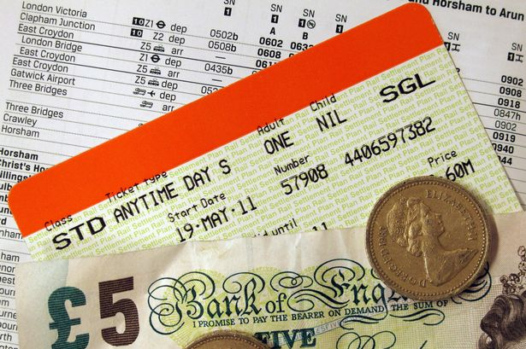
Ringing true
Accidents mean disruptions to services
Poorly maintained trains results in accidents
Spending money on maintenance means higher fares
Notes:
Ask students to discuss why these might happen and draw out that mechanical failure might be a cause of the first two, but that increasing maintenance will cause the third.
Ask students to explore and present ideas in response to three questions:
What happens if a bearing failure is not caught in time?
What happens if bearings are replaced too often?
How might you tell if a bearing was stating to wear out?
Draw out the following points:
Bearing failure is critical; it causes train failure which is expensive, disruptive and dangerous
Bearing replacement is expensive; it is important to manage costs by avoiding taking trains out of service and spending unnecessarily on maintenance.
The noise made by a bearing changes as it wears out.

Slide 4
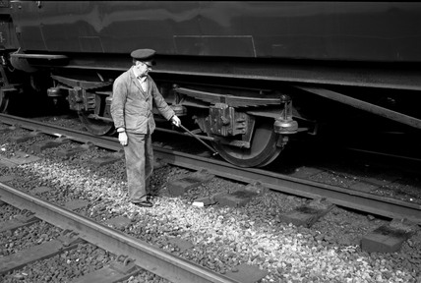
Ringing true
Wheel tappers checked for cracked wheels
Notes:
Until 1970s, wheels on trains in Britain were checked by striking them with a hammer. A cracked wheel makes a different note.
Show students first 2 minutes of “Oh Mr Porter”, a 1937 film in which Will Hay (initially) plays the part of a wheel tapper – http://archive.org/details/Oh_Mr.Porter_1937

Slide 5
Ringing true
Bearings allow wheels to rotate smoothly whilst taking the load of the vehicle
Notes:
This is an older style plain bearing, which needs to be packed with grease and checked regularly.

Slide 6
Ringing true
Roller bearings
Notes:
These are modern roller bearings. The wheel axle runs through the centre. These need less maintenance than plain bearings but will wear out over a period of time.

Slide 7
Ringing true
Bearing failure is dangerous
Notes:
This accident at Newton Abbot in 1997 was caused by bearing failure. Six people were injured.

Slide 8
Ringing true
Bearing failure is dangerous
Notes:
This bearing on a high speed train failed, causing the train to become unstable and leave the rails.

Slide 9
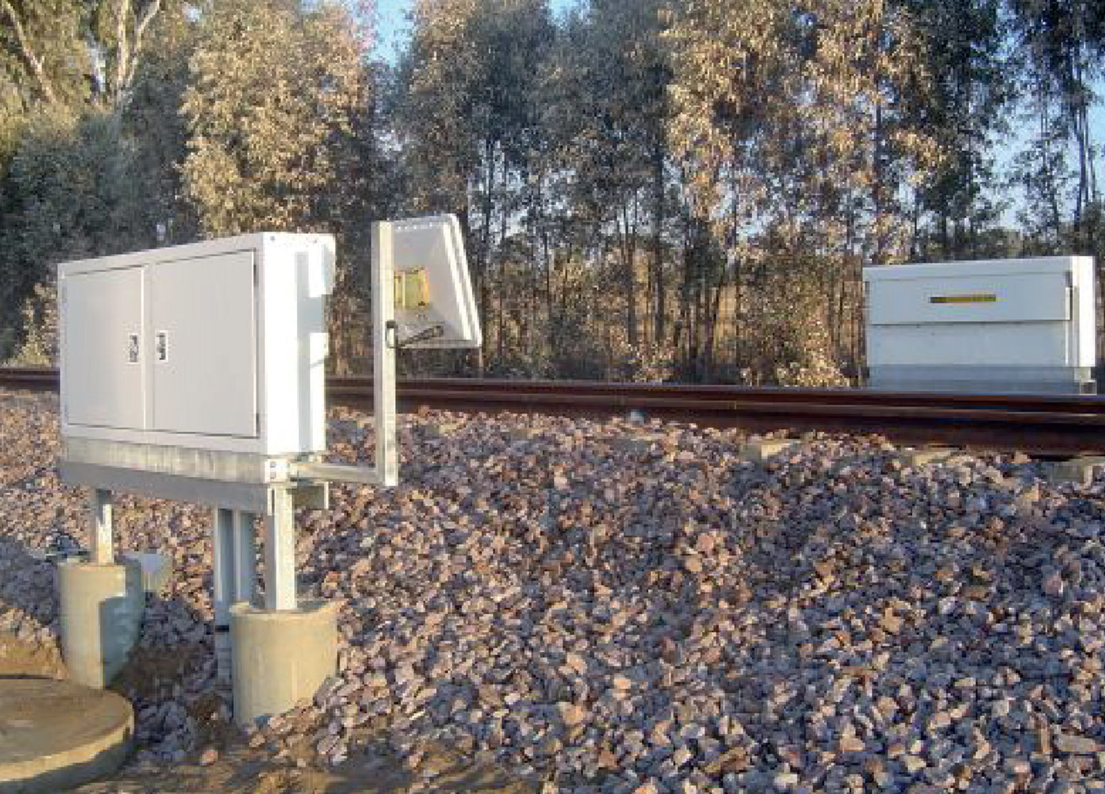
Ringing true
The RailBAM system
Notes:
Present students with Resource Sheets and ask them to work out how the RailBAM systems works. Ask them to identify key points and summarise on a flipchart sheets.
Take feedback and draw out the following points:
Bearings functioning properly make a certain sound when running
If the bearings are worn, the sound is different
The RailBAM system records the sound made by passing trains and compares it with the sound of a train with bearings in a good working order. If there is a difference the system notes this and issues a warning
The train can then be withdrawn from service for maintenance.

Slide 10
Ringing true
The RailBAM system
Notes:
The RailBAM (Rail Bearing Acoustic Monitor) systems listens to the sound of the wheel bearings are making on a passing train and compares this to the sound made by a train with sound bearings.

Slide 11
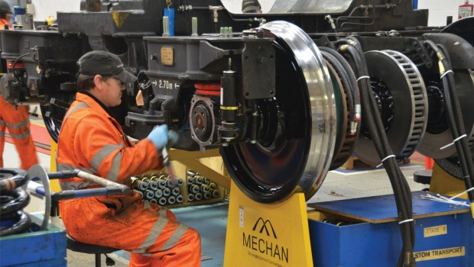
Ringing true
Replacing wheel bearings
Notes:
Wheel sets and bearings are amongst the most expensive parts of the train.
The bearings mustn’t be allowed to become worn out, but replacing them unnecessarily is expensive.

Slide 12
Ringing true
Plenary:
Select one of the following to summarise and express key features of the system and to explain how it works.
A4 explanatory leaflet
Poster
Diagram to explain to younger students
Podcast of no more than 2 minutes

