Slide 1


Topic 7: eZero Island
© Siemens AG 2012. All rights reserved.
www.siemens.co.uk/education
© Siemens AG 2012. All rights reserved.
www.siemens.co.uk/education

Slide 2

eZero Island
Overall learning objectives:
Investigate how maths can support the modelling of a multi-faceted system using data and logic.
Apply ideas about energy transfer and sustainability to a novel context to produce a practical overall system.
Devise technical solutions, appreciate their impact on ecosystems and communities and explore how they can be modified to respond to demands.
Introduction: eZero Island

Slide 3
eZero Island
Overall learning outcomes:
To identify various characteristics to be allowed for in effective energy provision.
To evaluate different methods of supplying energy for domestic consumption.
To present and evaluate plans effectively and persuasively.
Introduction: eZero Island
Introduction: eZero Island

Slide 4
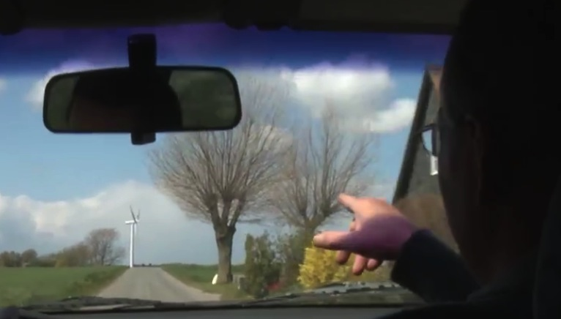
eZero Island
‘Island in the Wind’
Episode 1: eZero Island
Notes:
Show a video clip of, ‘Island in the Wind’.
https://www.youtube.com/watch?v=apGEhHvu_0s
Ask students for their responses as to why the islanders moved towards being self-sufficient in energy.

Slide 5
eZero Island
How have the islanders made their island self-sufficient?
Why do you think they wanted to?
Do you think it’s easier or more difficult to do that with an island than with, for example, a large town on the mainland?
Which of the techniques they used might work where you live?
Introduction: eZero Island
Notes:
Ask students to work in groups to consider these questions and formulate responses.
Take feedback and draw out key points including:
The island uses several different sorts of energy provision.
The islanders wanted to reduce their dependency on generators.
Explore how transferable the ideas are and emphasize that although this development might be easier to implement on an island, especially one where the energy requirements may be lower and where there is plenty of sun and wind, the ideas can be used in a variety of settings.

Slide 6
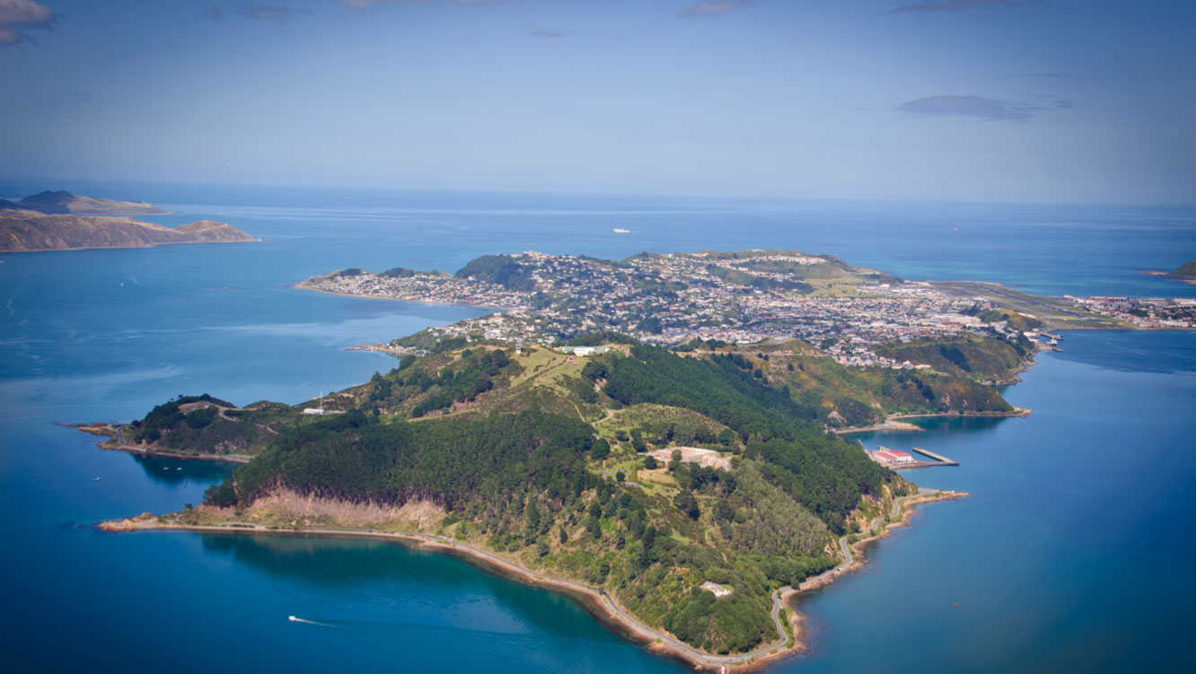
eZero Island
Island in the wind
Episode 2: eZero Island
Notes:
Show the students a picture of an island and explain that their challenge is to provide the islanders with a power generation system.
Say that there will be various alternatives as to how electricity can be generated.
Ask them to work in groups to identify a range of typical uses to which electricity is put in the home (they should not include battery powered devices but they should include mains chargers for battery powered devices).
Say that electricity is very useful as it can be used to produce a range of effects, such as heat, light, sound and movement, but that this may not necessarily be the most efficient method.
Ask the student to go through the list (heat, light, sound and movement) and divide it into two – devices that have to run on electricity such as TVs and functions which could be powered by electricity but don’t have to be.
Ask students to consider how the total energy demand in a home varies over a 24 hour cycle. Working in groups ask students to sketch and label a graph to demonstrate this. Ask students to identify the assumptions made in drawing their graph and draw out points such as:
Is the home empty during the day
Whether the outside temperature is warmer or cooler than the inside temperature
Is the home insulated
How many people live in the home
Ask what would make a good energy source and encourage students to consider pollution, reliability, storage and ease of starting up.
Gather ideas and capture key points.

Slide 7
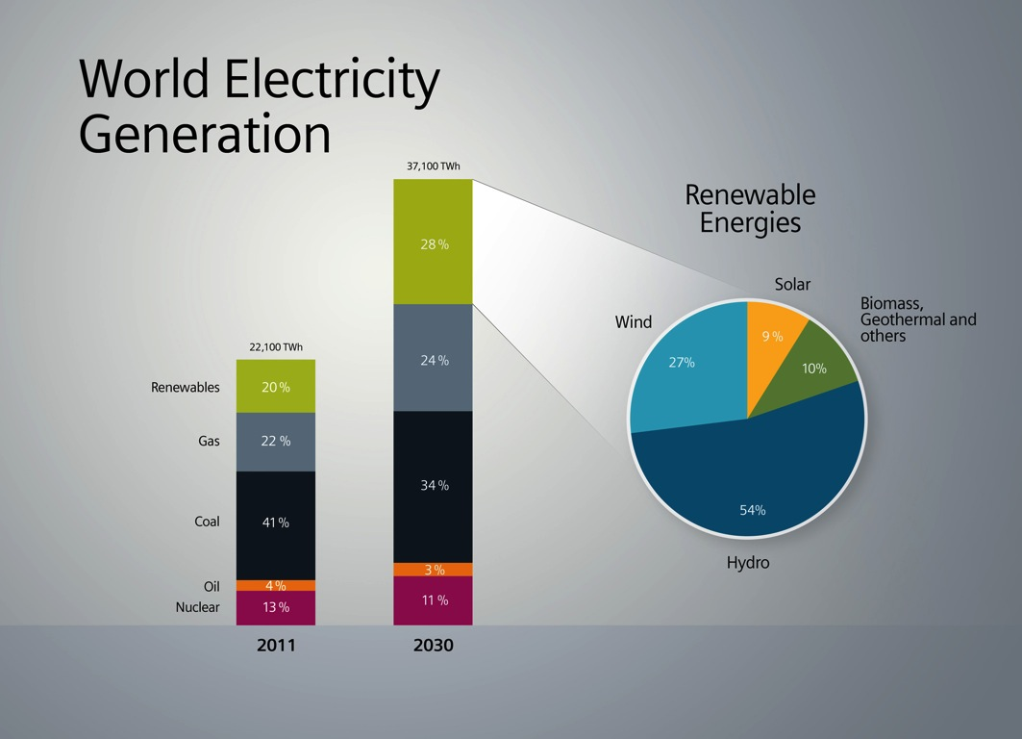
eZero Island
Energy Generation
Episode 3: eZero Island
Notes:
Explain that the task is to provide for the energy needs of the islanders. They will have to make decisions about the fuels to use, whether to generate electricity or to use it directly. The plan will have to allow for fluctuating demand, ease of storage and use and pollution.
Say that because this is an island, options that only work on a large scale, such as fossil or nuclear power stations aren’t available.
Provide each group with a map of the island and a set of energy cards using students support sheets 7 and 7A.
Explain that each energy card represents the same number of units of energy, it shows the cost, advantages and disadvantages of that energy source and that they are provided with a weather forecast and prediction of energy requirements.
Ask students to decide what combination of energy resources to use and to label and prepare a poster based on their plan. It should show:
The types of energy being used.
The cost of the plan.
The pollution caused.
How responsive the system would be if the demands upon it changed.
The good features of the plan.
The weaker features of the plan.

Slide 8

eZero Island
‘Photovoltaics’
Group discussion
Topic 4: ‘eZero Island’
Notes:
Three or four teams are selected to ‘make a pitch’ for the contract of supplying the island with its energy. The teams should have their poster presentations on display.
Each team should have three minutes to present the key features of the energy provision plan to the governor of the island (possibly played by the teacher) and to groups of islanders (students not making presentations – best in groups of 2/3). The audience should think through what they would be looking for example:
Islanders: happier if costs lower, less mess, energy needs met.
Governor: happier if less pollution, island looking attractive to tourists, islanders happy.
Say that the last contractor didn’t make a good job of it and there were some instances where the power went off. Both the governor and the islanders can ask questions.
At the end the groups of islanders explain which plan they prefer and why. The governor then provides a summing up, offering a broader perspective and ensuring that strengths from all bids are recognised. It may be considered appropriate for the governor to award the contract to a particular team.

Slide 9

Engineering the future. Inspire and be inspired.
For further information about the Siemens Education website and all support materials and downloads please visit us at
www.siemens.co.uk/education
© Siemens AG 2012. All rights reserved.

