Slide 1
Lesson Plan 2 The world of work
Siemens Education

Slide 2
The world of work
Learning objectives:
To learn about the skills and attributes needed for the world of work
Notes:
Learning objectives:
To learn about the skills and attributes needed for the world of work
Learning outcomes:
Identify personal strengths, interests and qualities that will be useful in the workplace
Describe skills that employers would potentially be looking for
Identify potential STEM career choices that are available to them

Slide 3
Groundrules
What should our groundrules be?
Notes:
At the start of the lesson review and re-visit with pupils.

Slide 4
What did we learn before?
What have we discovered so far about future careers?
What has been surprising to find out?
What would we like to know more about?
What do you notice about the pictures?
Notes:
Re-cap previous learning outcomes.

Slide 5
What did we find out?
Influences on parents’ / friends’
career choices
.
2. Skills and attributes that are
needed by parents to do their
current job
What do you notice about the pictures?
Notes:
Ask pupils to take turns to share three key points from their parent interviews with the rest of the pupils in their group.
An elected spokesperson summarises the findings of their group and feeds back to rest of class.
The class teacher or a ‘pupil scribe’ notes down each group’s feedback under the following two headings on whiteboard or flipchart:
1. Influences on parents’ career choices.
2. Skills and attributes that are needed by parents to do their current jobs.

Slide 6
What did we find out?
Plus
Minus
Interesting
What do you notice about the pictures?
Notes:
What do pupils notice about these lists?
Were there any surprises in what they were told?
What are their thoughts now about their own possible career choices?
List these under ‘Plus, Minus and Interesting’ on the whiteboard / flipchart to capture class reflections.

Slide 7
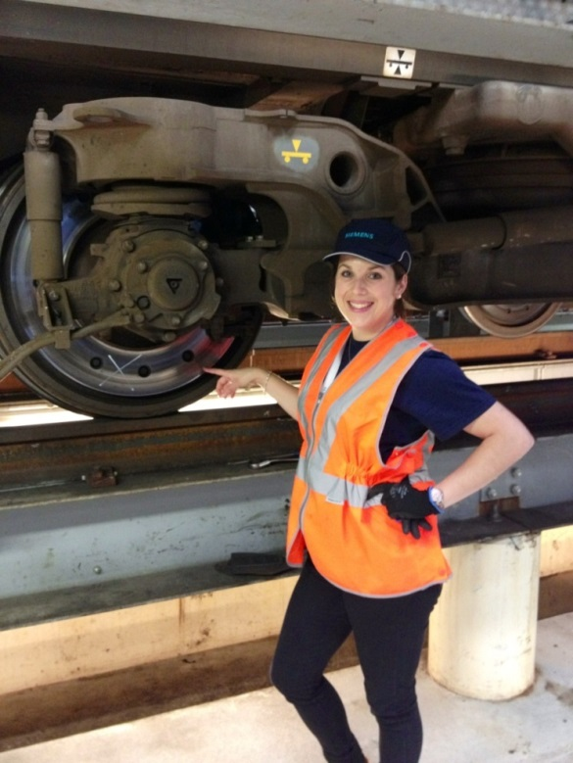
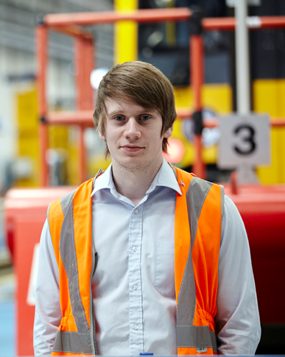
Different jobs
List 5 skills you think are important to be able to do each job
List 5 personal attributes that you think would be needed to help someone carry out the job well
Notes:
In pairs or small groups, choose two pictures depicting different jobs.
Ask the pupils to:
List five skills that they think are important to be able to do each job
List five personal attributes which they think would be needed to help them to carry out the job effectively.
Encourage pupils to debate and discuss before the pair or group reach a decision.
Which jobs could be described as STEM-based?

Slide 8
Thinking about STEM careers
Compile a mindmap
What specific qualifications might be needed for a STEM career?
Which skills and attributes might be particularly suited to doing a STEM job?
What different STEM career paths are available?
Which particular skill set might a STEM employer be looking for?
Notes:
Divide the class into groups to compile a mindmap to answer the following questions:
What specific qualifications might be needed for a STEM career?
Which skills and attributes might be particularly suited to doing a STEM job?
What different STEM career paths are available?
Which particular skill set might a STEM employer be looking for?

Slide 9
Career choices
Has anything we have discussed or found out surprised you?
Plus
Minus
Interesting
What do you notice about the pictures?
Notes:
Ask a spokesperson from each group to feedback on their group’s responses to the questions below:
Did anything they discussed or found out surprise them?
Are there any new or additional skills for the world of work that they hadn’t considered?
Add this to the ‘Plus, Minus and Interesting’ list.

Slide 10
Review
What are my personal skills and attributes?
How might they be useful in the workplace / in a job?
Which ones do I need to develop further / work on?
Notes:
Either independently or in pairs, discuss and then write about the following:
What are my personal skills and attributes?
How might they be useful in the workplace / in a job?
Which ones do I need to develop further / work on?

Slide 11
Homework
Collect adverts for three different kinds of jobs (from newspapers or online) that you would be interested in doing when you leave school, college or university
Talk to your parent / carer about the first job they did when they left school, college or university?
Compile three questions you would like to ask a visitor who has a STEM job.
What is your ‘dream’ job?
Notes:
Homework / working with a parent / carer:
Collect adverts for three different kinds of jobs (from newspapers or online) that you would be interested in doing when you leave school, college or university.
Talk to your parent / carer about the first job they did when they left school, college or university?
Compile three questions you would like to ask the visitor (SIEMENS employee / parent who has a STEM job).
What is your ‘dream’ job?

