Slide 1
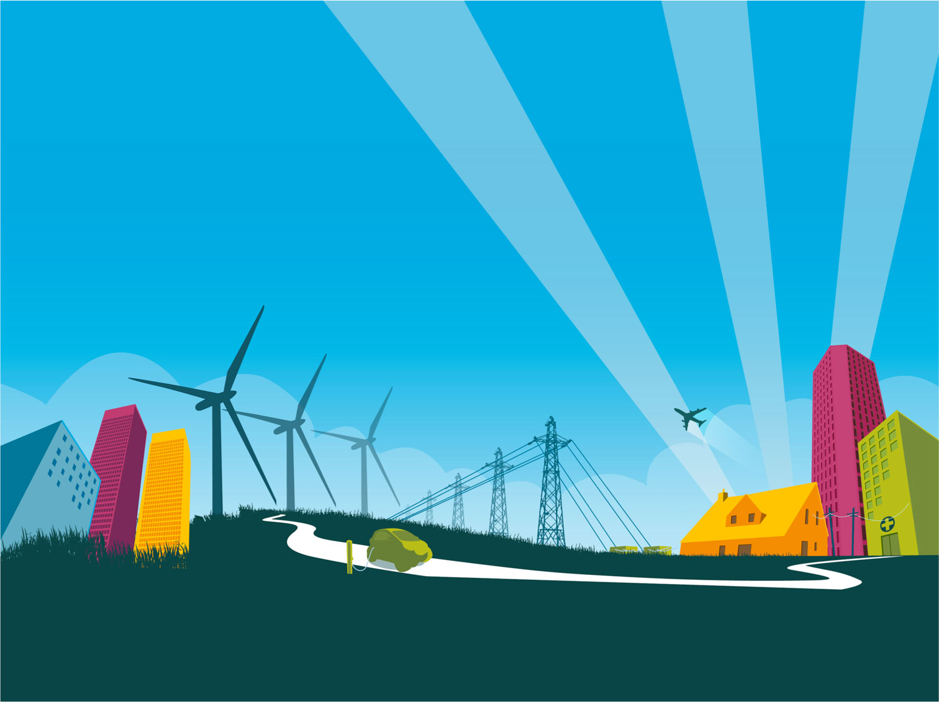

Topic 4: I can see clearly now
© Siemens AG 2012. All rights reserved.
www.siemens.co.uk/education

Slide 2
I can see clearly now
Overall learning objectives:
To gather and use data to construct Sankey diagrams to illustrate efficiencies and support conclusions.
To explain how light bulbs can transfer energy and the concepts behind different light bulb technologies, and to use ideas about reflection to design flood light reflector.
To evaluate the impact of different technologies on society and different technological approaches to a challenge.
To conduct cost benefit analysis and evaluate different solutions using set criteria.
Introduction: I can see clearly now

Slide 3
I can see clearly now
Overall learning outcomes:
Students will have analysed two different sorts of bulb in terms of how they work and how energy efficient they are.
Students will have used ideas about reflectors to design and test one of their own to meet a particular brief.
Students will have decided how to apply multiple success criteria.
Introduction: I can see clearly now

Slide 4
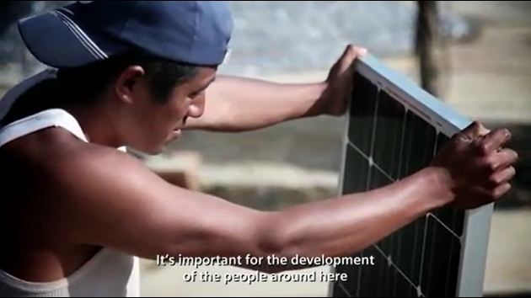
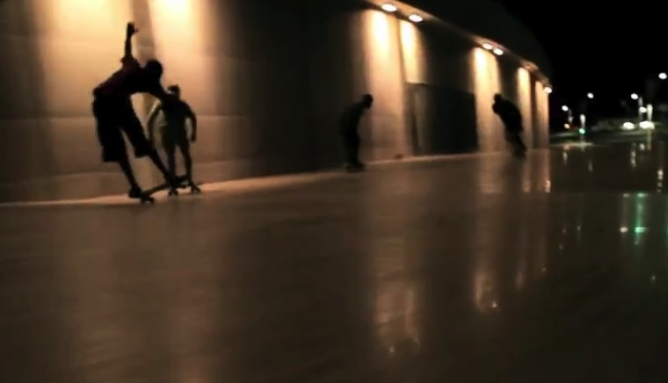
I can see clearly now
‘Into the Light’
Episode 1: I can see clearly now
Notes:
Show a video clip of ‘Light close to everyone’. http://m.energy.siemens.com/hq/en/energy-topics/energy-stories/light-close-to-everyone.htm
Explain that the video shows how cost effective lighting can be used to change areas and how people use them.

Slide 5
I can see clearly now
Why did the installation of lighting transform the villages?
Why did low energy lighting make it more affordable?
Why was it important to use low energy lights?
Episode 1: I can see clearly now
Notes:
After viewing the clip ask students these questions.
Ask students to talk about whether they use low energy light bulbs at home and what the advantages and disadvantages are.

Slide 6
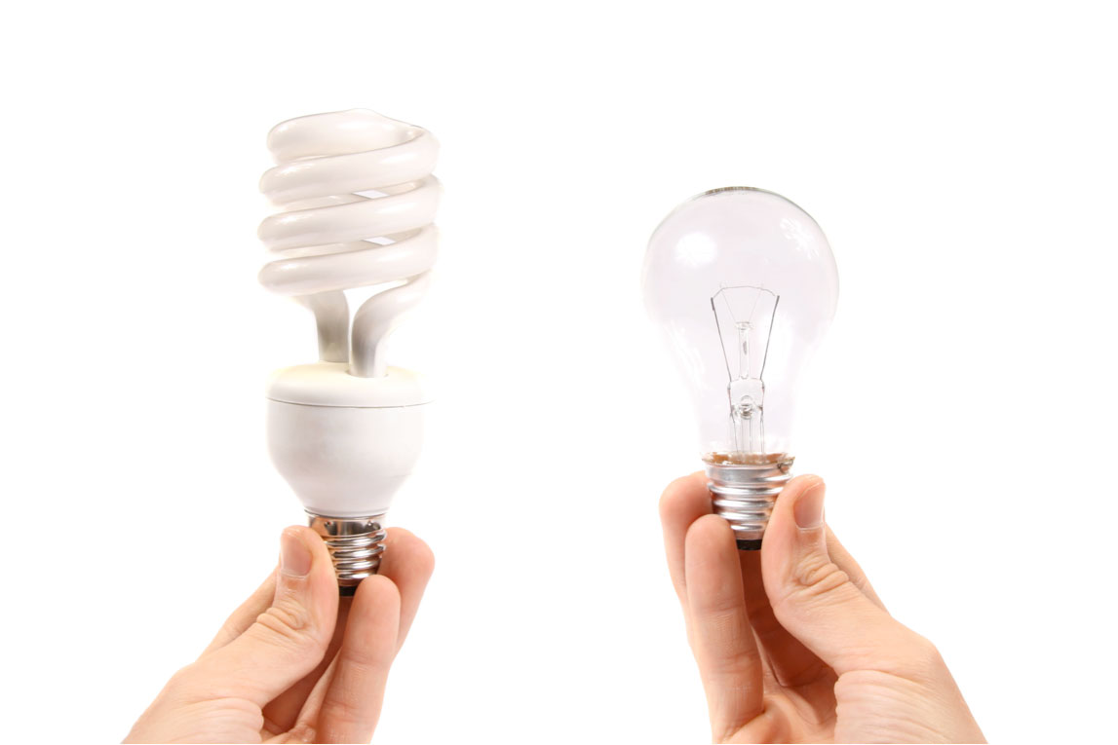
I can see clearly now
Low energy bulb and filament bulb
Episode 2: I can see clearly now
Notes:
Explain to students that the two most common ways of lighting rooms in a house are to use either filament or low energy light bulbs.
Say that both of these transfer energy from a flow of current to heat and light. However the amount of current used, the amount of heat released and the life expectancy are quite different for the same amount of usage.
Explain that:
In the case of a filament light bulb, as the current flows through the fine wire it glows. In the case of low energy light bulb they produce less heat for the same amount of time being used and that they last longer.

Slide 7
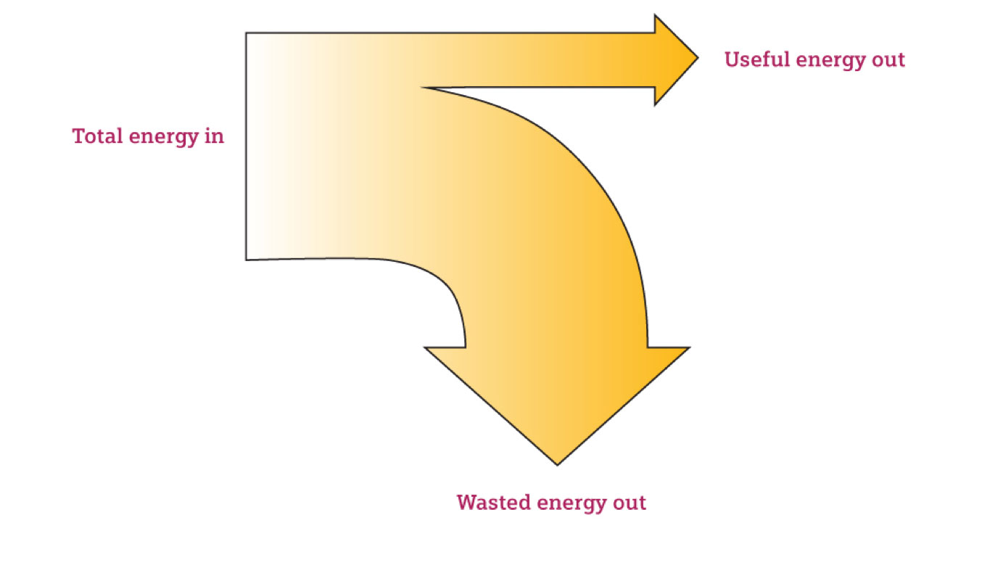
I can see clearly now
Sankey diagram
Episode 3: I can see clearly now
Notes:
Explain that the purpose of this activity is to compare how efficiently each type of bulb transfers energy from electricity to light.
This can be communicated using a special kind of diagram called a Sankey diagram.
The amounts of energy being supplied to a device and released from it are show by:
The width of the arrows is related to the amounts of energy
Total energy input equals total energy output
The input is shown on the left and the output(s) on the right
The useful output is shown by a horizontal arrow and the wasted output by an arrow on the right curving downwards.

Slide 8
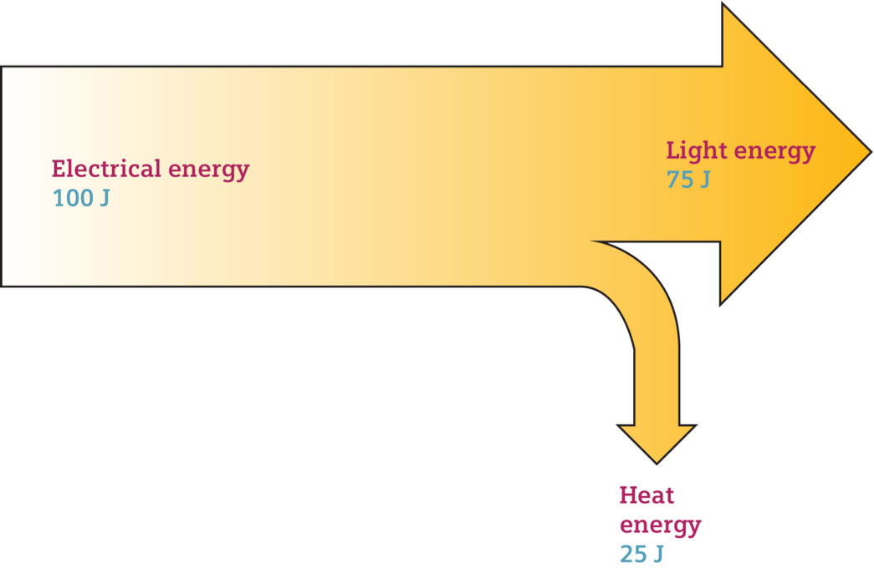
I can see clearly now
Sankey diagram for low energy bulb
Episode 3: I can see clearly now
Notes:
Say that a typical low energy bulb is 75% efficient so 75% of the output is light and shown horizontal; 25% is wasted as heat.

Slide 9
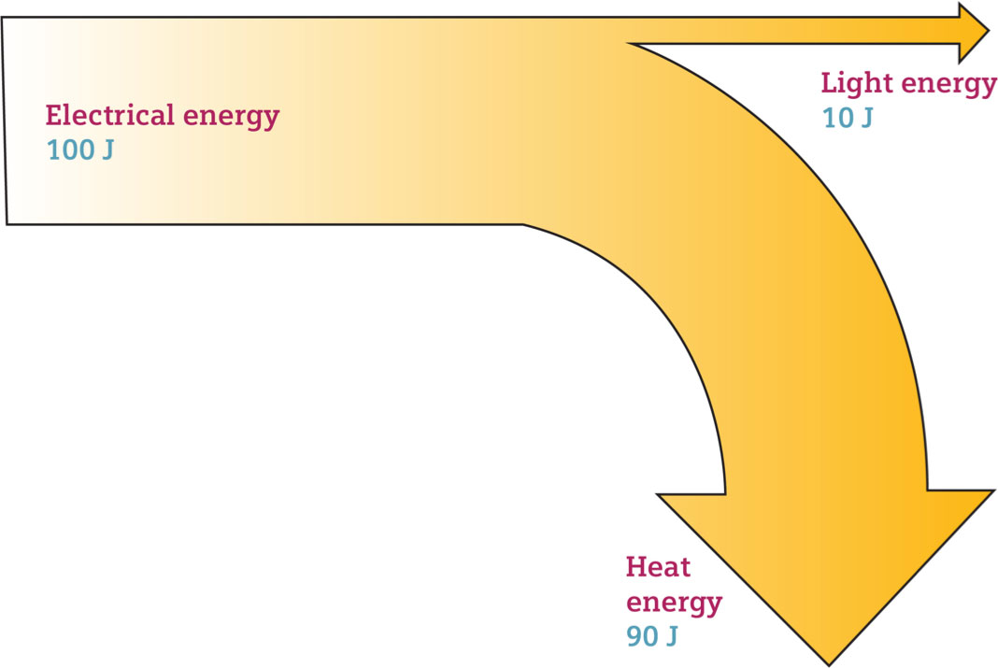
I can see clearly now
Sankey diagram for filament bulb
Episode 3: I can see clearly now
Notes:
Explain that a typical filament bulb is around 10% efficient, so 10% of the output is light and shown horizontal; 90% is wasted as heat.

Slide 10
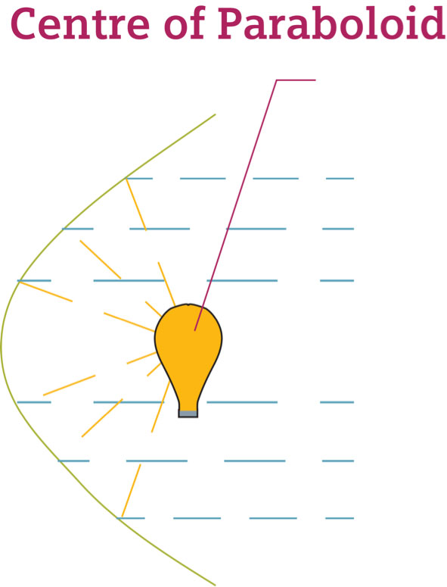
I can see clearly now
Parabolic reflector
Episode 4: I can see clearly now
Notes:
Explain to students that the purpose of this activity is for them to design a reflector for a low energy bulb to produce as strong and even an illumination as possible. They will be able to research their ideas, construct them and test them.

Slide 11

I can see clearly now
Group discussion
Episode 5: I can see clearly now
Notes:
Explore with students the idea that with the success criteria calling for strong and even illumination, that both of these need to be taken into account to identify the most effective design.
Ask students to consider what might happen if one or the other was effectively ignored. Students may suggest solutions; one would be to take light meter readings at various points in the circle and average them to get an overall score.
The various designs should be tested and judged.
Students should be asked to critically appraise their designs, to identify the strengths and the areas for development. There is an opportunity for peer assessment here as well.

Slide 12
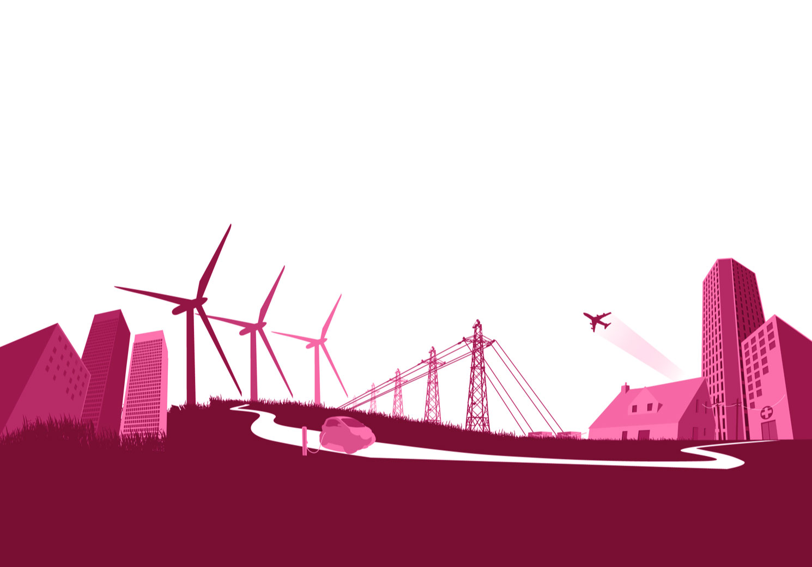
Engineering the future. Inspire and be inspired.
For further information about the Siemens Education website and all support materials and downloads please visit us at
www.siemens.co.uk/education
© Siemens AG 2012. All rights reserved.

