Slide 1
Clean, Green Trains
Siemens Education

Slide 2
Clean, Green Trains
Overall learning objectives:
To learn how scientific and technological developments have been used to improve the quality of life
To identify the advantages and disadvantages of different technologies
To understand how electrical systems can be used to reduce pollution in areas of high population density
To understand how rail systems are designed and managed to provide a service whilst maximising the use of resources

Slide 3
Clean, Green Trains
Overall learning outcomes:
To explain how electric traction offered an attractive option in terms of travel
To explain the use of electric motors in a range of contexts
To evaluate alternative solutions to the provision of an effective service

Slide 4
Clean, Green Trains: the power of steam
Siemens Education

Slide 5
Clean, Green Trains
Overall learning objectives:
To use evidence to understand how people travelled in the late 19th century
To evaluate the advantages and disadvantages of technology used in transport systems

Slide 6
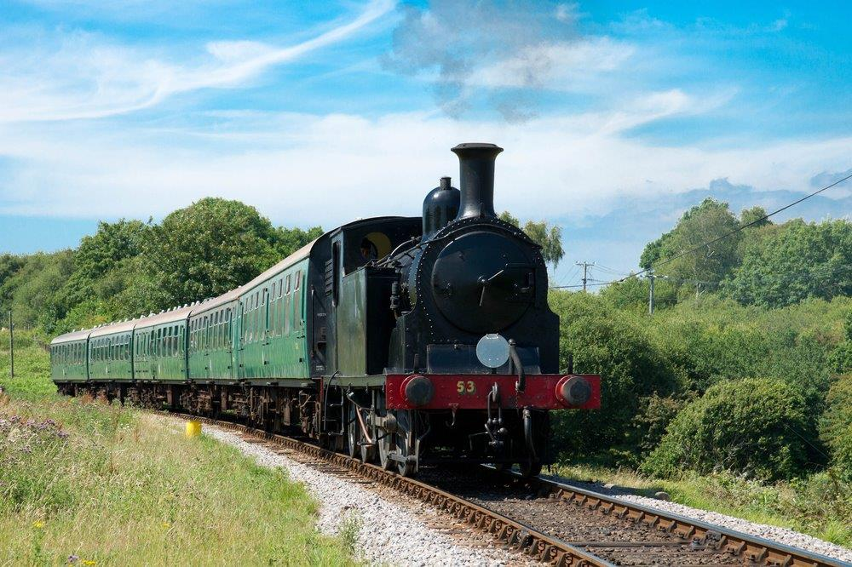
Clean, Green Trains
In the 1880s railways were still new
Railways were exciting
Railway travel wasn’t always a happy experience
Steam wasn’t the only way of powering trains through
Travelling to Brighton
Notes:
Show pupils an image of a steam train headed for Brighton in the 1880s.
Explain that:
At this time the railways were still fairly new and new lines were still being opened. There were no cars – the nearest anyone had to that was a horse drawn carriage. The only buses were horse drawn as well. Powered flight was yet to be invented.
Railways were exciting. They offered people the chance to travel the country and opened up areas that only the wealthy could previously have visited. Cheap excursions were offered and people flocked to take them up. Thousands of people would travel from the cities to the coast for days out and holidays. Coastal towns grew if they were on the railway system.
Yet railway travel wasn’t always a happy experience. The engines that pulled the trains were steam engines and though they were exciting to watch they produced large amounts of smoke, soot and ash. If you lived by a railway line, it wasn’t a good idea to hang washing out to dry – if you did you found that white sheets or shirts were no longer white. The first underground trains were steam powered – imagine that.
Steam wasn’t the only way of powering trains though. It was powerful and lots of staff knew how to make the engines work well. However some people were starting to experiment with other ways of moving people.

Slide 7
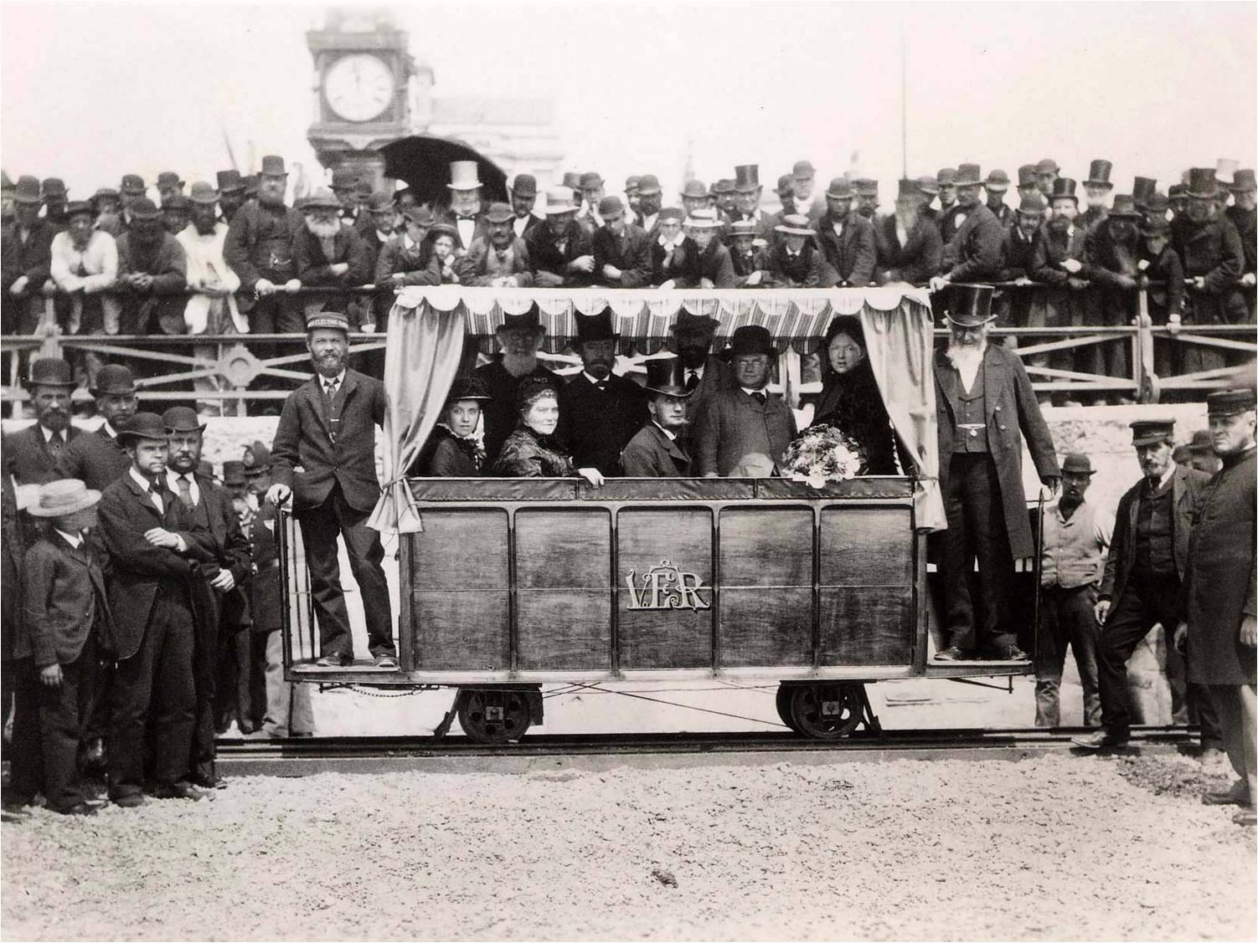
Clean, Green Trains
The world’s oldest electric railway
Each coach has an electric motor which powers it along
Compare the two trains
Volks Electric Railway
© Volks Electric Railway Association
Notes:
Show a picture of Volks Electric Railway.
Explain that:
This is the world’s oldest electric railway. It runs along the seafront at Brighton.
Each coach has an electric motor which powers it along.
Ask pupils to compare the steam train to the Volks Electric Railway.
Draw out points to get pupils to suggest similarities and differences. Their responses might include:
Similarities:
Run on rails
Carry people
Takes them to a destination
Passengers sit in carriages
Differences:
Electric train is smaller, lighter and slower
Electric train can carry fewer people at once
Electric train gives off no smoke, ash or soot (though the electricity has to be generated somewhere)
Ask pupils to produce a poster, divided into two parts. One side is to present the advantages of the steam trains that took people to places like Brighton; the other explains the advantages of having a seafront railway powered by electricity.
Click the picture of the steam train from the previous slide with text appearing at the same time: compare the two trains

Slide 8
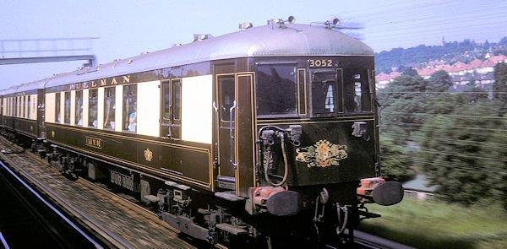
Clean, Green Trains
Forty years later from the 1920s, many of the trains from London to Brighton were electric
The ‘Brighton Belle’
© Neil Marshall 5BEL Trust
Notes:
Show pupils a picture of the Brighton Belle (an electric train) and explain that forty years later, many of the trains from London to Brighton were electric.

Slide 9
Clean, Green Trains: the impact of electric motors
Siemens Education

Slide 10
Clean, Green Trains
Overall learning objectives:
To understand the range of applications of electric motors
To identify advantages and limitations they offer as a practical solution

Slide 11
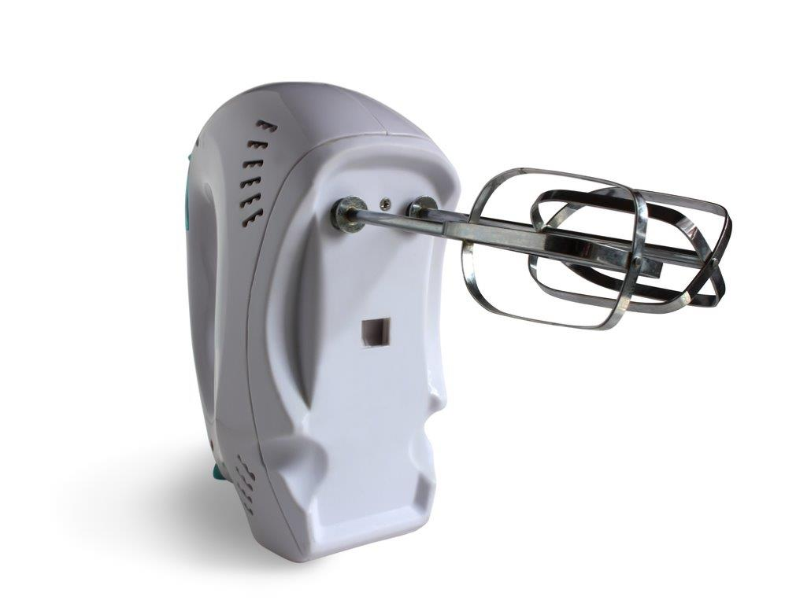


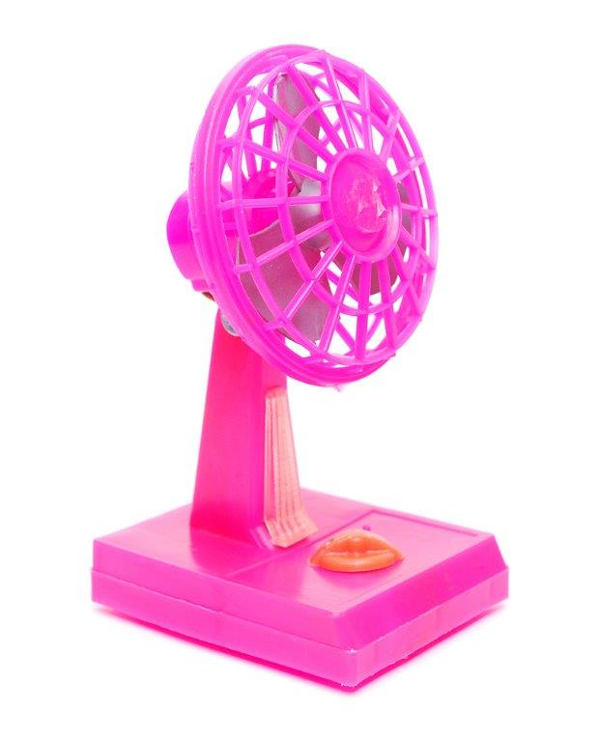
Clean, Green Trains
What do all the devices have in them to make them move?
What do the devices need to be supplied with to make them move?
What do we get from each of the devices?
What makes these work?
Notes:
Start by showing pupils a couple of devices that have electric motors in them.
Good examples might include:
Hair drier
Battery (or mains powered) fan
Food mixer
Drill
(Observe reasonable precautions when bringing domestic appliances into school)
Prompt pupils to answer the questions.
Draw out that they all have motors, that motors need electricity (whether from batteries or from the mains) and that the motor produces movement.
Pupils may also, quite rightly, suggest that they tend to produce heat and sound.

Slide 12
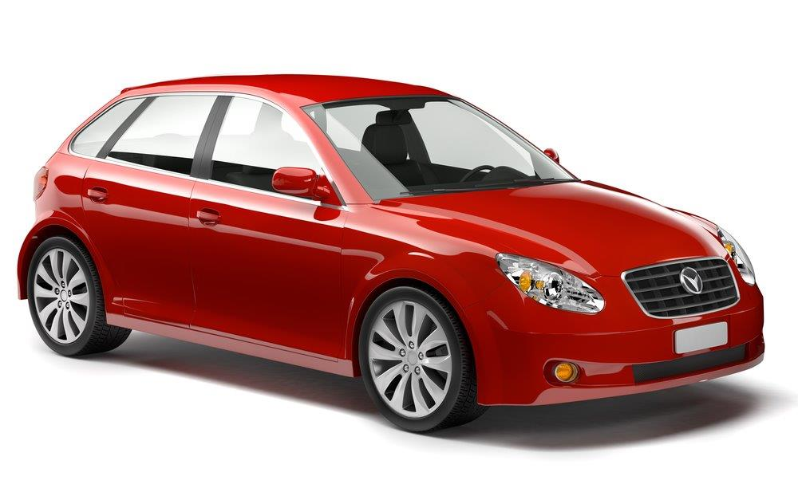
Clean silent trains
The engine on this car isn’t electric but there are many features that are. Can you point them out?
Where are electric motors used for in this?
Notes:
Show a picture of a car, and ask for suggestions as to where there are electric motors. Point out that the engine isn’t electric (unless it’s an electric car or a hybrid) but there are many other features that are.
Take feedback – ideas might include:
Starter motor
Windscreen wipers
Screen demister/heater
Door locks (if remote control)
Aerial (if retractable)
Windscreen washer jets

Slide 13
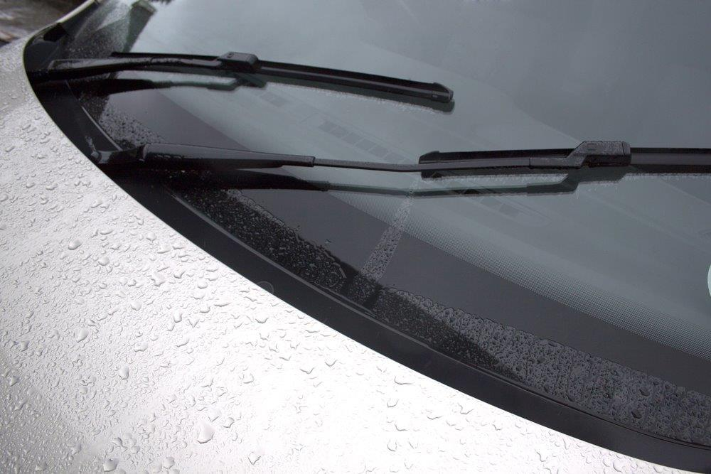

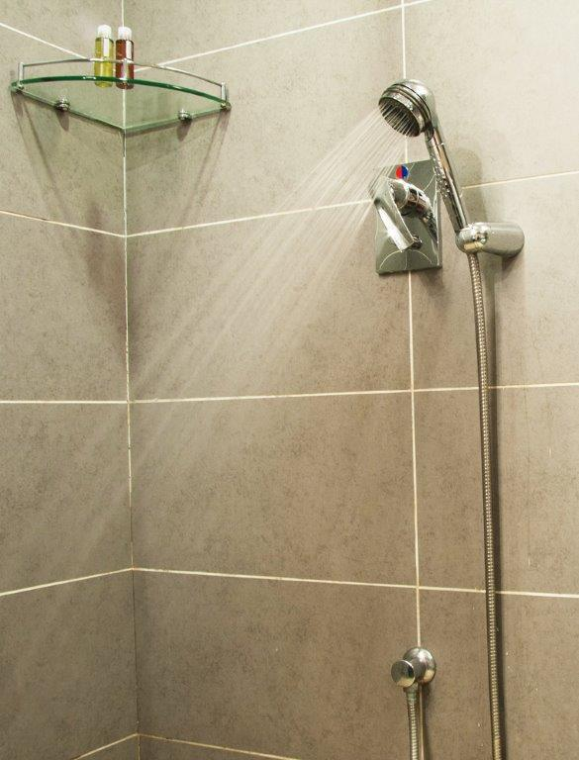
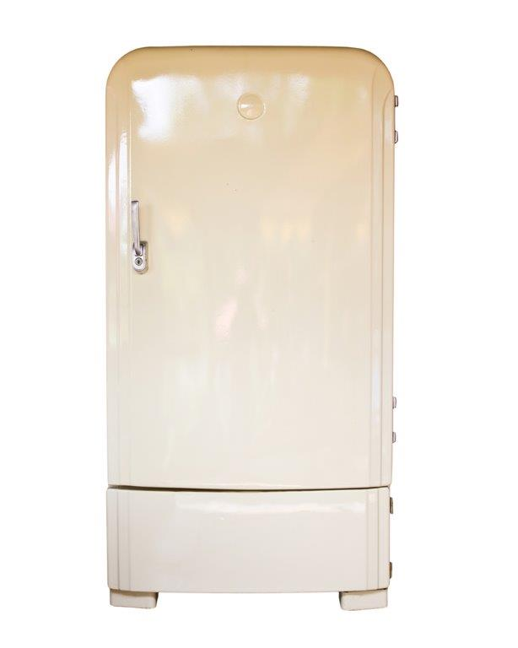

Clean, Green Trains
Can you think of things at home that have electric motors?
Notes:
Now ask pupils to come up with examples of domestic devices that have motors in them. They could work in pairs to come up with ideas that can then be shared. Not all devices do but motors are in a surprising range, including:
Cooker (if fan assisted)
Refrigerator (pumping coolant around
Computer (cooling fan and CD drive)
Printer (driving paper through)
Shower (if water is pumped by shower unit)

Slide 14
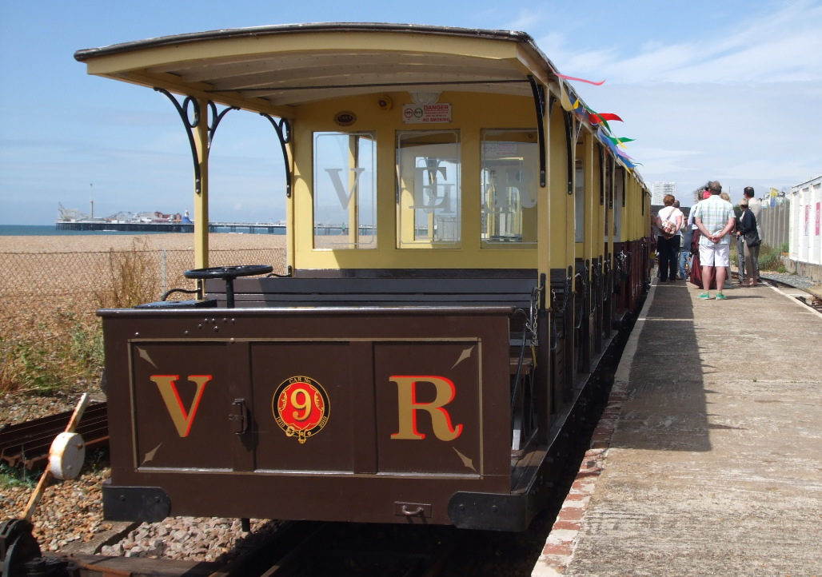
Clean, Green Trains
Each of these had a motor in them
Volks Electric Railway train
Notes:
Show picture of Volks Electric Railway train.
Explain that each of these had a motor in them to drive the train along.

Slide 15
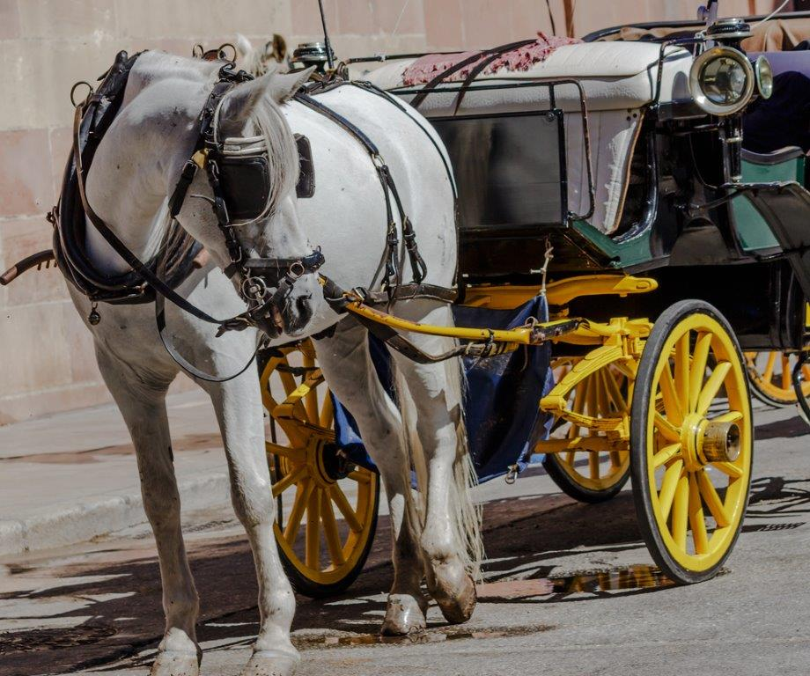
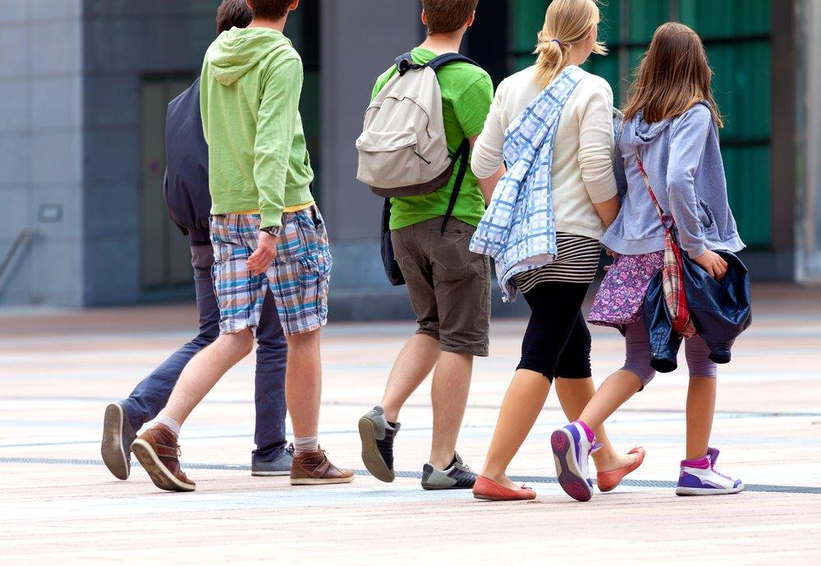
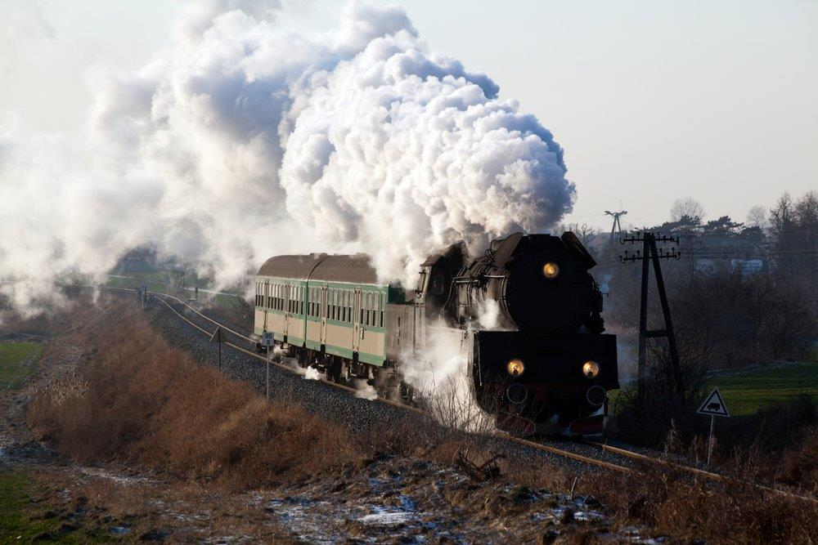
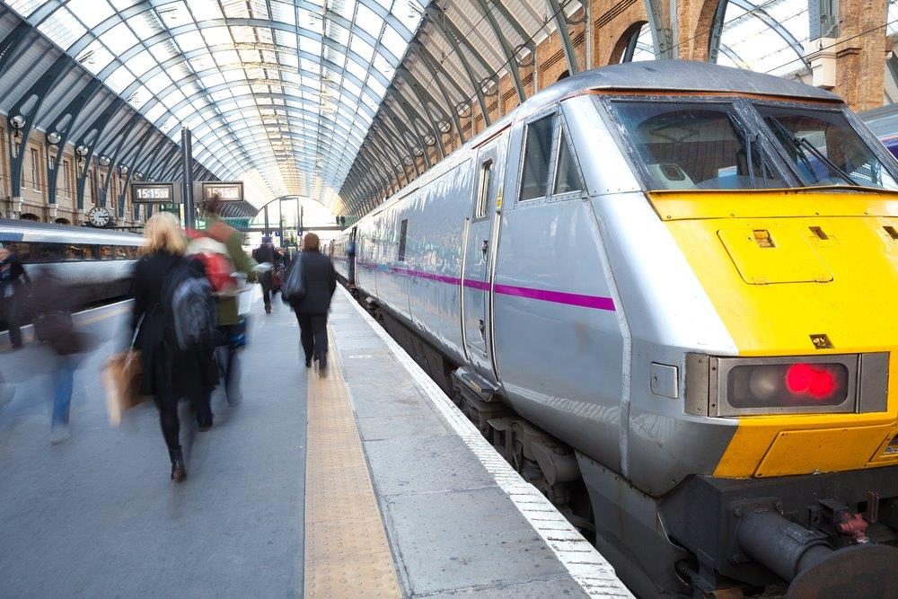
Clean, Green Trains
Lots of people wanted to ride on the railway. Why do think this was?
Notes:
Show picture of train, compared with horse drawn carriage, steam train and pedestrian.
Ask pupils to suggest why the idea of an electric train was a very interesting one when it first came out.
Lots of people wanted to ride on the railway – ask for suggestions as to why.

Slide 16
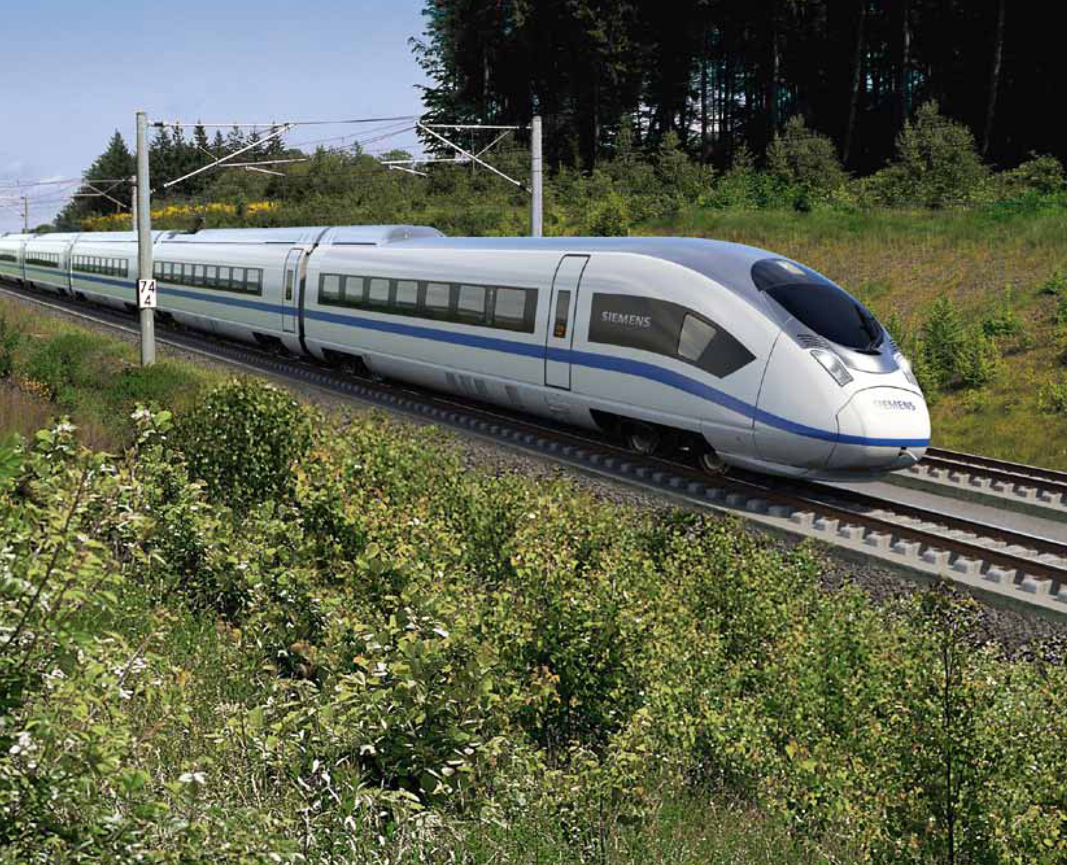
Clean, Green Trains
Today rail travel is much more common. How has it improved since the day of the Volks train?
A modern electric tram
Notes:
Show a picture of a modern electric train being used to transport people through a city.
Explain that these days it’s much more common.

Slide 17
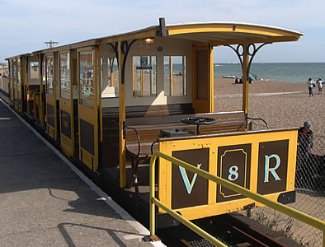
Clean, Green Trains
Compare the modern train with the Volks train
How has it improved?
A modern electric tram
Notes:
Compare the modern train with the Volks train and ask for suggestions as to how it’s improved.

Slide 18
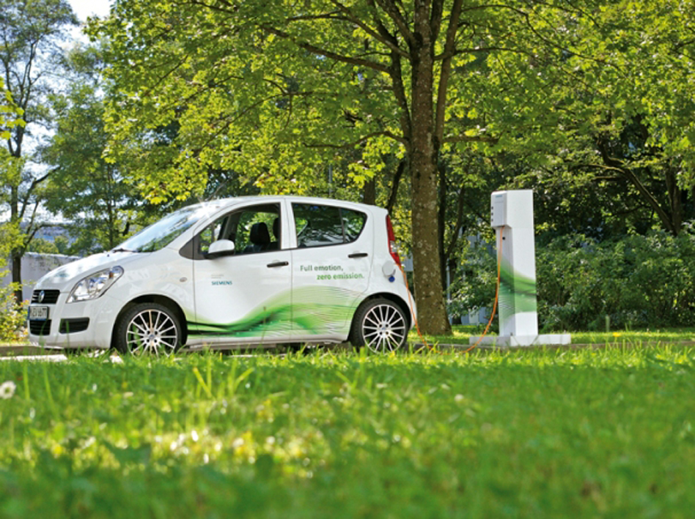
Clean, Green Trains
Electric cars
Notes:
Show picture of an electric car and explain that although electric trains are common in many parts of the country, electric cars are less familiar, even in urban areas.

Slide 19
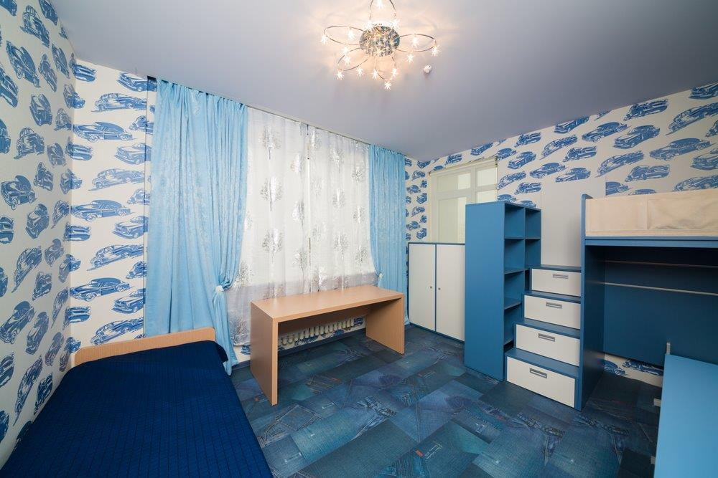
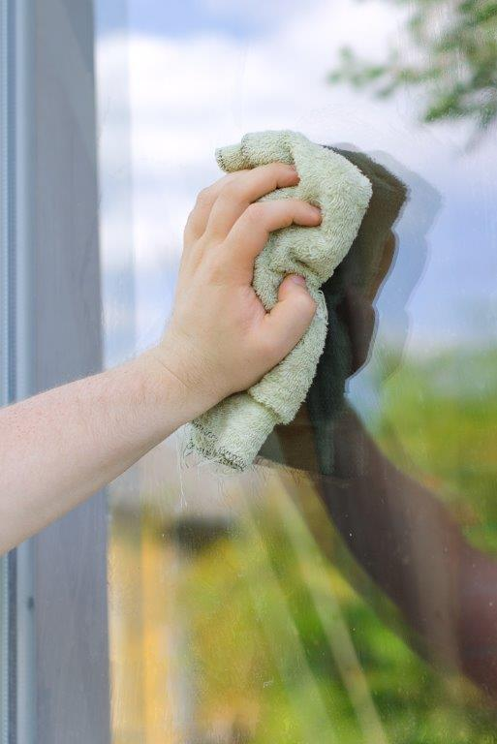
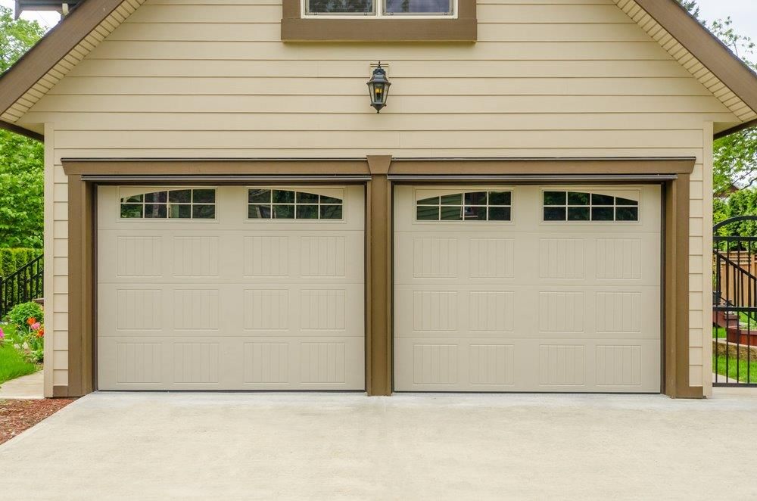
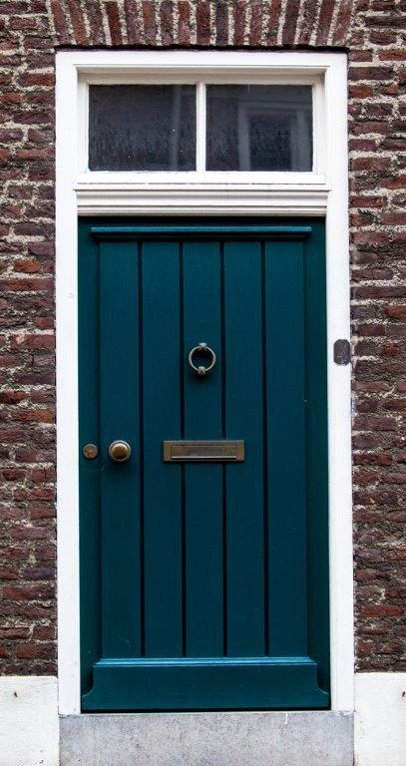
Clean, Green Trains
Why might an electric car be a good idea?
What might some of the problems be with it?
Why do you think that there are lots of electric trains in the world but not many electric cars?
Notes:
Ask pupils to discuss and suggest answers to these questions.
Next, ask pupils to suggest what might be powered by motors in a ‘house of the future’?
Take and display ideas; these might include:
Powered curtains
Powered garage door
Powered window washers
Powered doors

Slide 20
Clean, Green Trains: operating the railway
Siemens Education

Slide 21
Clean, Green Trains
Overall learning objectives:
To apply ideas about distance, time and speed to the context of a railway
To explore how information and estimation can be used to solve problems
To devise alternative solutions and evaluate them

Slide 22
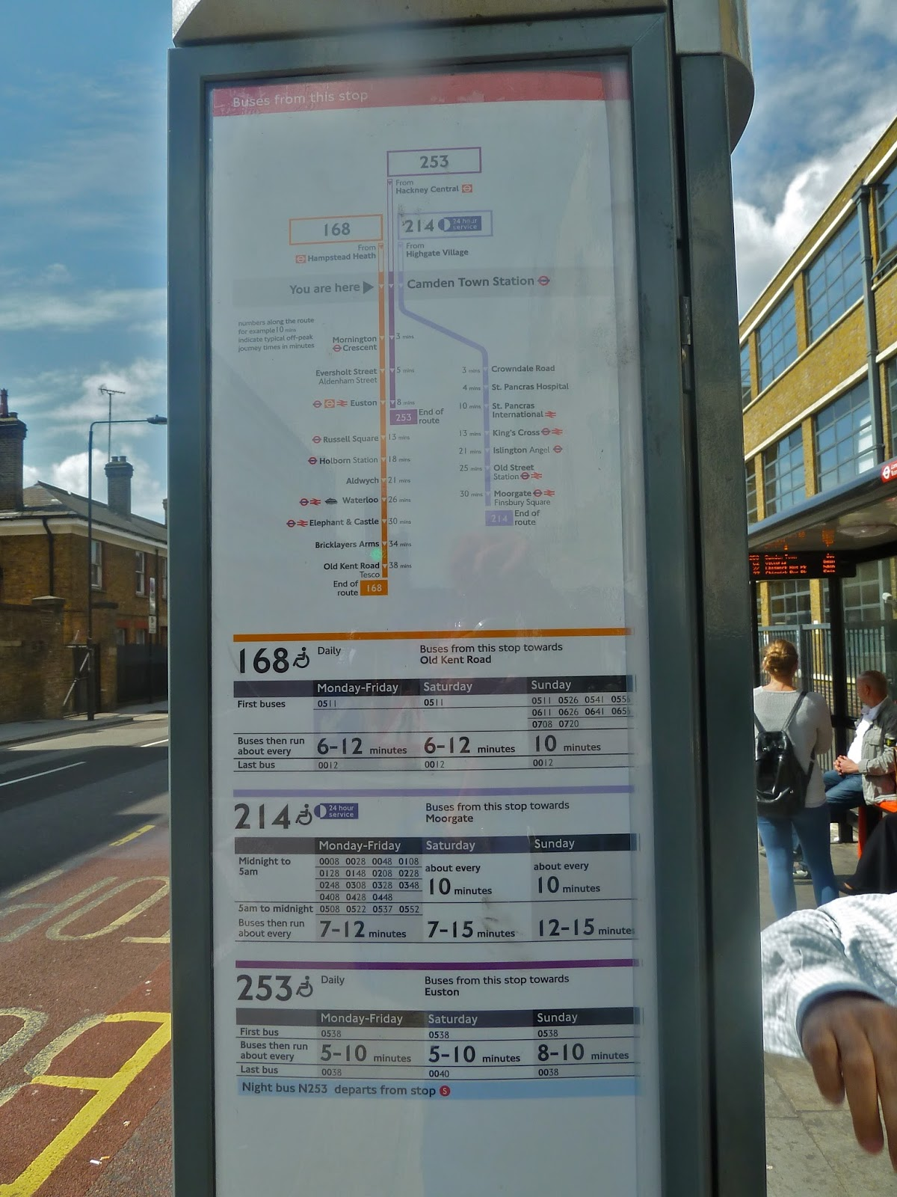
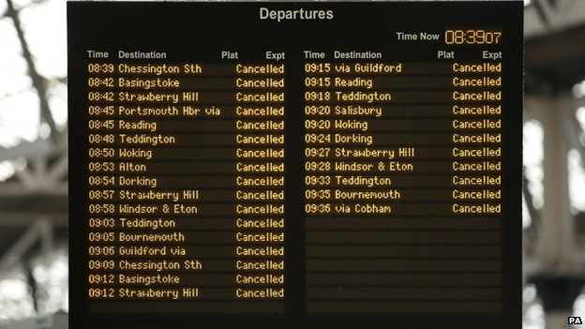
Clean, Green Trains
Notes:
Show pupils a bus departure board. Explain that somebody has had to work out when the buses will be arriving at a particularly stop.
A timetable has been written (show an example).
Ask what the timetable shows, and take ideas. Then ask what determines how long it takes the bus to get from one stop to another. Draw out a range of ideas, including:
The distance
The amount of traffic
How fast the bus can go
How long it needs to spend at a stop, allowing passengers to get off and on.
Ask which of these is fixed and which will vary according to the time of day.

Slide 23
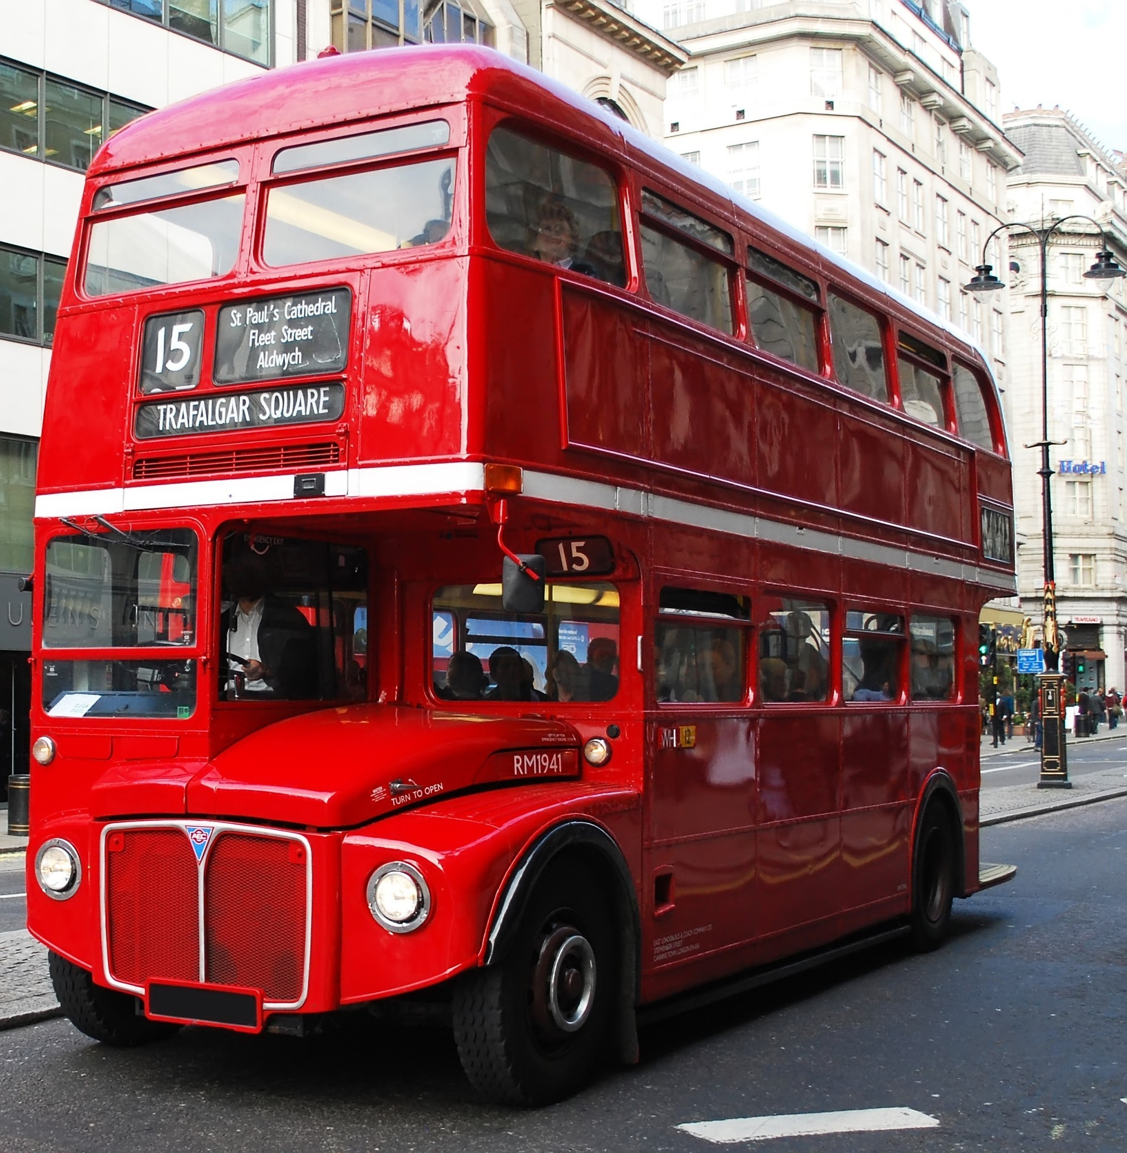
Clean, Green Trains
You can work out the speed if you know the distance and time:
A bus travelling 30 miles every hour is travelling at 30mph
Running a bus service
Notes:
Explain that we can work out the speed if we know the distance and the time.
A bus travelling 30 miles every hour is travelling at 30mph.

Slide 24
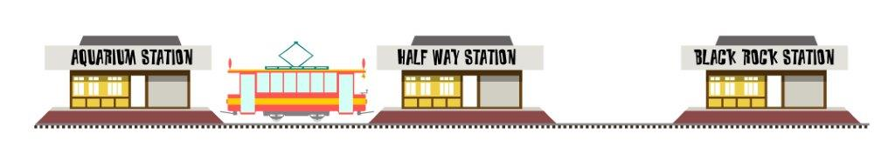
Clean, Green Trains
How fast does the train go?
Depart: 10.00
1620m
Arrive: 10.12
How long is the railway?
How many minutes does it take for a train to get from one end to the other?
Dividing the distance by the time will tell you the speed. This will be in metres per minute.
Dividing this by 60 will tell you how many metres per second.
A brisk walking speed is about 1.5 metres per second. Is this a fast train?
Notes:
This slide shows how we can calculate the speed of a train on the Volks Electric Railway. This involves pupils in extracting data, performing calculations (for which they will probably need a calculator) and commenting on the results.
Solution:
The railway is 1620m long
It takes 12 minutes to get from one end to the other
The speed is 1620/12 = 135 metres per minute
This is 135/60, or 2.25 metres per second
Compared with a brisk walking pace of 1.5 metres per second it is clear that this isn’t very fast.

Slide 25
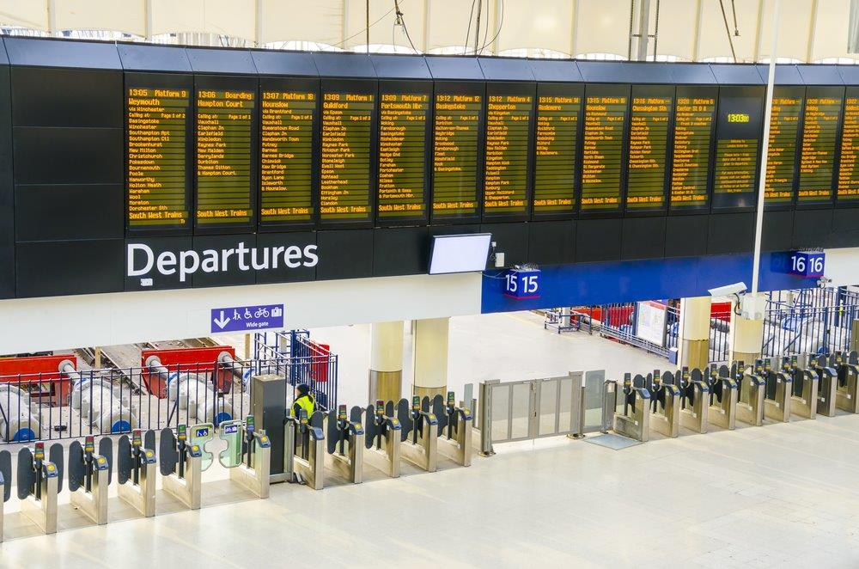
Clean, Green Trains
Would it be easier to make a bus timetable or a railway timetable work reliably?
Think about running a train service
Notes:
Ask pupils to compare organising a bus timetable with organising a railway timetable for a simple system such as the Volks Electric Railway (show picture and draw attention to single track).
Ask if it would be easier to make a bus timetable or a railway timetable work reliably. Draw out that a railway has a dedicated route which it doesn’t need to share – it’s like having a private road. However, it’s only single track – trains going one way have to share the track with those going the other way.
There are now various solutions that pupils are asked to think through about running a train service. These are designed to develop critical thinking and problem solving skills.

Slide 26
Clean, Green Trains
Running a service
This is a very simple arrangement. There is one train, running on a single track, between two stations.
If it takes 12 minutes to get from A to B and another 3 minutes for passengers to get on and off, how many single journeys will it make in an hour?
If the train can carry 30 passengers, how many passengers can it carry in an hour?
Notes:
In this pupils are presented with a simple system and asked to work out a timetable for one train going up and down. It takes 12 minutes to travel the length of the line and 3 minutes to unload and reload with passengers.
Solution:
It will make four single journeys in an hour
It can carry 120 passengers in the hour.

Slide 27
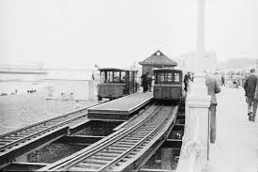
Clean, Green Trains
Sidings at the stations allow one train to depart as soon as another has arrived.
Notes:
There’s still only one train moving at once, but trains can unload and reload whilst another train is on the move.

Slide 28
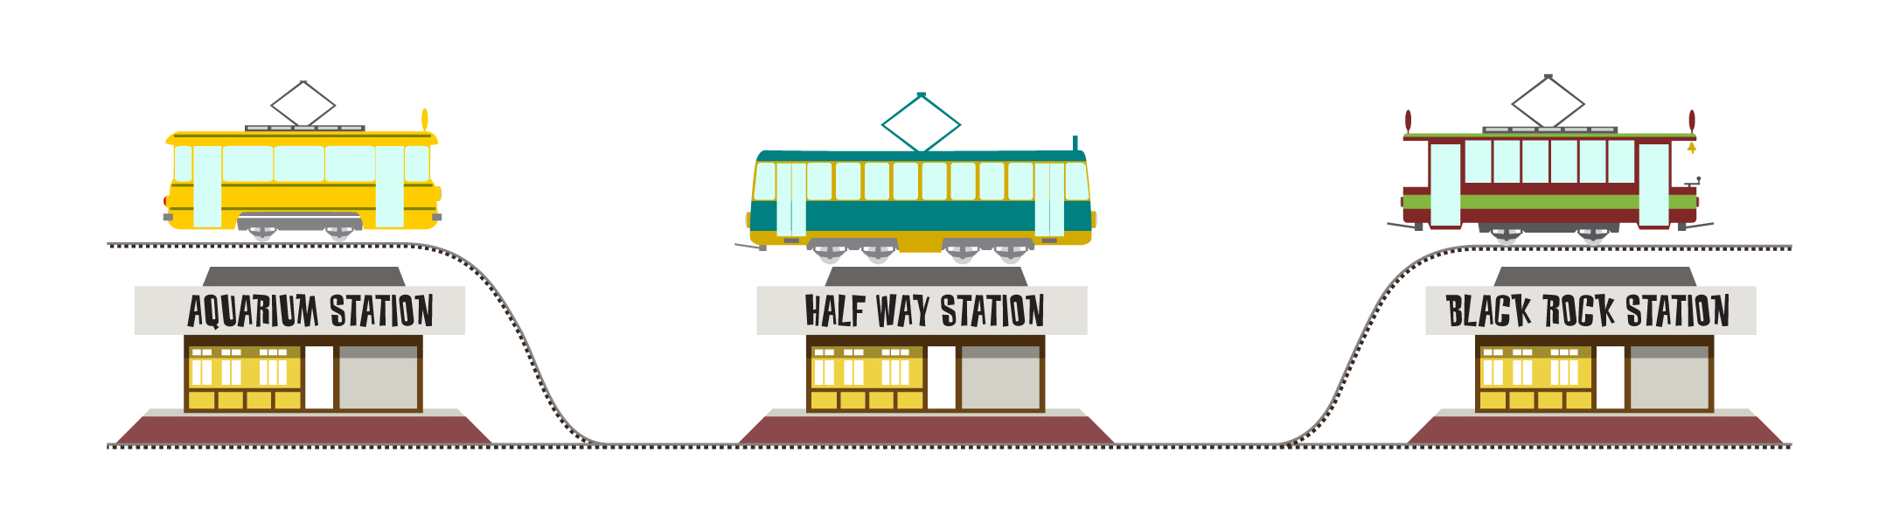
Running a service
Clean, Green Trains
There are now three trains, running on a single track, between two stations. However, each station has a siding, so that one train can arrive and another one depart straight away. There is always a train on the move.
It still takes 12 minutes to get from A to B but now passengers get on and off whilst another train is travelling. How many single journeys will take place each hour?
If each train can carry 30 passengers, how many passengers can the railway carry in an hour?
How does this solution compare with the first one?
Notes:
In this solution there are now three trains. Sidings at the stations allow one train to depart as soon as another has arrived. There’s still only one train moving at once, but trains can unload and reload whilst another train is on the move.
Solution:
There will now be five journeys each hour (60/12)
150 passengers can be carried per hour
More passengers are being carried, but the service uses three trains instead of one. There’s always a train waiting in a (terminus) station which is good for attracting passengers but each train is running for 12 minutes and standing for the next 24 minutes.

Slide 29
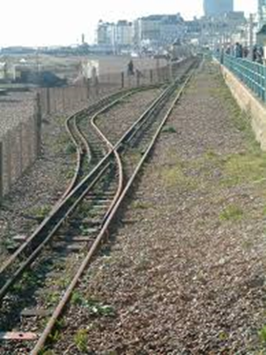
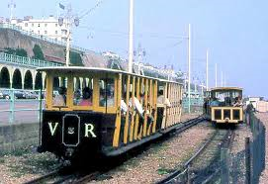
A different solution – a passing loop half way along
Trains now leave from either end simultaneously and pass in the middle.
Clean, Green Trains
Notes:
This is an alternative solution, using a passing loop in the centre instead of sidings at the stations.

Slide 30
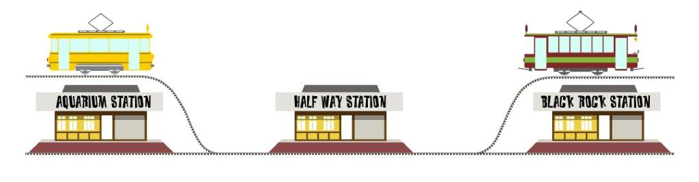
Running a service
Clean, Green Trains
There are now two trains, running on a single track, between two stations. However, there is now a passing loop in the middle. This means that trains travelling in opposite directions can pass each other.
How many single journeys will each train make in an hour?
How many journeys will be made in total each hour?
If each train can carry 30 passengers, how many passengers can the railway carry in an hour?
How does this solution compare with the others?
Notes:
This is an alternative solution, using a passing loop in the centre instead of sidings at the stations. Two trains now leave from either end simultaneously and pass in the middle.
Solution:
Each train will now make four single journeys an hour (12 minutes to travel and 3 to reload)
With two trains there will now be eight journeys an hour
This means that 240 passengers can be carried
This is better than the previous solution in that more passengers per hour can be carried and with fewer trains. It means that two trains are moving at once, so safety is more of an issue (though not that much at these speeds). It also means that there is a departure from each terminus every 15 minutes instead of every 24 minutes.

Slide 31

Running a service
Clean, Green Trains
This is a different arrangement. There is now one train but with two coaches, running on a single track, between two stations.
If it takes 12 minutes to get from one end to the other and another 3 minutes for passengers to get on and off, how many single journeys will it make in an hour?
How many passengers will this train be able to carry?
How many passengers can it carry in an hour?
Notes:
This solution simply involves running one train with two coaches. No additional track work is needed.
Solution:
It will make four single journeys in an hour
The train can carry 60 passengers
As each train now carries 60 passengers it can carry 240 per hour
This is clearly an effective solution as it carries up to 240 passengers per hour with only one driver and no complicated track work or risk of collision.
However there is now only one departure every half hour from each terminus so some business may be lost as passengers can walk the distance in less than 30 minutes.

Slide 32
Clean, Green Trains
Another thing to think about – frequency of service
When you’re organising a train service you need to think about things such as how many passengers you can carry in an hour. At busy times this is really important.
However, there’s something else to think about too – frequency of service (how often there is a departure). People don’t like to be kept waiting for too long. If they arrive at a station and there isn’t another train for ages, they may go away.
The railway manager wants to display a board at Aquarium Station saying “Trains depart every … minutes.” Look at each solution and decide what the number is.
Notes:
Extension activity:
It challenges pupils to think of solutions not simply in terms of how many passengers can be carried but also frequency of service.
If departures are too far apart, business will be lost.
Pupils can go back over their solutions and identify how frequently trains are departing from a terminus station.

