Slide 1
Topic 17: Lean machines
Siemens Education

Slide 2
Lean machines
Overall learning objectives
We are learning to:
Identify key features of a production line process and how it can be made more effective.
Monitor a simulated process and identify skills needed to make it work efficiently.
Understand concepts such as “just in time manufacturing” and “lean manufacturing” and apply them to the process.

Slide 3
Lean machines
Colt 45
Notes:
For an assembly line to run well, components have to be interchangeable.
The first example of this was the Colt 45 revolver.
Until this time, gun components were custom fitted to each other; i.e. they weren’t interchangeable.
Samuel Colt realised that interchangeability would make production more efficient.

Slide 4
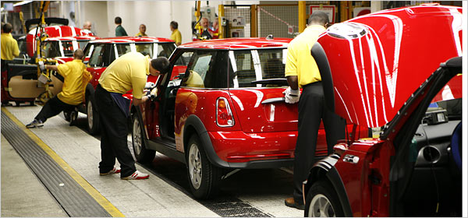
Lean machines
MINI assembly line
Notes:
Show video of MINI production line
Draw out common features from the activity the students have just been involved with (getting ready for school)
Sequence of stages in a logical order
Dependant upon the supply of components
https://www.youtube.com/watch?v=wXe-4kbrAXA

Slide 5
Lean machines
Lean Manufacturing
Lean manufacturing is an approach to the management of production which uses the concept of “added value” for the customer to be the prime determinant for assessing the use of resources.
In other words, every stage and every use of time, skill or materials should be assessed in terms of whether is makes the product more valuable to the customer.
Notes:
Introduce the idea of Lean manufacturing and the concept of every stage and process being reviewed in terms of the extent to which it adds value in the eyes of the customer.
Relate this to the ‘getting a student ready for school’ activity and ask for suggestions about additional features (combing hair, polishing shoes, etc).
Explain that production designers and managers have to consider this; mass produced items are usually sold in a competitive market and customers will choose items that are ‘good value’; this comes back to production line design and management.
Ask students why, although a supply of components is essential, it might not be a good idea to run with large stocks.

Slide 6
Lean machines
Just in Time Production
The “just in time” (JIT) approach to production aims to reduce the stock of components held by a manufacturer. The aim is to have the material needed arrive at the right time in the right place.
This eliminates holding stock that have been bought in, in advance, and need storage.
Notes:
Draw out that stocks have to be paid for and therefore stockpiles drain funds.
There are other advantages too; upgraded components can be incorporated quickly without having to use up the previous version and there can be a reduction in storage facilities and management. Introduce the concept of ‘Just in Time’ manufacturing and say that this is used in car production with vehicles such as MINI’s.

Slide 7
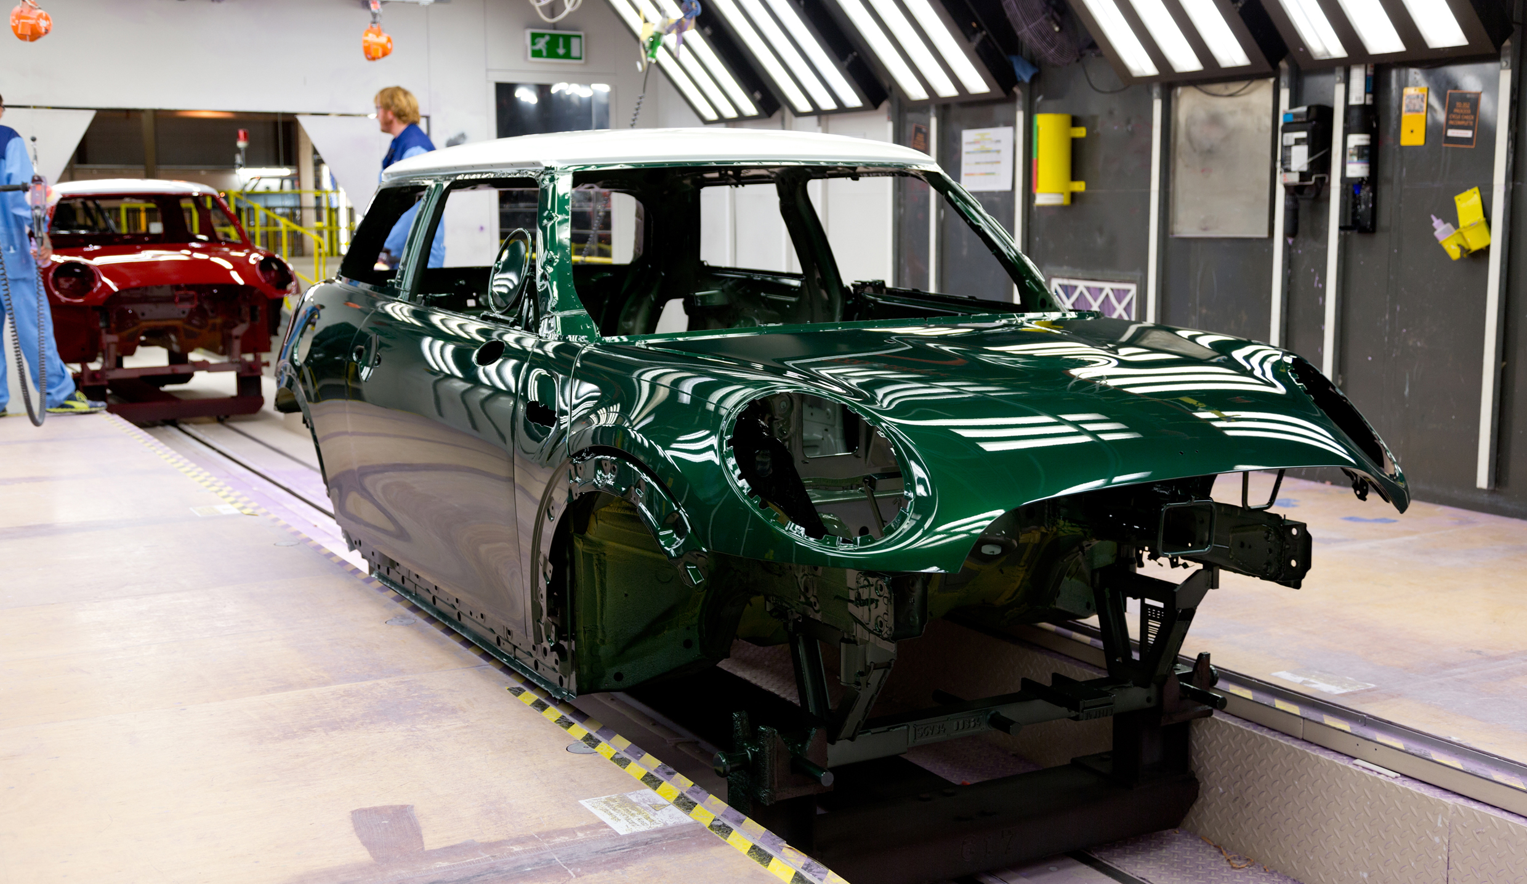
Lean machines
MINI assembly line
Notes:
Show students video clips of the MINI production line and ask them to identify key features about how it is organised.
Draw out that:
Components and sub-assemblies (such as engines) are added, building the car up to a finished unit
Items are added in a logical order; some items have to be added before others
Different options are available, such as paint schemes
The supply of components is essential to keeping the whole process under way
The organisation of personnel is critical.
https://www.youtube.com/watch?v=wXe-4kbrAXA

Slide 8
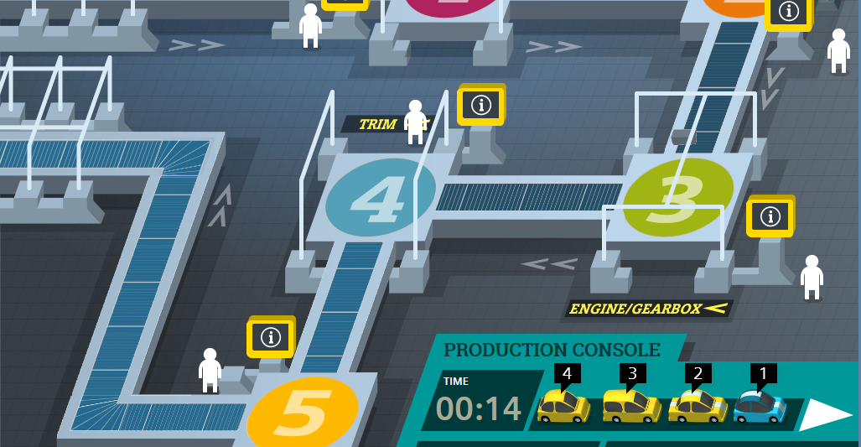
Lean machines
The Lean Machines Interactive
Notes:
Introduce the interactive activity.
Explain that this is a simplification and adaptation of the real process; it is not a direct copy. Nevertheless the skills needed to make a success of this are similar to those that real production managers and designers have to cope with.
Show the Interactive demonstration www.siemens.co.uk/education/en/students/interactives

Slide 9
Lean machine
Success in assembly
Explain that success is defined by:
The number of units completed according to customers’ orders in the allocated time.
Keeping stock levels low, whilst avoiding stalling the process because components aren’t available.
Using manpower most effectively.

Slide 10
Lean machines
Finding your way around the interactive
How do you find out what the customer has ordered?
How do you start a car on the assembly line?
How do you make sure the right components and manpower are available?
Notes:
Ask students to explore the game and experiment with finding out how it works.
After a few minutes ask students a number of questions whilst referring to a large image of the interactive. These might include: How do you find out what the customer has ordered?
How do you start a car on the assembly line?
How do you make sure the right components and manpower are available?
Then give students the chance to use the interactive more and try to obtain a higher score.

Slide 11
Being successful
How do you get a high score?
Is it better to have more cars for fewer cars going through at once? What is the optimum number?
How do you make sure that cars have a clear run through?
What are the more crucial things to watch out for and monitor?
What skills do you need to be an effective production manager?
Notes:
Discuss with students as they use the activity how they can improve their productivity.

Slide 12
Lean machines
Reflecting on the production process
What are the challenges involved in meeting customer orders? Does a good production process have more “customer options” or fewer?
How do you decide what stock levels to maintain? What might encourage you to maintain higher, or lower, stock levels?
What are the challenges involved with making best use of available manpower?
What skills do you need to run a production line successfully?
Notes:
Remind students, if necessary, of the way the interactive works and ask them to identify key aspects to getting a good score.
Ask students to reflect on what they’ve learned about assembly lines and to consider these aspects. Get them to think about not only the interactive but how it relates to a real assembly line. In particular ask them to focus on these points:
What are the challenges involved in meeting customer orders? Does a good production process have more ‘customer options’ or fewer?
How do you decide what stock levels to maintain? What might encourage you to maintain higher, or lower, stock levels?
What are the challenges involved with making best use of available manpower?
What skills do you need to run a production line successfully?
Draw together key points from this and summarise. Explain that many processes involve such decisions and that there are often compromises or ‘trade-offs’ that have to be made.

