Slide 1
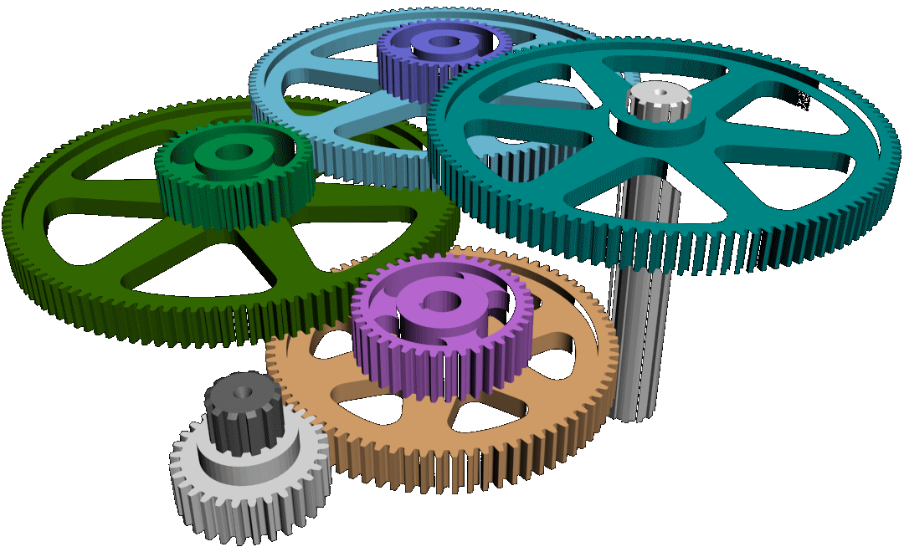
Gears & Levers
[Gear] noun
A toothed wheel that works with others to alter the relation between the speed of a driving mechanism and the speed of the driven part.
[Lever] noun
A rigid bar resting on a pivot (or fulcrum), used to move heavy or firmly fixed load with one end when a force is applied to the other
LOAD
Unrestricted

Slide 2

Gears & Levers
Learning Aims
Knowledge | Skills
How levers work How gears work How teeth-count affects gear-wheel movement The principle of force magnifiers and distance magnifiers Understand Torque | Develop a simple mathematical rule Ratio and proportionality Application of gears and levers Explain engineering concepts using descriptions and mathematics

Slide 3
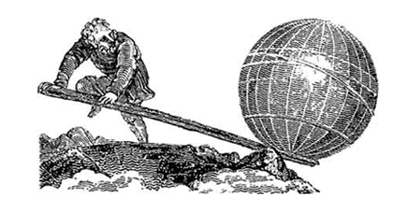
Levers
Levers are one of the most basic and fundamental tools used by humans since the dawn of time.
The first written account of a lever was over 2,300 years ago and attributed to Archimedes;
“Give me a lever long enough and a fulcrum
on which to place it, and I shall move the World”.

Slide 4
Three classes of Lever
Class 1 lever
The fulcrum (pivot point) is between the load and force.
The nearer the fulcrum is to the load the less force is needed to move it.
Class 2 lever
The load and the force are on the same side of the of the fulcrum.
The nearer the load is to the fulcrum the less force is needed to move it.
Class 3 lever
The force is acting between the fulcrum and the load.
Unlike class 1 and class 2 levers a class 3 lever delivers no Mechanical Advantage
LOAD
LOAD
LOAD
Notes:
There are three classes of Levers.
<Click 1>
Class 1 lever. The fulcrum (or pivot point) is between the load and the force (the input force and the output force). The nearer the fulcrum is to the load the less input force is required to move it, this gives a Mechanical Advantage.
<Click 2>
Class 2 lever. The load and the input force are on the same side of the fulcrum. Again, the nearer the load is to the fulcrum the less force is required to move it.
<Click 3>
Class 3 lever. The force is between the fulcrum and the load. Unlike Class 1 and Class 2 levers the Class 3 lever does not provide an Mehcanical advantage

Slide 5
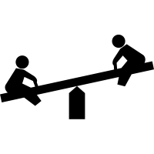

Examples of class 1 Lever
Class 1 lever
The fulcrum (pivot point) is between the load and force.
The nearer the fulcrum is to the load the less force is needed to move it.
Fulcrum
Input
Force
Fulcrum
LOAD
Output
Force
Notes:
This slide shows examples of a Class 1 lever
A seesaw and a pair of scissors.

Slide 6

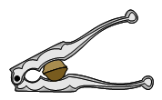
Examples of class 2 Lever
Input
Force
Class 2 lever
The load and the force are on the same side of the of the fulcrum.
The nearer the load is to the fulcrum the less force is needed to move it.
LOAD
Fulcrum
Input
Force
Output
Force
LOAD
Notes:
This slide shows examples of a Class 2 lever
A wheelbarrow and a nutcracker.

Slide 7
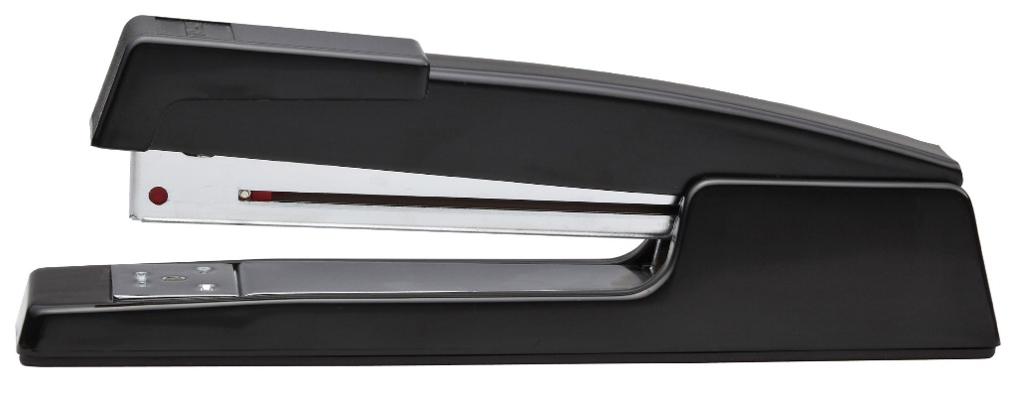
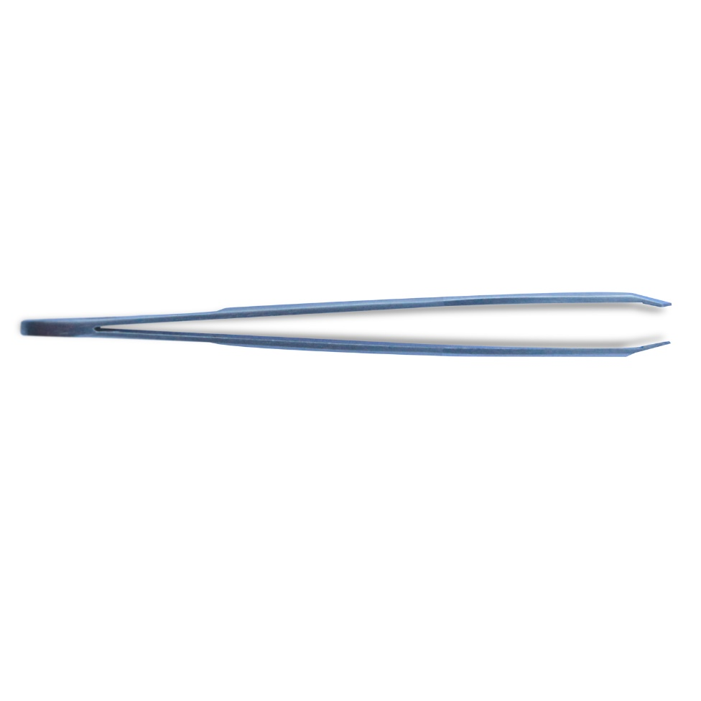
Examples of class 3 Lever
Input
Force
Class 3 lever
The force is acting between the fulcrum and the load.
Unlike class 1 and class 2 levers a class 3 lever delivers no Mechanical Advantage
Fulcrum
Output
Force
Input
Force
Output
Force
Fulcrum
LOAD
Input
Force
Output
Force
Notes:
This slide show examples of a class 3 lever.
A stapler and a pair of tweezers.

Slide 8
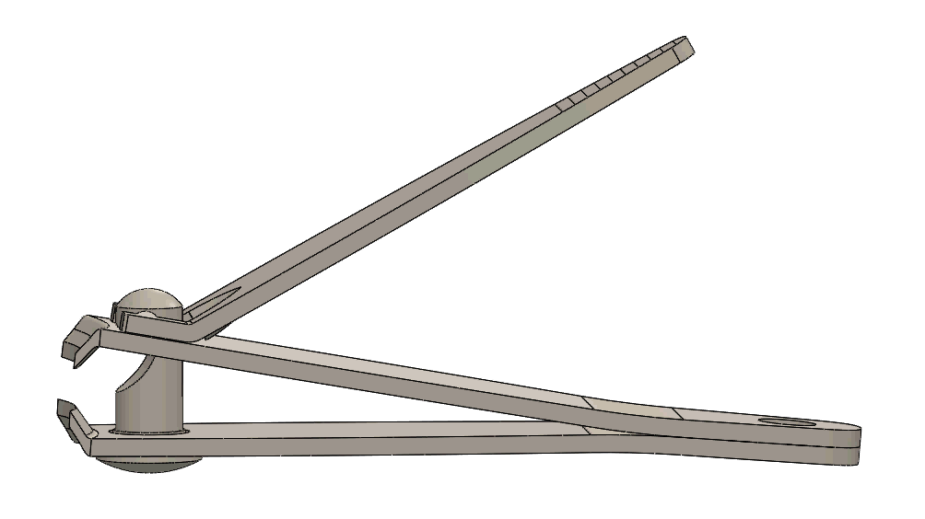
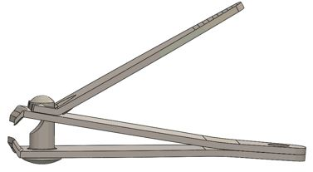
Examples of class 3 Lever
Class 3 lever
The force is acting between the fulcrum and the load.
Unlike class 1 and class 2 levers a class 3 lever delivers no Mechanical Advantage
1
2
1
2
1
2
2
LOAD
Notes:
Tis is an optional slide.
The nail clippers shown use two class 3 levers.

Slide 9
100N
Load
Effort
500N
100N
Mechanical Advantage =
= 5
Effort
LOAD
L₂
L₁
500N
Mechanical Advantage =
L₁
L₂
distance moved by effort
distance moved by load
Velocity Ratio =
Effort
Effort
LOAD
LOAD
Effort
d1
d2
LOAD
d1
d2
Notes:
A lever is a basic mechanism that produces Mechanical Advantage. The advantage is that the output Force is greater than the input Force.
Mechanical Advantage (MA) is a ratio and as such (for levers) can be calculated using either Load (weight, or output force) divided by effort (input force), or length of input arm (L₂) divided by the length of the output arm (L₁)
This Mechanical Advantage does not come free. The Velocity Ratio shows the distance moved by the effort (the input Force) is greater than the distance moved by the Load (output Force).
<Click 1>

Slide 10
Effort
LOAD
Calculating the force required for equilibrium
(W x L₁)
L₂
W
F
F x L₂ = W x L₁
F =
L₁
L₂
1kg
F
25kg
F
W
100kg
100mm
250mm
15mm
425mm
250mm
700mm
Notes:
When a lever (or beam) is in equilibrium it is “balanced”, i.e. the input equals the output.
<Click 1>
The equation to calculate the force required for equilibrium is “input force or effort (F) multiplied by the length of the input arm = the weight or output force (W) multiplied by the length of the output arm: F x L₂ – W x L₁”
<Click 2>
To calculate the Force (or effort) required to balance a lever with a specified output the equation is F = (W x L₁) divided by L₂
<Click 3>
Using this formula calculate the Force required to achieve equilibrium in the following levers (beams).
Note to teacher: you can also ask the students to calculate the Mechanical Advantage of each lever
<Click 4>
See if you can rearrange the formula to calculate the load (or output) would be for the following lever with an input load (force) of 100kg.

Slide 11
1kg
F
25kg
F
W
100kg
100mm
250mm
15mm
425mm
250mm
700mm
(1kg x 100mm)
250mm
(25kg x 15mm)
425mm
F =
F =
F x L₂ = W x L₁
(F x L₂)
L₁
F = 0.4kg
F = 0.882kg
W =
Mechanical Advantage
(100kg x 700mm)
250mm
W =
L₂
L₁
L₂
L₁
MA =
MA =
W = 280kg
250mm
100mm
= 0.25
425mm
15mm
= 28.3
Notes:
<Click 1>
In the first example the load is 1kg. To calculate for Force (load) required to achieve equilibrium we use the equation
<Click 2>
Which gives a Force of <Click 3> 0.4kg
To calculate Mechanical Advantage
<Click 4>
<Click 5>
In the second example the load is 25kg. To calculate the Force (load) required to achieve equilibrium the equation is;
<Click 6>
Giving an answer of <Click 7> 0.882kg
Note that due to the position of the Fulcrum (near to the output) and the distance at which the input Force is applied the input Force required to achieve equilibrium is relatively small.
<Click 8>
Mechanical Advantage for the second lever example is calculated using;
<Click 9>
In this example we know the input Force but not the output Force or weight. This requires the formula to be re-ordered to solve for W <Click 10>

Slide 12
W
1kg
L₁
100mm
L₂
350mm
F
F
(1kg x 100mm)
350mm
F =
Calculating the force required for equilibrium
(W x L₁)
L₂
F = 0.285kg
F x L₂ = W x L₁
F =
Notes:
Optional slide.
In this example the lever is a class 2 lever with the fulcrum at one end of the lever (beam) and the load positioned between the fulcrum and the input Force. Obviously the input Force is required to act in the opposite direction, but the equation is still the same.
Students can be asked to convert the input force and output Forces into Newtons;
1 Newton = weight (kg) x 9.81 (m/s)

Slide 13
Gears
A toothed wheel that works with others to alter the relation between the speed of a driving mechanism and the speed of the driven part.

Slide 14
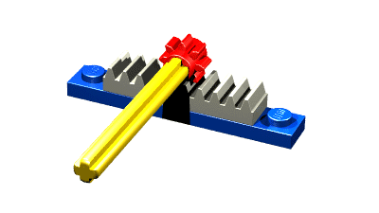

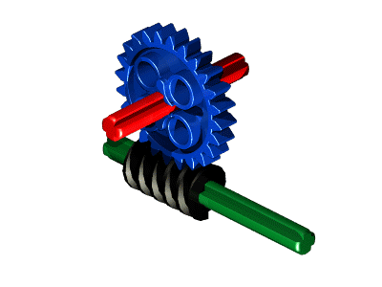
Types of gears and terminology
Pinion
Pinion gear: this is a round gear and usually the smallest gear in a drive chain.
Rack & Pinion:
this mechanism changes rotary movement into linear movement.
Pinion
Rack
Worm gear: are used when large gear reductions are needed. The worm gear can easily turn the gear but the gear cannot turn the worm.
Worm gear

Slide 15
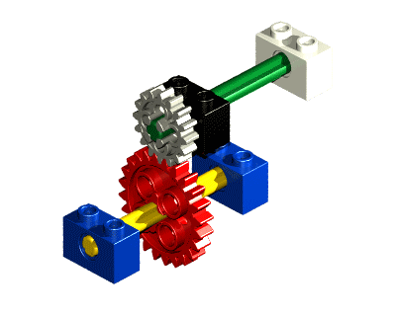
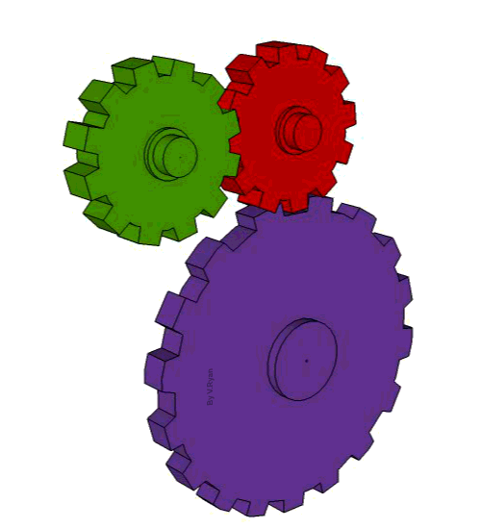

Types of gears and terminology
Spur gears: operate on axes which are parallel.
Gear-train: a mechanical system consisting of two or more intermeshing gears.
Bevel gears: are gears where the axis of rotation is at an angle and are commonly used to change the axis of rotation in a gear-train.

Slide 16
Types of gears and terminology
60 teeth
15 teeth
Gear ratio: is the input speed relative to the output speed.
If the smaller gear is the driver (input)
Gear ratio =
number of teeth on output gear
number of teeth on input gear
60
15
=
4
Input speed 200 rpm
Gear ratio typically displayed as 4 : 1
This means the driver gear (input) rotates four times to make the driven gear (output) rotate once.
If you know the input speed you can calculate the output speed.
input speed
gear ratio
200
4
output speed =
=
50 rpm

Slide 17
Gears can also be considered as levers -
1/3 of the distance moved results in 3 times the force
Gear B can be considered as an idler gear. The work is transferred from gear A to gear C but the idler gear B makes gear C turn in the same direction as gear A
10cm 30cm
B
C
A
Click to start wheels, then step back for summary
Gear A to Gear C
8 : 16 teeth
1 : 2 ratio
Gear A to Gear B
8 : 24 teeth
1 : 3 ratio
Three turns of A = 1 turn of B
Gear B has 3x the turning force as Gear A
Intermeshing gears turn in opposite directions
Gear B to Gear C
24 : 16 teeth
3 : 2 ratio
Notes:
This slide automatically builds. Show in Presentation Mode.
<Click 1> to start the animation of the gears. The text will appear at timed intervals over the course of about 1 minute and summarises the core concepts the students should have been able to discover and teach each other

Slide 18
number of teeth on output gear
number of teeth on input gear
input speed
gear ratio
Gear ratio =
output speed =
50 teeth
140 teeth
25 teeth
60 teeth
Input speed 1000 rpm
Input speed 150 rpm
50
25
140
60
=
1 : 2
Gear ratio =
=
1 : 2.333
Gear ratio =
1000
2
150 2.333
output speed =
=
500 rpm
output speed =
=
64.28 rpm
Notes:
Leave the slide and ask students to calculate the Gear Ratio and output speed of the two examples.
<Click 1> to reveal the Gear Ratio for example 1
<Click 2> to reveal the output speed for example 1
<Click 3>to reveal the Gear Ratio for example 2
<Click 4> to reveal the output speed for example 2

Slide 19
Torque
Torque is the turning (rotational) force on an object such as a bolt, or wheel (or gear).
The symbol for Torque is the Greek letter Tau (τ)
Torque is measured in Nm
τ = r x F
Force (F)
Torque
Distance (r)

Slide 20

Torque
A
B
C
Door
Door
Door
Force
Force
Force
Notes:
Assume you’re trying to open a door. Above there are three different scenarios.
In scenario A; if you push close to the hinge it is possible to open the door but a greater force is required
In scenario B: if you push in the middle of the door less force is required to open it.
In scenario C: pushing the door at a point furthest away from the hinge is much easier, requiring the least amount of force in the three scenarios.

Slide 21

Maximum torque is produced when θ is 90°
τ = r F sinθ
lever arm r
Force
Force
θ
θ
Force
θ = 90°
lever arm r
lever arm r

Slide 22

Classroom Task
LOAD
Levers
Discover how your system works
Can you product a Force Multiplier? Something where for a smaller input force you can produce a larger output force.
Gears
Discover how your system works
Can you product a Force Multiplier? Something where for a smaller input force you can produce a larger output force.
Levers
Discover how your system works
Can you product a Distance Multiplier? Something where for a smaller movement you can produce a larger movement.
Gears
Discover how your system works
Can you product a Distance Multiplier? Something where for a smaller movement you can produce a larger movement.

Slide 23
