Slide 1
Topic 12:
A case to resolve
Siemens Education

Slide 2
A case to resolve
Overall learning objectives:
Understand how systems are developed to meet certain requirements
Applying ideas about waves such as light and x-rays to develop solutions to problems
Using logical reasoning to analyse the outcomes from a process

Slide 3
A case to resolve
Overall learning outcomes:
Being able to explain how and why systems are designed in certain ways
Applying scientific concepts such as the properties of light and x-rays
Logically deducing the range of outputs from a system

Slide 4
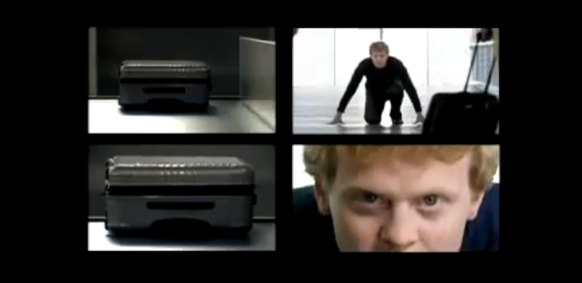
A case to resolve
Airport baggage handling systems
Notes:
Show the video clip which presents, in a humorous way, the importance of a baggage handling system being both rapid and precise in terms of getting the right bag to the right place.
Ask the students who have experienced baggage handling facilities at airports, if this has been their experience.
Present students with the situation and the solution. Explain that passengers are to be provided with a city centre baggage drop facility that means that their luggage can be deposited in the city, leaving them free to do other things and follow on afterwards.
Explain that the airport wants to avoid manual sorting in that it’s expensive and slow.
Ask students questions to clarify that they understand the nature of the challenge.

Slide 5
A case to resolve
Imagine that you’re on holiday in a big city in another country. You’ve flown there and had several days, staying in a hotel, exploring the sights and enjoying the city life.
It’s the day of your return so you check out of the hotel and leave with your suitcase. However, your flight isn’t until the evening. You don’t want to sit in the airport all day and you certainly don’t want to lug your cases round with you. You could go out to the airport, drop the bags and return but that will take time and money.
The airport, however, has a solution. They have a baggage drop in the city centre. Take your cases there, check them in and go off to enjoy your last day in the city.

Slide 6
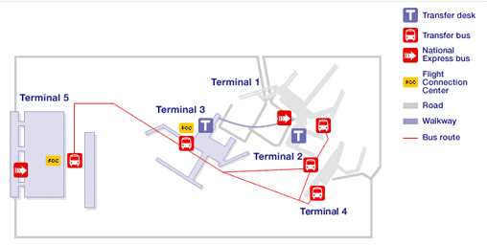
A case to resolve
Which terminal?
Notes:
Notes:
The airport wants to avoid manual sorting, it’s expensive and slow.
Handlers would have to reach each label to see which flight the case was destined for, sort out which terminals that flight went from and group the cases accordingly
The airport wants a system that works automatically, with luggage being recognised and routed to the correct terminal
Their plan is that when the luggage is checked in, passengers are given a sticker to attach to each case, showing which terminal
The challenge is for the system to read the sticker.

Slide 7
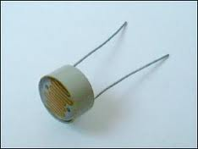
A case to resolve
Light dependent resistor
Notes:
Explain to students that a key part of the design system will be the ability to recognise the difference between light and dark surfaces.
Show the students (or remind them) an ORP12 LDR (light dependent resistor) and explain that its resistance changes according to the amount of light. Show how a multi-meter can be switched to a resistance range and connected to the ORP12.
Ask students to work in groups to investigate how the resistance of an ORP12 alters in varying amounts of light.
Take feedback and draw out the point that its resistance increases if there is less light.

Slide 8
A case to resolve
A five detector system
Imagine five optical detectors in a row, scanning labels as they go through.
Suitcase sticker for Terminal 1
Suitcase sticker for Terminal 2
etc
Notes:
Remind students of the outcomes of the previous episode as appropriate and of the design for a detector which would tell the difference between a light and a dark area.
Explain that the next step is to design a system that uses a number of these detectors to decode a luggage sticker.
Ask the students to work in groups to answer these questions and present responses:
What happens if Terminal 1 sticker is put on or read the wrong way round?
What happens if the airport opens a sixth terminal?
What happens if the costs of five detectors in every unit pushed the cost up to the point that your system is more expensive than that of your competitors?
Take feedback and draw out these points:
Having labels that are misleading if reversed is not a good idea
Good systems should have capacity for expansion
The idea of units with fewer detectors could be explored.

Slide 9
A case to resolve
A single detector system
Imagine one optical detector, scanning labels as they go through.
Suitcase sticker for Terminal 1
Suitcase sticker for Terminal 2
Notes:
Explain that this system would work for a two terminal system

Slide 10
A case to resolve
A two detector system
Imagine two optical detectors in a row, scanning labels as they go through.
Suitcase sticker for Terminal 1
Suitcase sticker for Terminal 2
etc
Notes:
Ask students to work out how many terminals a two detector unit would be able to code for.
Then ask the students to find out if any of these could be reversed to give a wrong response.
Draw out that if would work for four terminals but that two of these could be reversed to give incorrect responses.

Slide 11
A case to resolve
A three detector system
Imagine three optical detectors in a row, scanning labels as they go through.
Suitcase sticker for Terminal 1
Suitcase sticker for Terminal 2
etc
Notes:
Ask students to investigate how well a three detector system would work. They should determine:
How many terminals this system could code for
Whether any of the labels could be reversed to give an incorrect response
Whether they would recommend this for a five terminal airport and why.
Take feedback and draw out there are eight different labels but that there are two “reversible pairs” (BBW/WBB) and WWB/BWW).

Slide 12
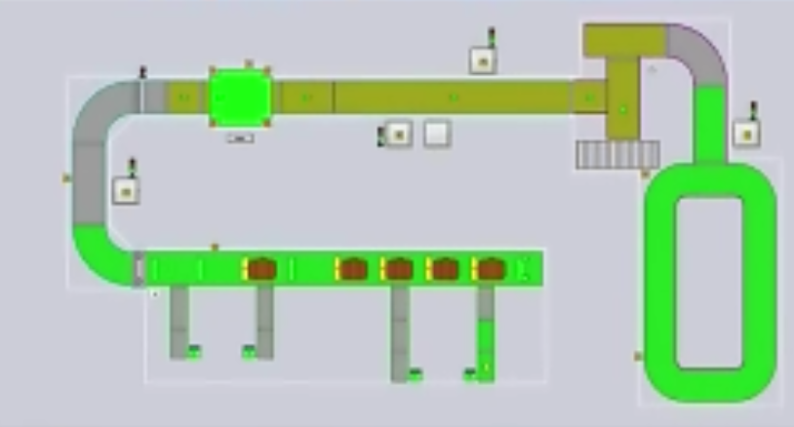
A case to resolve
Baggage check in system
Notes:
Ask students to identify various features of the system. If necessary prompt them to recognise where:
Luggage is entered
Luggage is x-rayed
Luggage goes onto carousel to be collected by baggage handlers.
Ask students to:
suggest what the purpose of the x-ray machine is and how it works
Draw out that x-rays penetrate materials of a lower density but are absorbed by ones of a higher density, thus not passing through to the detector.

Slide 13
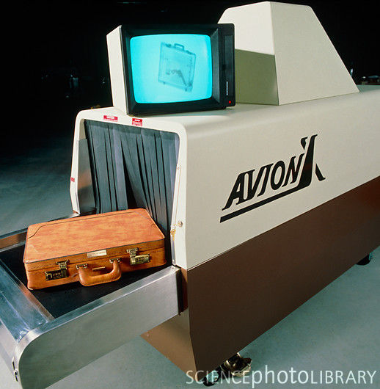
A case to resolve
Notes:
Draw out that items such as keys, belt buckles and aerosol cans will absorb x-ray and hence show up (as silhouettes) on the screen.

Slide 14
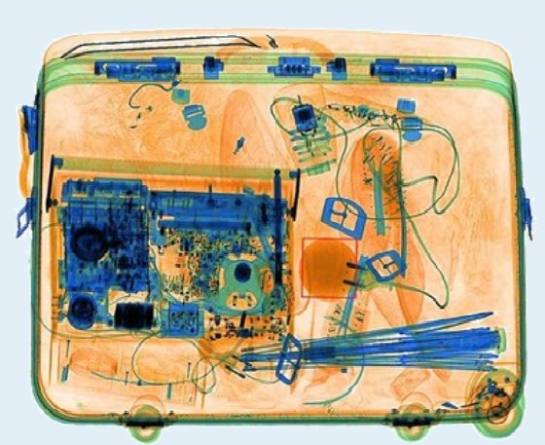
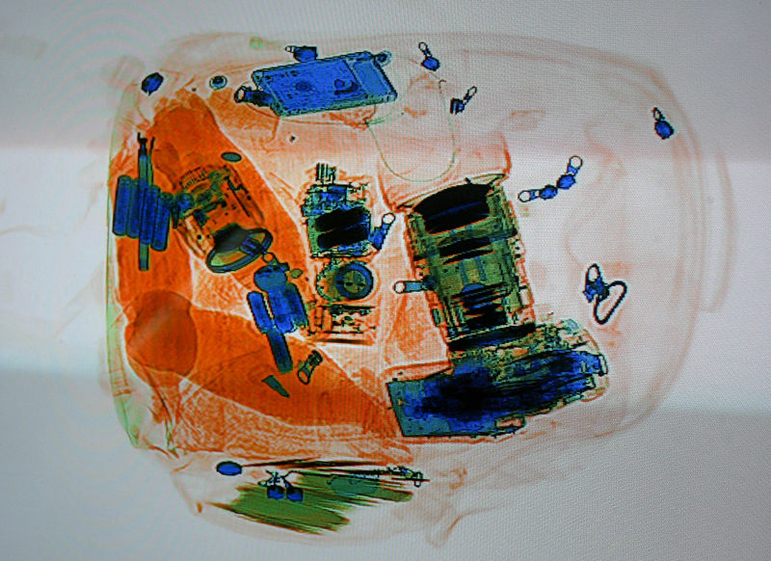
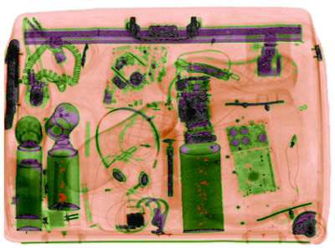
A case to resolve
What’s in the bag?

