Slide 1
Siemens and The Wildlife Trusts
Restricted © Siemens AG 20XX
July 2017
In partnership with

Slide 2
Lesson 2 - Water
In partnership with

Slide 3
Learning Objectives
To understand the importance of natural environments and organisations being responsible and collaborating to achieve long term sustainability.
To identify how we use water personally vs how we use water as a resource.
To gain an understanding of the water cycle and how it impacts specific habitats.
To explore the impacts that water turbines have on animals and the surrounding environment.
In partnership with

Slide 4
Learning Outcomes
Understand the stages of the water cycle
Understand how the water cycle is affected by climate change
Gain an understanding of how reliant ecosystems are on water
Explore the advantages and disadvantages of using water to generate and decarbonise our energy generation.
In partnership with

Slide 5
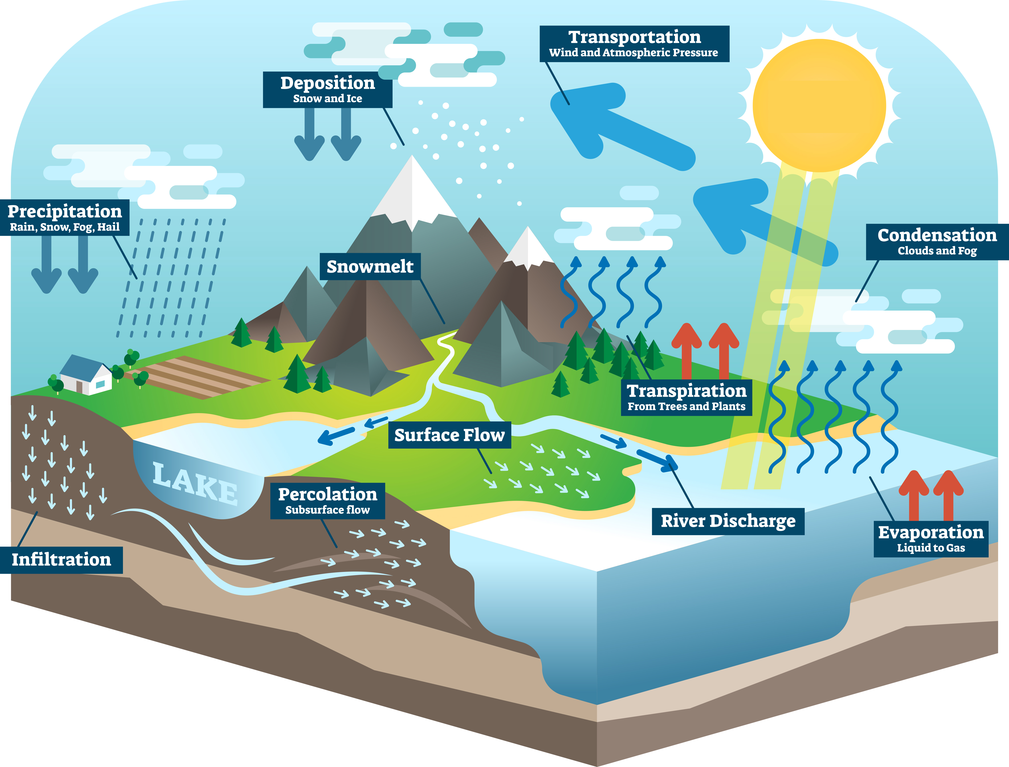
The Water Cycle
The water cycle is the process by which water travels from the Earth's surface to the atmosphere and then back to the ground again. The sun provides the energy to exchange continuous moisture between oceans, land and atmosphere.
In partnership with
Notes:
Explanation video hyperlinked to image https://www.youtube.com/watch?v=al-do-HGuIk
Global warming affects the water cycle. As air warms it can hold more moisture, so heavier rainfall occurs where it cools.
Increased heating of oceans can also lead to more intense and frequent hurricanes.

Slide 6
How much do you know about water?
Decide whether each of these statements is true or false.
There are fewer than one million lakes and ponds in the world.
Ponds are very important for combating climate change.
Lake Windermere is England’s largest lake.
Reservoirs can affect the Earth’s rotation.
https://www.opalexplorenature.org/water-quiz
In partnership with

Slide 7
How much do you know about water?
There are fewer than one million lakes and ponds in the world
False: There are an estimated 304 million natural lakes and ponds in the world, covering an area of about 4.2 million km² – that's 17 times the size of the UK!!
Ponds are very important for combating climate change?
True: They can trap carbon 20-50 times faster than trees, and together they bury four times as much carbon as the world’s oceans.
Lake Windermere is England’s largest lake?
True: Lake Windermere is the largest lake in England, it has a surface area of 14.7km², a maximum depth of 67m and its own tide. However, the largest ‘lake’ in Britain is Loch Ness in Scotland which holds more water than all the lakes and rivers in England and Wales combined
Reservoirs can affect the Earth’s rotation?
True: Over the past 40 years about 10 trillion tonnes of water have been stored in reservoirs, mostly in the northern hemisphere, which has become heavier as a result. This redistribution of mass has quickened the Earth's spin in much the same way an ice skater might bring their arms close to their body in order to spin faster. A faster spin shortens the day and so, due to water storage in reservoirs, the day is now shorter than it was 40 years ago - but only by about eight-millionths of a second, so don't worry too much!
In partnership with

Slide 8
Water Cycle and Habitats
All living organisms need water to grow and survive. In an ecosystem, water cycles through the atmosphere, soil, rivers, lakes, and oceans. Some water is stored deep in the earth. Surface water, on the other hand, is the source that sustains life on land.
In many cases, water structures the habitat of an ecosystem. Polar bears, for example, rely on ocean ice in order to successfully hunt and capture seals.
What’s more, the majority of life on Earth actually lives completely submerged in the waters of the oceans.
In partnership with
Notes:
Activity Notes:
Ask students to think about how the how global warming will affect different habitats.
For example:
Coral Reef bleaching
Sea level rise causing salination of soil destroying its agricultural value as well as the species that occupy it.

Slide 9
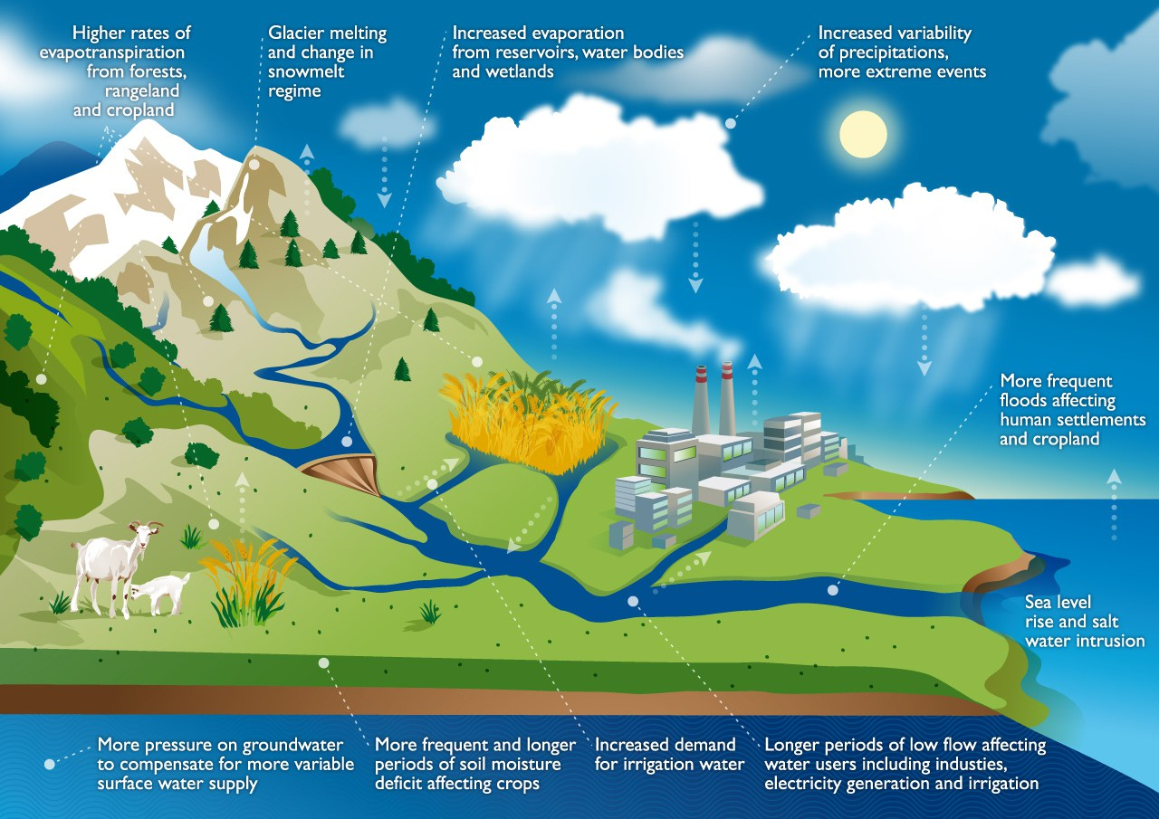
How climate change will affect the Water cycle
Climate Change Impact on Water Cycle © FAO 2015 - http://www.fao.org/land-water/en/
Bring in image again and DO NOT STRETCH
Climate change will have a drastic affect on the water cycle from the sea to the mountains, use the diagram to explore the different changes that are occurring and consider their impacts.
Climate Change Impact on Water Cycle © FAO 2015 - http://www.fao.org/land-water/en/
Restricted © Siemens AG 20XX
In partnership with
YYYY-MM-DD
Page 9
Author / Department

Slide 10
Wetlands
Wetlands are among the most productive ecosystems in the world, comparable to rainforests and coral reefs, and have a valuable role in protecting and improving water quality, providing habitats, storing floodwaters and helping reduce the impacts of extreme weather events.
https://www.flickr.com/photos/usfwsnortheast/8070749192/
In partnership with
Notes:
Activity Notes:
Benefits of Wetlands:
Store carbon within their plant communities and soil instead of releasing it to the atmosphere as carbon dioxide. Thus, wetlands help to moderate global climate conditions.
Often called “nurseries of life”, wetlands provide habitats for thousands of species of aquatic and terrestrial plants and animals.
When rivers overflow, wetlands help to absorb and slow floodwaters. This ability to control floods can alleviate property damage and loss and can even save lives.
They also absorb excess nutrients, sediment and other pollutants before they reach rivers, lakes, and other waterbodies

Slide 11
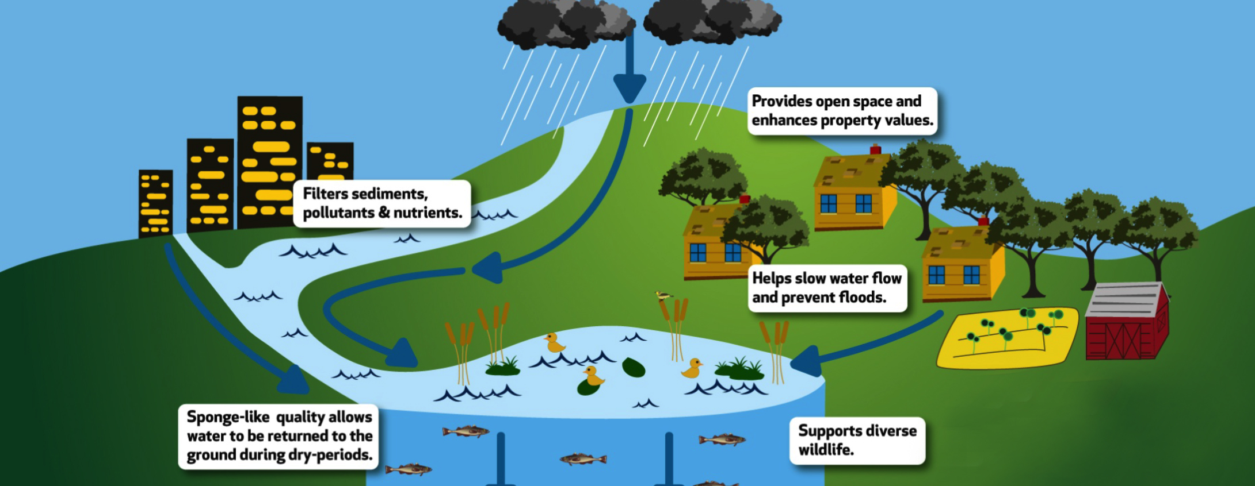
Benefits of Wetlands
Source: Food and Agriculture Organization of the United Nations, [2016], [FAO - HQ], [Climate Change and food security: risks and responses], [http://www.fao.org/3/a-i5188e.pdf]. Reproduced with permission
In partnership with
YYYY-MM-DD
Page 11
Author / Department
Notes:
Activity Notes:
Benefits of Wetlands:
Store carbon within their plant communities and soil instead of releasing it to the atmosphere as carbon dioxide. Thus, wetlands help to moderate global climate conditions.
Often called “nurseries of life”, wetlands provide habitats for thousands of species of aquatic and terrestrial plants and animals.
When rivers overflow, wetlands help to absorb and slow floodwaters. This ability to control floods can alleviate property damage and loss and can even save lives.
They also absorb excess nutrients, sediment and other pollutants before they reach rivers, lakes, and other waterbodies

Slide 12
Desertification
The amount of water on the planet is finite. Whilst some areas of the world may see increased rainfall and risk of flooding due to global warming, others will become increasingly arid. This can lead to desertification which is when land that was a different biome, like Savannah, degrades into a desert.
There are many reasons why this occurs such as deforestation and over grazing, but the effects of prolonged droughts caused by changing weather patterns are exacerbating desertification. This process is extremely damaging to both the natural and human population of a region, increasing risk of famine, wildfires and species loss.
Biomes are distinct biological communities that form in response to a shared physical climate. A biome can comprise a variety of habitats.
In partnership with

Slide 13
How can technology help?
Water Turbines and Hydroelectricity
Hydro electric plants help produce renewable energy that does not release Carbon Dioxide. However, most hydroelectric power plants use a dam and a reservoir, obstructing fish migration and affecting their populations.
Operating one can affect water temperature and the river's natural flow. These changes may harm plants and animals both in the river and on land.
http://www.elanvalley.org.uk/discover/reservoirs-dams/6-dams - Elan Valley Trust
In partnership with
Notes:
Activity Notes:
Other points to consider include:
The cost of Hydroelectric power
The space needed for Hydroelectric power to be effective
Methane, a greenhouse gas, can also sometimes be formed in reservoirs and released into the atmosphere – though hydroelectric power is still less polluting.
For a more detailed exploration please see here: https://water.usgs.gov/edu/wuhy.html

Slide 14
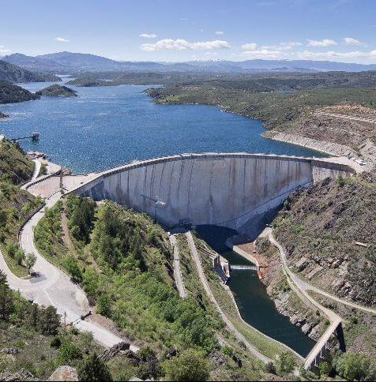
Problems caused by dams
Nature
Reservoir water is usually slow moving. As a result, the reservoir will have excess amounts of sediments and nutrients, which can lead to a surplus of algae and other weeds.
These weeds can take over other forms of animal and plant-life in the river. This can be controlled by manual harvesting or by introducing fish that eat these plants. Although there are many methods to minimize the impact of injuries to animals, including fish ladders and intake screens, fish and other organisms can be injured and potentially killed by turbine blades
People
Reservoirs may cover people's homes, important natural areas, agricultural land, and archaeological sites. Thus, building dams can require relocating people.
Methane, a strong greenhouse gas, may also form in some reservoirs and be emitted to the atmosphere.
Carlos Delgado; CC-BY-SA
In partnership with

Slide 15
Solutions to protect wildlife
If too much water is stored behind the reservoir, segments of the river downstream can dry out. Most hydroelectric operators are required to release a minimum amount of water at certain times of year. If not, water levels downstream will drop, endangering animal and plant life.
In addition, reservoir water is typically low in dissolved oxygen and colder than normal river water. When this water is released, it could have negative impacts on downstream plants and animals.
To mitigate these impacts, aerating turbines can be installed to increase dissolved oxygen and multi-level water intakes can help ensure that water released comes from all levels of the reservoir, rather than just the bottom (which is the coldest and has the lowest dissolved oxygen).
In partnership with

Slide 16
SIEMENS SMART water turbine for running rivers
SMART hydrokinetic turbines only use the river's water flow energy to generate electricity. This can be used over and over again, so you can connect multiple turbines in one to make the most out of the power in a simple way. The turbine is powered by kinetic energy so no dams are necessary to operate the device.
Additionally, the river shape is unchanged and no infrastructural investments are required. The product is cost effective meaning it is perfect for both industrialised countries and emerging countries. The system doesn’t require any maintenance and only needs regular cleaning.
The impact is that, with energy available in rural areas, productivity per population increases which means partnerships can be made with local and national economies.
The impact of this can be seen using ‘Water is Life’ resources.
In partnership with
Notes:
Activity Notes
If more information is required please see here: https://www.empowering-people-network.siemens-stiftung.org/en/solutions/projects/smart-turbine-for-running-rivers/

