Slide 1
Words along wires
Siemens Education

Slide 2
Words along wires
Overall learning objectives:
Explore different communications systems
Compare systems, identifying strengths

Slide 3
Words along wires
Overall learning outcomes:
To be able to explain different communication systems and how they work
To be able to compare different communication systems

Slide 4
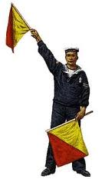
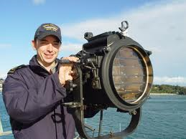
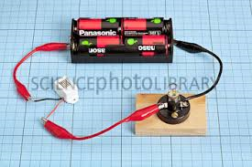
Words along wires
Different ways of communicating
Notes:
Start off by asking pupils the various ways in which information could be sent from one side of the classroom to another, without physically crossing it.
Take feedback and display ideas on the board. They might include:
Light
Sound
Showing a sign of some sort
Using radio or mobile phone
Using a telephone (conventional, with wires)
Explain that you’re going to focus on three of these. Say that you’re going to explore how it would be possible to use light, signs and circuits. Explain that at the time (Victorian times) radio had yet to be invented and the distances we want to use are too great for sound to be practical.
Ask pupils to work in pairs and give each pair the job of inventing a way of sending information by:
Using a beam of light
Using some form of signs, such as sticks or flags
Using an electrical circuit which reaches from one place to the other
Give pupils a few minutes to devise solutions. Then gather pupils working on a particular approach together and ask them to share the ideas. Repeat with the other two groups.
Then use activity sheets 1, 2 & 3. Each of these develop one of the ideas in more detail and guide pupils to carry out an investigation which involves using code. Pupils need to work in groups; each group is then divided into two and one half of the group has to communicate a word to the other half using a particular code and technology.
The key point is that pupils evaluate the particular technology and identify its strengths and weaknesses, which can then be shared.
Depending on time available pupils may all be able to have a go at each technology.
Logistics:
For the beam of light, use a torch. It needs to be bright enough to be easily seen without running the risk of dazzling people.
Sticks or flags (colours unimportant) can be improvised.
The circuit is a simple series circuit with battery, switch and either a bulb or a buzzer. The wires need to be long enough to reach across the room and care will be needed to avoid this becoming a tripping hazard.
It may be possible to take pupils outdoors either to introduce the context or test the solutions developed. This will need planning in advance, especially if learning outside the classroom isn’t an established feature of the curriculum.
Equipment (this can be varied according to what is available and ideas that pupils develop but might typically include:
Coloured flags
A light with four different coloured filters
Four boards, each with a different letter. These could be A3 sheets, laminated on thin card
A bell that can be struck

Slide 5
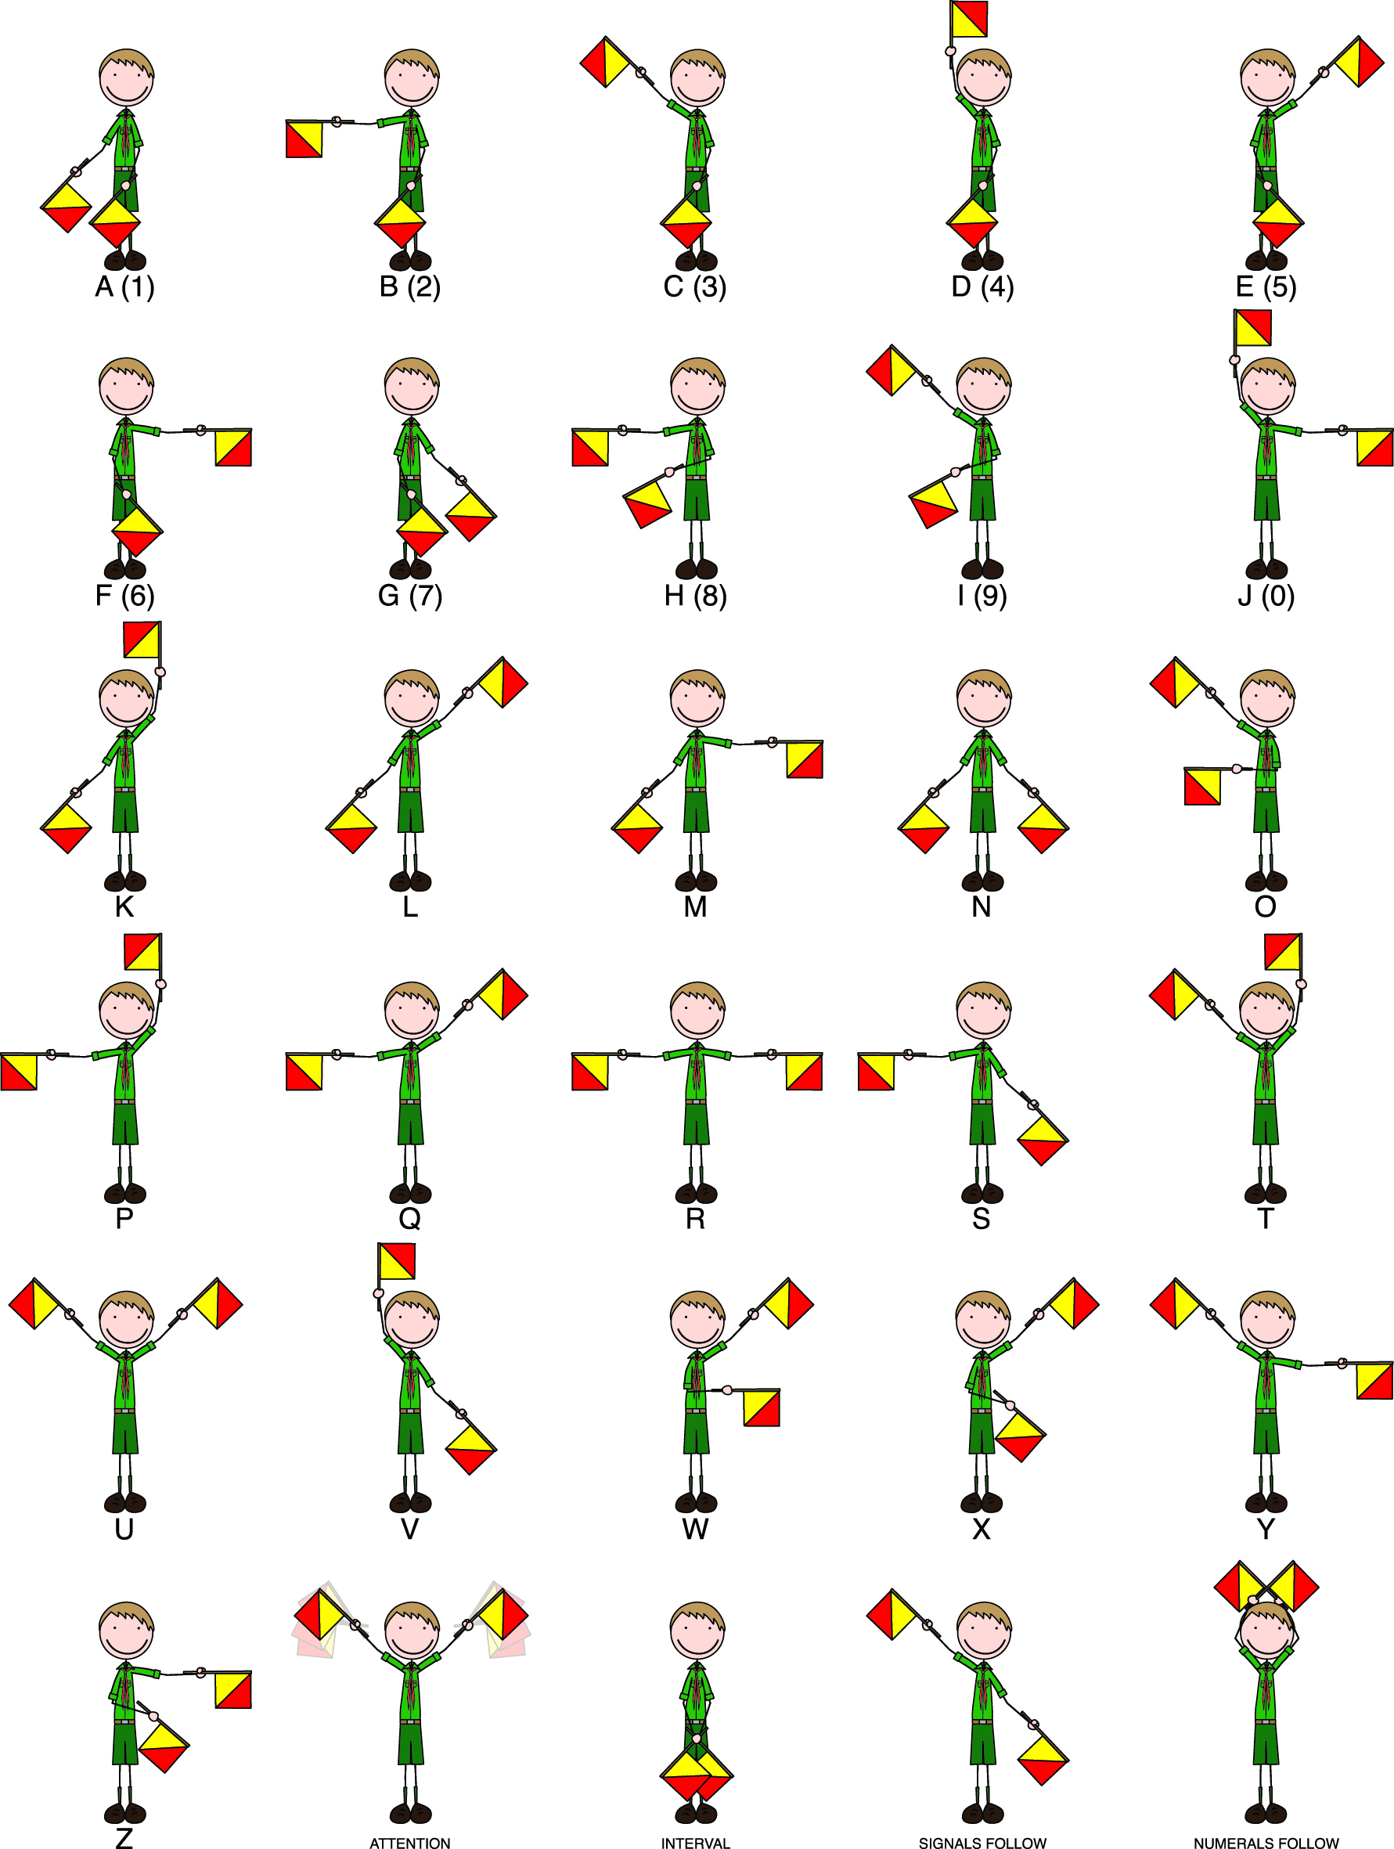
Words along wires
Semaphore code

Slide 6
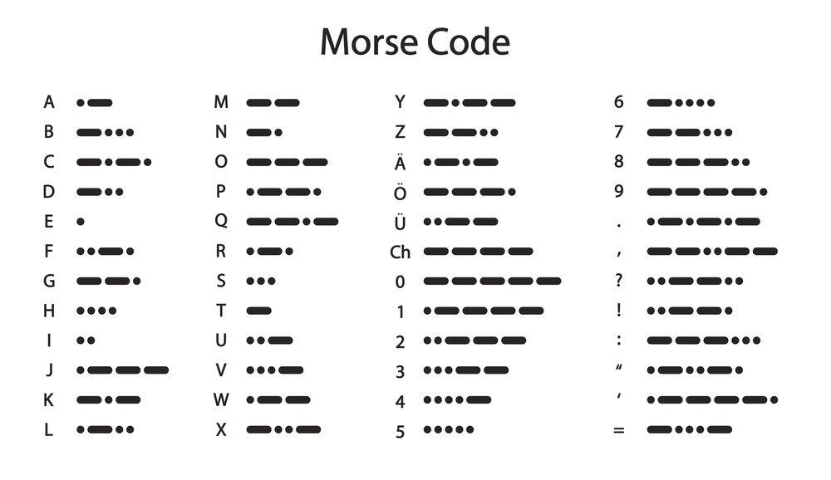
Words along wires
Morse code

Slide 7
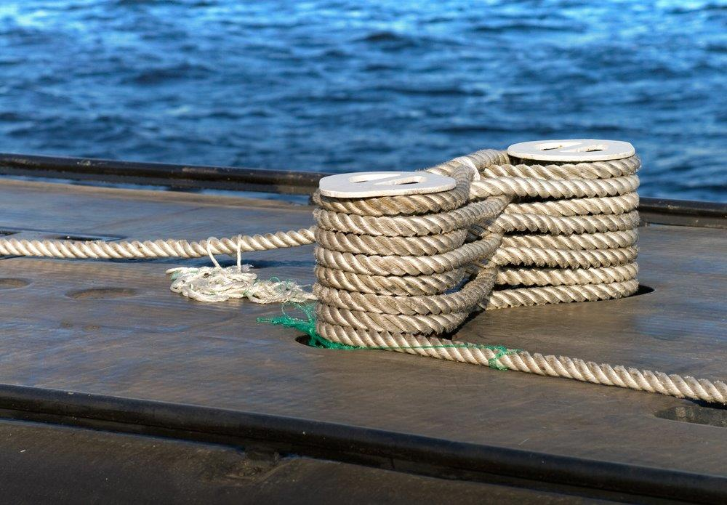
Words along wires
Planning a link – What are the risks?
Notes:
Resources required:
Copies of maps
Pens
Explain that one of the uses of cable communication was being able to connect countries separated by water. Cables could be run under the water and messages sent using circuits that linked countries. Explain that this meant laying cables though, and this could be a tricky business. Once a cable is broken, the circuit ceases to work. No circuit means no communication.
Show pupils a picture of a submarine cable and ask them to suggest the risks to the safety of the cable by various features, such as:
Sharp rocks (could chafe and damage cable)
Drilling area (drill could damage cable)
Mooring area (anchors could damage cable)
Fishing area (trawl nets could catch on cable)
Soft sand (might leave cable exposed to weather and thieves)

Slide 8
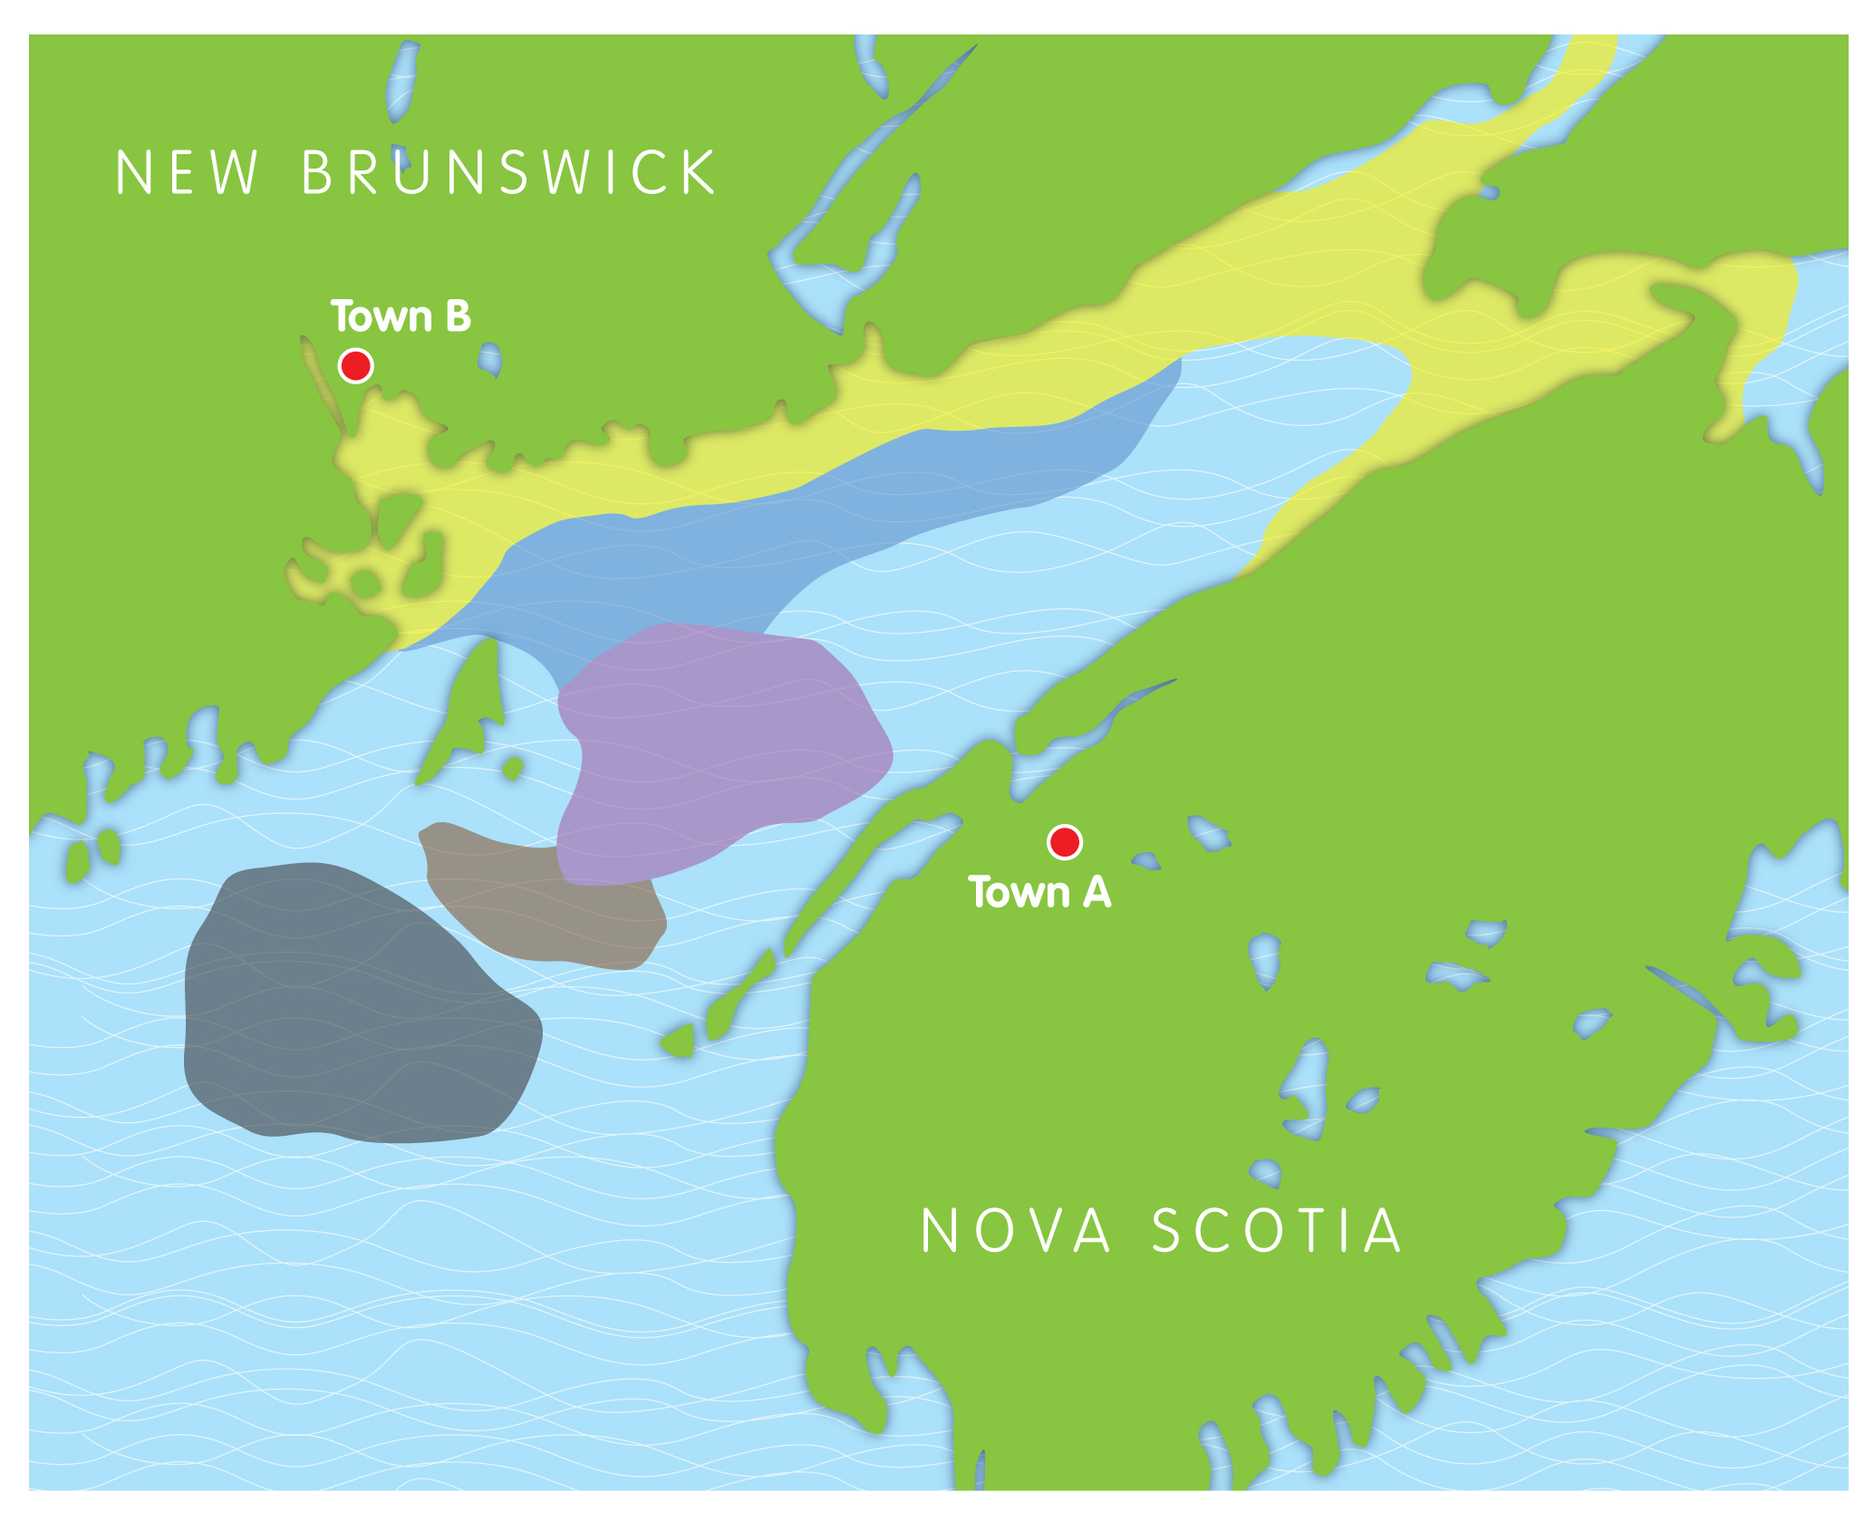
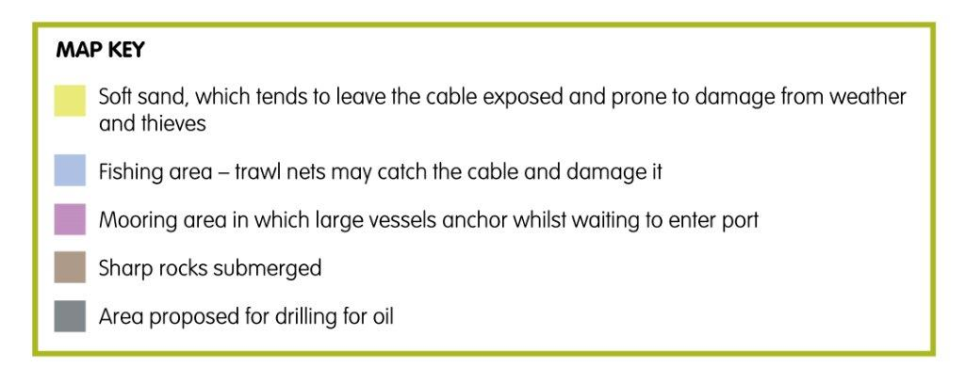
Words along wires
Planning a link
Notes:
Resources required:
Copies of the map
Pens
Hand out copies of activity sheet 4, which presents pupils with a map of an area of sea between two pieces of land.
The idea is that they draw the route of a communications cable to link towns A and B, using the shortest route whilst avoiding potential hazards. This will work best if the sheets are printed A3 size and pupils work in pairs.
They should plan a route and be prepared to share the reasons for their decisions.
After pairs have been able to develop their responses, ask some to share their ideas. A good way of doing this is by using a visualiser, so that they can explain the route that they adopted.

Slide 9
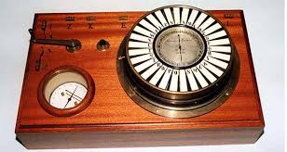
Words along wires
The Morse code system used dots and dashes
The Siemens pointer system used a dial
Morse code transmitter
Notes:
Pupils may imagine that when new discoveries or inventions emerge that they are openly and widely accepted. In fact, it is often the case that ideas have to compete for interest. This section is about comparing two technologies, each using circuits.
Explain to pupils that in the 1840s there were two competing systems that could be used by people wanting to set up communications links.
Morse Code
One was a Morse code system which used dots and dashes. An operator would send messages by turning them into code and then tapping the message out. The receiver listened to the short and long sounds and converted these back into letters.
Siemens pointer system, which used a dial. The operator would press one of 30 switches, which made the pointer swing round to point to a letter. Releasing the key brought the pointer back to the start.

Slide 10
Words along wires
The Morse code system used dots and dashes
The Siemens pointer system used a dial
Morse code transmitter
Notes:
Explain that they are going to compare these two systems.
Resources required:
Activity sheet 3 (name)
A simple series circuit with battery, switch and either a bulb or a buzzer. The wires need to be long enough to reach across the room and care will be needed to avoid this becoming a tripping hazard
Activity sheet 5 printed on thin card
Scissors
Paper fasteners
The Morse code can be set up using a simple circuit with either a buzzer or a bulb.
Pupils should work in small groups and arrange to send a message by turning it into Morse code, transmitting using light or sound and decoding at the other end.
The Siemens system can be represented using a pointer and dial, set up using Activity sheet 5.
Explain that the real system would work electrically but that this is a mock up to allow the systems to be compared.

Slide 11
Words along wires
How easy is each system to use?
How quickly can messages be sent?
Would either system get quicker with practice?
Which do you think is the better one, and why?
Evaluating the systems
Notes:
Make the point that engineers sometimes develop different solutions to a problem. These solutions can then be compared in a number of ways to identify the best one.

